Slide 1


Small Animal Glycemic Clamp core
Glucose Clamps in the Conscious, Unrestrained Rodents
Contact Information
Kirk Habegger, PhD, Associate Professor, Dept. of Medicine, Endocrinology
E-mail: kirkhabegger@uabmc.edu
Teayoun Kim, PhD, Scientist, Dept. of Medicine, Endocrinology
E-mail: teayounkim@uabmc.edu
Shelby Bldg. 1230

Slide 2
The Gold Standard for Assessment of Insulin Sensitivity
Initially developed to investigate insulin sensitivity in humans, the hyperinsulinemic-euglycemic clamp procedure has been adapted to other species, such as apes, dogs, rats, and mice.
This procedure provides a mechanistic interrogation of insulin action in the intact rodent, which uncovers mechanisms underlying pathologies and novel therapeutic interventions.
During the clamp, hyperinsulinemia is achieved by a constant insulin infusion through an indwelling venous catheter. Blood glucose is measured via an indwelling arterial catheter allowing both infusion and sampling to occur in the conscious, unrestrained rodent with minimal stress.
Euglycemia is maintained throughout the study via a concomitant glucose infusion at a variable rate (GIR), and provides the primary measure of whole-body insulin action, as animals with enhanced insulin sensitivity require a greater GIR.

Slide 3
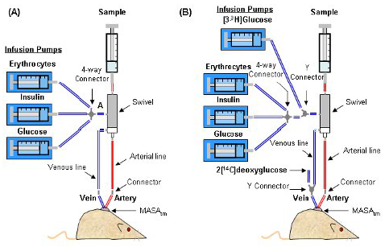
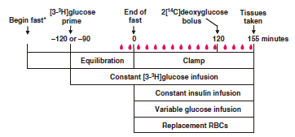
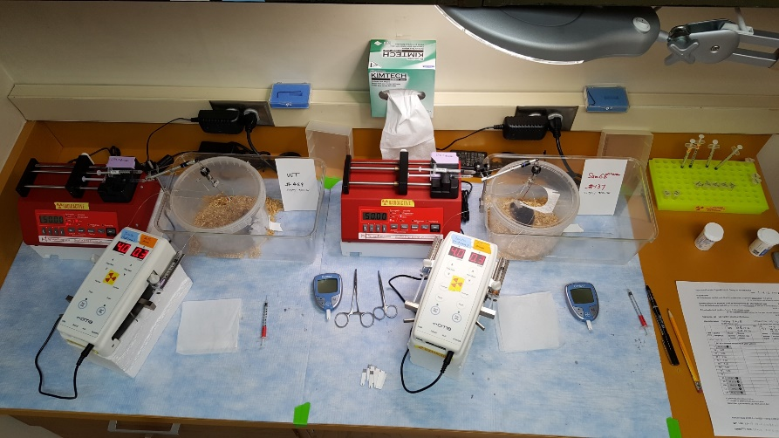
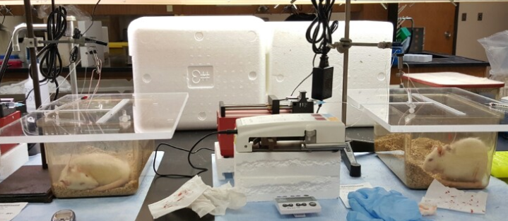
(A)
(B)
(C)
Figure 1. Depiction of the experimental setup for Cold (A) and Tracer-based (B) clamps. Infusion and sampling time-line during a typical glucose clamp experiment.
(A)
(B)
Figure 2. Current experimental setup for glycemic clamping in mice (A) and rats (B).

Slide 4
Services Offered
Indwelling catheter cannulation
  Jugular vein (insulin, glucose, tracer infusion)
  Carotid artery (blood sampling; patent up to 2 weeks)
In Vivo Glucose-Stimulated Insulin Secretion (GSIS)
Ex Vivo adipose tissue glucose uptake
iWAT, eWAT, gWAT with [3-³H]-2-Deoxy-D-glucose & insulin
Hyperinsulinemic-Euglycemic Clamp / Hypoglycemic Clamp / Hyperglycemic Clamp
  Glucose infusion rate (GIR), Glucose disposal rate (Rd)
  Tissue-specific (2-Deoxy-D-glucose) uptake (Rg)
  Hepatic glucose production (Endo Ra), Tissue-specific Glycogen synthesis
  Insulin signaling Western Blot from tissues snap-frozen at clamp termination
Islet studies
  Islet isolation, Ex Vivo glucose-stimulated Insulin Secretion (GSIS)
Primary cell isolation from mouse tissues
Hepatocyte, Adipocyte

Slide 5
(A)
(B)
(C)
(D)
(E)
(F)
(G)
(H)
Figure 3. Blood glucose (A), GIR (B), glucose disposal (C), endogenous glucose production (D), plasma insulin (E), glucose uptake (F-G), and glycogen (H). Representative data from tracer-based hyperinsulinemic-euglycemic clamp with somatostatin-blockade of endogenous insulin secretion (Kim et al. Diabetes 2018).

Slide 6
Figure 3: Plasma insulin (a) in male C57Bl/6J mice (n=7-8) pre-treated 60 min with IUB288 prior to 1mg/kg i.v. glucose. Immunofluorescent labeling of insulin (green), glucagon (red), and somatostatin (blue) in islets from 5h fasted mice treated with GCGR agonist IUB288 for 14 d (b). Fold insulin secretion in islets isolated from chow-fed mice treated 4d with IUB288 or vehicle (c). IUB288² = islets from IUB288-treated mice, then exposed to IUB288 during 16.5mM glucose stimulation. Data represent mean ± SEM. *p< 0.05 in 1-way (b) or 2-way (a) ANOVA.
Figure 4. ex vivo adipose tissue glucose uptake in mesenteric and inguinal white adipose depots treated with 50 nM insulin for 20min. Data represent mean ± SEM (n = 8-9 mice/ group). *p< 0.05, ** p< 0.01, *** p< 0.001, in 2-way ANOVA.

