Slide 1
UAB Faculty Background Check Process Automation with UAB PeopleAdmin
How to Guide
Office of the Senior Vice Provost

Slide 2
Introduction: New Faculty Background Check Process
To further streamline the faculty recruitment and hiring process; the faculty background check process is fully integrated with UAB PeopleAdmin.
Faculty background checks will be initiated in UAB PeopleAdmin for all full-time regular (01) and part-time regular (03) faculty who are hired through the UAB PeopleAdmin System.

Slide 3
Old Process
Department (Search Chair/Hiring Manager receives signed Offer Letter from candidate.
Log in to UAB PeopleAdmin and move the candidate to “Offer Accepted”.
Email Background Check Request Form to Background Check Coordinator.
Disposition remaining candidates in UAB PeopleAdmin; by moving them to final workflow state (i.e. INTERVIEWED/NOT HIRED). * This step is required to close out a faculty search.

Slide 4
New Process
Department (Search Chair/Hiring Manager receives signed Offer Letter from candidate.
Log in to UAB PeopleAdmin; while candidate’s Hiring Proposal is in EXTEND OFFER status, verify that Date of Birth and Social Security Number have been entered on the Hiring Proposal.
If the DOB & SSN have not been entered on the Hiring Proposal, edit the Hiring Proposal to add DOB & SSN. Save changes. And, move the candidate to “Offer Accepted”.
If you do not have the DOB and SSN, please move the candidate to “Offer Accepted” and proceed to the next step.
Disposition remaining candidates in UAB PeopleAdmin; by moving them to final workflow state (i.e. INTERVIEWED/NOT HIRED). * This step is required to close out a faculty search.

Slide 5
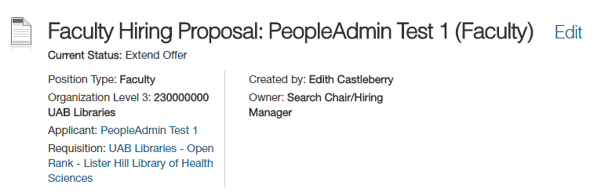
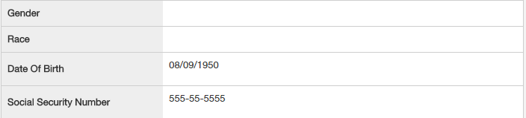
Initiating the Faculty Background Check Process
The candidate must be moved to “Offer Accepted” to notify the Background Check Coordinator to start the background check process.
The Date of Birth and Social Security Number are not required. However, it is highly preferred that these fields be completed if you have the information available before mark the Hiring Proposal as “Offer Accepted”.
The Hiring Proposal is editable while in the EXTEND OFFER status; but not after.

Slide 6
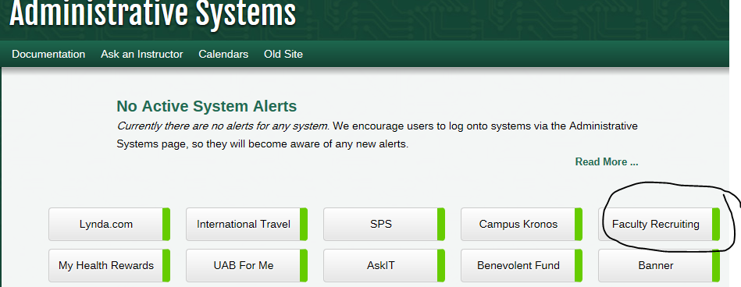
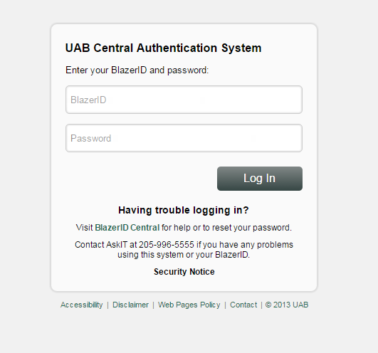
Login Information

Slide 7
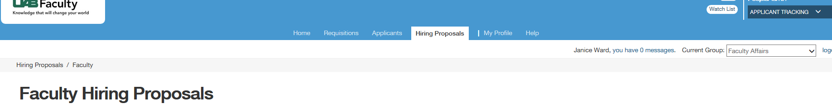
Selecting the Hiring Proposal for Background Check
Click on the Hiring Proposal Tab.
Choose the correct candidate Hiring Proposal that is in the “Extend Offer” state.

Slide 8
Selecting the Hiring Proposal for Background Check
3. Open the candidate’s Hiring Proposal to Edit; if you have the DOB and SSN; by clicking on the blue hyperlink that is the candidate’s name.

Slide 9
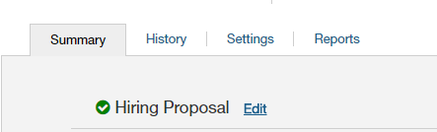
Editing the Hiring Proposal
You can edit one of two ways to add the DOB & SSN:
1.) Click “Edit” beside the title of the Hiring Proposal:
2.) Click “Edit” beside Hiring Proposal on the Summary Tab:

Slide 10
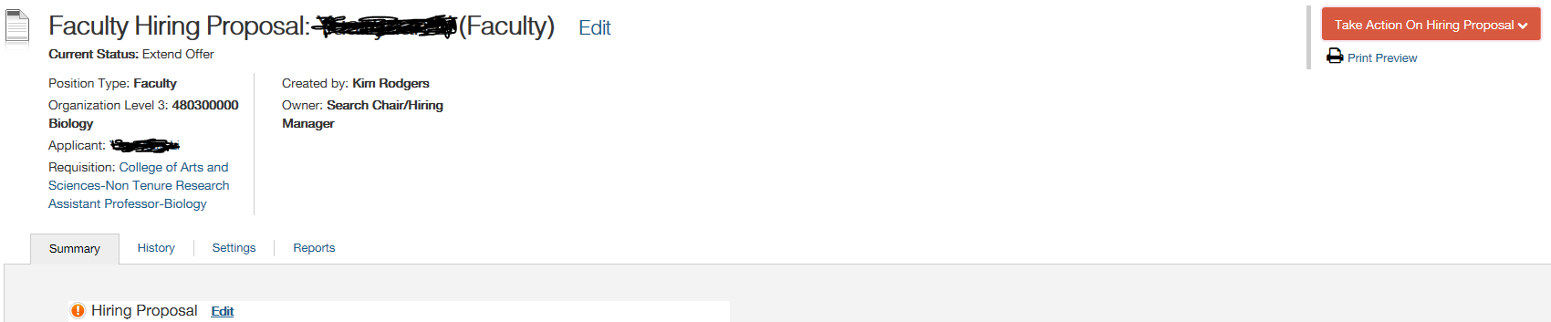
Editing the Hiring Proposal
Choose one of the editing options, and open the Hiring Proposal for editing.
Input the Date of Birth and Social Security Number and click Save.
Click on Hiring Proposal Summary on the left hand side of the page.
Click on Take Action and, move the Hiring Proposal to “Offer Accepted”.
5. Your Take Action button should no longer be available.
6. Repeat these steps, if you have additional Hiring Proposals that are ready for the background check process.

Slide 11
Need Help?
For assistance, please contact, Faculty Affairs at 934-0513 or, contact the Background Check Coordinator at 975-6086 (Geneva Thompson).

