Slide 1
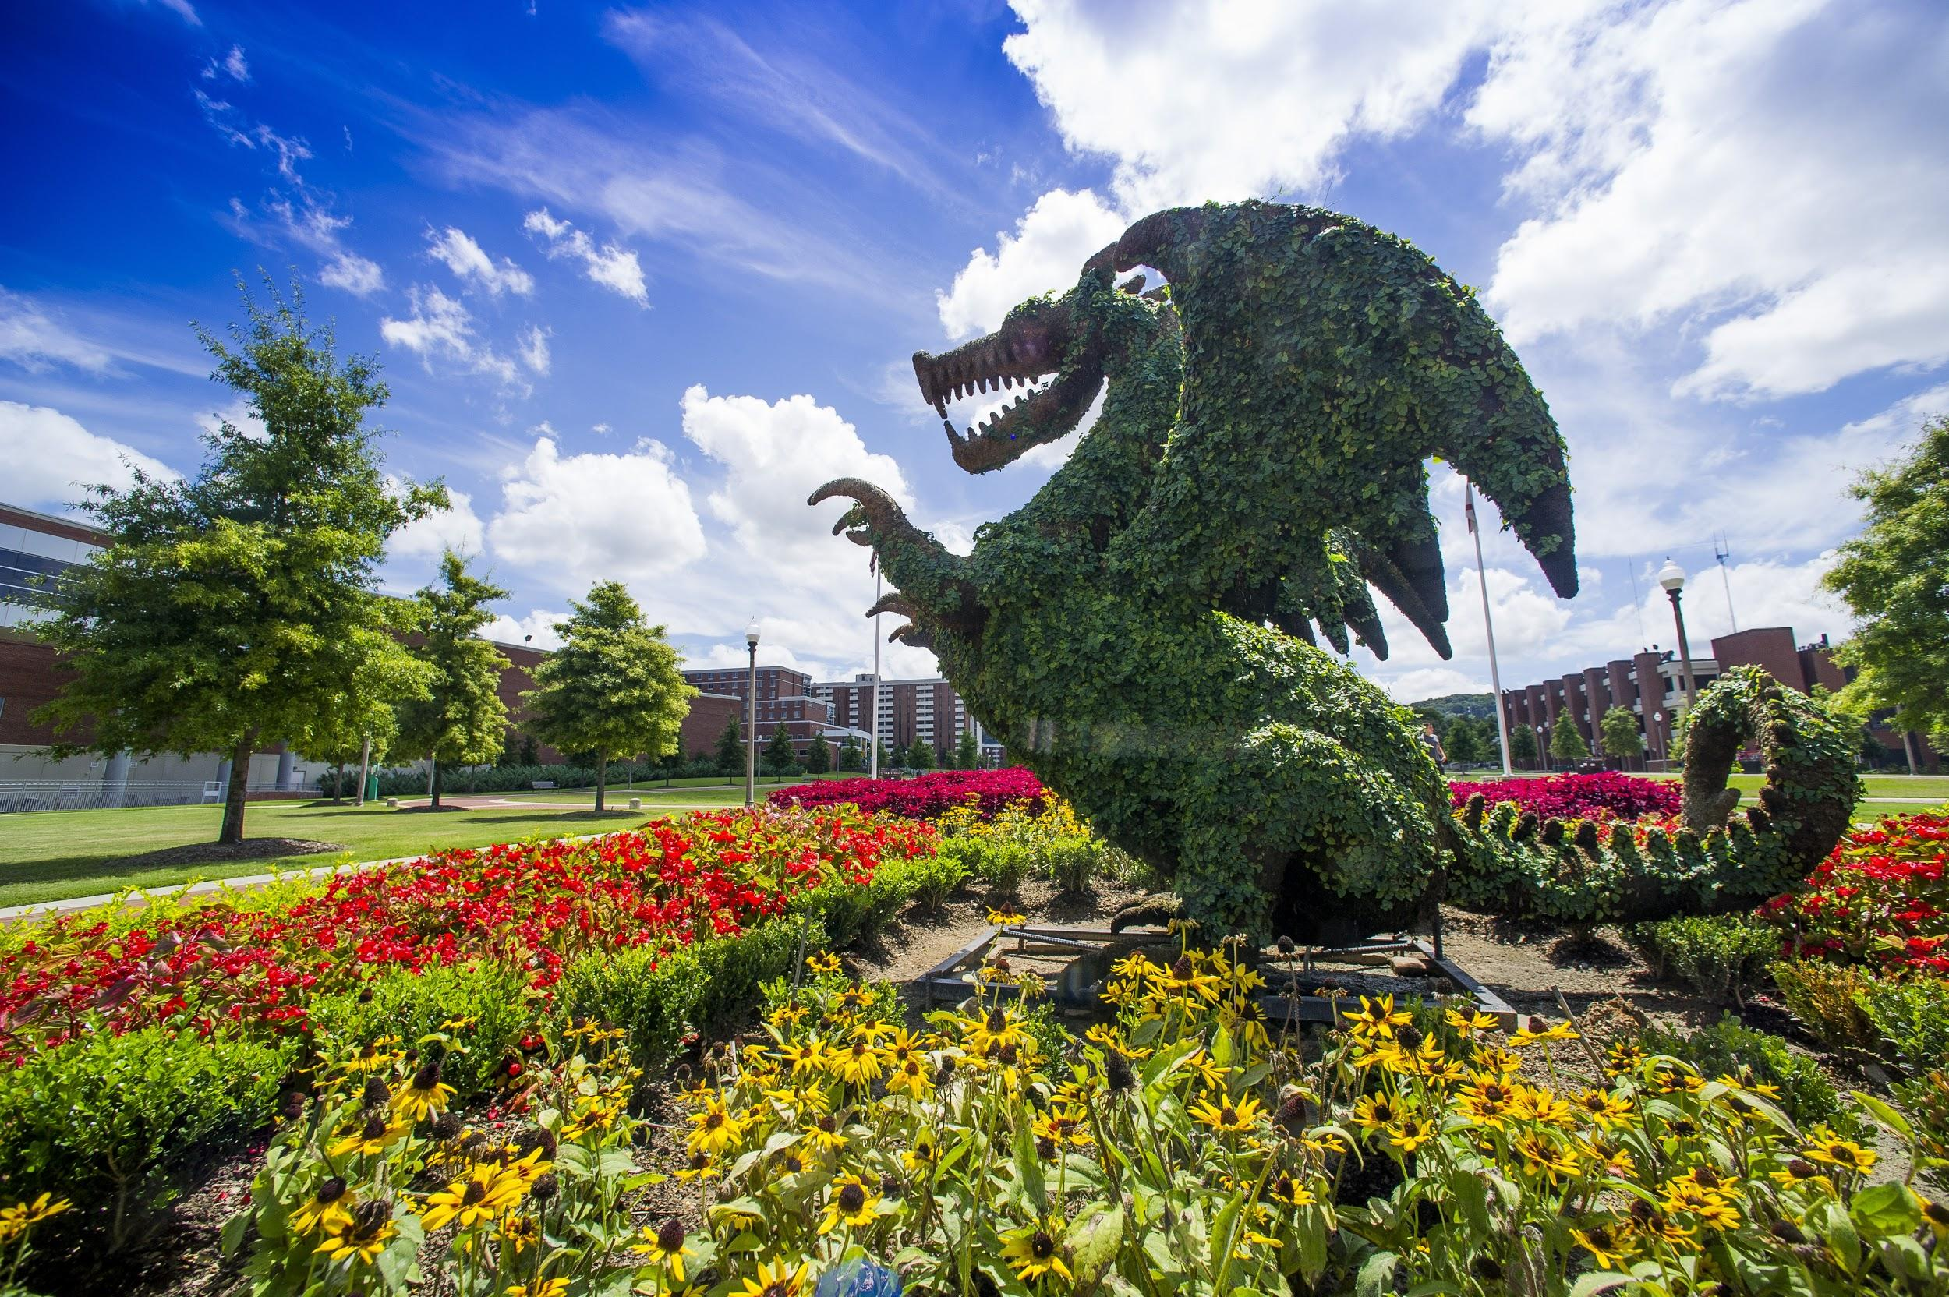
Natural Networking: It’s All About Who You Know
Presenter: Elizabeth Simmons
Assistant Director, UAB Career and Professional Development
Notes:
Networking is considered a bad word-it’s associated with smarmy groups of suited people in hotel conference rooms eating tiny sandwiches and trying to talk to everyone they see to get something that they want. Networking gets a bad rap, and in reality, that hotel conference room scene is not where most really good networkers create great professional relationships.

Slide 2

Networking is Natural
Notes:
We as humans have been wired to network since the dawn of time. We’ve done it by banding together and sharing knowledge in small migrant groups, knowledge that helped keep us alive. Then we started building societies and cities and did the same thing! When we share and learn from each other, we survive, grow, and have more fun. It’s actually pretty awesome. And it happens more than you think. Source: TheMuse.com
https://www.themuse.com/advice/everyone-feels-awkward-5-more-networking-truths-thatll-make-it-so-much-easier
For example: Anytime you ask for a restaurant recommendation or catch up with someone you bump into while running errands, you are networking. Seriously.

Slide 3

What is
networking
really
for?
Notes:
Explore career opportunities
Learn more about a job, industry or company
Gather advice from different perspectives
Tap into the hidden job market – remember, a single personal connection can lead to multiple opportunities
Build your base of contacts for future reference and provide you with a support network

Slide 4

Calling every person you know (or don’t know) and asking them for a job
Working a room in an attempt to collect business cards and make contacts with people who can provide you with something of value
Asking for a job
Randomly passing out resumes
Using people for information you think they have
Notes:
Why does networking get such a bad reputation? It’s because most people associate networking with activities and actions that are inherently unnatural and uncomfortable.

Slide 5

A give and take process of connecting with people and building lasting relationships
About meeting new people, sharing information and learning about potential opportunities and various career fields
Meeting and getting to know people who are willing to share with you career information and advice
Building ongoing relationships to exchange information and advice
Following up and maintaining contact with those who have assisted you
Notes:
Networking should be about creating and maintaining authentic relationships, and all it really takes is doing what comes naturally to us as human beings, but with a career-related focus. What is essential it remember is that a relationship created through networking should be like any other relationship-mutually beneficial. Relationships that are one-sided never work, and this is especially true of professional relationships.

Slide 6

Notes:
Who is a part of your current network? Every one of us already has a network. Sometimes we call it our support system. Sometimes we just call it friends and family. But every time you call someone from your support system for advice, or every time you give advice or assistance, you are participating in your already existing network. So let’s take some time to identify who is in your current network.

Slide 7

Friends
1.____________________________________
2.____________________________________
3.____________________________________
4.____________________________________
Relatives
1.____________________________________
2.____________________________________
3.____________________________________
4.____________________________________
Other Contacts
List neighbors, important people from your past,
community members, new associates, etc.
1.____________________________________
2.____________________________________
3.____________________________________
4.____________________________________
Co-Workers (Past and Present)
List people with whom you discuss work matters.
1.__________________________________
2.___________________________________
3.___________________________________
4.___________________________________
5.___________________________________
Business/Professional Associates
List people who you respect, on whom you would rely for advice, write letters of recommendation, to make introductions, etc.
1.___________________________________
2.___________________________________
3.___________________________________
4.___________________________________
5.____________________________________
PLANNING AHEAD:
Who would you like to meet that isn’t currently in your network (professional heroes, people you admire)?
1._________________________________________
2._________________________________________
3._________________________________________
Notes:
When you are thinking about networking, it is always a good idea to explore your current connections. A lot of times we think that networking is only about meeting new people, when in reality, it might be easier to enhance the relationships that you already have. Often, your best sources of advice and support are already there, but you haven’t taken the time to nurture your relationships with them. So use the first two charts to brainstorm a list of your current network.
The last box on this slide is to help you think about taking your network to the next level. Who do you admire? Who would you like to get professional advice from? Shoot high. If you can’t think of anyone, that’s something to work on. Go on LinkedIn. Read journal articles and industry magazines. Try to identify a few people who are doing something you find impressive, so that you can potentially add them to your network in the future.

Slide 8

SO WHAT’S MISSING?
Notes:
We know now that we all have a network already, so what’s missing? Usually what’s missing is the actions that put your network to work for you and your career. You haven’t stayed in touch, or you haven’t taken the time to reach out to people who you admire.

Slide 9
What do I say when I meet someone?
Express admiration. If he or she recently received an award, or published an article, mention that.
Ask them what they are working on, and actually listen to them when they answer!
Acknowledge awkwardness, especially at formal networking events. (“I always feel awkward at these events, don’t you?”)
Don’t be afraid to talk about what you love (work-related or not!).

Slide 10
How do I maintain connections?
Comment on and share your friends and colleagues social media posts, especially those that are professional in nature.
Send a “check-in” email every once and a while. Include relevant articles or studies that might interest your connection.
Pick up the phone and call! Suggest getting together for coffee.
Include them on your holiday card lists.
Be genuine, and try to make sure that your networking is a two way street. Offer something interesting and helpful to your connections.

Slide 11
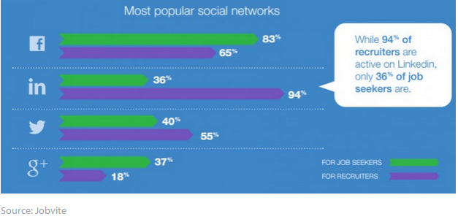
Do You have a LinkedIn Profile? (over 400 million people do)
Notes:
While not highly utilized in the medical professionals, LinkedIn is still a very good source for finding thought leaders and other professionals in your area. If you don’t have a profile, consider creating one, and using LinkedIn groups and connections to increase your network.

Slide 12

Notes:
You need to have a goal, and a plan to make contacts in the places that you need them! Make a plan to reach out to 2-3 old friends or colleagues a week, and/or attend one professional event or lecture a month. Look at the people you named who you would like to meet, and follow them on social media or LinkedIn. Check out whether they will be at a conference near you soon and plan to attend (make sure to stay after for the reception and introduce yourself). When you make new connections, follow up to ensure that your connection stays strong.

Slide 13
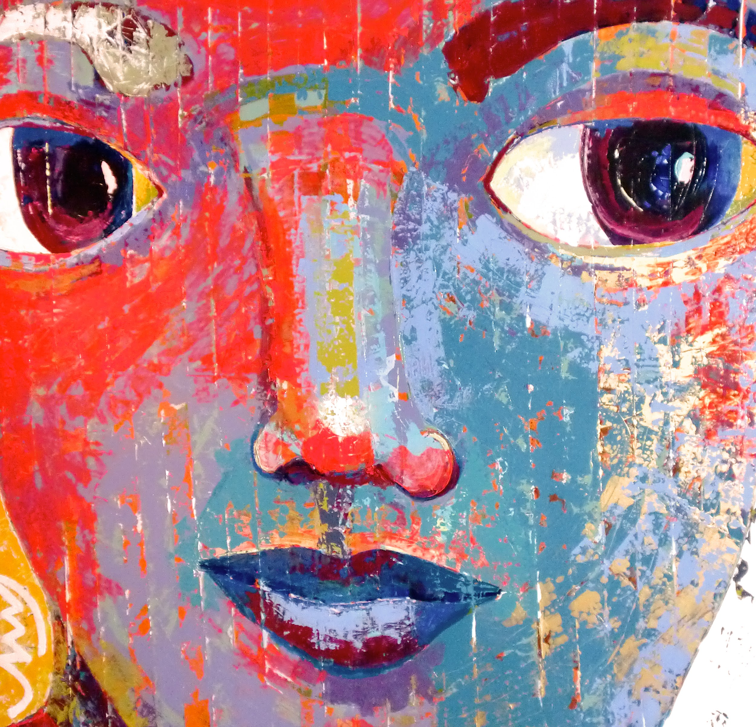
Have coffee with a colleague
Participate in a twitter chat on an industry topic
Attend a lecture/play/concert
Join a professional group
Ask friends to lunch
Volunteer
Notes:
Theses activities are all networking, and they are fun and/or informative, too!

Slide 14

Notes:
Most of all, relax and have fun. Networking isn’t just good for your career. It’s can be positive for you whole life—by focusing on having more real conversations with people who interest you, you can make more friends and improve your professional career.

Slide 15
Thank you!
Elizabeth Simmons, JD, MaEd, MA
Assistant Director, UAB Career and Professional Development

