Slide 1

2nd Annual Workshop on Metabolomics
Integration of Biology and the Metabolome: Breaking Barriers Across Disciplines
Wednesday, June 4, 2014
Adam Wende, PhD
Lalita Shevde-Samant, PhD
Krista Casazza, PhD, RD

Slide 2
UAB DIVISION of Molecular and Cellular Pathology
Adam Wende

Slide 3
Defining the Problem
2.5 million years
50 years
From: Roger Unger - UTSW

Slide 4
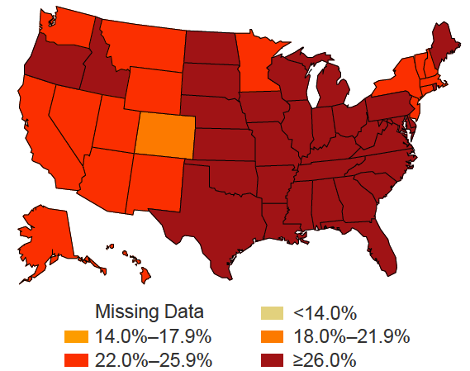
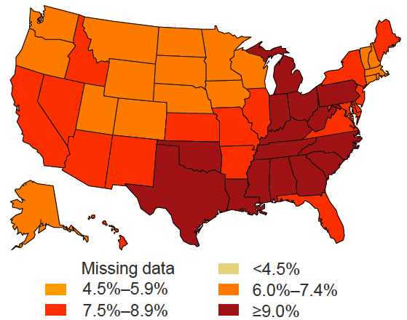
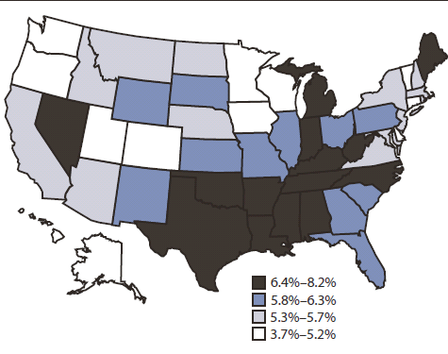
2010 – Obesity
2010 – Physical Inactivity
2010 – Diabetes
2010 – Heart Disease
www.cdc.gov/diabetes/statistics and www.cdc.gov/mmwr
Notes:
In 2012 there were ~371 million diabetics worldwide
~65% will die from
cardiovascular diseases

Slide 5
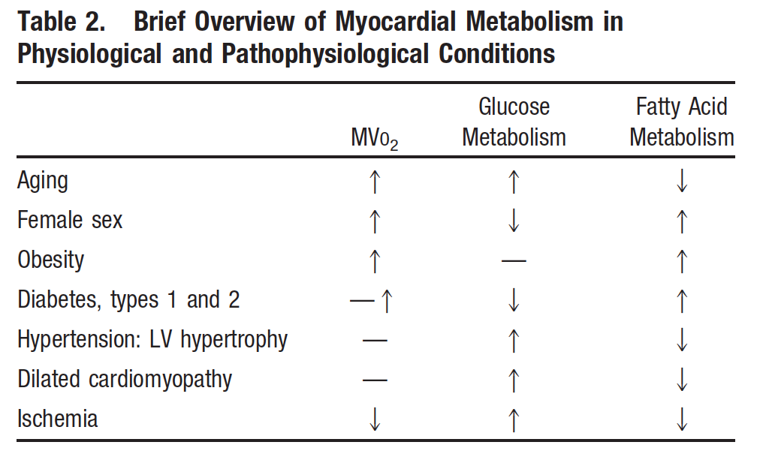
Cardiac Metabolic Substrate Utilization
Peterson and Gropler 2010 Circ Cardiovasc Imaging 3:211

Slide 6
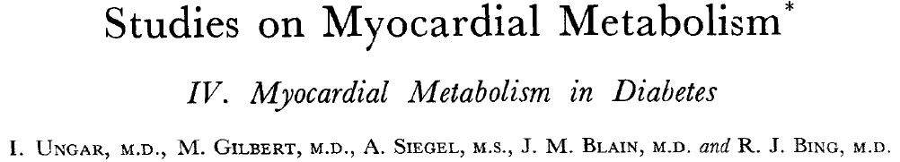
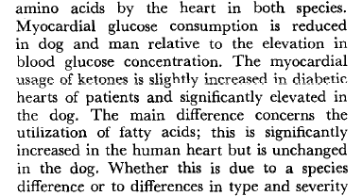
Cardiac Metabolic Substrate Utilization
UAB founded in 1969
Ungar … Bing 1955 Am J Med 18(3):385
Notes:
1953, Watson & Crick attributed with the discovery of the double helix

Slide 7
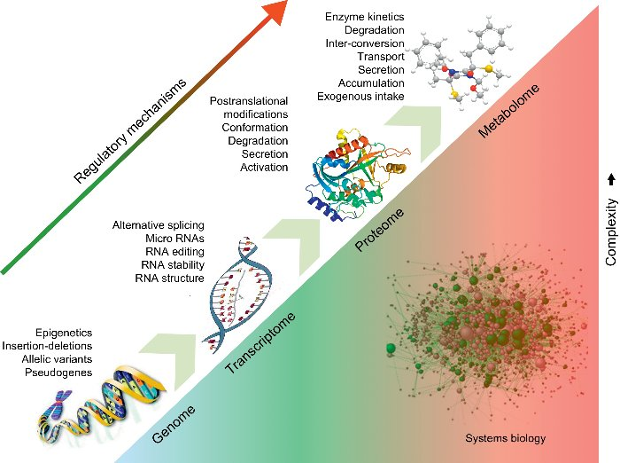
Defining the Mechanism
Barallobre-Barreiro … Mayr 2013 Rev Esp Cariol 66:657

Slide 8
Model Development
DOX absent = OFF
α-MHC
rtTA
TRE
mycGLUT4
MHC-rtTA
TRE-GLUT4
DOX present = ON
α-MHC
rtTA
TRE
mycGLUT4
MHC-rtTA
TRE-GLUT4

Slide 9
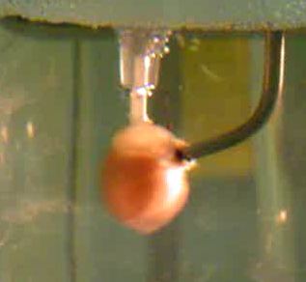
GLUT4 Induction Increases Glycolysis and
Rescues Diabetic Cardiac Glycolytic Defects
Isolated Working Hearts
Glycolysis
§
§
Vehicle
STZ
n = 6 – 10
§ P < 0.01 vs. Con

Slide 10
GLUT4 Induction Increases GLOX but
Accelerates Diabetic Cardiac GLOX Defects
‡
Isolated Working Hearts
Glucose
Oxidation
(GLOX)
*
Vehicle
STZ
n = 6 – 10
§ P < 0.01 vs. Con

Slide 11
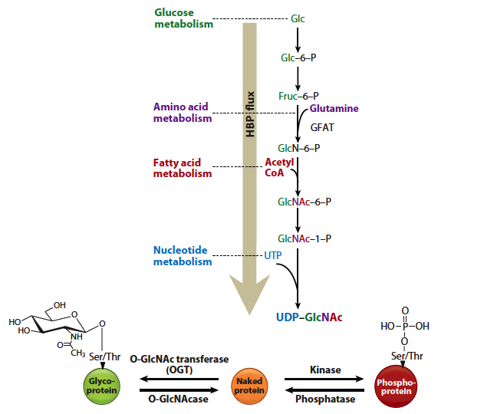
Metabolism, Bringing the System Together
Hart … Lagerlof 2011 Annu Rev Biochem 80:825

Slide 12
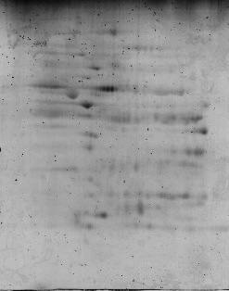
Metabolite Modification of the Proteome
Isolated Mitochondria
2D-PAGE
Pro-Q Emerald
mG4H-Veh

Slide 13
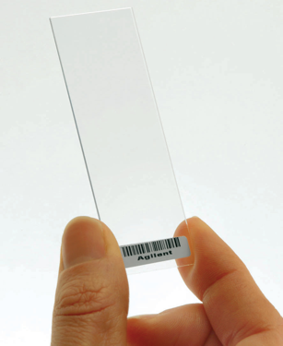
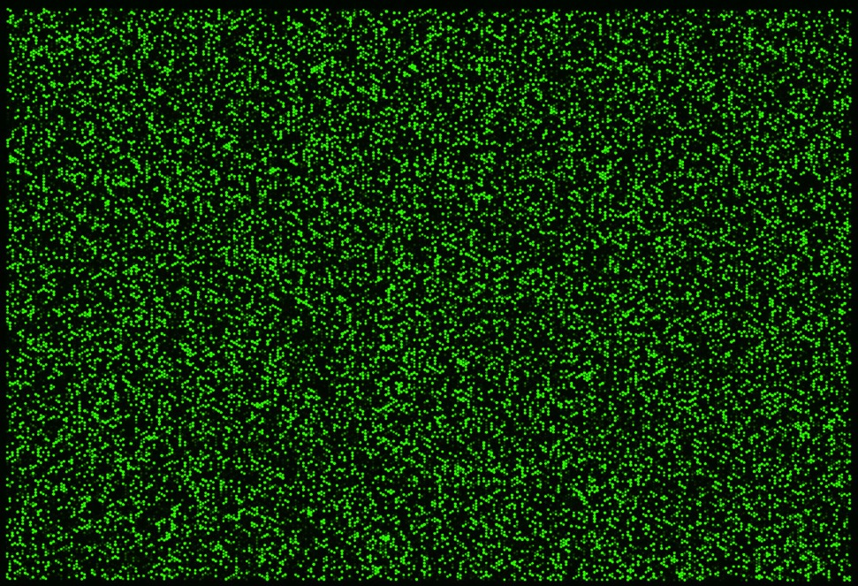

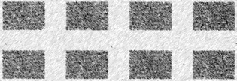
Metabolite Modification of the Transcriptome
mG4H-Veh
181.9 MB

Slide 14
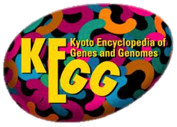
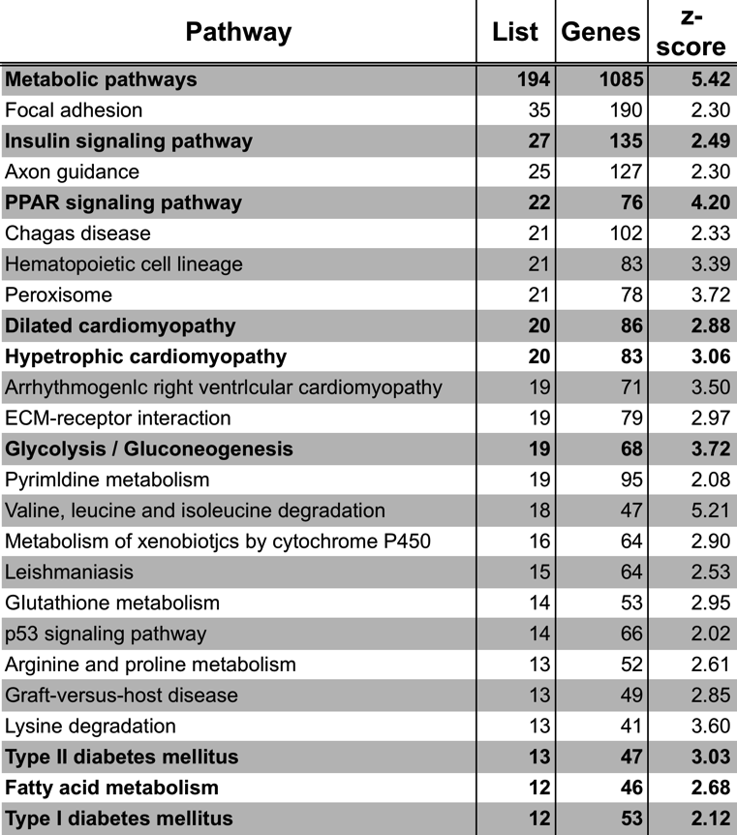
pathway analysis of Microarray
Microarray
2-way
ANOVA

Slide 15
Metabolite Modification of the Methylome

Slide 16
Metabolite Modification of the Metabolome

Slide 17
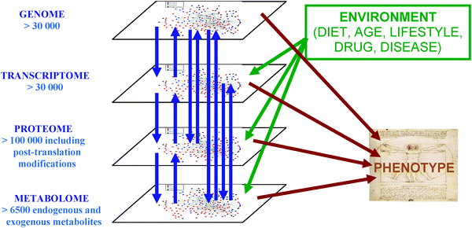
Systems Biology of the Diabetic Heart
Dunn … Griffin 2011 Chem Soc Rev 40:387

Slide 18



Acknowledgements
Wende Lab
Mark C. McCrory – Manager
Brenna G. Nye – Undergrad
Lamario J Williams – Undergrad
UAB Collaborators
Steve Barnes – Metabolomics
John C. Chatham – GlcNAc
David Crossman – Genomics/Informatics
Farah D. Lubin – Epigenetics
E. Dale Abel – Utah to Iowa
John C. Schell – MD/PhD student
Joseph Tuinei – Industry
U of U Cores
James Cox – Metabolomics
Brett Milash – Genomics/Informatics
Krishna Parsawar – Proteomics
Hansjörg Schwertz – GU, Germany
Zymo Research
Keith Booher – DNA methylation
Hunter Chung –Informatics
Molecular & Cellular Pathology
Redox Biology
Diabetes Center
Cardiovascular Center
JDRF 51002608
R00 HL111322

Slide 19
UAB Division of Molecular and Cellular Pathology
Lalita Shevde-Samant

Slide 20

Acknowledgments
Dr. Steve Barnes
Landon Wilson
Ray Moore
William Jackson
Metabolomics Workshop Faculty of 2013
Metabolomics Supplement to R01CA138850

Slide 21
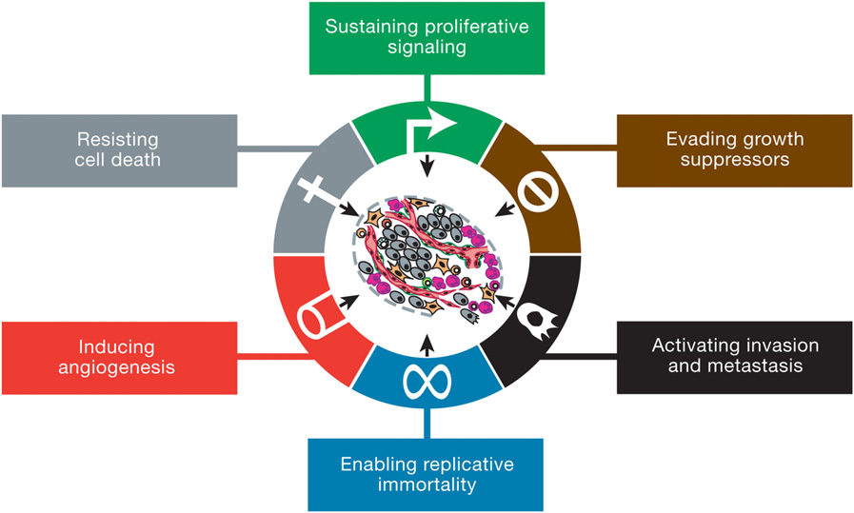
Hanahan and Weinberg, Cell 144, March 4, 2011

Slide 22
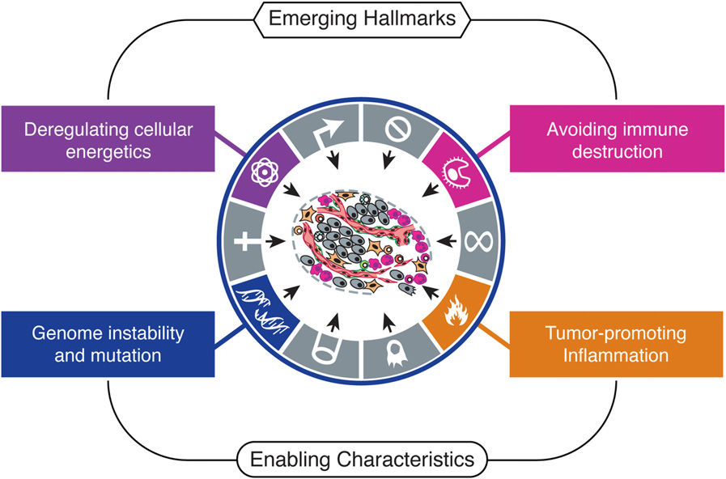
Emerging Hallmarks and Enabling Characteristics
The capability to modify, or reprogram, cellular metabolism in order to most effectively support neoplastic proliferation.
Hanahan and Weinberg, 2011
Warburg effect - An anomalous characteristic of cancer cell energy metabolism ;even in the presence of oxygen, cancer cells can reprogram their glucose metabolism, and thus their energy production, by limiting their energy metabolism largely to glycolysis, leading to a state that has been termed ‘‘aerobic glycolysis.’’

Slide 23
Investigations on the role of Merlin in metabolism and bioenergetics
Metabolism
Merlin
Bioenergetics

Slide 24


Merlin – functional role in malignancies
Regulates cell growth and proliferation: suppresses tumor growth rate by bringing about contact inhibition.
Inhibits invasiveness, reduces motility.
Introduction of Merlin into human metastatic breast cancer cells reduces attributes of metastases.
Surely, Merlin must be doing something to the cellular metabolism or metabolomics..….right?
Morrow et al., J Biol Chem , 2011; Morrow et al., BBA Cancer Revs, 2012

Slide 25
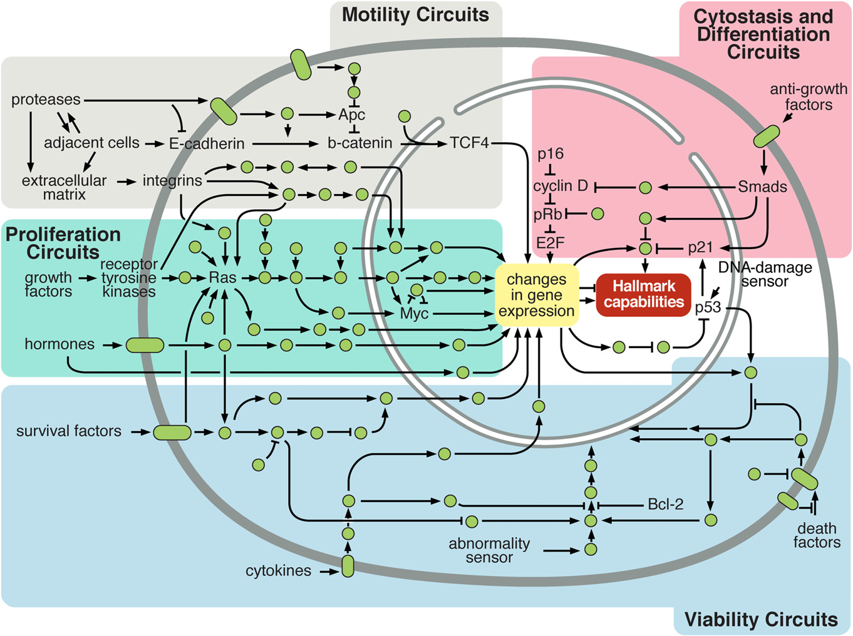
Hanahan and Weinberg, 2011

Slide 26
What is cell metabolism?
Cell metabolism describes the intracellular
chemical reactions that convert nutrients and
endogenous molecules into the energy and
matter (proteins, nucleic acids and lipids) that
sustain life.
What is metabolomics?
Metabolomics allows for a global assessment of a cellular state within the context of the immediate environment, taking into account genetic regulation, altered kinetic activity of enzymes, and changes in metabolic reactions

Slide 27
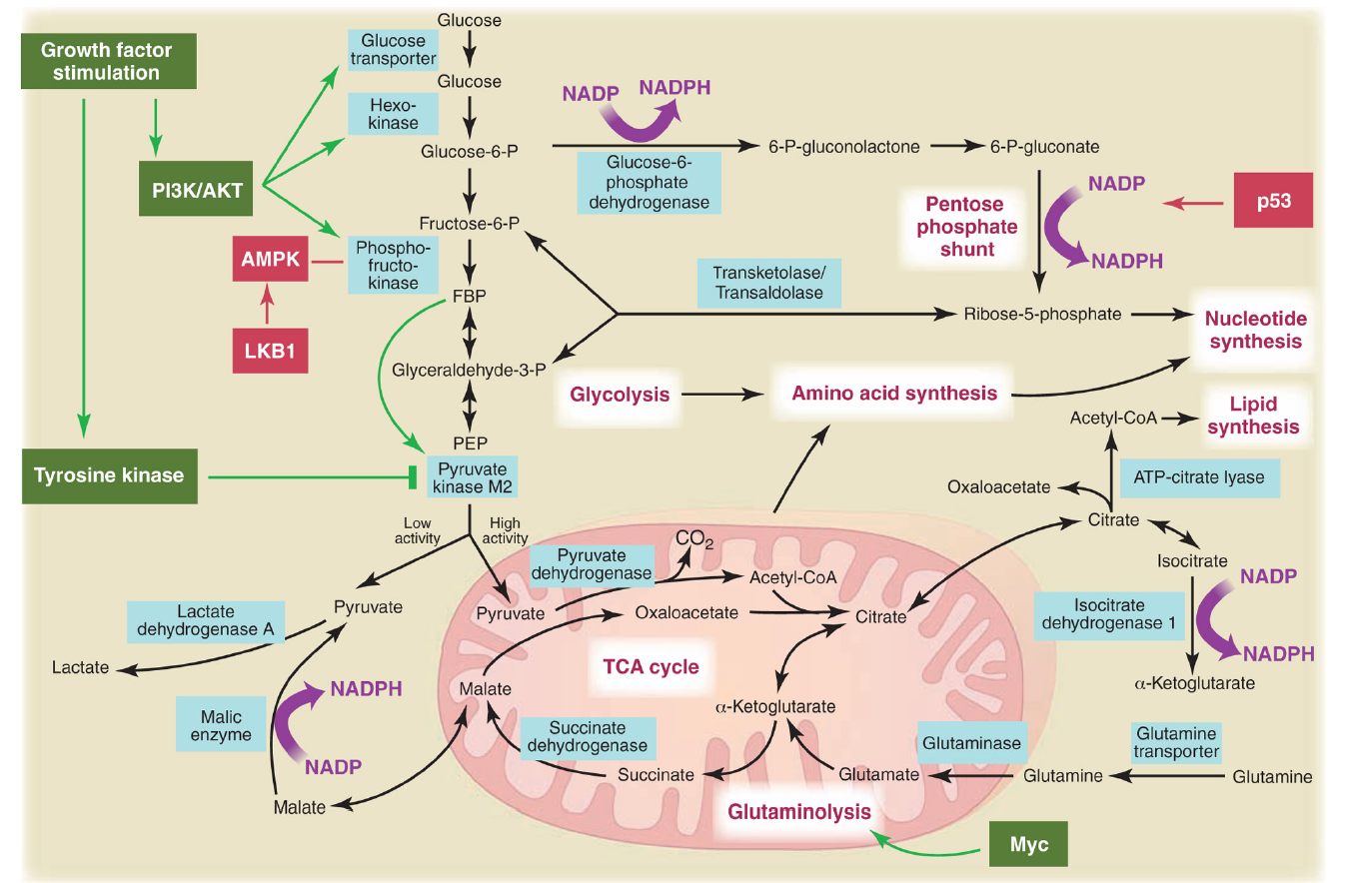
Science. 2009 May 22; 324(5930): 1029–1033.

Slide 28
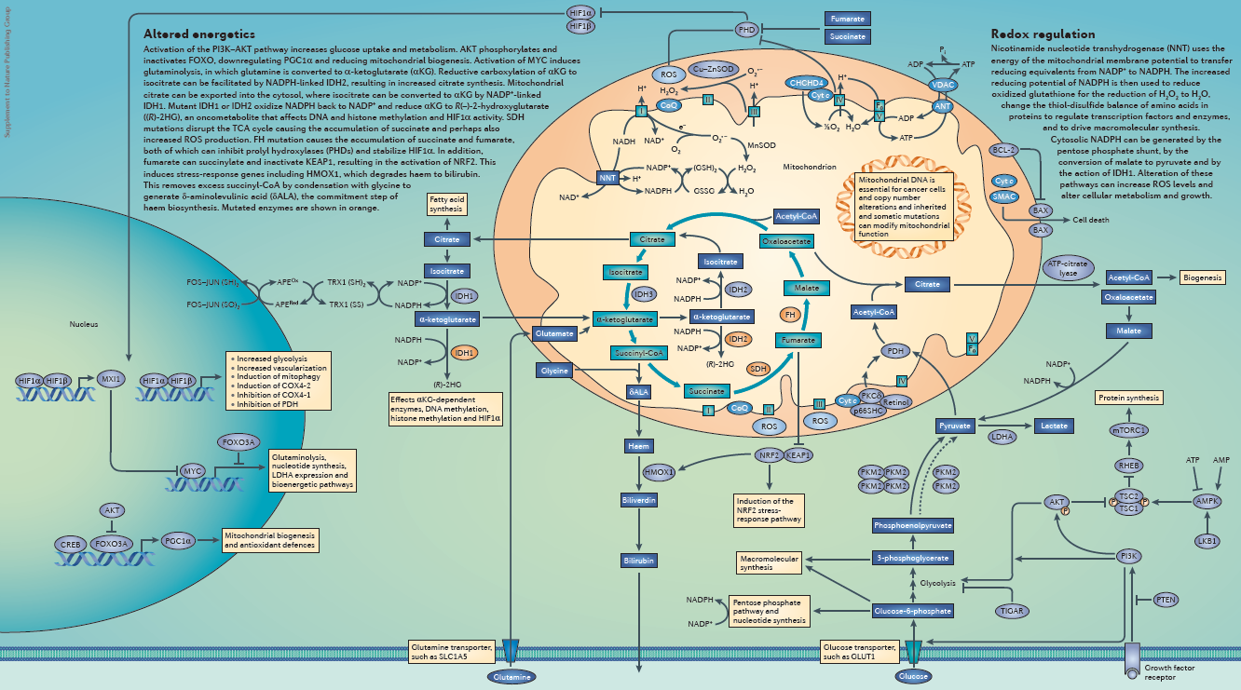
Wallace D., Mitochondrial function and Cancer Nature Reviews Cancer Poster 2012

Slide 29
Lactate production in SUM159 breast cancer cells – vector control and Merlin-restored transfectants
*
*
*
*
Medium | SUM159-vec Lactate produced (nmol) | SUM159-Merlin Lactate produced (nmol)
Regular (24h) | 131 | 233
Regular (48h) | 212 | 405
Minus Glutamine (24h) | 0 | 14
Minus Glutamine (48h) | 62 | 149

Slide 30


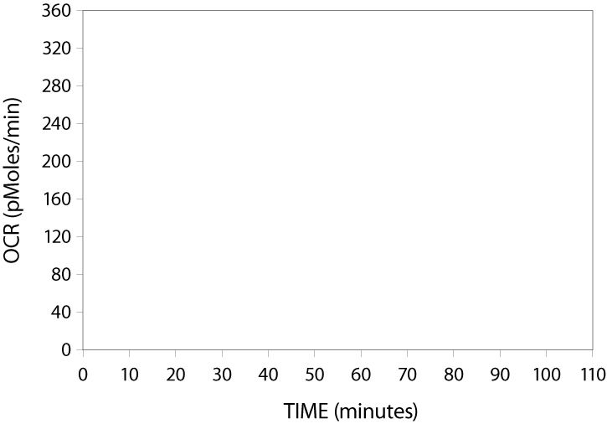

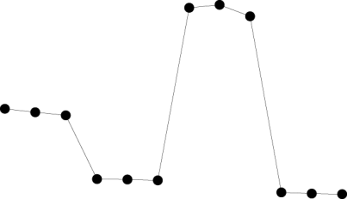

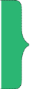


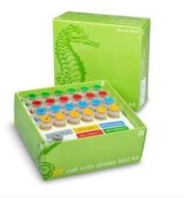
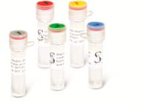
Oxygen consumption rate determined using the Seahorse analysis
Basal-Oligomycin-FCCP-Antimycin (BOFA)
Kit measures the key parameters
of mitochondrial function:
Basal Respiration
Spare
Capacity
ATP Production
Maximal and Spare Capacity
Maximal
Respiration
Proton Leak
ATP
Production
Basal
Respiration
Proton Leak
Non-mitochondrial Respiration
XF Cell Mito Stress Test Profile

Slide 31
Oxygen consumption rate determined using the Seahorse analysis done in SUM159 breast cancer cells – vector control and Merlin-restored transfectants
Basal-Oligomycin-FCCP-Antimycin (BOFA)
O
F
A

Slide 32
TCA/Kreb’s cycle metabolite analysis done in TMPL - in SUM159 breast cancer cells – vector control and Merlin-restored transfectants
Metabolite (normalized to total protein) | SUM159-vector | SUM159-Merlin
Glucose-6-phosphate | 0.216 | 0.211
Fructose-6-phosphate | 0.014 | 0.018
Pyruvate | 0.21 | 0.19
Lactate | 12.26 | 23.72
Citrate | 3.13 | 2.8
Cis-aconitate | 0.21 | 0.09
Isocitrate | 0.31 | 0.15
α-ketoglutarate | 0.70 | 0.4
Succinate | 0.14 | 0.10
Fumarate | 0.54 | 0.44
Malate | 4.2 | 3.5
Oxaloacetate | 0.054 | 0.033

Slide 33
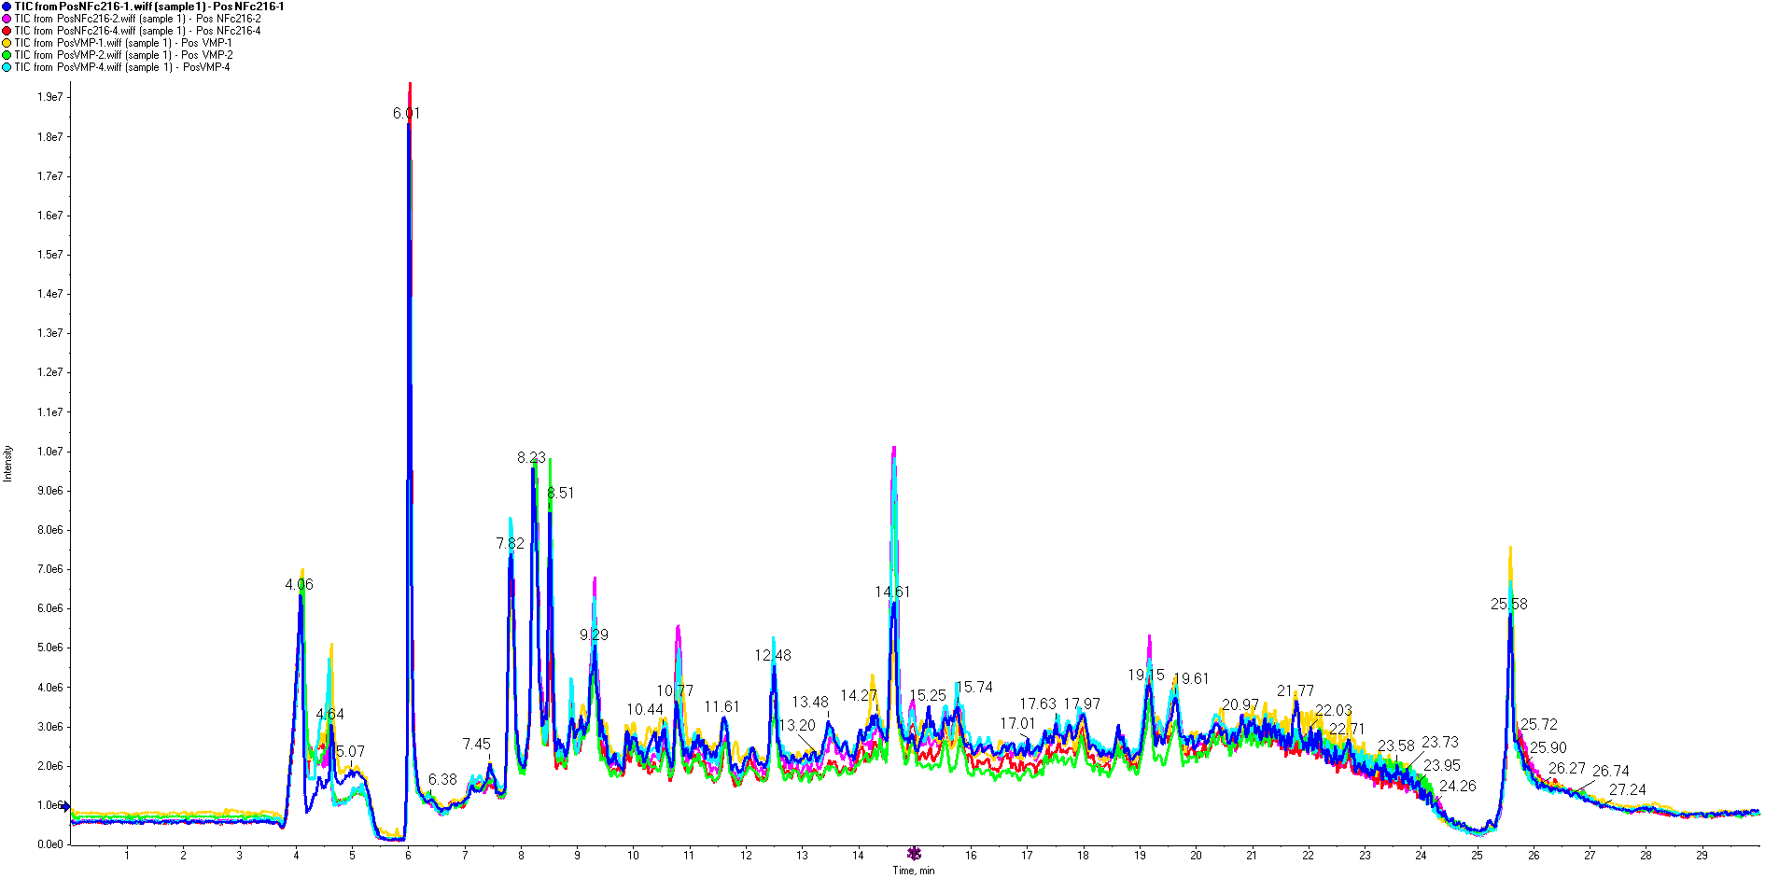
Total Ion Chromatograph Overlays: All Samples

Slide 34
Total Ion Chromatograph Overlays: SUM159 NF2c16

Slide 35
Total Ion Chromatograph Overlays: SUM159 VMP

Slide 36
Extracted Ion Current for 437.2339 m/z
Highly reproducible peak elution times

Slide 37
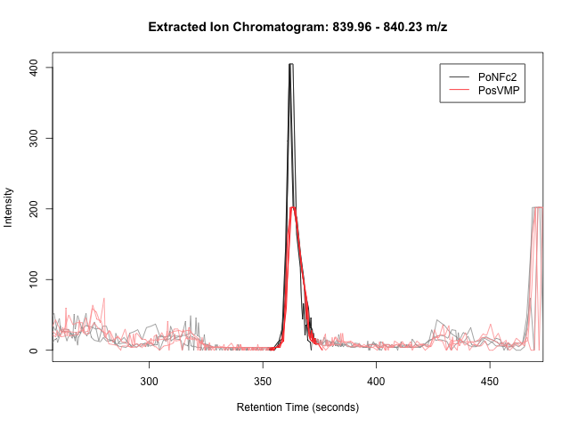

Slide 38
Negative ion data
Log₂(Fold change)

Slide 39
Positive ion data
Log₂(Fold change)

Slide 40
Department of Nutrition Science
Krista Casazza

Slide 41
Pediatric Obesity
Infancy
Pre-puberty
Puberty
Bioactive Components of HBM
Dietary Intervention
Resistance Training Intervention
Musculoskeletal Development

Slide 42
Metabolomics in Nutrition Research
Relative to pharmacology and toxicology
  Infancy
  Similar goals
    Identify those molecules that make a difference between “treatments”
It is KNOWN that many “disease targets” for nutrition research are directly related to the metabolome
  chronic metabolic stress, diabetes, obesity, cardiovascular diseases, inflammation-related diseases, and osteoporosis

Slide 43
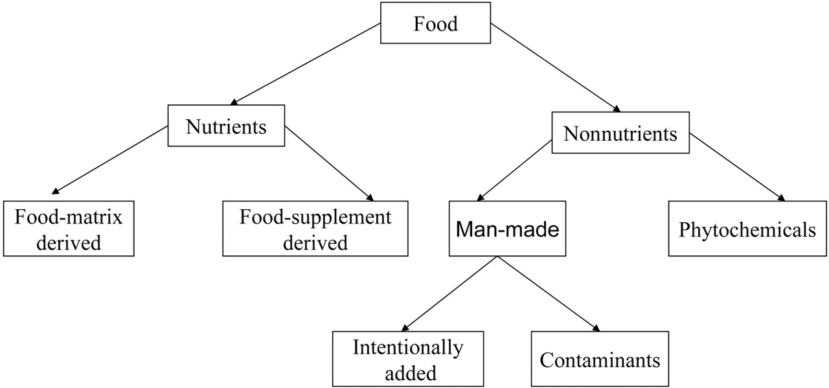
Diet
Analyze CHO, pro, Fat
  Signatures of nutrient related diseases
Depends on more than essential nutrient intake
  Global chronic disease epidemic driven by diets with “adequate” nutrition
Vary across physiologic, metabolic, lifestage
Nutrients and non-nutrients in the human food supply.
Gibney M J et al. Am J Clin Nutr 2005;82:497-503
Notes:
Nutrients and nonnutrients in the human food supply.

Slide 44
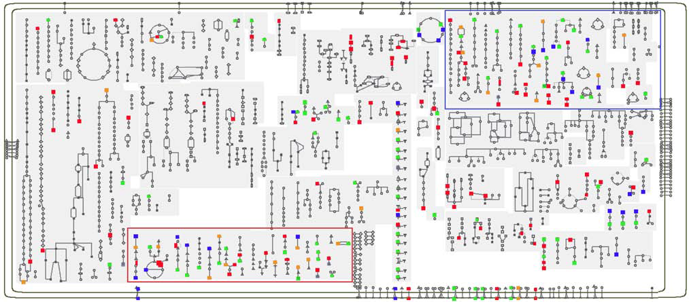
The metabolites overlaid onto the core metabolic map offered for humans. Red points = serum, blue points = urine, and orange points = feces. Green points represent metabolites that were found to be diet-responsive in two or more biofluids. Particularly rich coverage is provided in amino acid metabolism (red box) and catabolism (blue box).

Slide 45
Exercise
Examining humans, exposed to exercise as a standardized input variable, using metabolomics to measure outcomes, revealed a wide array of metabolic pathways that are quantitatively responsive to exercise consistent with cellular mechanistic predictions
Sportomics
  nutritional modulation in the immediate post-exercise period
    BCAAs

Slide 46
Challenges
Nutrition
Exercise
How might we create a list of nutrients and metabolites for the “ideal” metabolome?
Integration of other systems
  Systems biology approach utilization
  Dysregulation within the principal metabolic organs (e.g. intestine, adipose, skeletal muscle, liver) are at the center of a diet-disease paradigm
Non-elite vs elite athletes
Physiologic state
Building extensive knowledge across such a complex healthscape will require studies from a range of disciplines and targets.

Slide 47
Cancer
Obesity
Diabetes
METABOLOMICS
Challenges for (Young) Investigators
Network to identify what is important
Common platform
What has been learned

