Slide 1
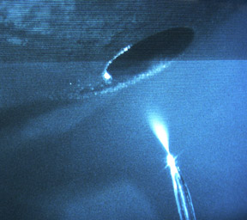
Proteomics
James Mobley, Ph.D.
Director, UAB Bioanalytical & MS Shared Facility
Director, Urologic Research
Assistant Professor, Surgery, Chemistry, Pharmacology, Preventative Medicine.

Slide 2
What is Proteomics?
Studies with focus on proteins (not necessarily MS based)
What tools do we have?
How do we study specific proteins that are known, or even unknown?
We generally want to obtain a measurement of an exact or relative change in the quantity of a protein (or protein modification) as they are effected by the introduction of a specific treatment or exposure.
This may be to an isolated protein in a test tube, in a cell culture setting, or a live animal.

Slide 3
Experimental side of things…..
Before we go forward, what are we measuring when we study a compound in a specific setting:
Test tube (purified protein + compound = modification to that protein? what modification at what concentration?)
Cell culture (biological mechanism can be studied; direct change to protein, indirect changes i.e. receptor mediated, parent or daughter molecule)
Animal model (translatable; system wide multi-organ effects, and discovery of biological markers to mark those effects)
Also, what problems and advantages do we have in the way of proteomics studies when we go from one setting to the next?
We go from a purified known protein in high quantity to increasingly complex systems, with the ability to measure indirect system wide effects.

Slide 4
What Tools Encompass Proteomics
Relative or Absolute Quantification of Known Proteins…….
  Mass Spectrometry (Mass Tags/ AQUA)
  Immuno-Directed (examples)
    1) Protein Arrays, 2) Western Blot, 3) ELISA, 4) Bioplex/ Luminex
Characterization of Unknown Proteins/ Mapping Post Translational Modifications (PTM’s)……..
  Sequencing of Unknowns, Mass Spectrometry alone!

Slide 5
Comparative proteomics often from a clinical perspective…..
To find associations between biological components (i.e. SM, FA’s, Proteins) and any clinical endpoint quickly, non-invasively, affordably.
To non-invasively determine…..
  Pathologic Changes (i.e. early detection of cancer)
  Aggressiveness/ Stage of Disease
  Predicting Rx Response
  Drug Target Discovery
  Mechanistic Studies (Systems Biology)
The Potential Clinical Impact is Tremendous!!

Slide 6
General Theme: Mass Spectrometry Driven
Discovery & Directed Quantitative Proteomics
(non-Tagged/ SILAC/ AQUA)
IP (PTM or Protein Directed)
(SILAC)
1D or 2D PAGE
(SILAC/ AQUA)
In-Solution Digest
Systems Biology
(i.e. Cytoscape)
Cellular Location
Molecular Process
Biological Function
HTP-MALDI-Tof/Tof
(200 spots per night)
Nano-LC-MS(MS)²-CID/ETD
(~6000/spectra/hr)
Characterization
(Relative/ Absolute Quantification)

Slide 7
Discovery and Directed Based Proteomics/ Lipidomics
Non-Tagged

Slide 8
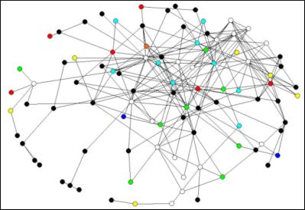
Systems Biology Workflow
DNA
mRNA
Protein
Protein-Complex/
Enzymes
Genomics
Functional Genomics
Proteomics
Functional Proteomics
Systems Biology
Biomarker Discovery
Better Understanding of Global Analysis
Informatics of Complex Data Sets
Cells
Tissues
Organs
Organism

Slide 9
Overview of Systems Biology Approaches
Now you have a long list of “interesting proteins”……..
How do you sidestep the “So What” factor…….. Systems Biology!
Great Overview at……..
http://www.cytoscape.org/
http://cytoscape.org/cgi-bin/moin.cgi/Presentations

Slide 10
Example (Secreted):
Example of Common Proteins
*Acyl-CoA-binding protein
Aldose reductase
*Alpha-enolase
*Apolipoprotein D precursor
*ATP synthase-coupling factor
Bisphosphoglycerate mutase
*Copper transport protein ATOX1
*Cytochrome c oxidase
*D-dopachrome decarboxylase
Dynein light chain roadblock-type 1
*Glutathione S-transferase P 1
Isopentenyl-diphosphate isomerase 1
L-xylulose reductase
*Peptidyl-prolyl cis-trans isomerase A
*Phosphatidylethanolamine-binding protein 1
Polyadenylate-binding protein 1
Protein S100-A6
*Ptms protein
*Selenium-binding protein 1
*Superoxide dismutase [Cu-Zn]
Thioredoxin
*Thymosin beta-4
*TSC22 domain family protein 1
*Albumin
*Apolipoprotein A-II
Calmodulin 1
*Caronic anydrases (2)
*Hb-alpha
*Hb-beta
*Keratin Subtypes (10)
*MIF
Mitochondrial Membrane Tim8 A
Mitochondrial Membrane Tim8 B
*Niemann Pick type C2
*Prosaposins (3)
Ubiquitin C, full insert sequence
*Unknowns or Not Annotated (8)
Brain
119
Liver
75
Total Unique Proteins = 277
Brain (B) 119
Liver (Li) 75
Lung (Lu) 122
Kidney (K) 131
Common (>2) 57
*Common (all 4) 33
57
Lung
122
Kidney
131

Slide 11
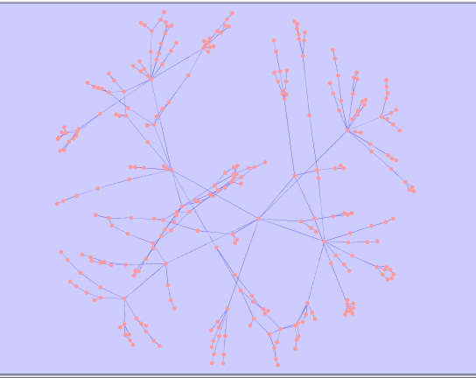
Example (Mouse Model – Pancreatic Cancer):
Protein bands were excised from the 1D gel for Ras and Ras:p53-63, digested with trypsin and run with LTQ-XL/CID mode. The results from LTQ-XL were run through SEQUEST to identify proteins. The proteins unique to Ras;p53-63 was run through *Cytoscape to see how those proteins relate to one another based on their molecular functions.
Ras
Ras;p53
Binding
Red-ox
532
150
Transporter
520
Transferase
Ligase
Protein modification
Receptor
*Cytoscape is an open source bioinformatics software platform for visualizing molecular interaction networks and integrating these interactions with gene expression profiles and other state data.

Slide 12
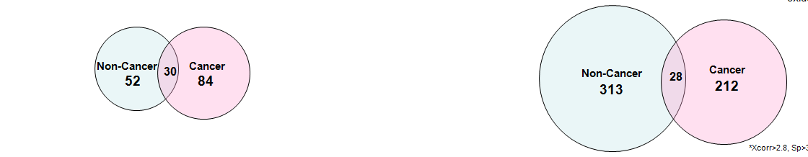
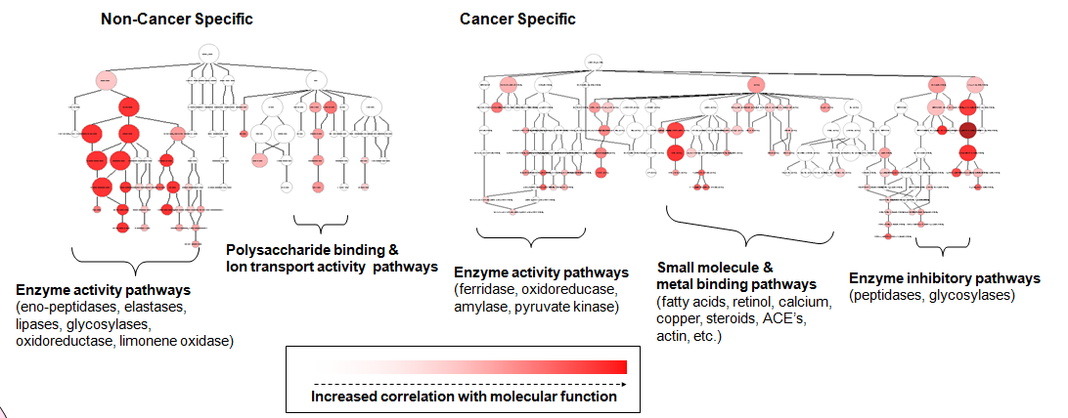
Non-Tagged Analysis of Pancreatic Juice
(Cancer Vs. Non-Cancer)
Protein images

Slide 13

Slice frozen tissue on cryostat (~12 μm thick)
Thaw slice onto MALDI plate, allow to dry
Droplets
Spray
coating
Apply matrix
+
+
+
Acquire
mass spectra
+
+
+
Laser
Laser
Protein profiles
Protein images
m/z 18 388

Slide 14
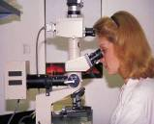
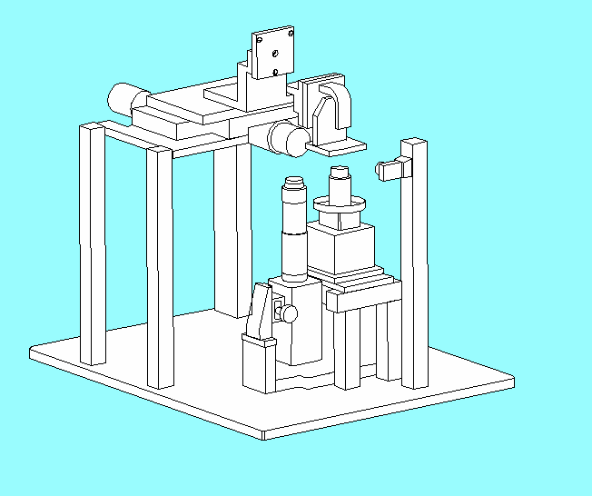
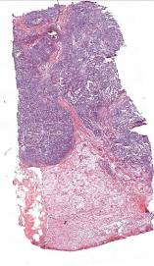
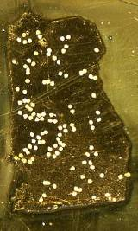
Tissue Based Discovery Proteomics:
Histology Guided Matrix Deposition (Profiling MS)
Laser
M3
M2
M1
Mass (m/z)

Slide 15
Results from Mass Profiling Tissue Sections
M.G. - NO Tumor
M.G. – Early BCa
M.G. – Late BCa
2 kDa 20 kDa

Slide 16
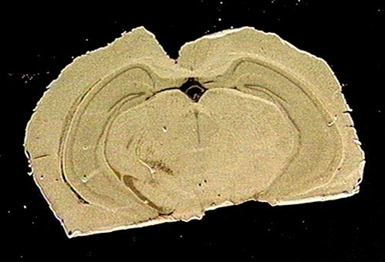
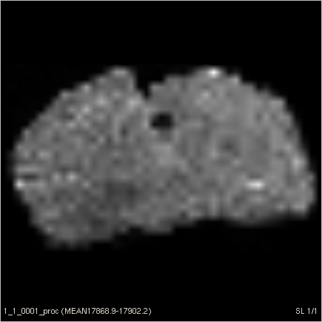
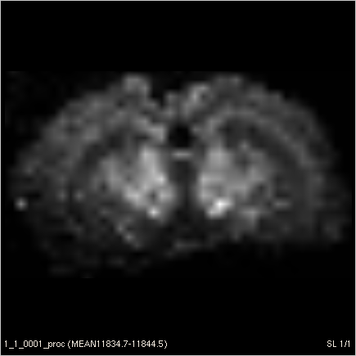
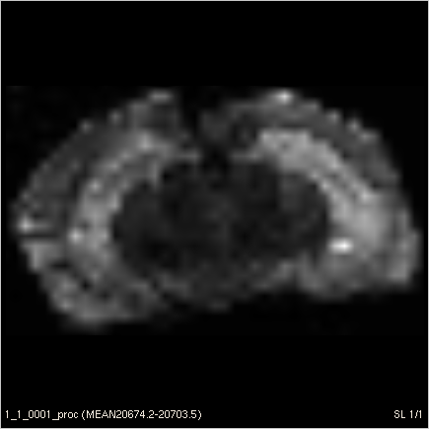
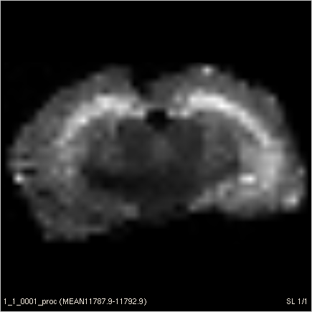
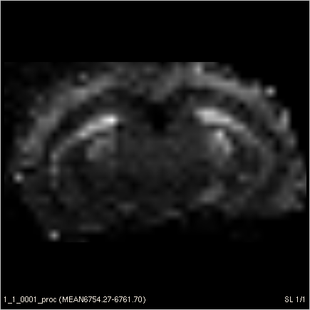
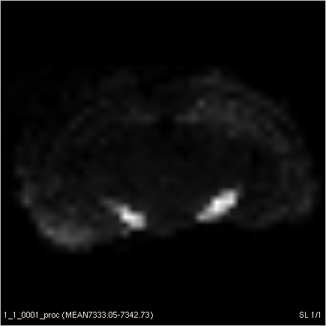
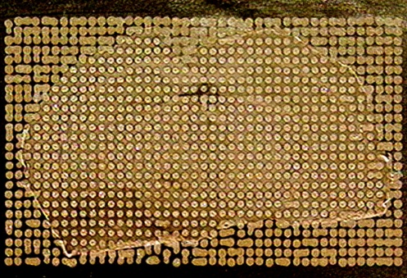
MS Imaging of a Mouse Brain Section
m/z 17885
m/z 11839
m/z 20688
1000 μm
0 %
100 %
m/z 11790
m/z 6759
m/z 7338
Intensity
2014
15579
29144
Mass (m/z)
42708
56273
69838

Slide 17
Focus Today:
Tissue profiling ; LC/MS and directed MALDI
Pharmaco-Proteomics (pristanic acid & AMACR)
Identification of Markers from Gentamicin Induced
Kidney Damage in Monkey…….

Slide 18
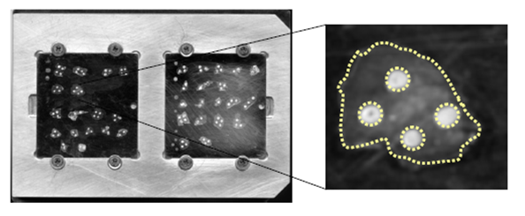
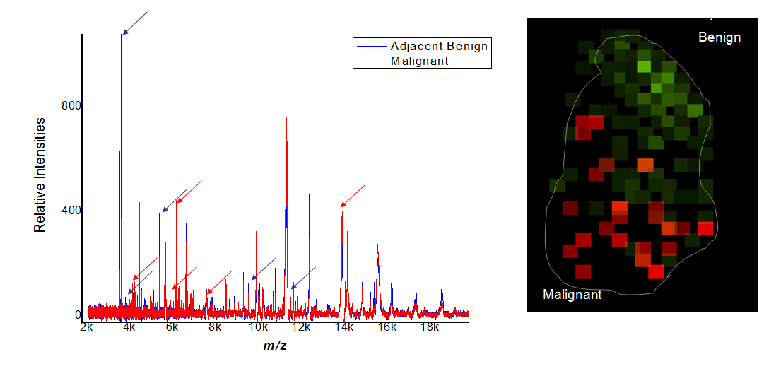
Project 1; Tissue Profiling; mining for markers of diagnosis & progression?

Slide 19
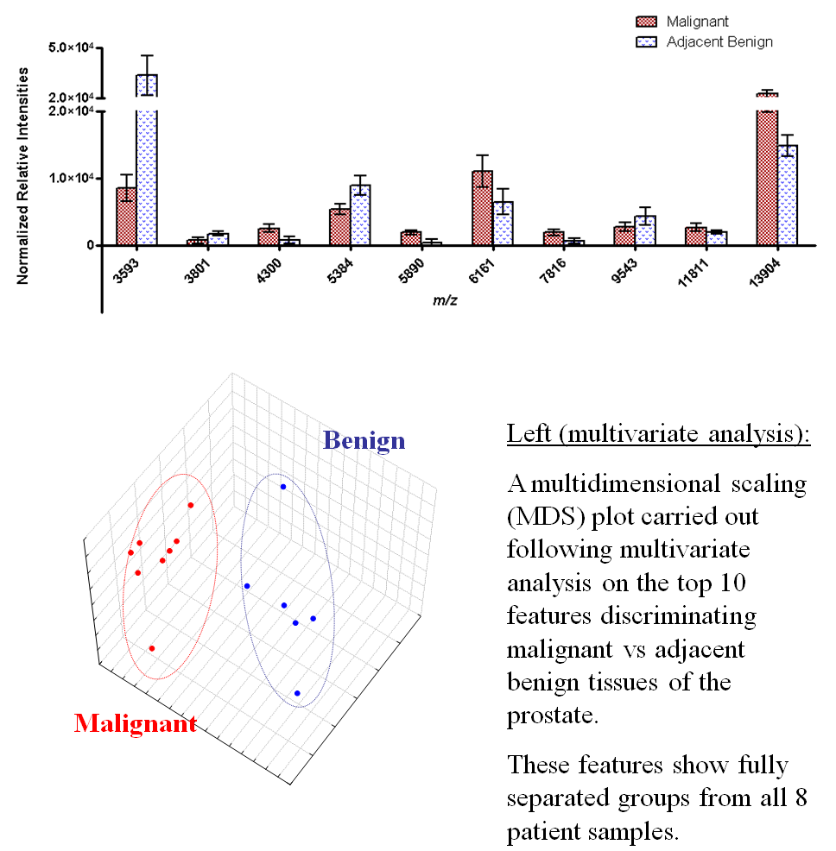
Protein markers indicative of disease will be identified through a series of separation approaches and validated by IHC.
Present data is novel and adequate for preliminary data for a funding mechanism.

Slide 20
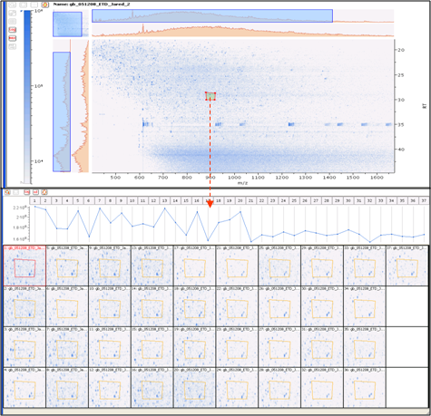

Slide 21
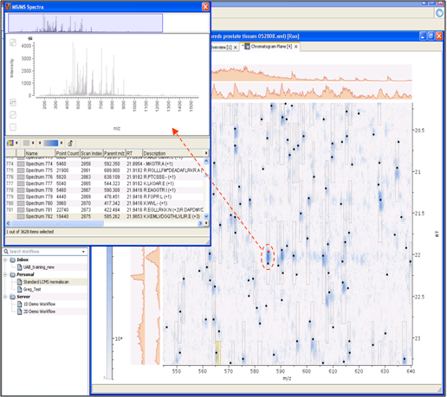

Slide 22
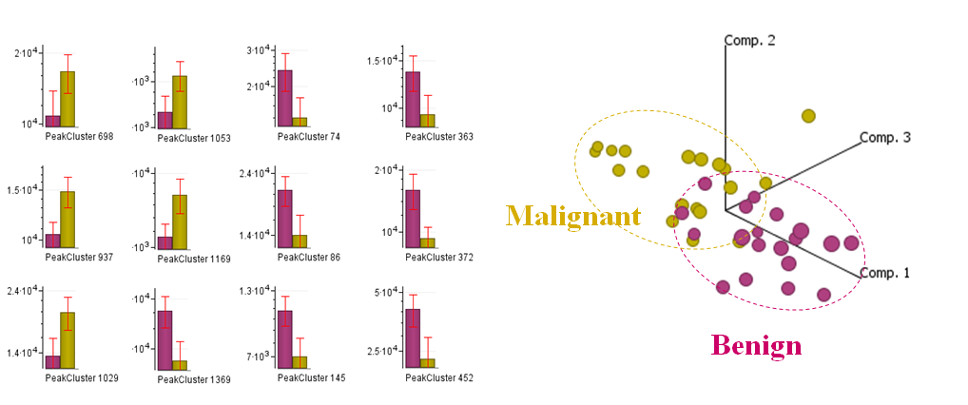

Slide 23
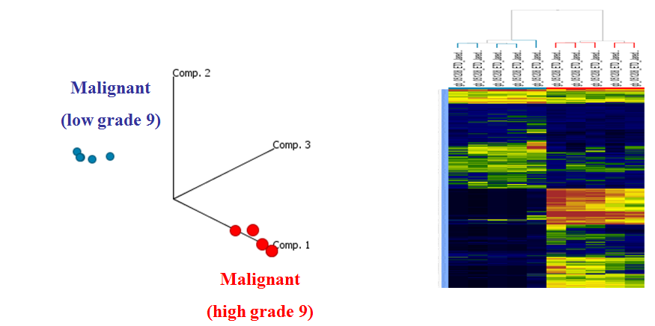
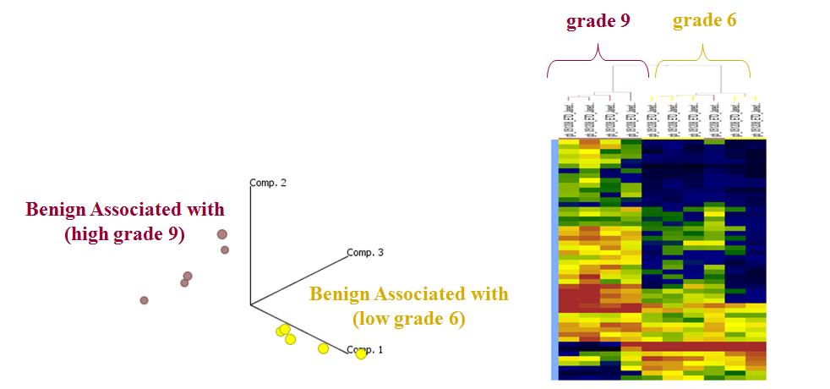
6)

Slide 24
Protein Identified in this Study:
Diagnostic - Cancer Specific
Heat shock cognate 71 kDa protein, Prostate specific antigen, Alpha-2-HS-glycoprotein, IGHA2, Golgi phosphoprotein 2, APS protein, 60 kDa heat shock protein, RcTPM3, Macrophage migration inhibitory factor, Histone 1, Antithrombin-III, Peroxiredoxin-1, Alpha-enolase, Malate dehydrogenase, Fructose-bisphosphate aldolase, ATP synthase subunit alpha
Prognostic - Grade Specific
Malate dehydrogenase, Alpha-enolase, Tropomyosin, Filamin-A, Apolipoprotein A-I precursor (Apo-AI), Zinc-alpha-2-glycoprotein, Serotransferrin, prostate specific antigen, Lipoma-preferred partner, Prostatic acid phosphatase, APS protein, Vimentin, Calponin-1, Cytochrome c oxidase, Alpha-1-antichymotrypsin, Smooth muscle myosin, Beta-microseminoprotein, Elongation factor 1-alpha 1

Slide 25
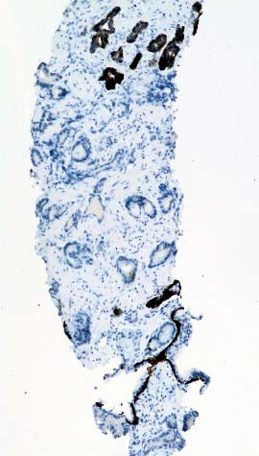
Project 2; AMACR in Prostate Cancer
AMACR is overexpressed in the epithelial cells of high-grade prostatic
intraepithelial neoplasia (PIN), and in a majority (60 –100 %) of prostate
cancers (CaP) as compared to minimal expression in normal and benign
hyperplastic lesions of the prostate
HMWCK
AMACR
CaP Biopsy

Slide 26
Metabolic
Effects of
AMACR
Production of:
H₂O₂
NADH
FAS substrates
Active -
Intermediates

Slide 27
Optimizing With a Cellular Model
Transcript;
Real Time PCR:
LNCaP Vs. NPrEC
12-16 Fold Increase
LNCaP Cells
2-4 cell sensitivity
Tested on 27 Patient
Samples;
15 Healthy
12 CaP

Slide 28
AMACR is not Induced……..
Rather Stabilized by Its Substrate
NPREC
Westerns
Quantitative PCR
LNCaP

Slide 29
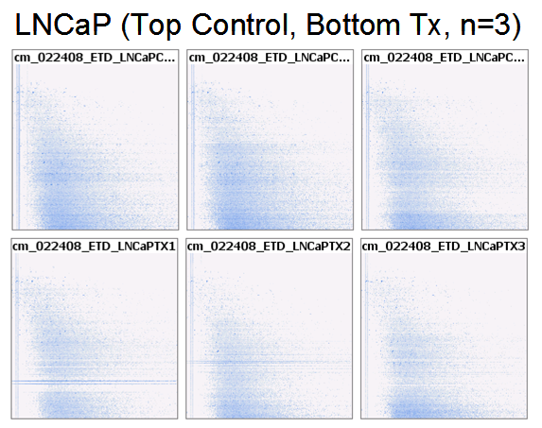
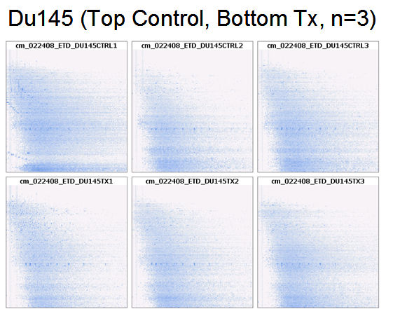
Treatment with Substrate…..2D Plots LC/MS
Cells Expressing AMACR Vs. Cells that do not!
Above (LCMS ion plots from 3x3 treated vs non treated LNCaP and Du145 cell lines): Overall these ion plots illustrate the first step in overall consistency between runs, with minor adjustment to RT alignment required.

Slide 30
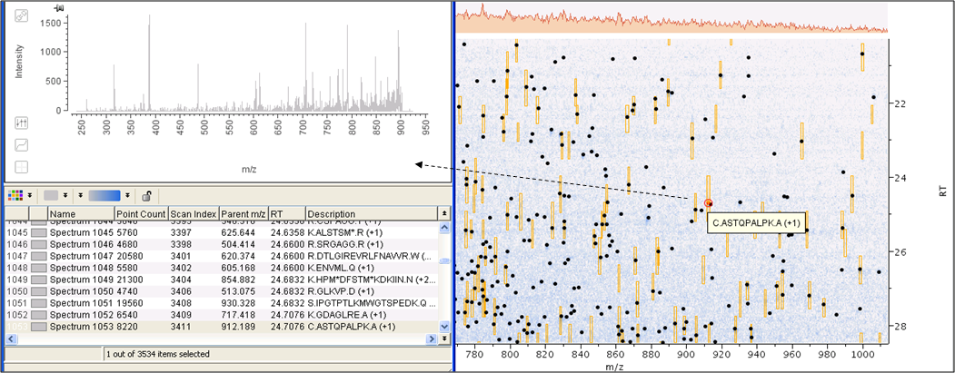
Treatment with Substrate…..2D Plots LC/MS
Comparative Analysis and Protein ID’s?
Above (LCMS/MS spectra from a single binned averaged representation of all runs with peptides sequence attached. Following RT alignment and binning (clustering all runs into single bins by time and mass) by Refiner MS by Genedata, statistical analysis can be carried out in Analyst by Genedata.

Slide 31
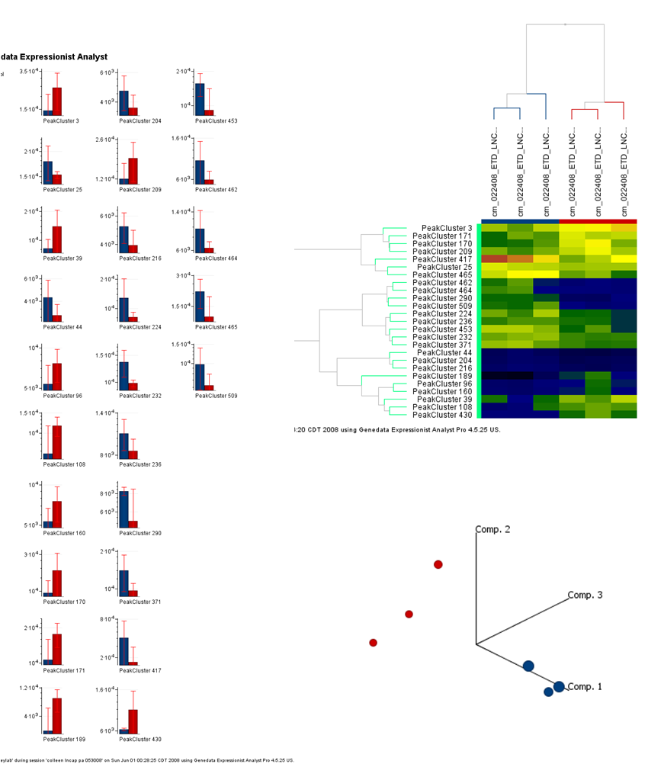
Statistical Outcome:
The plots on the left indicate the relative differences in abundance of the top 25 ions between treated and non-treated LNCaP cells, with a heat map of the same ions just to the upper right, and a PCA plot illustrating complete separation of these two groups

Slide 32
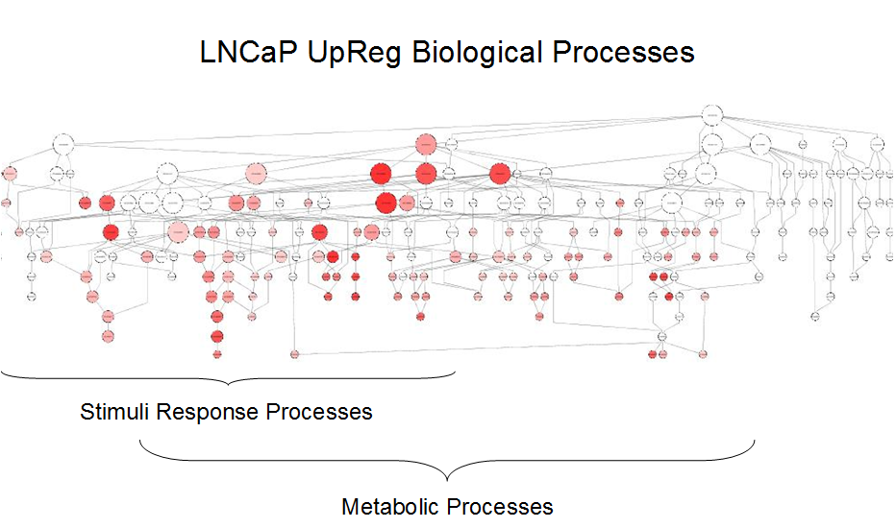
Proteins Specific to Treatment (LNCaP):
dihydrolipoamide dehydrogenase, H2B histone, RAS oncogene family, annexin A5, citrate synthase, karyopherin (importin), phosphatidylethanolamine binding protein 1, APEX nuclease (multifunctional DNA repair enzyme), lactate dehydrogenase B, non-metastatic cells (NM23A & NM23B), glycyl-tRNA synthetase, adenine phosphoribosyltransferase, Rho GDP dissociation inhibitor (GDI), aldehyde dehydrogenase, aldolase, fructose-bisphosphate, nucleolin, cathepsin B

Slide 33
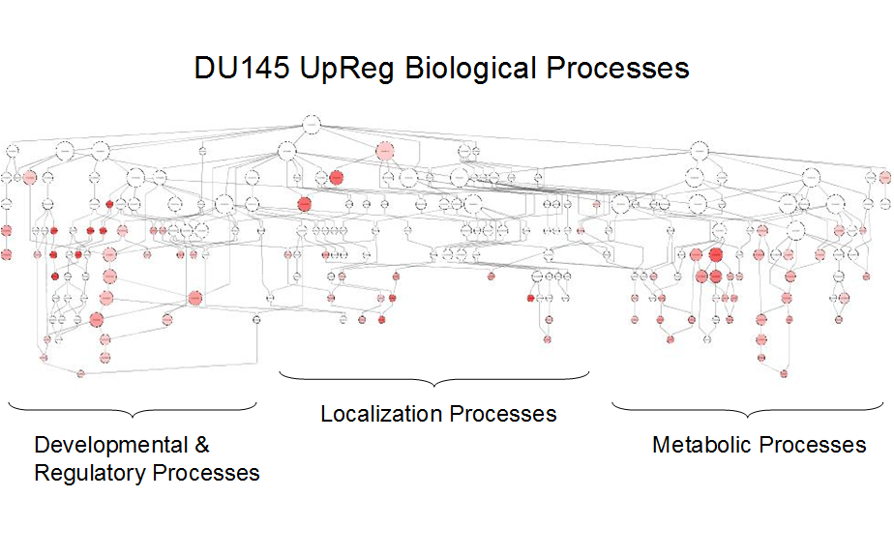
Proteins Specific to Treatment Du145:
enolase alpha, non-metastatic cells (NM23B),eukaryotic translation elongation factor 1, ubiquinol-cytochrome c reductase, Rieske iron-sulfur polypeptide 1, SMT3 suppressor of mif, enoyl Coenzyme A hydratase, peptidylprolyl isomerase A, proteasome (macropain), tropomyosin 4, histone H2, integrin beta, thioredoxin reductase, vinculin, enolase (alpha), protein disulfide isomerase, nicotinamide N-methyltransferase, profilin 1, eukaryotic translation elongation factor, tyrosine 3/5-monooxygenase

Slide 34
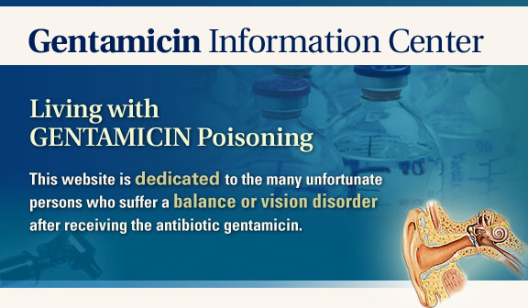
Identification of Markers from Gentamicin Induced
Kidney Damage in Monkey…….

Slide 35
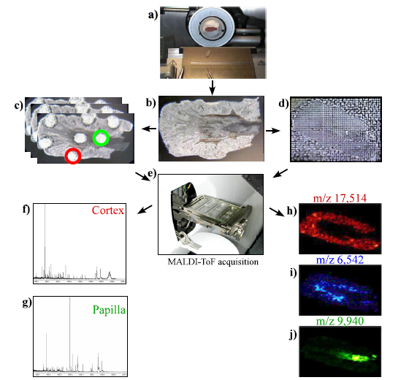
Overview of Approach From Similar Study on Rat
Meistermann, et. al. MCP 2006

Slide 36
Identification of Toxic Markers Via Mass Profiling
(Monitored by MALDI-Tof MS)

Slide 37
Expansion of Region of Interest
Control
Treated
Relative Intensity (%)
m/z

Slide 38
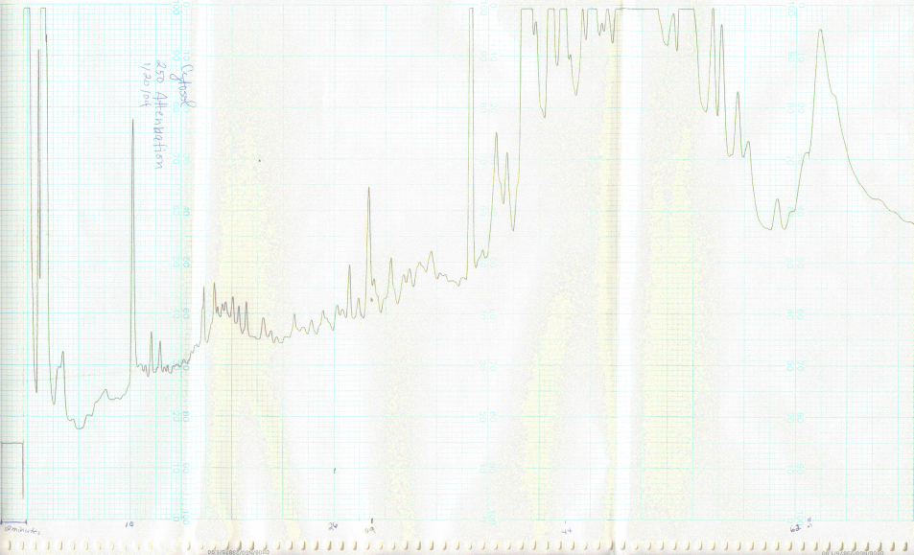
1st Dimension Separation by RF-HPLC
(Top-Down Approach – Monitored by MALDI-Tof MS)
Tissue Preparation:
288 mg tissue, minced by hand with razor at 4°C
Homogenized in Kontes Duvall in 500 μl of homogenization medium
HB(25% sucrose, TRIS HCL10 mM pH 7.5, 500 μM PMSF)
Transferred to 1.5 ml eppendorf vial and wash 3x with 50mcl HB
Centrifuged at 4°C 680g 10 min, (looked a bit thick – more HB added up to 850 μl and centrifuged again)
Super transferred to a 1.5 μl eppendorf vial, note that nuclear pellet contained some traces of the protein of interest but at levels considerably lower than that of the cytosol.
Centrifuged for 1 hour at maximal (i.e. 16,000 g), pellet discarded
MALDI Spectrum from fraction 43
Fraction 43
12898.9 Da
Relative Intensity (%)
absorbance
0
10000
20000
m/z
Time (minutes)
*- All ID work including HPLC fractionation was carried out on the cytosolic fraction

Slide 39
2nd Dimension Separation Strategy on F43 Following LCMALDI-MS
(Negative Cu-Stained 1D PAGE)
standards
blank
sample
(x µg)
pre-cut
sample
Albumin (66.4 kDa)
Post-RF HPLC
Impurities
Apomyoglobin (16.9 kDa)
Cytochrome C (12.4 kDa)
100-200ng
(~12.7 kDa)
ng protein/ lane
gel slices
1400
350
87
22
5
0
1) The proteins are either electroeluted or in-gel digested followed by Tof/Tof based characterization!

Slide 40
Characterization of Unknown Protein by LC-MS(MS)²
60 min RF-LC Run on Tryptic Peptides

Slide 41
Performed in-gel digestion of excised gel band using trypsin
Characterized tryptic fragments by LC-MSMS on the LCQ-Deca^{+plus} and by MALDI-TOF/TOF
MASHRLLLLC LAGLVFVSEA GPTGVDESKC PLMVKVLDAV RGSPAVNVAV NVFKKAADET WAPFASGKTS ESGELHGLTT EEEFVEGIYKVEIDTKSYWK SLGISPFHEH AEVVFTANDSGPRHYTIARLLSPYSYSTTAVVTNPKE
 | Sequenced tryptic fragments | AA Position
 | VLDAVRGSPAVNVAVNVFK * | 36 - 54
 | VLDAVR | 36 - 41
 | GSPAVNVAVNVFKK* | 42 - 55
 | GSPAVNVAVNVFK* | 42 - 54
 | KAADETWAPFASGK* | 55 - 68
 | AADETWAPFASGK* | 56 - 68
 | TSESGELHGLTTEEEFVEGIYK* | 69 - 90
 | VEIDTK | 91 - 96
 | SYWK | 97 - 100
Protein ID:
gi|23574795|dbj|BAC20609.1| transthyretin [Macaca fascicularis] Avg Mass: 15916.1
Coverage:
65/147 = 44.2% by amino acid count, 7103.9/15916.1 = 44.6% by mass
*Designates coverage by Applied Biosystems 4700 Tof-Tof analysis as well.

Slide 42
Finding the Correct form of the Protein Can be a Challenge
Macaca TTR, 15918Da, 13792Da,
mashrllllc laglvfvsea/ gptgtgeskc/ (cleavage sites?)
1 plmvkvldav rgspainvav hvfrkaaddt wepfasgkts esgelhgltt eeefvegiyk
61 veidtksywk algispfheh aevvftands gprrytiaal lspysystta vvtnpke
127 AA, active form, 21-147, 13763 Da
gptgtgeskcplmvkvldavrgspainvavhvfrkaaddtwepfasgktsesgelhgltteeefvegiykveidtksywkalgispfhehaevvftandsgprrytiaallspysysttavvtnpke
Extrahepatic sequence?, 31-147, 12845 Da
plmvkvldavrgspainvavhvfrkaaddtwepfasgktsesgelhgltteeefvegiykveidtksywkalgispfhehaevvftandsgprrytiaallspysysttavvtnpke
Pro-form, 147 AA, 15887 Da
mashrllllclaglvfvseagptgtgeskcplmvkvldavrgspainvavhvfrkaaddtwepfasgktsesgelhgltteeefvegiykveidtksywkalgispfhehaevvftandsgprrytiaallspysysttavvtnpke
11810.7 Da with potential cleavage at site aa:
gptgtgeskcplmvkvldavrgspainvavhvfrkaaddtwepfasgktsesgelhgltteeefvegiykveidtksywkalgispfhehaevvftandsgprrytia

Slide 43
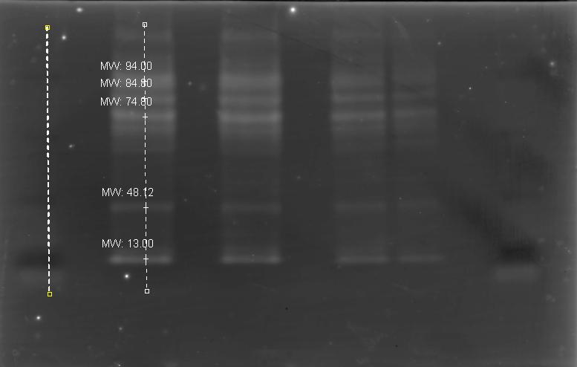
Initial Confirmation by Western Analysis
(Rabbit anti-TTR 1ºpAb (Novocastra Labs), Donkey anti-rabbit HRP 2ºAb)
Gel:
Ran 4-12% Tris-Glycine gel at 150V with 50 μl of
cytosol sample (10 μl cytosol in 20μl LDS buffer, 15 μl H2O,
5 μl Reducing agent) approx. 1 hr. Sample was first heated on
thermocycler for 10 min. at 70°C. Loaded 14 μl (50 μg) and
7 μl (25 μg) of sample in duplicate along w/ 10 μl
See Blue STD.
Running Buffer (950 ml H2O, 50 ml MOPS SDS 20X
NuPage running buffer).
MW
Standards
Cytosolic
Fraction*
Electroblotting w/BioRad Trans-Blot SD cell:
Transfer Buffer (5.82g Tris, 2.93 g Glycine, 0.0377g
SDS, 200ml MeOH, 800 ml H2O)
Wetted Imobilon –psq Millipore membranes with MeOH
then TB.
Assembled Trans-blot apparatus and ran for 30 min. @
15V.
Placed gel in H2O, then PBS/Tween (500 ml Dulbecco’s
PBS, 0.05 ml Tween 20).
36
22
16
6
~12-14 kDa
Introduction of Antibodies:
Added Blocking Agent (2.5g BA from kit, 50 ml PBST),
left on lab rotator for 1 hr @ RT, then washed 3X for 15min. w/PBST
Diluted 1° Ab in 1 ml H2O. Diluted further @ 1:1000(50 μl Ab, 50 ml PBST)
Added 1° Ab to membrane and rotated @ 4°C for 2 hrs., washed 2X quickly in PBST, 3X for 15 min.
Added 2° Ab @ 1:5000 (10 μl Ab, 50 ml PBST), rotated for 1 hr @ RT, washed 2X quickly, 3X for 15 min. in PBST.
Using BCA reagents from Amersham ECL kit, combined 2 ml soln. A with 50 μl of soln. B. Pipetted over membrane for
approx. 5 min. in dark. Used Typhoon Imager with blue laser to image membrane and TTR band.
*- Single band shown in MW range of interest, non-specific bands present above 50kDa

Slide 44
IP-MALDI-MS for TTR
TTR (Control Kidney)
TTR (Treated Kidney)
Mass Difference (1,221 Dalton)
12,220 Da
13,756 Da

Slide 45
Initial Confirmation by Western Analysis
(Rabbit anti-TTR 1ºpAb (Novocastra Labs), Donkey anti-rabbit HRP 2ºAb)
Urine Specimens
Control/ Treated
Truncated Protein
Specific to Disease

Slide 46

Questions?

