Slide 1
Center for Clinical and Translational Science
Meeting Title
Presenter(s) Name(s)
Credentials
Credentials
Credentials
Credentials

Slide 8
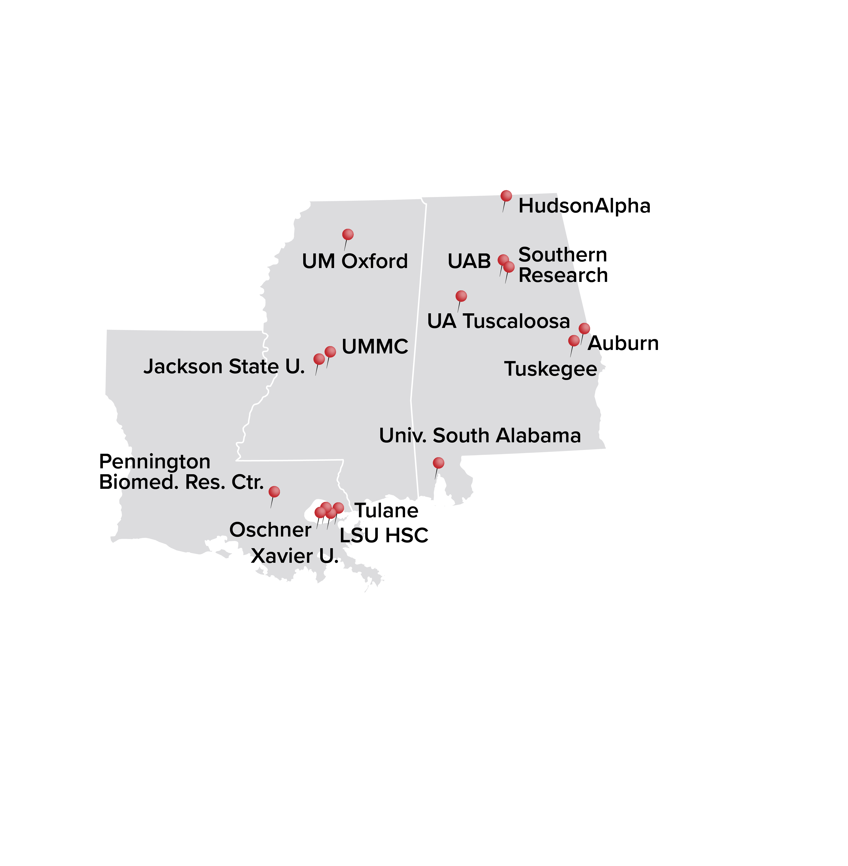
Questions?

Slide 9
STAY CONNECTED

Slide 10
Thank you for joining!

