Slide 1
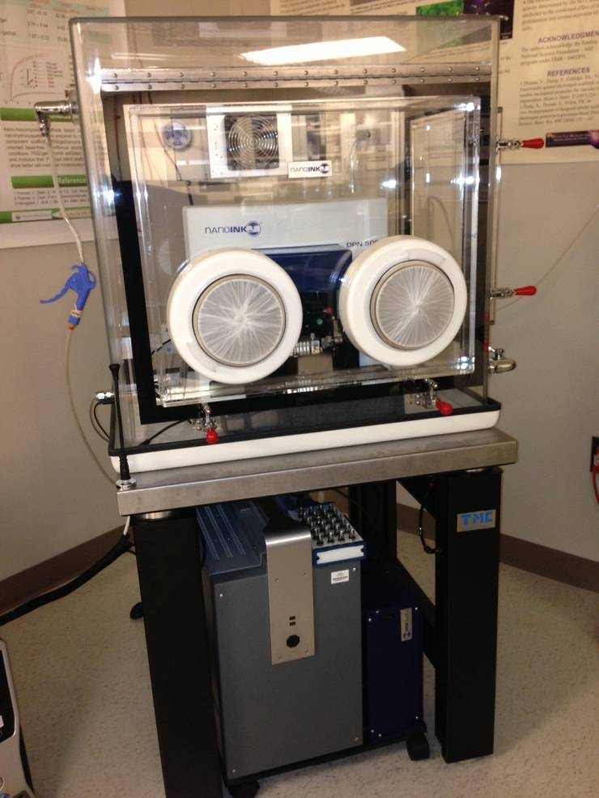
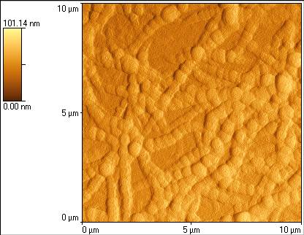
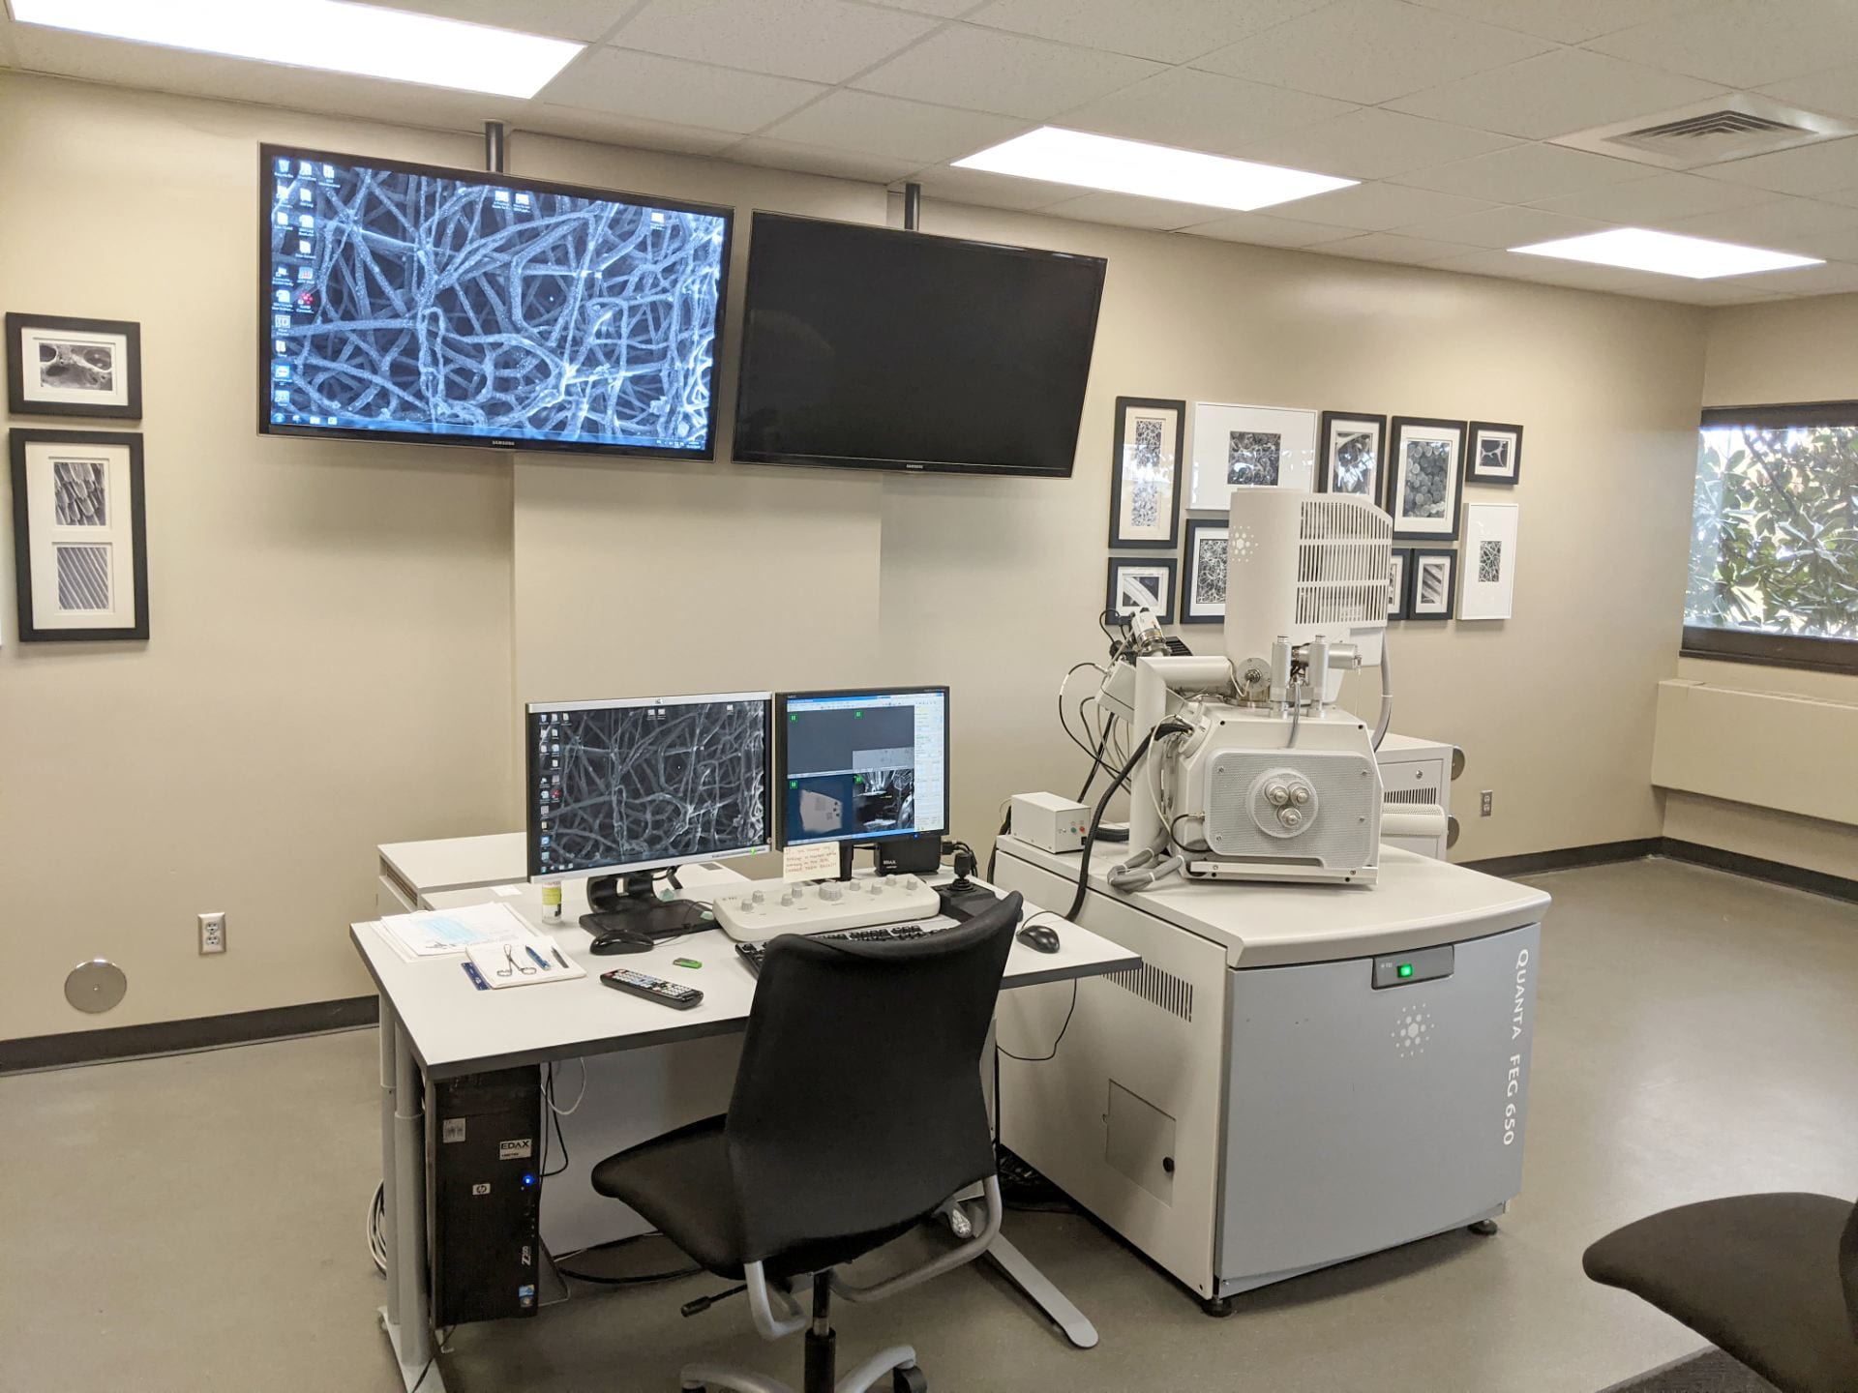
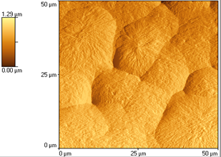
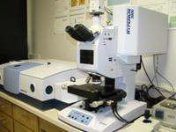
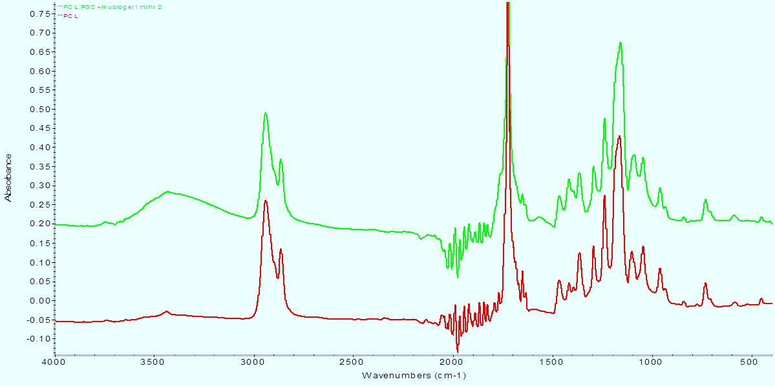
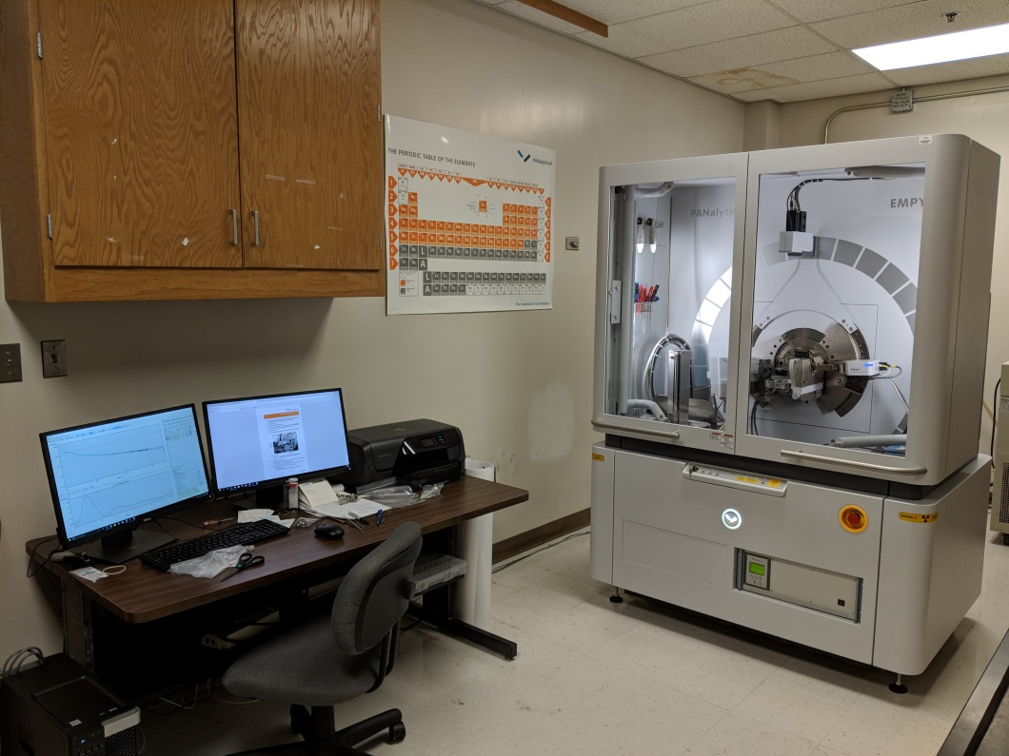
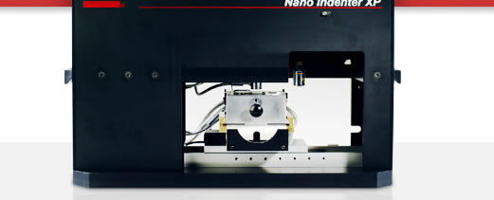
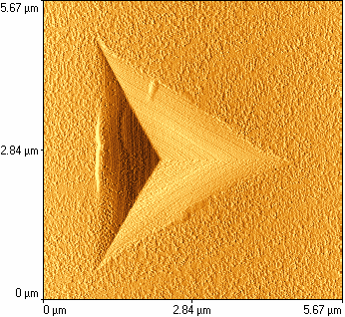
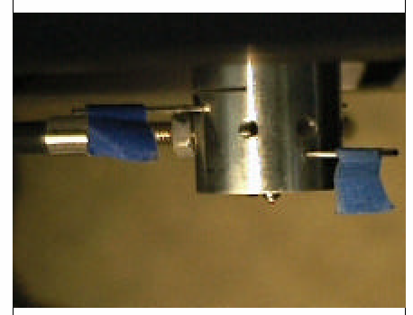
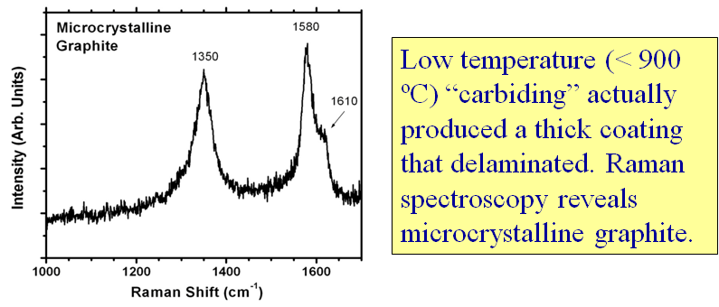
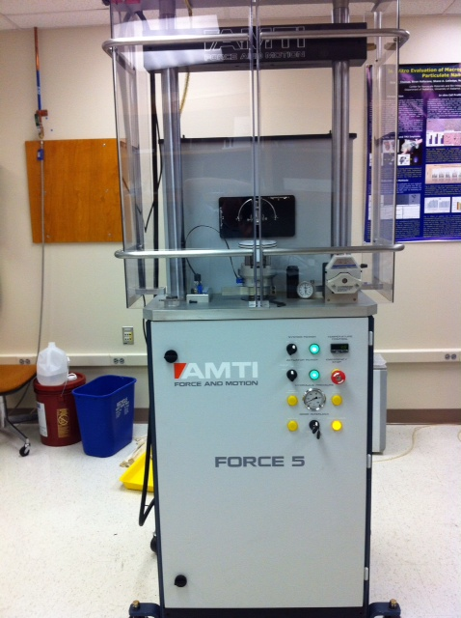
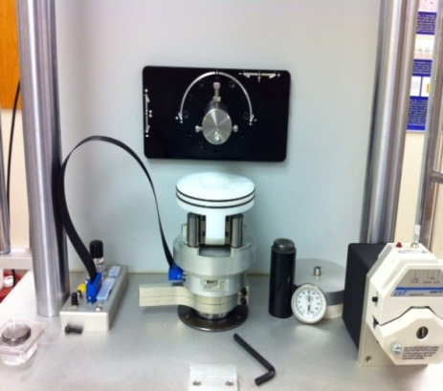
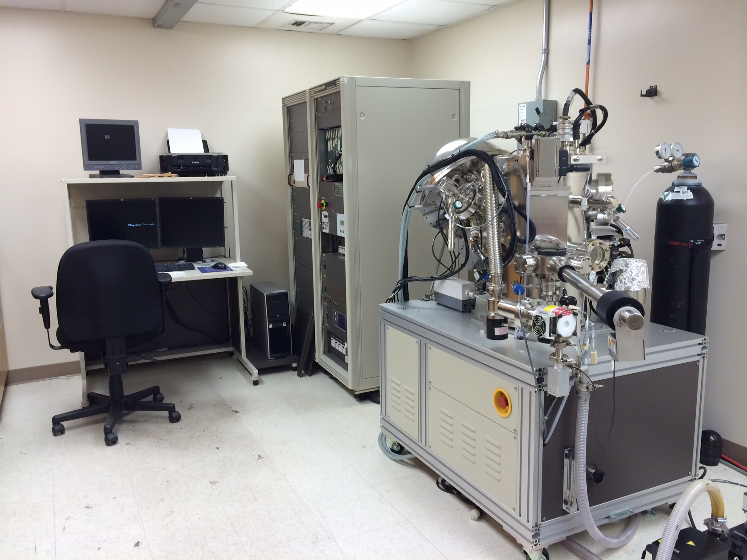
Advanced Materials Characterization Core Director: Dr. Paul A. Baker, Department of Physics, CAS. Contact emails: pabaker@uab.edu, vthomas@uab.edu, charita@uab.edu
Materials Characterization Services:
Scanning Electron Microscope (SEM):
Multi-Purpose X-ray Diffraction (XRD):
Raman Spectroscopy
X-ray Photoelectron Spectroscopy (XPS):
Atomic Force Microscopy (AFM):
AFM instrument and images of collagen nanomatrix and polymer spherullites
Infrared Spectroscopy (Micro-FTIR):
Typical FT-IR spectra of polymer and protein
Nano-indenter :
Image after indentation
Orthopedic and Dental Joints Wear Simulator:
Image nanocale surface features and morphologies of metals, biomaterials, thin films, particles, polymers, proteins and other biometrices, grain boundaries, composites etc.
Two AFM instruments with tapping and contact modes are available for topographic and phase imaging and roughness measurements
Image surface features of metals, biomaterials, thin films, particles, polymers, grain boundaries, composites etc.
Energy dispersive X-ray spectroscopy (EDX) to identify elemental composition of materials
Can perform analysis on biological samples using environmental mode (ESEM)
The instrumentation includes the Bruker Optics Hyperion 3000 infrared microscope and Vertex 70 FTIR spectrometer with numerous options for infrared imaging and composition mapping with down to 2-micrometer resolution , in addition to organic functional group analyses.
Both transmission and reflection modes available.
Multi-purpose X-ray Diffractometer is non-destructive method to characterize materials’ composition, crystal structure, phase change, grain-size and stress analyses of thin films, polymers and ceramics
Can also perform particle size analysis using small angle X-ray scattering (SAXS)
Epitaxial film analysis can be performed using Ultra Fast Reciprocal Space Mapping (URSM)
Measurement of nanomechanical properties such as hardness and Young’s modulus of nanostructured materials and thin films by a nano-tip indentation
Micro-Raman/Photoluminescence Spectrometer for non-destructive characterization of materials.
Very effective in characterizing carbon materials (CNTs and Diamonds)
Complimentary to FT-IR.
AMTI Force 5 - An industry standard simulator which can replicate the loading and multi-axis motions associated with joints (Hip, Knee &TMJ)
Performs wear simulation of articulation components such as metal-on- metal, diamond-on-metal, metal-on-polymer, and diamond-on-diamond
Operated in both force and displacement control modes and allows the continuous or periodic measurement of the forces and moments of the
x, y, and z axes under physiological serum conditions
PHI-5000 Versaprobe is equipped with dual Al/Mg anode, focused (10 - 100 µm) and scanned X-ray beam for sample imaging and analysis, hemispherical energy analyzer with multi-channel detection, depth profiling capability
Useful for chemical elemental analysis and quantification, Bonding characteristics
Operative Modes- Qualitative survey scan, quantitative high resolution scan and depth profiling by simultaneous surface etching scanning.

