Slide 1
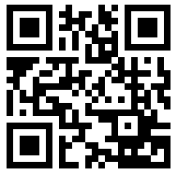
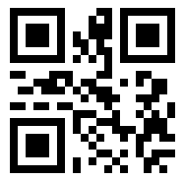
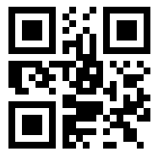
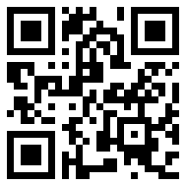
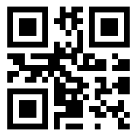
ANIMAL RESOURCES PROGRAM (ARP)
Office of Research
Overview
ARP provides animal care and husbandry for all UAB research animals.
Average daily census is approximately 150,000 animals.
ARP maintains animal facilities in 13 different buildings, including one ~30 miles East of campus.
Greater than 20 different species of animals.
Approximately 180,000 square feet of net assignable space for animal housing, procedure, and support.
Continuous AAALACi accreditation since 1971.
Last inspection dates 3/22/2021-3/26/2021
Assured by the NIH Office of Laboratory Animal Welfare (OLAW)
Assurance D16-00162
Renewal effective 6/8/2021
Registered as a Research Facility with the USDA
Registration 64-R-0004
Last inspection 8/4/2021
Staff Values
ARP staff strive to hold true to the values below. They are our story, our sCRIPT.
Communication
Respect
Integrity
Professionalism
Trust
ARP is a partner with you to help you conduct the best possible animal research. These values guide us in our partnership.
Operation
Regardless of weather, holidays, etc., ARP staff are here 365 days a year.
Over the year ARP staff conduct well over 9 million daily animal care checks and observations.
They change over 1.5 million cages a year.
They receive, store, and distribute over a million pounds of food and bedding a year.
ARP Team
There are over 100 dedicated ARP staff here everyday to partner with you. We welcome the opportunity to take care of your animals and love the chance to help with your experiments in any way we can.
Contact Information
ARP Website – www.uab.edu/arp.
General information, forms, instructions
ARP Operations Manager – Jon McGill
Staff and operational questions
ARP Facilities Manager – Dale Payton
Facilities information, building issues
ARP Financial Manager – Tim Crutchfield
Billing information, Bioware questions
ARP Veterinary Staff – arpvetstaff@uab.edu
Veterinary questions, procedure training, protocol help, study design.
ARP Executive Director – Erik Dohm
All other questions or concerns.
Questions about animal studies? Contact us!
We are here to help, from animal study design, IACUC protocol writing, animal model techniques, etc. Scan the corresponding QR code to the right for relevant contact information.
uab.edu
Notes:
Welcome and thank you for taking the time to hear about the Animal Resources Program, otherwise known as ARP. ARP strives to partner with you to facilitate your animal studies.
ARP is a component of the Research Facilities and Infrastructure division of the Office of Research. It is a substantial operation that must be staffed every day 365 days a year without fail regardless of circumstance. There are ARP animal facilities in 13 different UAB buildings, one of which is approximately 30 miles East of campus. All together the animal facilities amount to around 180,000 square feet of net assignable space for animal housing, common and specialty procedure rooms, and support spaces. To put that into perspective, ARP animal facility space amounts to nearly the space available in the Shelby building.
ARP is registered with the USDA and has an assurance on file with the NIH OLAW. It has been continuously accredited by AAALAC International since 1971, which means we are held to the gold standard of animal care.
The average daily census is around 150,000 animals comprised of more than 20 different species. However, the vast majority, approximately 78%, are rodents. Fish account for 20% and all other species are in the remaining 2%. Through out the year ARP receives, stores and distributes more than a million pounds of food and bedding to supply the operation, and enable change outs of over 1.5 million rodent cages, and checks on and observations of animal enclosures over 9 million times.
There are over 100 very dedicated staff that keep ARP running. The ARP staff use a set of core values, which are Communication, Respect, Integrity, Professionalism, and Trust, to help us provide the best service possible for your animals. However, we want to deliver more than that, we strive to be your partners in your animal research. We can do that not only through providing husbandry tasks for your animals, but also by taking care of and addressing any of your concerns, by helping with your IACUC protocols, by helping with both basic and advanced techniques with your animals, and much much more.
We hope you enjoyed this glimpse into ARP. If you have questions or need more information, please scan the appropriate QR code in the lower right of the screen corresponding to the topic or topics that most interest or concern you. We look forward to our continued and productive partnership.

