Slide 1
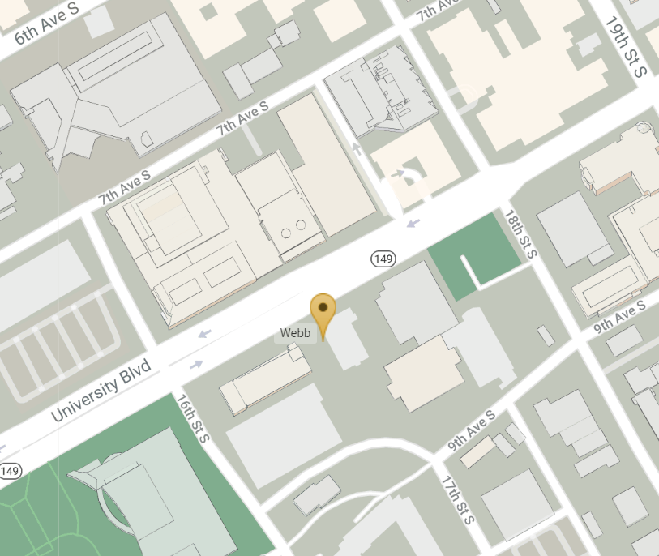

Bio-Analytical Redox Biology (BARB) Core
1675 University Blvd, WEBB 416 & 418
Lab phone:(205) 996-2661
Director: Douglas Moellering, PhD
Research Associates:
Kelley Smith-Johnston, BS: johnk@uab.edu
Melissa J. Sammy, PhD: mjsammy@uab.edu
8th Ave
Volker Hall
18th St.
WEBB
16th St.
BARB

Slide 2
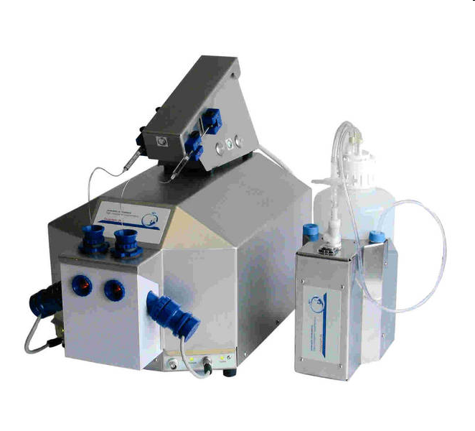
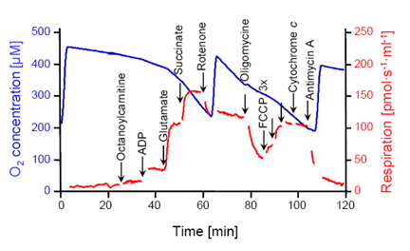
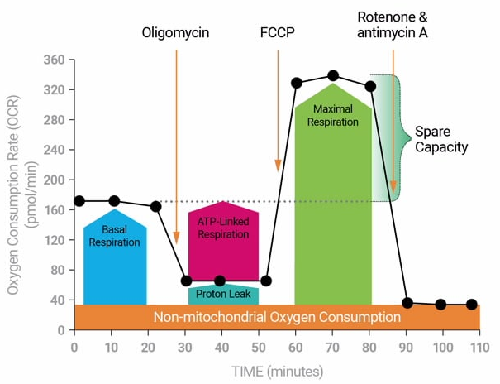
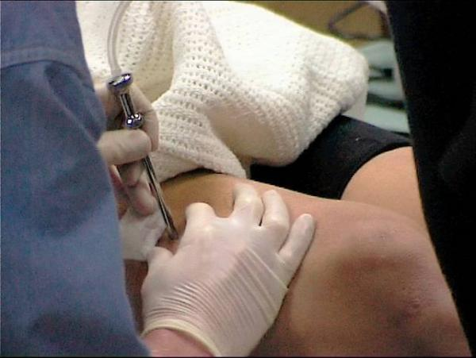

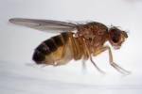
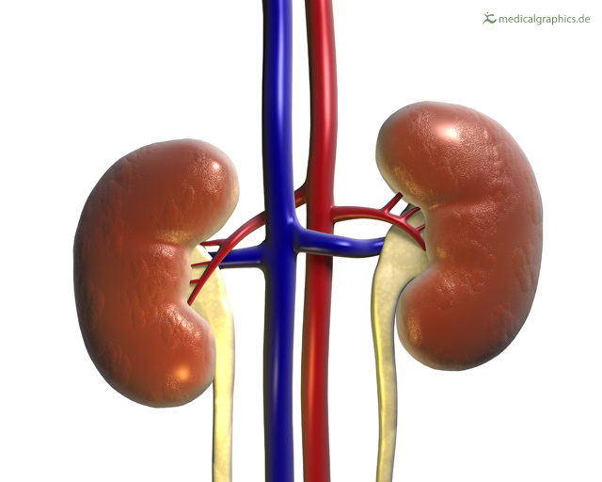


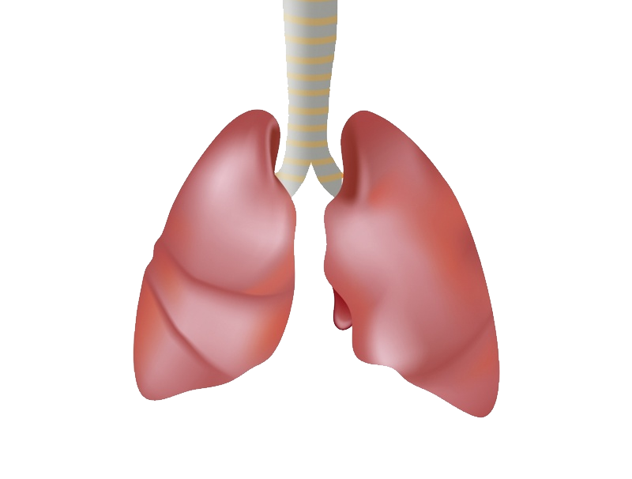

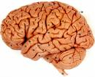
Mitochondrial Bioenergetics
High Resolution Respirometry
Seahorse Extracellular Flux
In permeabilized tissue and/or mitochondria isolated from:

Slide 3

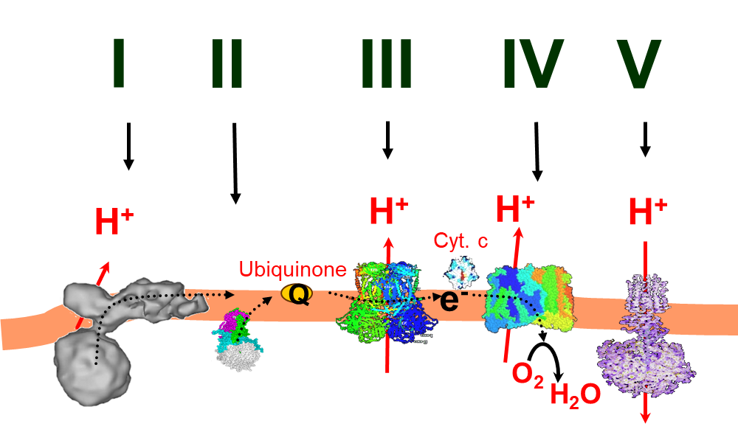
Mitochondrial Electron Transport Chain Kinetics
Cortisol Assay
(long-term stress)
Samples:
Frozen tissue
Isolated Mitochondria
Total Homogenates
Samples: Hair and Nails

Slide 4
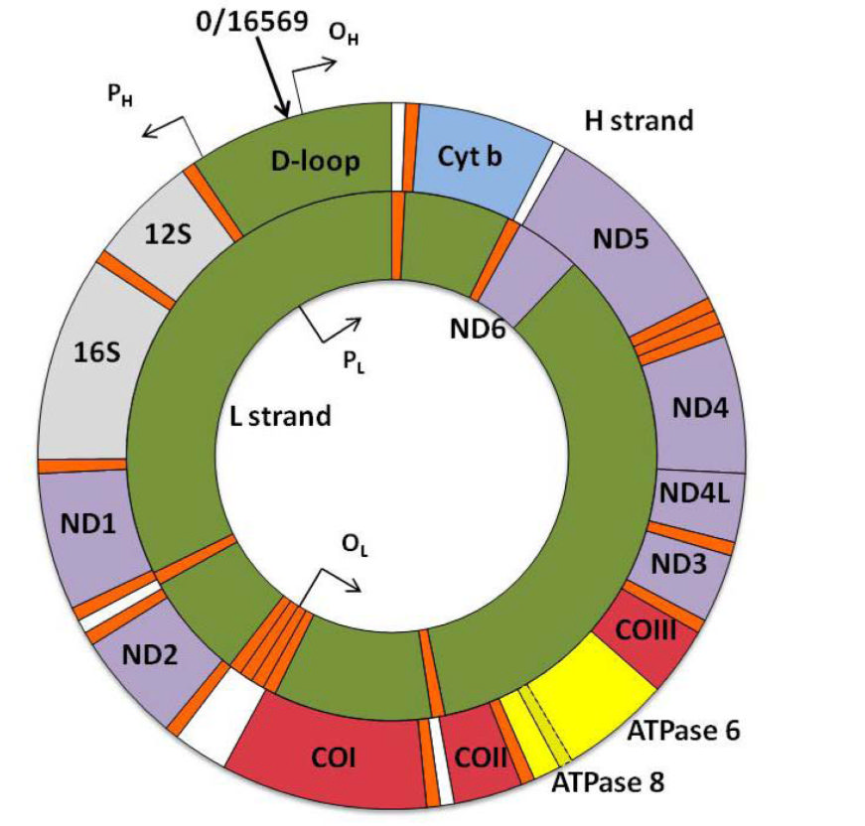
Mitochondrial DNA (mtDNA) Assays
Redox Assays
Glutathione
(GSSG and GSH)
Glutathione
Peroxidase (GPX)
mtDNA Content
Superoxide
Dismutase (SOD)
Samples: frozen tissues, cells, buffy coat
mtDNA Damage
Samples: frozen tissues, cells, buffy coat
mtDNA DAMPs
Catalase
Samples: serum/plasma

Slide 5
Bio-Analytical Redox Biology (BARB)
Core Service Request
To schedule a consultation or request a service please use the below link to access the service request form
https://forms.office.com/Pages/ResponsePage.aspx?id=5J-Z2K92s0C0NR2Jd6vAjFhwSNcRj2xNq6xVd0pdaG9UOUtJMTgwNkRXS0NKN1NKWko5TFVWNFI2QyQlQCN0PWcu

