Slide 1
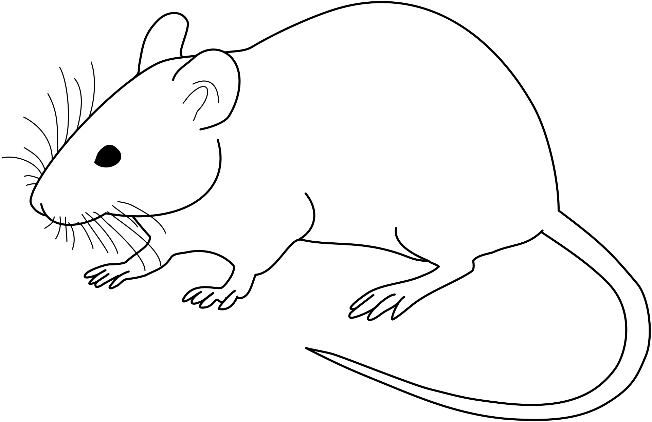
Virtual Core Day 2022
Cystic Fibrosis Mouse Model Core
Ming Du, M.D., Ph.D. & David Bedwell, Ph.D.

Slide 2
Mouse Models of Cystic Fibrosis
null
-Cftr tm1Unc/J -Neo cassette inserted into exon 10 on B6 or BALB/c congenic backgrounds
-Cftr △10/△10 -Conditional null allele; exon 10 flanked by loxP sites
-Cftr △F508 Erasmus -△F508 mutation only (no other markers); most common CF mutation; causes ER retention of CFTR
-Cftr G551D -G551D in exon 11 + neo cassette in intron 11; congenic B6 background;
causes CFTR gating defect
-G542X in exon 11 + floxed neo cassette excised from intron 10; -Cftr tm1 G542X/J congenic B6 background; negligible CFTR expression/function; reduction of CFTR mRNA by nonsense-mediated mRNA decay
-Cftr Cam Tg(hCFTR W1282X) -Human CFTR W1282X cDNA under fatty acid binding protein promoter control in Cftr null, congenic B6 background
Folding
Defect
Gating
Defect
nonsense

Slide 3
Cystic Fibrosis Mouse Models with Corrected or Attenuated Phenotypes
-Cftr tm1Unc Tg(FABP-hCFTR) -Human CFTR cDNA under fatty acid binding protein promoter control in a Cftr null background; available in B6 or BALB/c congenic genetic backgrounds.
-Humanized CFTR -BAC carrying the complete human CFTR gene (including regulatory elements within 40.1 kb of DNA 5′ and 25 kb of DNA 3′) expressed in a Cftr null background.
-Cftr tm1 G542X Tg(TRE-hUPF1-R844C) -Tet-regulated dominant negative UPF1 allele inhibits nonsense- mediated mRNA decay in the Cftr G542X knock-in background.

Slide 4
Non-Cystic Fibrosis Mouse Models
-Tg(Scnn1b) -Overexpress beta-ENaC in airway cells.
-Idua tm1 W402X -Nonsense mutation in the Idua gene (encodes ⍺-L-iduronidase, an enzyme that degrades glycosaminoglycans). Homologous to the W402X mutation, the most common mutation found in patients with the lysosomal storage disease, Mucopolysaccharidosis I-Hurler (MPS I-H).
-Tg(TRE-hUPF1 R844C) -Tet-regulated dominant negative UPF1 allele inhibits nonsense- mediated mRNA decay. Two transgenic lines available that show differential tissue expression of the transgene.
-Idua tm1 W402X Tg(TRE-hUPF1 R844C) -Tet-regulated dominant negative UPF1 allele inhibits nonsense- mediated mRNA decay in the Idua W402X knock-in background.

Slide 5
Contact Information
Core Director: Dr. Ming Du
Email: dalian@uab.edu
Phone: (205) 934-3080
A complete, detailed list of mouse strains maintained by the core is available upon request.

