Slide 1
CFTR Protein Production Core
PI: John C. Kappes, PhD
Co-PI: Zhengrong Yang, PhD
Funded by the Cystic Fibrosis Foundation
Cystic Fibrosis Transmembrane Conductance Regulator (CFTR) is an ABC transporter-class ion channel protein that regulates chloride conductance across epithelial cell membranes

Slide 2
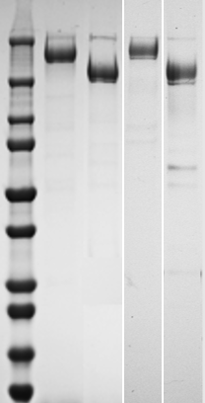
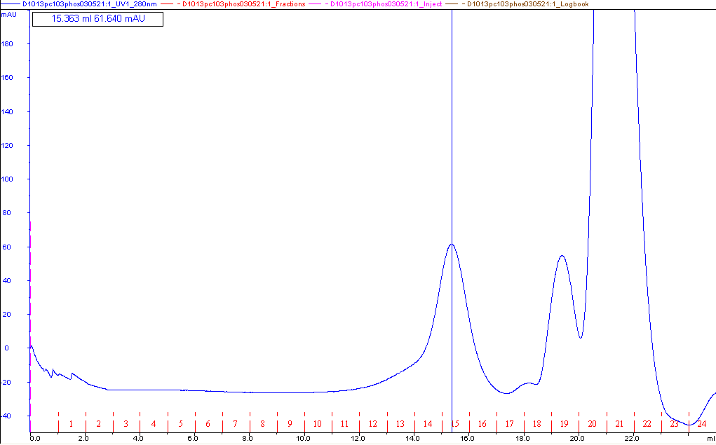
Pure, monodisperse, and functional full-length CFTR proteins
> 90% pure
Monodisperse
High sequence coverage in LC-MS
1
2
3
4
Superose 6 Increase 10/300 GL
250
150
CFTR monomer
Elution vol. = 15.3 ml
100
75
50
Abs_{280nm} (mAU)
37
25
End of column
20
15
Elution volume (ml)
Data provided by GL Lukacs, McGill University
10

Slide 3
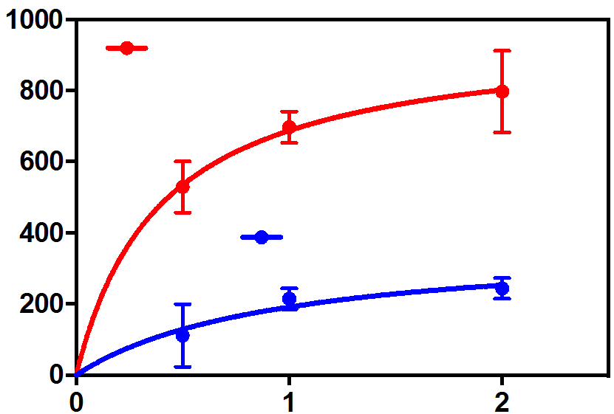
Pure, monodisperse, and functional full-length CFTR proteins
ATPase activity of purified 6SS CFTR
Channel function in Isolated microsomal membranes
33ºC
WT
45ºC
Phosphorylated
ATPase Rate (nmol/min/mg)
WT CFTR: γ = 12.5 ± 0.3, pS P_{o}= 0.29 ± 0.05
6SS γ = 15.8 pS and P_{o}= 0.51
Unphosphorylated
6SS: γ = 12.6 ± 0.04 pS, P_{o}= 0.27 ± 0.03
High thermostability of channel function in 6SS-CFTR
[ATP] (mM)
6SS/E1371Q: γ = 13.2 ± 0.45 pS, P_{o}= 0.98 ± 0.01
6SS/F508del: γ = 12.7 ± 0.3 pS, P_{o}= 0.07 ± 0.02
Data provided by JR Riordan, UNC Chapel Hill

Slide 4
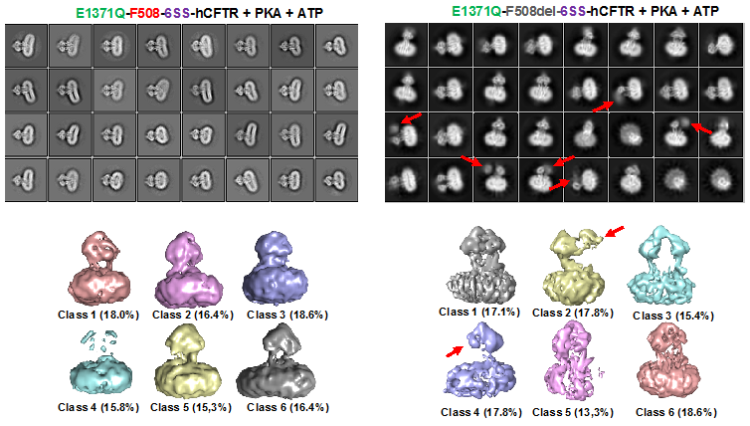
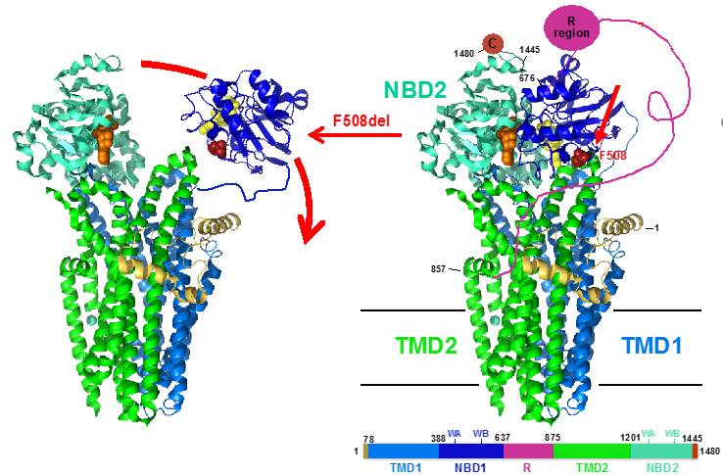
High-resolution cryo-EM structures elucidating conformational effects of F508del mutation
Dynamic dissociation of NBD1 in F508del 6SS/E1371Q CFTR
Data provided by JF Hunt, Columbia University

Slide 5
Visit us
https://www.uab.edu/medicine/cysticfibrosis/facilities-core/cftr-protein-production-core
https://www.cff.org/cftr-proteins#cftr-protein-production-core-at-the-university-of-alabama-at-birmingham
Contact us
johnkappes@uabmc.edu
yangzw@uab.edu

