Slide 1
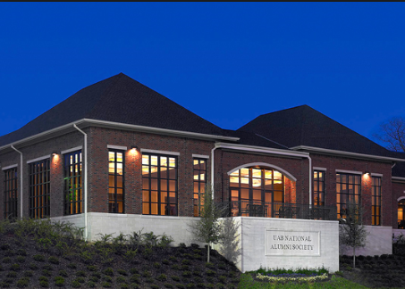
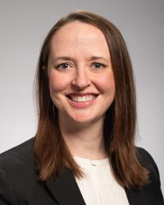
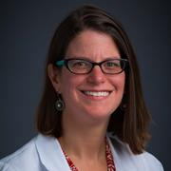
UAB Hypertension Research Center (HRC)
~ Providing an environment and resources to support translational hypertension research ~
Paul Muntner, PhD
HRC Co-Director
UAB School of Public Health
http://scholars.uab.edu/individual/pmuntner
The UAB Hypertension University Wide Interdiscplinary Research Center, established in 2019, facilitates acceleration of hypertension-related research discoveries, mentorship for students, fellows and early stage investigators and recruitment of burgeoning early stage investigators known for expertise in the field of hypertension to sustain UAB as a world-renowned institution for hypertension research.
HRC
Overview
David M. Pollock, PhD
HRC Co-Director
UAB Heersink School of Medicine
http://scholars.uab.edu/individual/dpollock
Internal Advisory Committee
April 28-29, 2022
Vascular Biology & Hypertension Symposium
UAB Alumni House
HRC Equipment Loan Program
The HRC has equipment available on campus at no cost to facilitate pilot studies and support investigators conducting hypertension research.
Validated automated blood pressure devices
Wrist actigraphy devices
Ambulatory blood pressure monitors
Email faithlang@uabmc.edu for rental details.
Members
Faculty
Trainees
ESIs
Suzanne Oparil MD
HRC Executive Committee
UAB Heersink School of Medicine
http://scholars.uab.edu/individual/soparil
External Advisory Committee
Jointly Sponsored VB&H/HRC Seminar Series
JOIN
US!
Save the Date
When Tuesdays at NOON (2021-2022 series)
Where *Virtual (TBA Location: Finley Conference Center)
Attendees will gain a better understanding of most recent developments in the fields of clinical and basic science cardiovascular research!
HYPERTENSION TRAINING
T32 Postdoctoral Positions Available
T32 HL007457
“Mechanisms of Hypertension and
Cardiovascular Diseases”
Suzanne Oparil, MD, PD/PI
**APPLY NOW**
Email faithlang@uabmc.edu for details and application process.
Please visit https://www.uab.edu/hypertension/education
for other available training opportunities
Email faithlang@uabmc.edu for program details.
Hypertension Research Pilot Grant Program Recipients
Annual Poster Session
April 28, 2022
Co-Sponsors
$$ Prizes for Top Posters
Rachel G. Sinkey, MD │ Assistant Professor (Obstetrics and Gynecology)
“Validation of a Remote Monitoring Blood Pressure Cuff”
HRC/CWRH
Yulia Khodneva, MD, PhD │ Assistant Professor (Preventive Medicine)
“Patient-reported perspective on barriers to exercise and acceptance of a remotely delivered home cardiac exercise rehabilitation program for heart failure”
HRC/CCTS
Become a Member
Learn More!
Amy W. Amara, MD, PhD │ Assistant Professor (Neurology)
“The heart-brain connection, neuroinflammation and cognitive dysfunction in older adults”
HRC/UCEM/MBI
Complete online application:
https://www.uab.edu/hypertension/about/center-membership-application
2. Email CV/Biosketch to faithlang@uabmc.edu
CWRH-Center for Women’s Reproductive Health; CCTS-Center for Clinical and Translational Science; UCEM-UAB Center for Exercise Medicine; MBI-UAB McKnight Brain Institute
https://www.uab.edu/hypertension/

