Slide 1
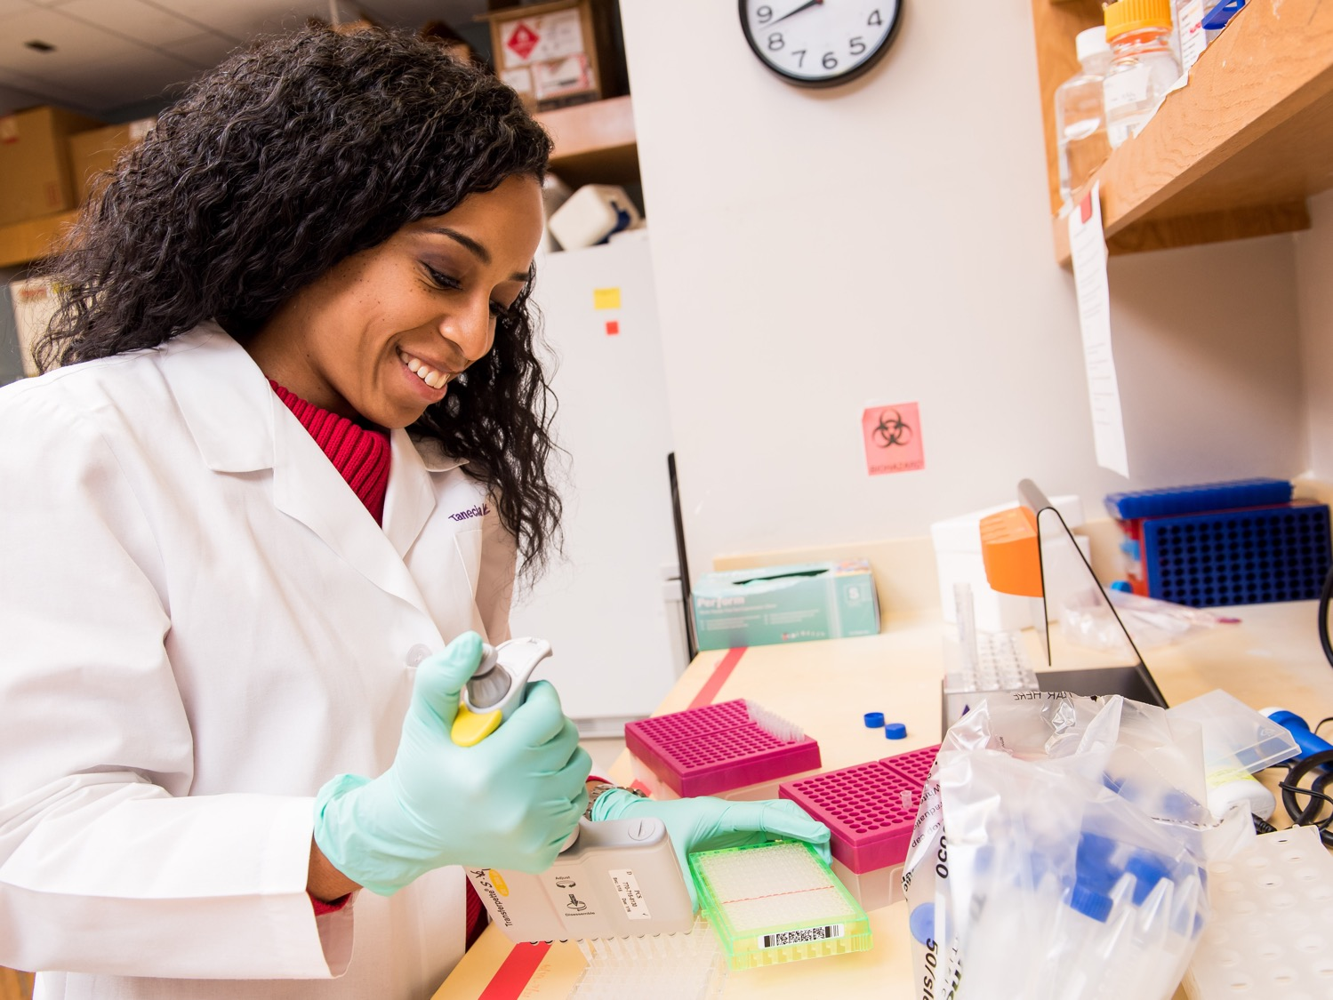
Microbiota Culture and Analytic Resource
What We Can Do For You
Obtaining and growing defined bacteria from culture collections, including strict anaerobes.
Isolating bacteria of interest from complex biological samples
We already have an extensive library of bacteria obtained from ATCC and DSMZ including many obligate anaerobes isolated from human and mouse gut.
We have isolated numerous organisms yet classified that belong to the families Lachnospiraceae and Ruminococcaceae, a notoriously difficult to isolate and propagate group.
Culturing the unculturables
We have worked with Drs. Casey Morrow, Craig Maynard, Matt Stoll and others in obtaining and growing difficult to manage organisms necessary for their research.
These families are also under-represented in having their genomes sequenced. We have contributed 15 isolates which have been genome sequenced. Some represent unique genera that have no other close relative.
Lachnospiraceae bacterium A4
Charles O. Elson, MD and Wayne Duck (duck@uab.edu)

Slide 2
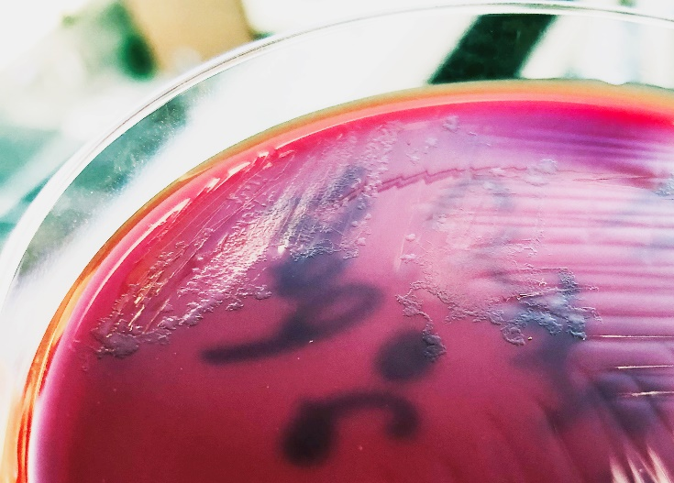
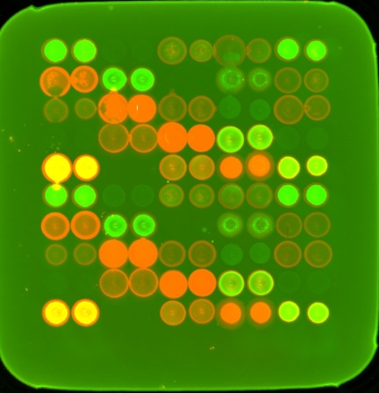
Microbiota Culture and Analytic Resource
What We Can Do For You
Isolating, expressing, and purifying recombinant microbiota bacterial proteins.
Analyzing sera/plasma for IgG or IgA reactivity to defined bacterial lysates or recombinant proteins using a microbiota antigen microarray.
We have an extensive library of bacterial proteins isolated from different bacterial families and representing a wide range of functions.
Our library has a deep and broad representation of Lachnospiraceae and Ruminococcaceae flagellins (above).
Our lab is equipped with a Spotbot MicroArrayer (below) capable of printing proteins or bacterial extracts onto nitrocellulose padded slides.
Slides are then probed with sera and visualized with a fluorescently-labeled secondary antibody
Scans of the slides are done with a GenePix 4000B microarray scanner.
Charles O. Elson, MD and Wayne Duck (duck@uab.edu)

Slide 3
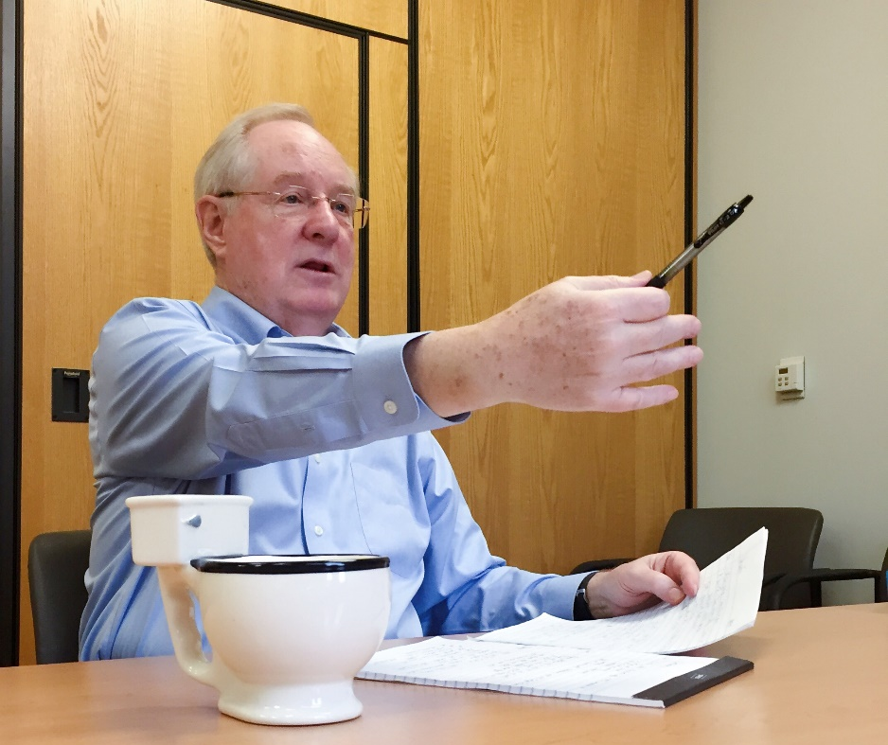

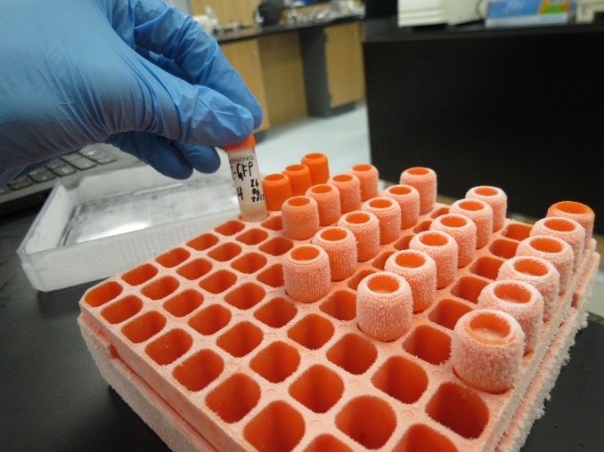
Microbiota Culture and Analytic Resource
What We Can Do For You
Recovery and freezing of mouse anaerobic and aerobic microbiota to preserve and restore organisms that are key to experimental mouse model phenotypes.
Instructing lab staff on methods and procedures for direct microbiota experimentation.
Charles O. Elson, MD and Wayne Duck (duck@uab.edu)

