Slide 1
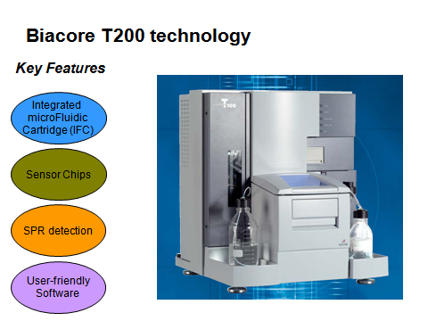
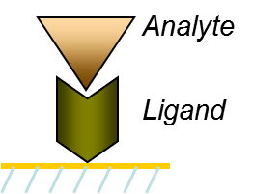
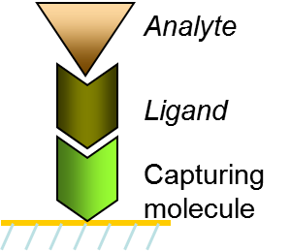
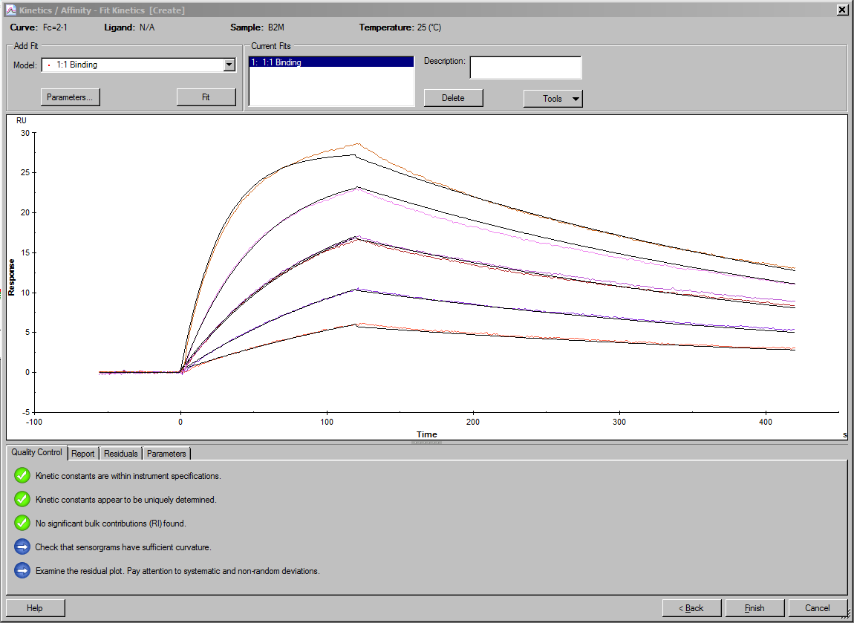
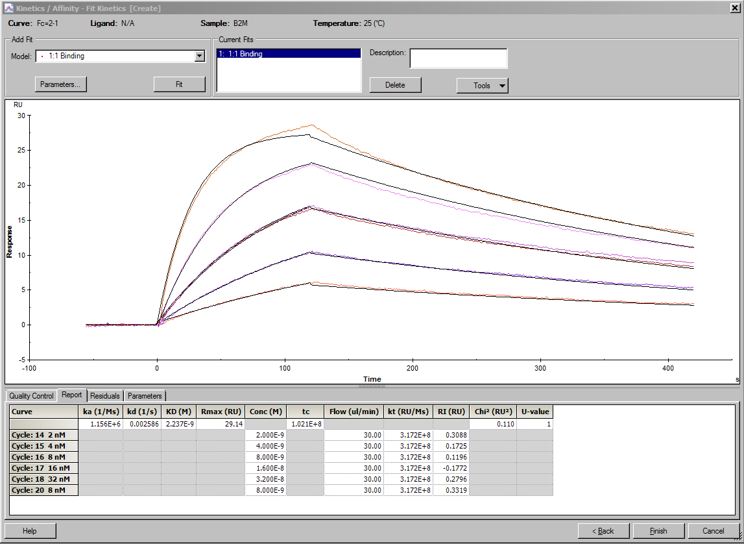
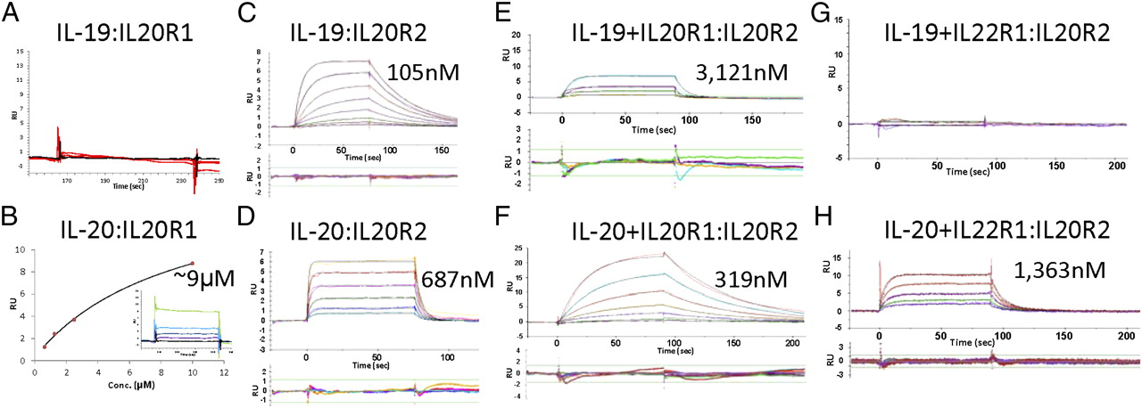
Typical Interaction Sensorgram (RU vs. time)
Multidisciplinary Molecular Interaction Core (MMIC) Facility Shelby Biomedical Research Building (SHEL) 420
MMIC Information
Advantages of the Biacore T200
Biacore Assay Steps
Biacore Assay Steps (cont)
Director: Randall S. Davis, MD
Manager: Edlue. M. Tabengwa, PhD
Contact: 975-0963; tabengwa@uab.edu
Web: https://www.uab.edu/medicine/mmic/
Label–free
Measures/defines binding of unlabeled molecules
Real-time
Binding characteristics (on- and off-rates) observed in real-time
Weak and fast interactions can be studied
Non-invasive
Directly measures opaque samples without compromise of sensitivity or accuracy
Surface preparation
(immobilization of the ligand to the Sensor Chip)
Sample (analyte) injection
Resonance units (RU)
1000 RU = 1ng bound protein/mm²
of Sensor Chip surface
Regeneration
4000
Υ Υ Υ Υ Y
Data evaluation
3000
Υ Υ Υ Υ Y
Introduction
Biacore T200 Components
Terminology
Ligand: molecule to be immobilized on the sensor chip
Analyte: sample to be injected over the chip surface for analysis
Surface preparation-ligand immobilization
Direct ligand immobilization
Covalent chemistry
Heterogeneous orientation
Requires high binding capacity
Capture approach
Orientation specific
Selectively capture from crude samples
Low binding capacity required
Sample injection
The sample is injected over the chip surface with immobilized ligand at a constant flow rate
The analyte from the sample binds to the immobilized ligand resulting in a change in the mass on the chip surface, which is recorded
Continued buffer flow allows monitoring of the analyte dissociation from the ligand
Regeneration
The bound analyte is completely removed from the ligand
Can be achieved by use of buffers with changes in pH, salt, or detergents
After regeneration the immobilized ligand is maintained on the chip surface, with full activity
To achieve high quality data effective regeneration is essential
Data evaluation
Flexible evaluation software for data analysis
Software has quality control tools for guidance on data quality and validity
Υ Υ Υ Υ Y
Association
Dissociation
The MMIC facility provides use of a GE Biacore T200 Biosensor instrument (https://www.biacore.com) which employs surface plasmon resonance (SPR) technology for monitoring biomolecular binding interactions.
The instrument has the capacity to provide comprehensive real-time information without the use of labels.
Integrated fluidic cartridge (IFC)
The Biacore T200 IFC is optimized for the highest quality kinetics
The system has 4 flow cells connected in pairs (FC1-FC2, FC3-FC4)
However, flow cells can be run single, pair-wise or serially
Pair-wise runs give good reference subtraction
The system requires low volume reagents
2000
Υ Υ Υ Υ
Regeneration
Υ Υ Υ Υ
Υ Υ Υ Υ
Chip +
immobilized
ligand
Buffer
Analyte injection
Buffer
Regen-
eration
Buffer
Chip +
immobilized
ligand
Examples:
-Amine chemistry
-Thiol coupling
Maleimide coupling
Aldehyde coupling
100 200 300 400 500 600
Time (sec)
Conclusions
Examples:
-Streptavidin-Biotin
Anti-mouse IgG-MAb
Anti-GST-GST
NTA-6HIS
Anti-FAG-FLAG
Use of the Biacore T200 can provide comprehensive
information from one system
Analyzes molecular interactions in real time and obtain a wide range of critical
binding-related data.
Detect
Identify
Characterize
Yes/No
Specificity
Binding partners
Affinity/Kinetics
Concentration
Thermodynamics
Immunogenicity
Biacore data is included in over 50,000 publications
Publications include basic and applied research in the following fields:
Cancer
Neurobiology
Immunology
Infectious diseases
Functional proteomics
Cell signaling
Vaccine development
Drug discovery
Selection and characterization of binding reagents
Carboxyl group
Biacore gold-dextran sensor chip
(for covalent attachment
of molecules to the sensor chip
Surface)
The Biacore T200 is capable of analyzing a wide range
of molecular interactions
Proteins
Nucleic acids
Lipid & membrane associated molecules
Carbohydrates
Low MW compounds (100-1000 Da)
Whole cell cells
Viruses/bacteria
Key SPR applications
Protein-protein interaction analysis
Determination of specificity, concentration, kinetics, affinity and thermodynamics
Small molecule drug discovery
Screening large libraries of compounds or fragments, and selection based on
kinetics and affinity
Biotheraupetic/target-based drug discovery
Ranking and selection of biotherapeutics based on kinetics and affinity
SPR is now the standard for real-time determination of antibody antigen kinetics
and affinity in target-based drug discovery
Bioanalytical drug development and QC
Comprehensive protein characterization, reliable and robust definition, and
analysis of QCA and drug release parameters
Dextran matrix
Select MMIC-related publications (out of 20)
Gold
Piepenbrink MS, Park J-G, Oladunni FS, Deshpande A, Basu M, Sarkar S, Loos A, Woo J, Lovalenti P, Sloan D, Ye C, Chiem K, Bates CW, Burch RE, Erdmann NB, Goepfert PA, Truong VL, Walter MR, Martinez-Sobrido L, and Kobie JJ. Therapeutic activity of an inhaled potent SARS-CoV-2 neutralizing human monoclonal antibody in hamsters. Cell Rep Med. 2021 Feb16:2(3) 100218. Doi: 10.1016/j.xcrm.2021.100218. PMID:33649747; PMCID: PMC7904445
Deshpande A, Harris BD, Martinez-Sobrido L, Kobie JJ, and Walter MR. Epitope Classification and RBD Binding Properties of Neutralizing Antibodies Against SARS-CoV-2 Variants of Concern. Front. Immunol. 2021June 04 ;12:691715. Doi: 10.3389/fimmu.2021.691715. eCollection 2021. PMID: 34149735; PMCID: PMC8212047
Cao W, Cao W, Zhang W, Zheng XL, Zhang, XF. Factor VIII binding affects the mechanical unraveling of the A2 domain of von Willebrand factor. J. Thromb Haemost. 2020;18:2169-76. PMID: 32544272; PMCID: PMC7789802
Mitra A, Ko Y-H, Cingolani G, Niederweis M. Heme an hemoglobin utilization by Mycobacterium tuberculosis. Nat Commun. 2019 September 18;10(1):4262. Doi: 10.1038/s41467-019-1209-5. PMID: 31534126; PMCID: PMC6751184
Shea LK, Honjo K, Redden DT, Tabengwa E, Li R, Li FJ, Shakhmatov M, Chiorazzi N, Davis RS. Fc receptor-like 2 (FCRL2) is a novel marker of low-risk CLL and refines prognostication based on IGHV mutation status. Blood Cancer J. 2019 May 15;9(6):47. PMID: 31092813; PMCID: PMC6520396
Harris BD, Schreiter J, Chevrier M, Jordan JL, Walter MR. Human interferon-ϵ and interferon-κ exhibit low potency and low affinity for cell-surface IFNAR and the poxvirus antagonist B18R. J Biol Chem. 2018 Oct 12;293(41):16057-16068. PMID: 30171073; PMCID: PMC6187621
Miersch S, Kuruganti S, Walter MR, Sidhu SS. A panel of synthetic antibodies that selectively recognize and antagonize members of the interferon alpha family. Protein Eng Des Sel. 2017 Sep 1;30(9):697-704. PMID: 28981904; PMCID: PMC5914384
Mitra A, Speer A, Lin K, Ehrt S, Niederweis M. PPE Surface Proteins Are Required for Heme Utilization by Mycobacterium tuberculosis. MBio. 2017 Jan 24;8(1). pii: e01720-16. PMID: 28119467; PMCID: PMC5263243
Glass support
Biacore Sensor Chip
A few simple clicks to complete kinetic evaluation
Series S
CM5
How the SPR System Works
Data fitted into appropriate
interaction model
Measures changes in refractive index
Measurements depend on concentration and temperature
1 Resonance unit (RU) is equivalent to a change in surface concentration
of approximately 1 pg/mm² (proteins on a sensor ship)
Light
source
Optical
detection
Intensity
Data quality control
evaluation
Polarized light
Prism
I
Reflected light
I
II
Angle
Figure from a MMIC-related publication
Sensor surface
with gold film
II
II
Resonance
signal
IL19/IL-20 receptor interactions and complex stability
Υ
Υ
Υ
Υ
Υ
I
Time
Sample
Flow channel
Sensorgram
Schematic representation of SPR
Kinetic parameters displayed within seconds
Logsdon N J et al. PNAS 2012;109:12704-12709

