Slide 1


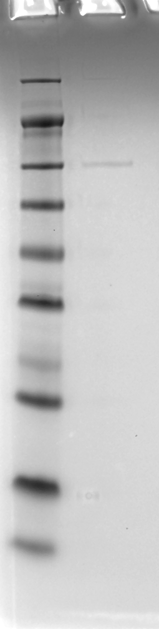
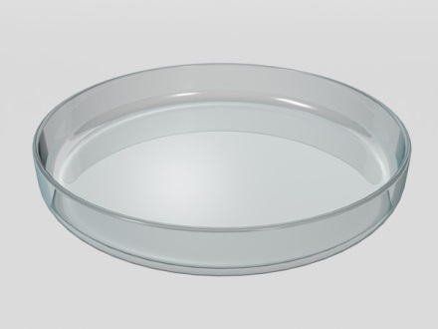
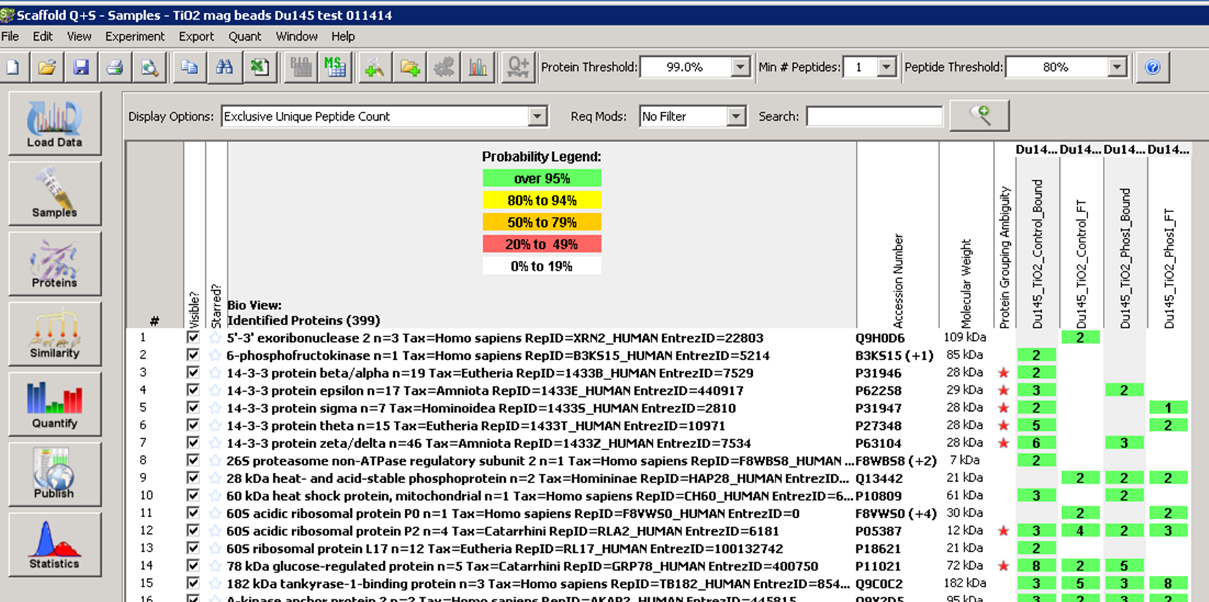
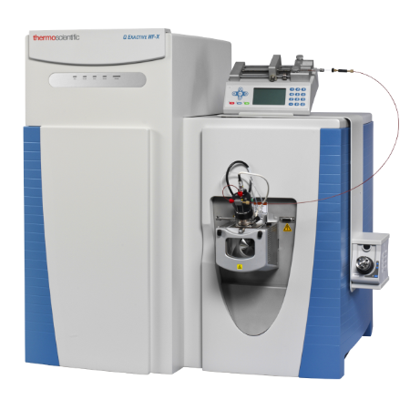
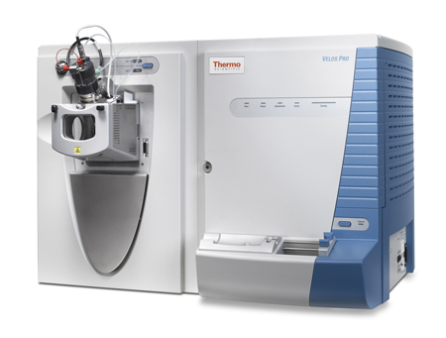
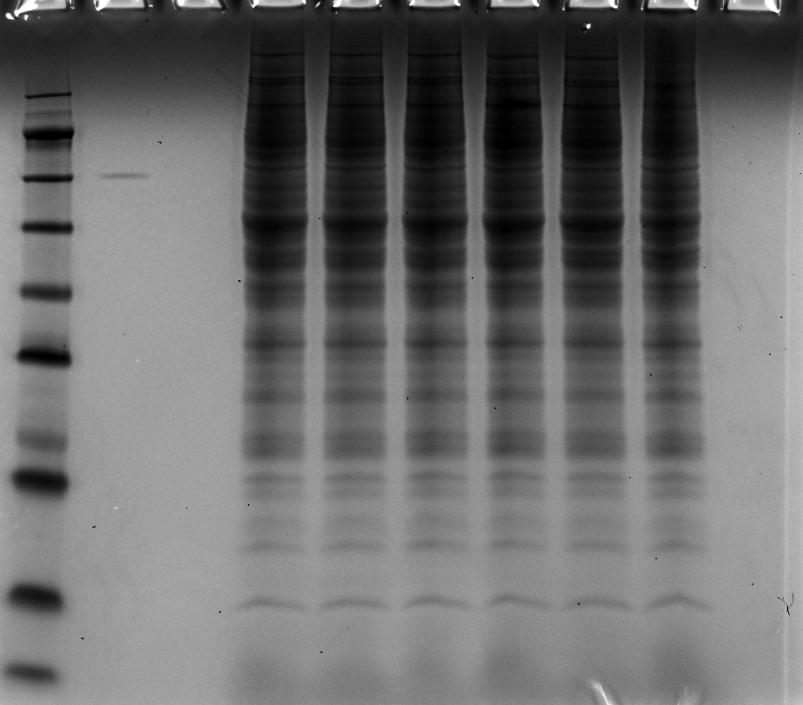

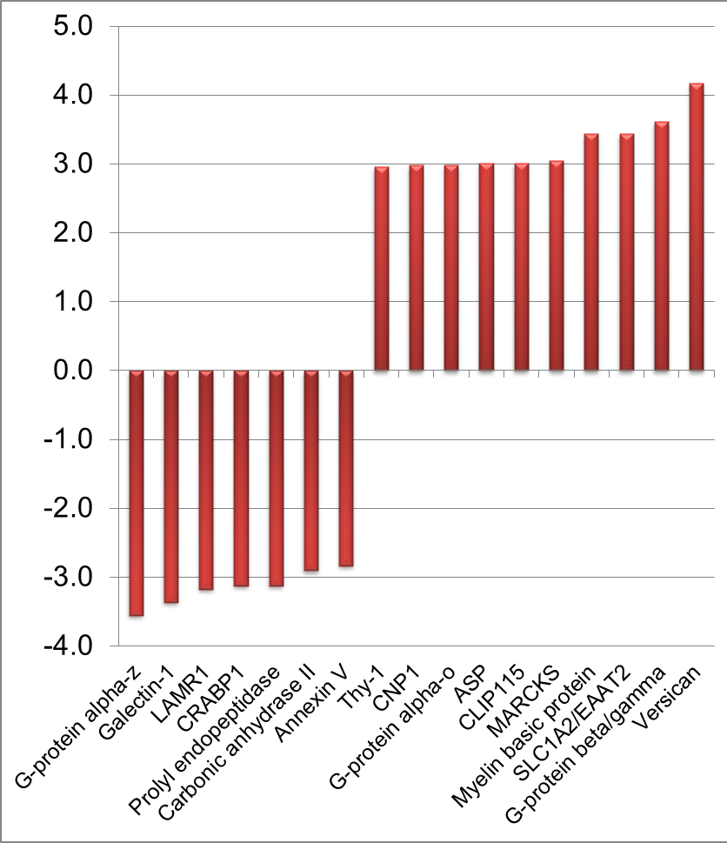
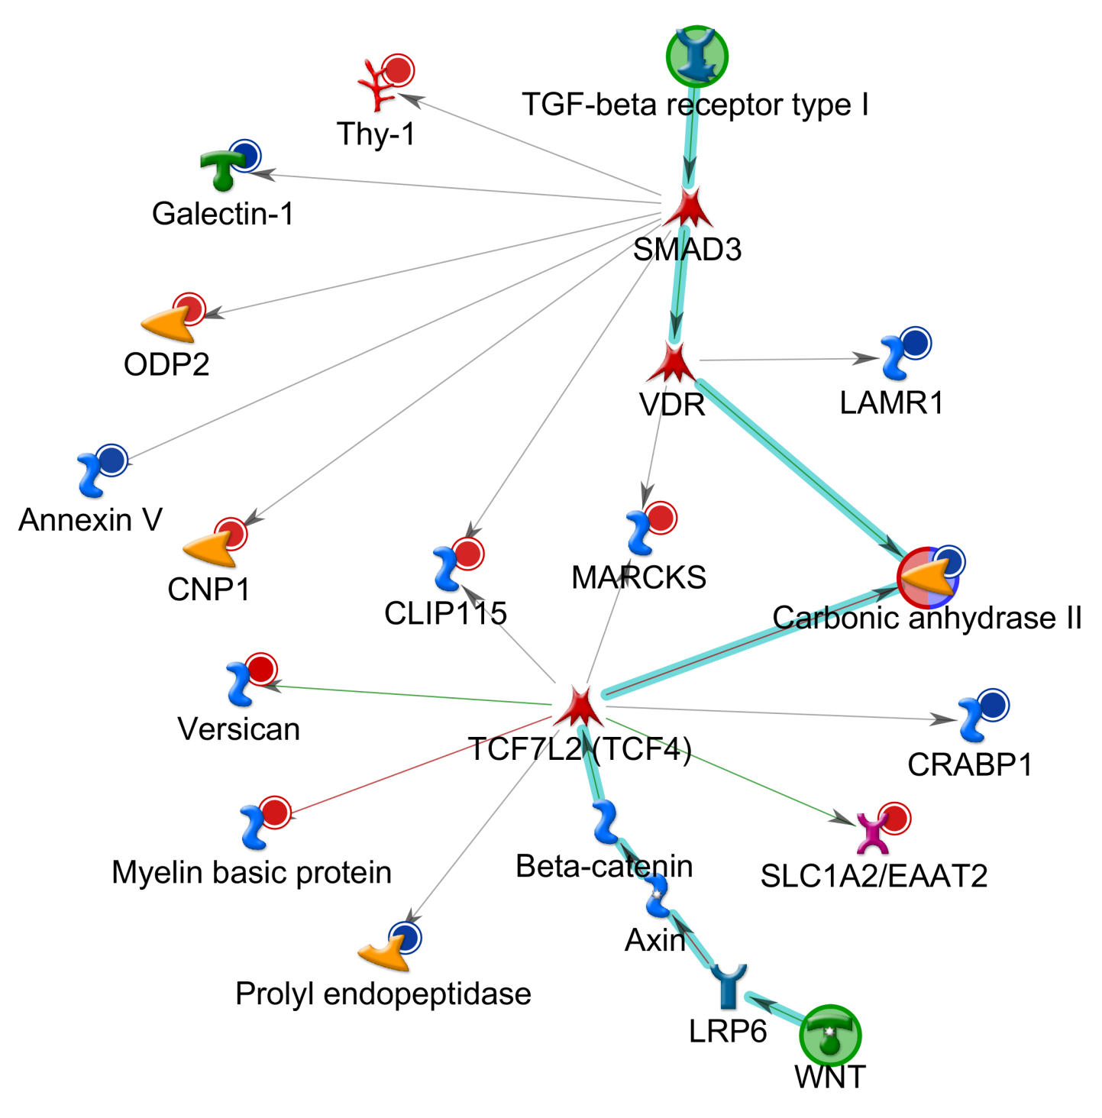
UAB O’Neal CCC Mass Spectrometry & Proteomics (MSP) Shared Resource
Director: James A. Mobley, Ph.D., Web-site: https://www.uab.edu/medicine/msproteomics/
1. Organization & Goal
3. Workflow and Pricing for Non-Complex Samples
(ex: purified protein, overexpressed/ enriched, etc.)
5. Labeled - Quantitative Proteomics Studies
Including SILAC, SILAM, AQUA, etc. (pricing varies based on application)
The UAB CCC Mass Spectrometry/Proteomics Shared Resource (MSP-SR) offers access to capabilities that are not available in individual laboratories.
The facility is organized into five modules:
Administrative & Laboratory Management
Experimental Design, Sample Preparation & Separations
Discovery Proteomic Analysis
Statistics, Bioinformatics, & Reporting
Manuscripts, Grants, & Education.
Modules are supported by highly trained scientists who are experts in mass spectrometry, bioanalytical chemistry, statistics, systems biology, and information handling.
The goal of the MSP Shared Resource is to provide state-of-the-art capabilities in mass spectrometry, proteomics, and bioanalytical technologies to support the research needs of UAB internal and external researchers.
Example: non-complex sample (three samples)
Example: Stable Isotope Labeling with Amino Acid in Cell Culture (SILAC)
Week 0
OPTIONAL
Consultation with the Director (Including experimental design, timeline, cost, etc.) (1st hour free; additional: $120×1hr=$120)
Example 1D-PAGE for Non-Complex Sample
Control cells are cultured in heavy stable isotope 15N, 13C lysine (K+6) and heavy stable isotope 15N, 13C arginine (R+10) supplemented media, without any treatment. Experimental cells are cultured in standard lysine (K) and arginine (R) supplemented media, with the treatment of interest.
Cells are lysed, protein is quantified, the control and treated protein lysates are combined, and digested in-gel with trypsin.
kDa
MW
marker
Purified protein
Samples are accepted, and service Forms are uploaded to LIMS
Protein quantification (where applicable, $20×3=$60)
1D PAGE ($20×3=$60)
Gel staining and imaging ($35)
Enzymatic digestion ($30×3=$90)
188
Week 1
98
Ex. Purified protein sent for MS analysis to confirm ID.
62
Control (Heavy)
49
Lysine+6
Arginine+10
13C-
15N-
38
Combine equal amount of Heavy and Light labeled proteins
High Resolution LC-MS analysis, 1hr ($110×3=$330)
Data extraction and searching (complementary)
Post LC-MS analysis (basic reporting: $30)
28
Cell Lysis
1D-PAGE
Trypsin Digestion
Week 1-2
17
LCMS
Analysis
14
Experimental (Light)
6
Lysine
Arginine
12C-
14N-
Search data with MASCOT
Quantify with MASCOT DISTILLER Q+
Analyze and Filter with Scaffold PTM/ Q+S
Pair wise Statistical Analysis
Pathway Analysis
Validation with Heavy Isotope Peptide Standards (AQUA)
Reporting (Graphs, Tables)
Consulting
2. Facility Overview
Week 1-2
Data is uploaded to the LIMS with notes (complementary)
3
Research Team:
  James Mobley, Ph.D. (Facility Director)
  Kyoko Kojima, Ph.D. (Operations Director, Applications Scientist)
  Willis Hampton (IT Support)
Instrumentation:
  Thermo QExactive HF-x
  2 Thermo Orbitrap Velos PROs with nanoLC-ESI/ CID/ PQD
  Thermo LTQ-XL Orbitrap
  Beckman Optima MAX-XP Ultracentrifuge
Computing
  Our facility houses nearly 30 computers on the UAB network in our own subdomain. Our computing equipment includes 2 high-end workstations and 5 high-speed high capacity double firewalled servers(below) that contains over 80TB of dynamic drive space and an additional 105TB of backup storage for archiving and automated nightly backups for all computers throughout the MSP-SF (including all MS instruments).
  Primary fileserver: 44TB of drive space, 64 GB RAM, AMD EPYC 7401P 24Core processors
  Unix application server: powered by Oracle Linux and Oracle Database 64 GB RAM, 2 - AMD 2.6GHz 12 Core processors
  Primary domain controller: for our network: 2 GB RAM, 1 - Intel 2.0 GHZ Dual Core processor
  Backup domain controller: Hyper-V Virtual Machine
  Secondary fileserver: 30TB, 32 GB RAM, 2-AMD 3.1GHz 8 Core processors
  Application server: 64GB RAM, AMD EPYC 7401P 24Core processor 2.0GHz, 44TB between 1.7 TB high speed SSD and 6 8TB HDD in RAID 5 Array
Software/ Licenses:
  SEQUEST & MASCOT (Search Engines)
  Nonlinear SameSpots (2D-PAGE analysis)
  ProteomeSoftware Scaffold PTM Q⁺/S, Mascot Distiller, Thermo Proteome Discoverer (All-In-One Proteomic Analysis Tool)
  Mascot Distiller Q⁺ (Quantitative & De Novo Sequencing Proteomic Analysis Tool)
  Clarivate Analytics Metacore, Blast2Go-Pro (Systems Biology & Pathway Analysis)
  LIMS (Data sharing, https://www.uab.edu/medicine/msproteomics/services/lims)
Total Price: $605 (~$200/sample)
Example Basic Reporting
Example: Stable Isotope Labeling with Amino Acids in Mammals (SILAM)
Tissues obtained from 15N-labeled control and N14-labeled experimental animals are analyzed. Following lysis of tissue, equal amount of protein from experimental mice are mixed with 15N-labeled standard control lysate and analyzed by 1D-PAGE. Each gel lane are excised in 6 MW fractions and digested with trypsin, and each fraction is analyzed via LCMS.
Control
1
15N-
Chow
Combine equal amount of 15N and 14N labeled proteins
2
Tissue Lysis
1D PAGE
3
In gel tryptic digestion
6-fraction GeLC
4. Workflow and Pricing for Label-Free Biomarker Studies
(ex: animal models & clinical specimens such as serum, urine, tissues)
Experimental
4
LCMS
Analysis
14N-
Chow
5
Example: 30 serum samples
6
Week 0
OPTIONAL (Strongly Recommended)
Consultation with the Director (Including experimental design, timeline, cost, etc.) (1st hour free; additional: $120×1hr=$120)
Samples are accepted, and service Forms are uploaded to LIMS
Advanced sample preparation (depletion of abundant proteins, $60×16hr=$960)
Protein quantification ($20×30=$600)
1D PAGE ($20×30=$600)
Gel staining and imaging ($35×4=$140)
Enzymatic digestion (in case of 3 fraction per sample: $30×90=$2,700)
Search data with MASCOT
Quantify with MASCOT DISTILLER Q+
Analyze and Filter with Scaffold PTM/ Q+S
Pair wise Statistical Analysis
Pathway Analysis
Validation with Heavy Isotope Peptide Standards (AQUA)
Reporting (Graphs, Tables)
Consulting
Week 1-2
Week 2-3
High-Resolution LC-MS analysis, 1hr ($110×90=$9,900)
Data extraction and searching
Post LC-MS analysis (Basic reporting, $60×4hr=$240)
Week 3-4
OPTIONAL
Statistical analysis and systems biology analysis (Advanced reporting, Ex. $120×8hr=$960)
6. Recent Selected Publications
(we support grant submission and publications)
Week 3-4
Data is uploaded to the LIMS
[1] Addis DR, Aggarwal S, Doran SF, Jian MY, Ahmad I, Kojima K, et al. Vascular permeability disruption explored in the proteomes of mouse lungs and human microvascular cells following acute bromine exposure. Am J Physiol Lung Cell Mol Physiol. 2020;319:L337-L59.
[2] Arrant AE, Davis SE, Vollmer RM, Murchison CF, Mobley JA, Nana AL, et al. Elevated levels of extracellular vesicles in progranulin-deficient mice and FTD-GRN Patients. Ann Clin Transl Neurol. 2020;7:2433-49.
[3] Asfari A, Hock KM, Byrnes JW, Borasino S, Halloran BA, Mobley JA, et al. Biomarkers for Adverse Lung Injury Following Pediatric Cardiopulmonary Bypass. Crit Care Explor. 2021;3:e0528.
[4] Carter AM, Tan C, Pozo K, Telange R, Molinaro R, Guo A, et al. Phosphoprotein-based biomarkers as predictors for cancer therapy. Proc Natl Acad Sci U S A. 2020;117:18401-11.
[5] Chanda D, Rehan M, Smith SR, Dsouza KG, Wang Y, Bernard K, et al. Mesenchymal stromal cell aging impairs the self-organizing capacity of lung alveolar epithelial stem cells. Elife. 2021;10.
[6] Filippova N, Yang X, Ananthan S, Calano J, Pathak V, Bratton L, et al. Targeting the HuR Oncogenic Role with a New Class of Cytoplasmic Dimerization Inhibitors. Cancer Res. 2021;81:2220-33.
[7] Goliwas KF, Simmons CS, Khan SA, Wood AM, Wang Y, Berry JL, et al. Local SARS-CoV-2 peptide-specific Immune Responses in Convalescent and Uninfected Human Lung Tissue Models. medRxiv. 2021.
[8] Han D, Yang J, Zhang E, Liu Y, Boriboun C, Qiao A, et al. Analysis of mesenchymal stem cell proteomes in situ in the ischemic heart. Theranostics. 2020;10:11324-38.
[9] Jin L, Chen Y, Crossman DK, Datta A, Vu T, Mobley JA, et al. STRAP regulates alternative splicing fidelity during lineage commitment of mouse embryonic stem cells. Nat Commun. 2020;11:5941.
[10] Li FJ, Surolia R, Li H, Wang Z, Liu G, Kulkarni T, et al. Citrullinated vimentin mediates development and progression of lung fibrosis. Sci Transl Med. 2021;13.
[11] Weeks SE, Kammerud SC, Metge BJ, AlSheikh HA, Schneider DA, Chen D, et al. Inhibiting beta-catenin disables nucleolar functions in triple-negative breast cancer. Cell Death Dis. 2021;12:242.
[12] Zhang E, Liu Y, Han C, Fan C, Wang L, Chen W, et al. Visualization and Identification of Bioorthogonally Labeled Exosome Proteins Following Systemic Administration in Mice. Front Cell Dev Biol. 2021;9:657456.
Total Price: $16,220 (~$540/sample, optional items included )
Example: Statistical and Systems Biology Analysis
For specific inquiries, please contact us;
UAB O’Neal CCC Mass Spectrometry/Proteomics Shared Resource
Attn: Kyoko Kojima, Ph.D.
1900 University Blvd., THT 520, Birmingham, AL 35294
Email: kkojima@uab.edu Phone: (205)996-6213

