Slide 1
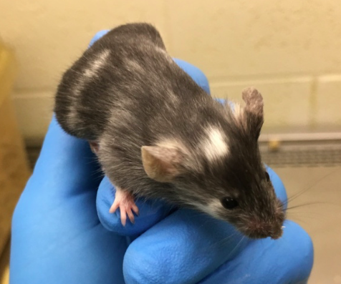
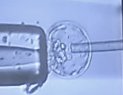
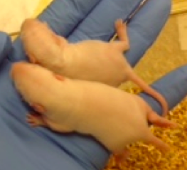
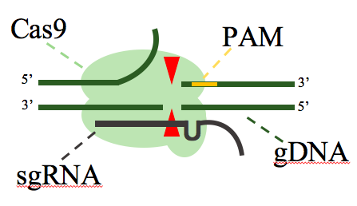
Transgenic & Genetically Engineered Models (TGEMs) Core
Laura Lambert, Ph.D., Director
Mouse and Rat Model Generation
Rodent Model Generation
Pronuclear Microinjection
Pronuclear Microinjection
ES Cell Microinjection
CRISPR/Cas9
Loss of function alleles
Knockout
Large genomic deletions
Hypomorphic
Targeted insertions
Patient mutations
SNPs
Conditional alleles
ROSA26 insertions
Reporter tags
Simple Transgenics
Reporters
Overexpression vectors
CRISPR/Cas9
Loss of function alleles
Knockouts
Large genomic deletions
Hypomorphs
Targeted insertions
Patient mutations
SNPs
Conditional alleles
ROSA26 insertions
Reporter tags
Simple Transgenes
Reporters
Overexpression vectors
ES Cell Targeting
Conventional
CRISPR induced recombination
CRISPR guides and compatible ROSA26 targeting vector
Preparation of commercially available ES cells (EUCOMM / KOMP)
ES Cell Microinjection
ES Cell Targeting
Conventional
CRISPR induced recombination
CRISPR guides and compatible ROSA26 targeting vector
Preparation of commercially available ES cells (EUCOMM / KOMP)
Rederivation

Slide 2
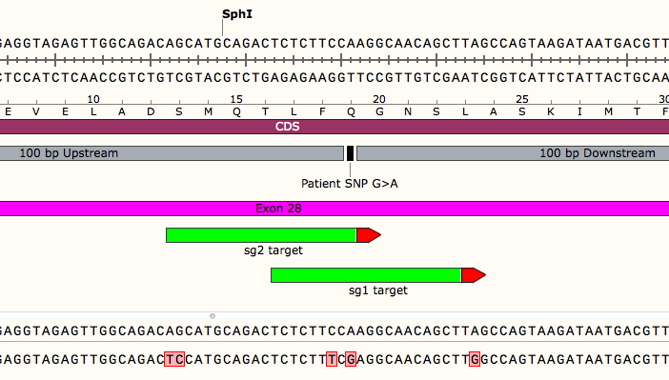
Transgenic & Genetically Engineered Models (TGEMs) Core
Laura Lambert, Ph.D., Director
Complete CRISPR/Cas9 Service
Rodent Model Generation
Pronuclear Microinjection
CRISPR Model Creation
CRISPR Model Design
CRISPR/Cas9
Loss of function alleles
Knockout
Large genomic deletions
Hypomorphic
Targeted insertions
Patient mutations
SNPs
Conditional alleles
ROSA26 insertions
Reporter tags
Simple Transgenics
Reporters
Overexpression vectors
Guide design and preparation
Repair template design
Genotyping strategy
Pronuclear microinjection of 150 embryos
Transfer of embryos to surrogate dams
Optional screening of founder animals
Transfer of founder litters at weaning
ES Cell Microinjection
ES Cell Targeting
Conventional
CRISPR induced recombination
CRISPR guides and compatible ROSA26 targeting vector
Preparation of commercially available ES cells (EUCOMM / KOMP)
WT
RT
F1 KO
Assisted Reproductive Techniques
Cryopreservation
Rederivation
Mouse
Sperm
Embryos
Oocytes
Ovaries
Mouse
In vitro fertilization
Transfer of cryopreserved embryos
Pathogen-free
Ovarian transplant
Rat
Transfer of cryo-preserved embryos
Rat
Sperm
Embryos
F1 KI
WT
Guide Design
Founder Screen
Germline Transmission

Slide 3
Transgenic & Genetically Engineered Models (TGEMs) Core
Laura Lambert, Ph.D., Director
Additional Services
Rodent Model Generation
Pronuclear Microinjection
Assisted Reproductive Techniques
Cryopreservation
NIH P30 Support
Mouse
IVF
Transfer of cryopreserved embryos
Pathogen-free rederivation
Ovarian transplant
CRISPR/Cas9
Loss of function alleles
Knockout
Large genomic deletions
Hypomorphic
Targeted insertions
Patient mutations
SNPs
Conditional alleles
ROSA26 insertions
Reporter tags
Simple Transgenics
Reporters
Overexpression vectors
Rat
Sperm
Embryos
Oocytes
Ovaries
Rat
Transfer of cryopreserved embryos
Ovarian transplant
Mouse
Sperm
Embryos
Oocytes
Ovaries
Comprehensive Cancer Center (CCC)
Hepatorenal Fibrocystic Diseases Core Center (HRFDCC)
Nutrition Obesity Research Center (NORC)
Diabetes Research Center (DRC)
ES Cell Microinjection
ES Cell Targeting
Conventional
CRISPR induced recombination
CRISPR guides and compatible ROSA26 targeting vector
Preparation of commercially available ES cells (EUCOMM / KOMP)
Maintenance of Stock Lines
Consultation
Design of transgenic constructs
Screening strategies
Breeding schemes
Contact
Cre strains (ex. EIIa)
Reporters (ex. TdTomato, GFP)
Male/female breeders and controls (ex. C57B6J)
Assisted Reproductive Techniques
Cryopreservation
Rederivation
Laura Lambert, PhD
ljack12@uab.edu
205-934-7212
Mouse
Sperm
Embryos
Oocytes
Ovaries
Mouse
In vitro fertilization
Transfer of cryopreserved embryos
Pathogen-free
Ovarian transplant
Rat
Transfer of cryo-preserved embryos
Rat
Sperm
Embryos

