Slide 1
TMPL, the Targeted Lipidomics, Metabolomics and Proteomics Laboratory – your resource for mandated NIH analytical rigor Director: Stephen Barnes, Ph.D. Bevill Building 709

Slide 2
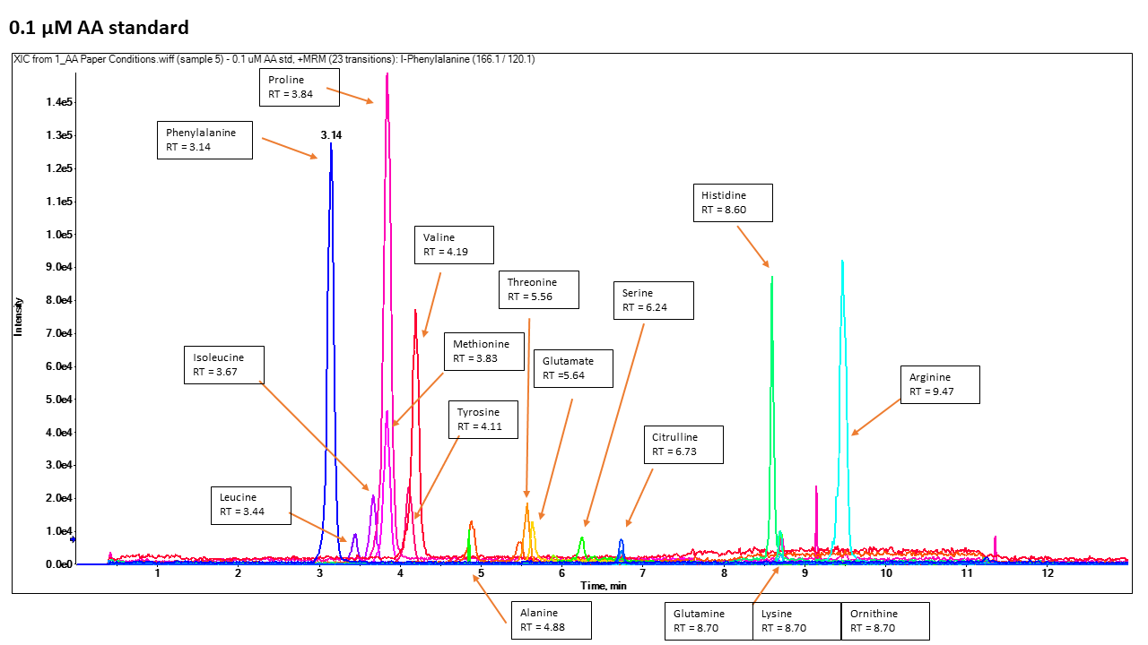
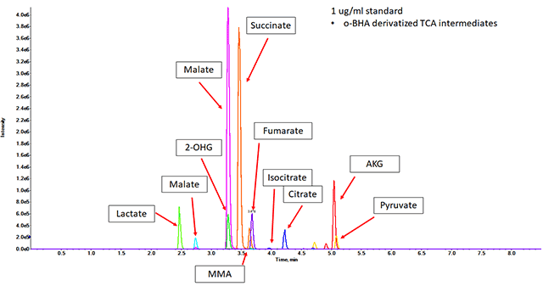
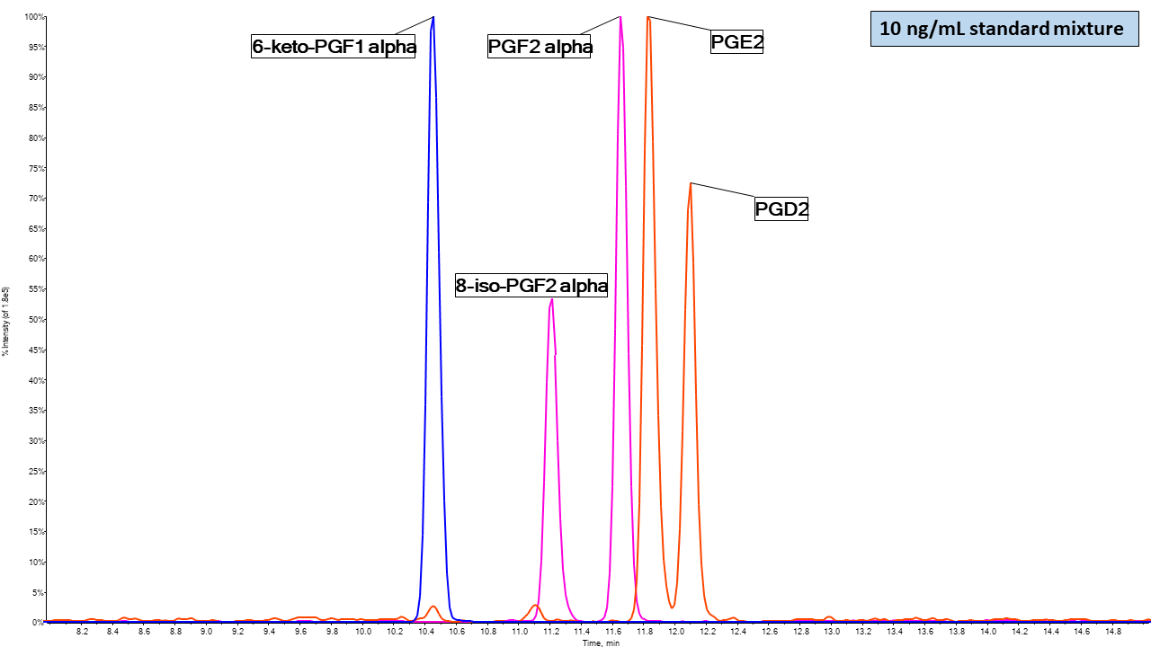
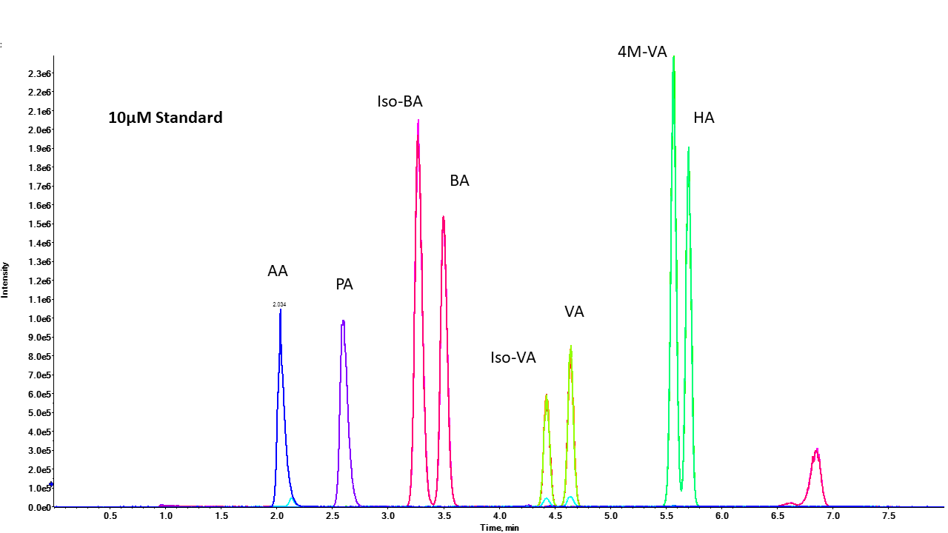
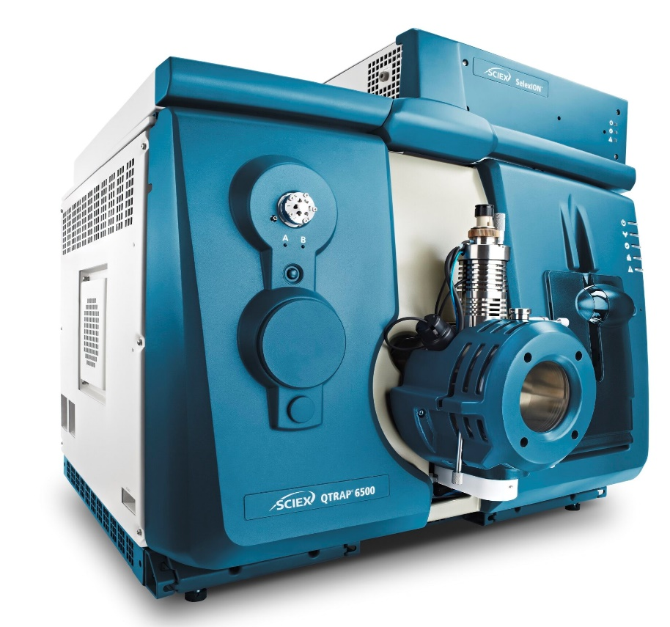
Targeted Analyses
Short Chain Fatty Acids
Free Amino Acids
Prostaglandins
TCA Intermediates
Contact: Taylor Berryhill

Slide 3
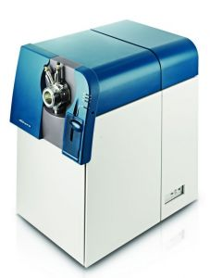
Untargeted Analyses

Slide 4
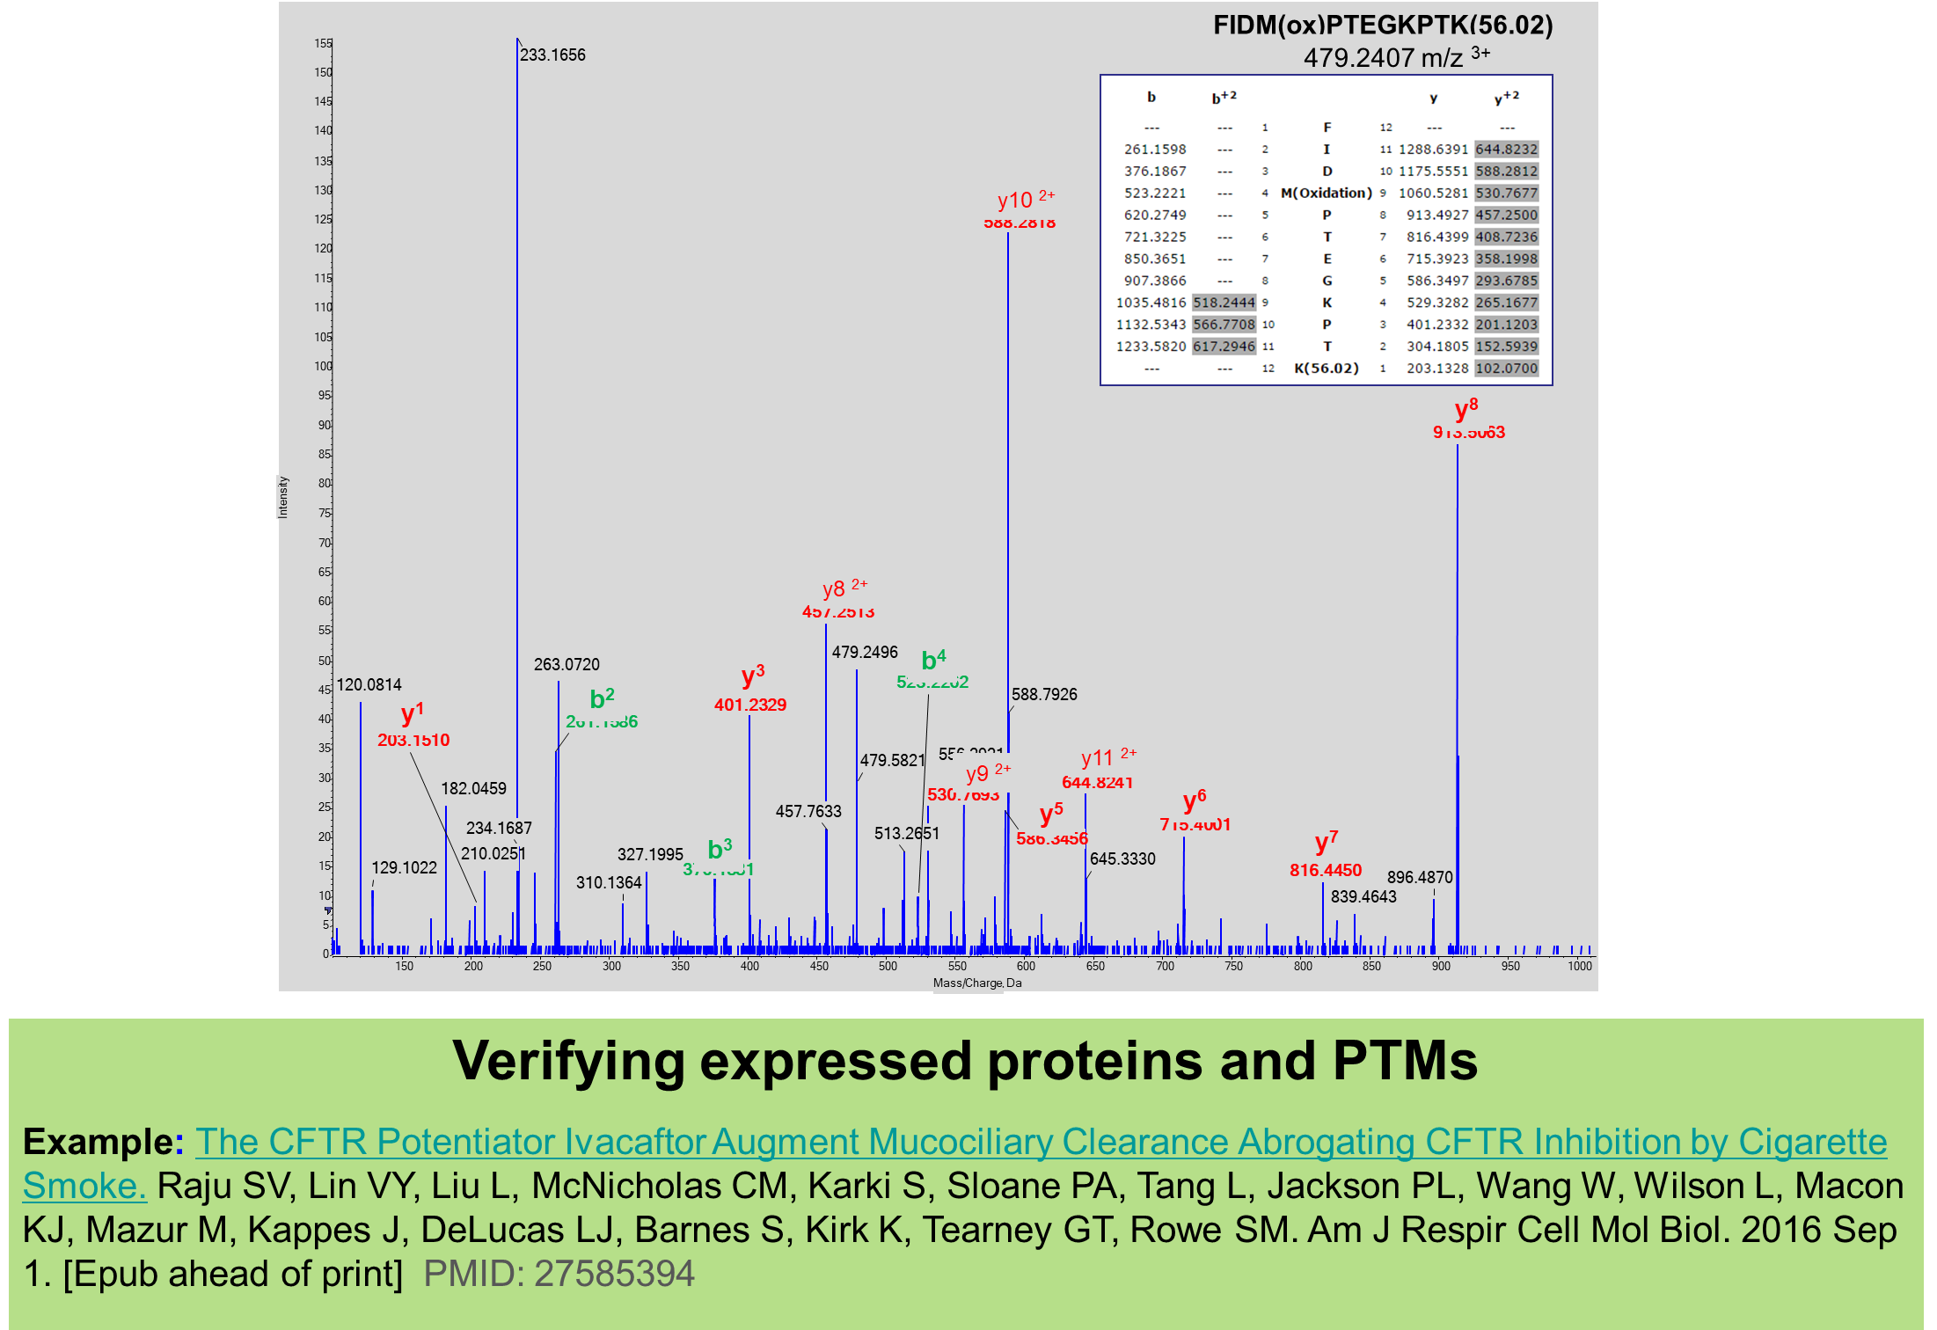
Other Analyses Options
Acrolein modified CFTR
Verification of Post-Translational Modifications
PTMs on proteins ascertained by high resolution peptide sequencing on the SCIEX 5600 TripleTof Mass Spectrometer.

Slide 5
Consultations, Questions, Concerns or Ideas….
TMPL Contact Information
Put “UAB” and “TMPL” in your browser to access the TMPL website
Taylor Berryhill (Targeted Mass Spectrometry; Method Development): berrytf@uab.edu
(205) 934-3462
Caroline Andrews (Sample Processing and Statistical Analyses): cfa1231@uab.edu (205) 934-3462
Landon Wilson (Lipid, Protein, and Profiling/Untargeted Mass Spectrometry): empy1977@uab.edu
(205) 934-3462
Jeevan Prasain (Small Molecule MSMS Interpretation; Lipid Specialist): jprasain@uab.edu
(205) 996-2612
Stephen Barnes (Director, -Omics and Statistical Analysis): sbarnes@uab.edu (205) 934-7117

