Slide 1
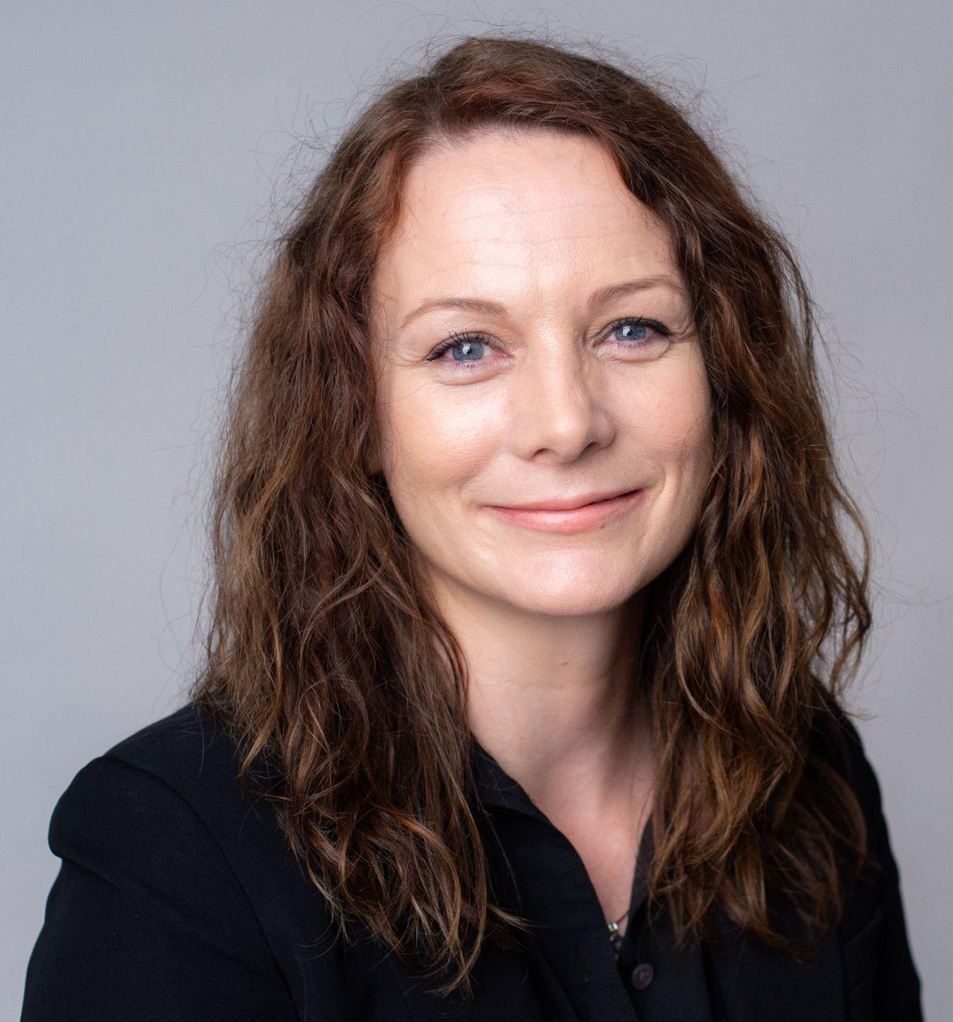
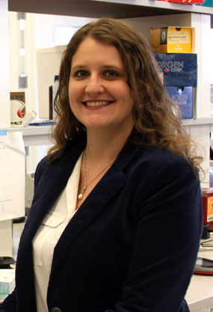
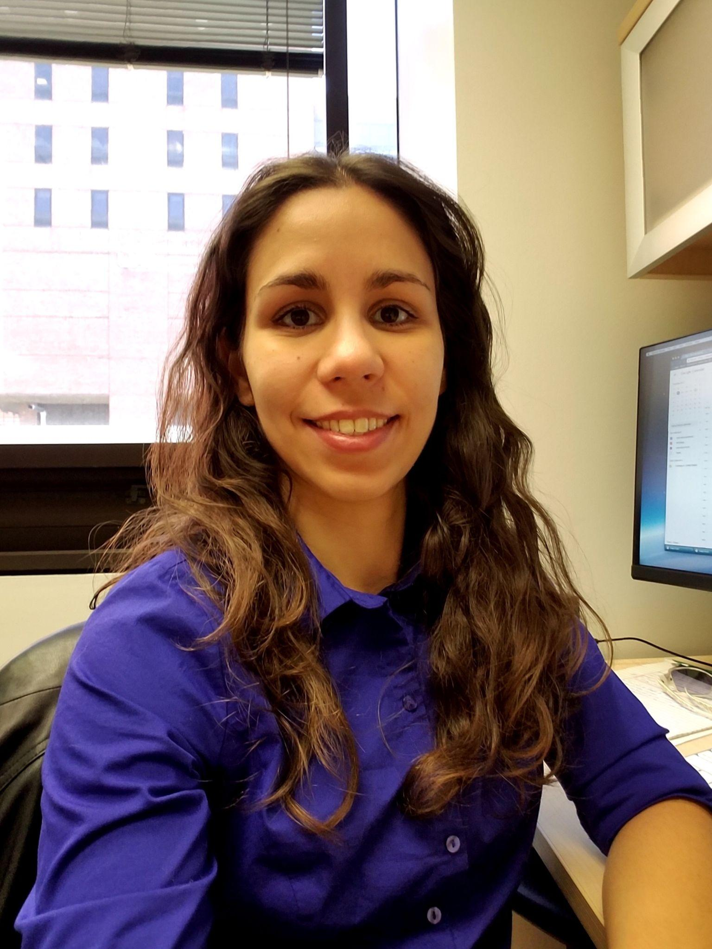
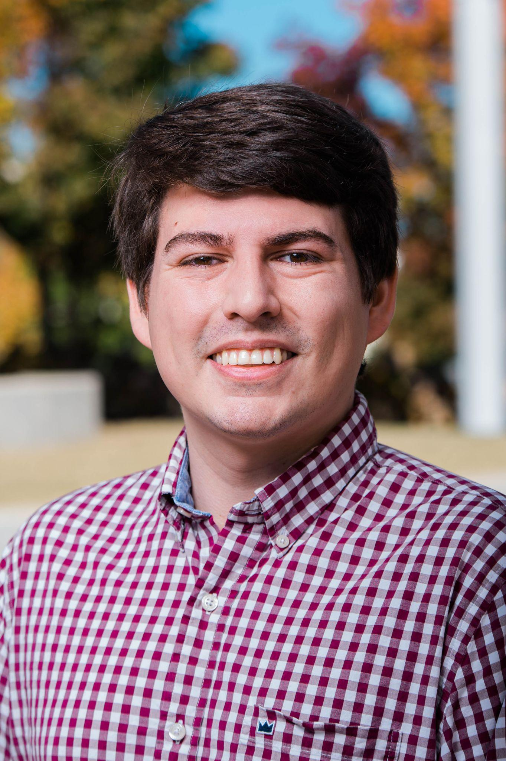
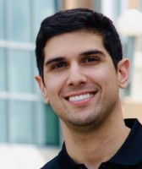
UAB Biological Data Science (U-BDS) Core
Brittany Lasseigne, Ph.D.
Co-Director
Liz Worthey, Ph.D.
Director
Lara Ianov, Ph.D.
Managing Director
Austyn Trull
Bioinformatician I
Basil Khuder
Bioinformatician III
TBA:Bioinformatician II
Website: https://www.uab.edu/cores/ircp/bds | Twitter: @UAB_BDS

Slide 2
U-BDS overview
Provides high-quality and cost-effective computational services to the UAB research community with emphasis in the areas of genomics, transcriptomics, systems biology and translational medicine.
Services:
Genomics: Exome and Whole Genome Sequencing analysis.
Transcriptomics: bulk RNA-seq (mRNA, total, miRNA), single-cell/nuclei RNA-seq including multiome (ATAC-seq/CITE-seq).
Support in method development: pipeline development, and custom projects which overlap with areas of specialization from U-BDS.
Aid in data visualization and web-app development: R Shiny apps for interactive visualization of data, high-quality figures for grants and manuscripts.
Support for writing manuscripts and grant applications
Training: weekly data science office hours - Thursdays 3:30-4:00 pm
join #datascience Slack channel for more information: https://join.slack.com/t/uablabs/signup
check online guides
https://u-bds.github.io/training_guides
https://www.lasseigne.org/education/
Other custom work: develop reproducible research environments (e.g.: Docker containers), wrangling of data from commonly used databases etc.
Website: https://www.uab.edu/cores/ircp/bds | Twitter: @UAB_BDS

Slide 3
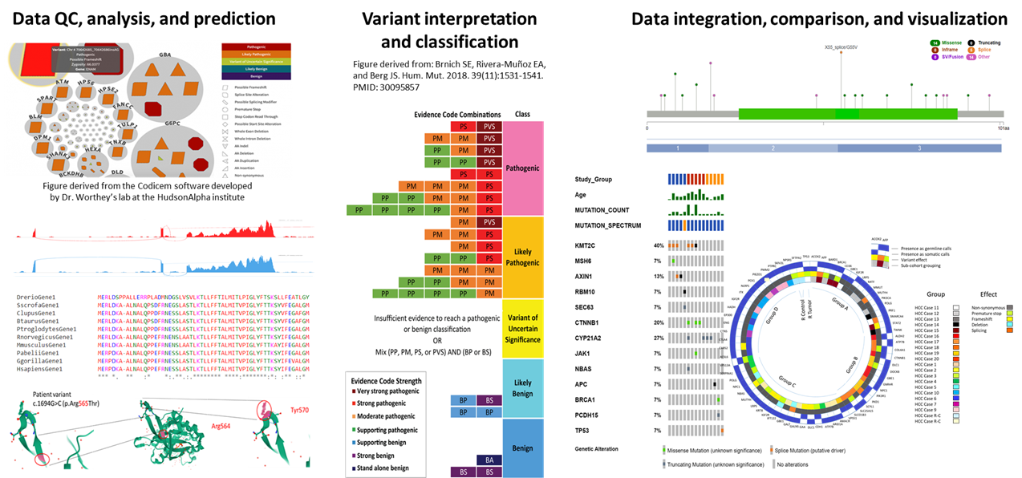
Example of genomics analysis

Slide 4
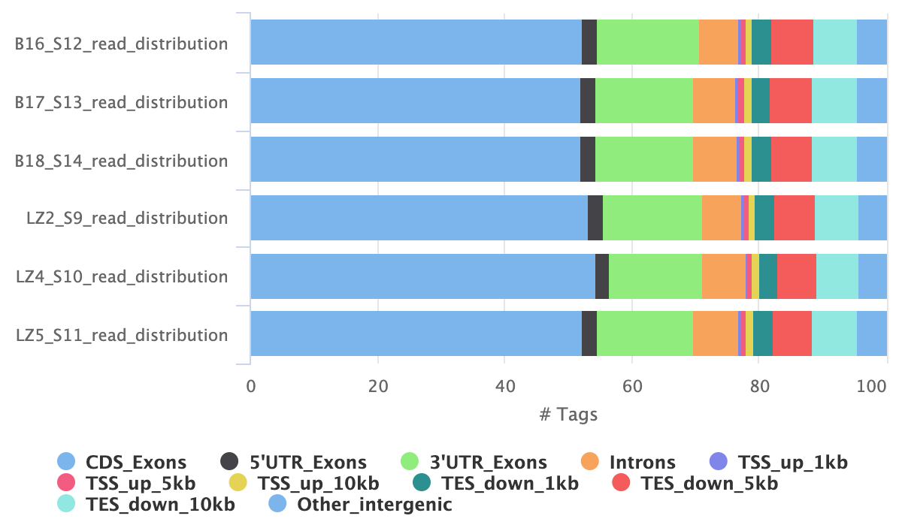
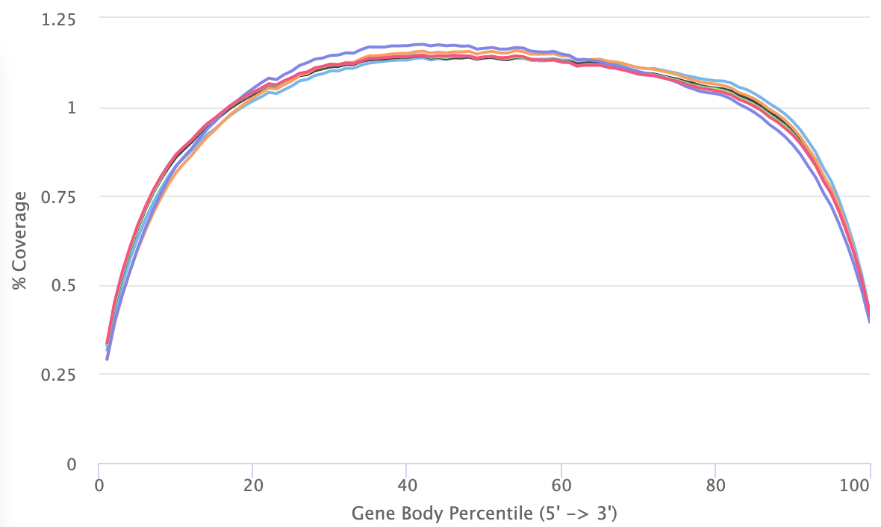
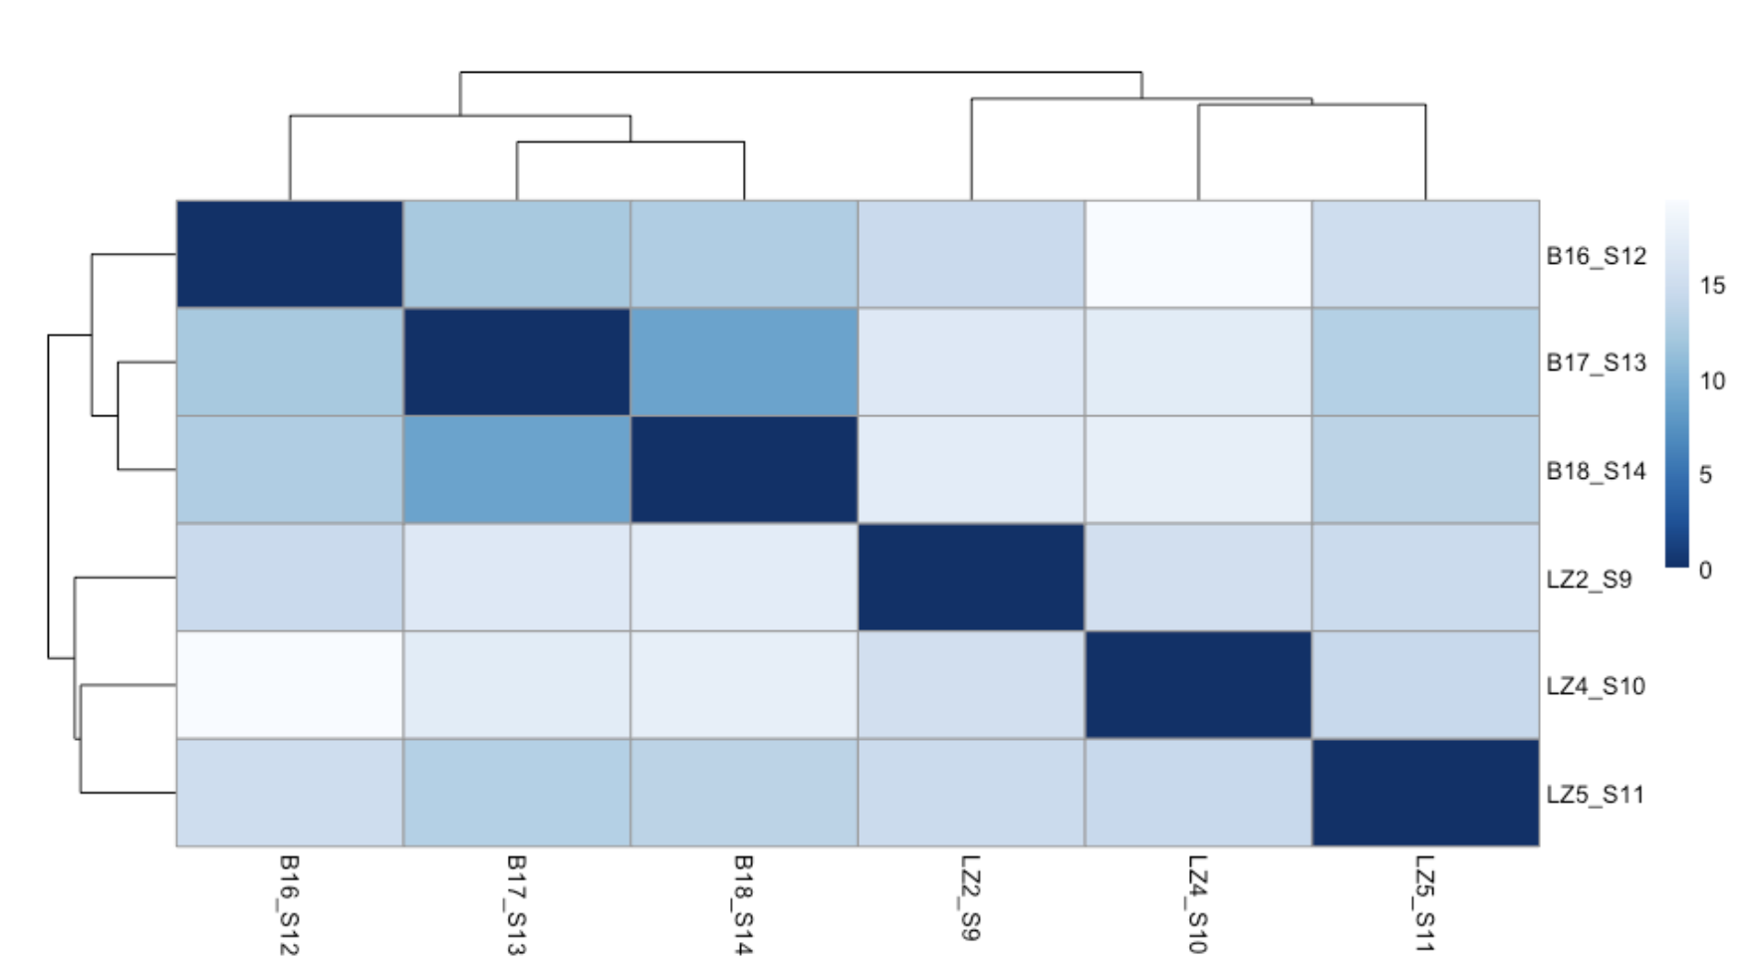
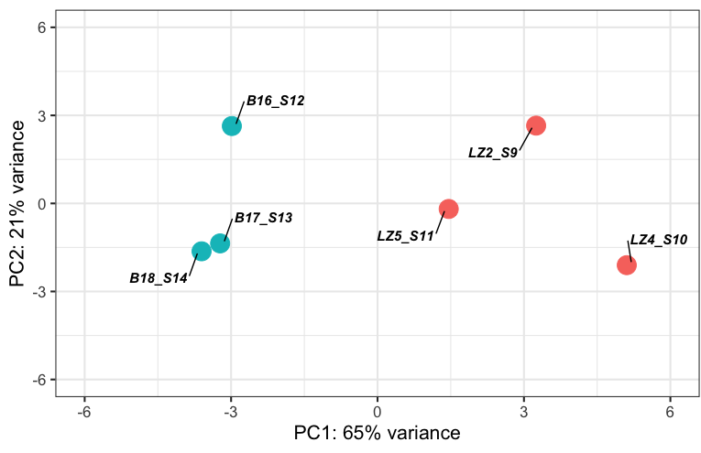
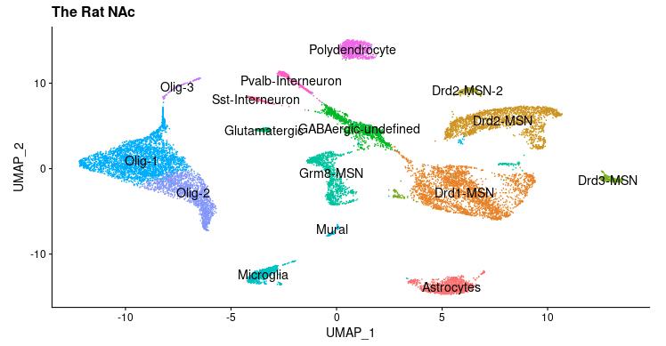
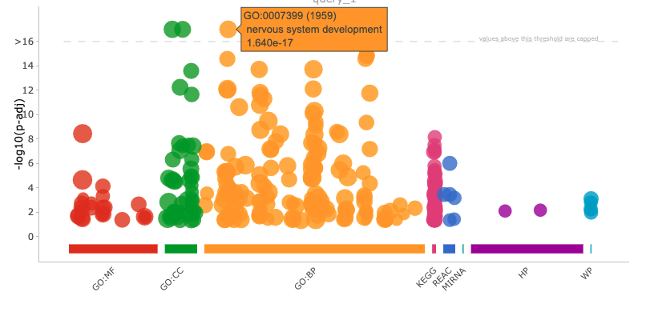
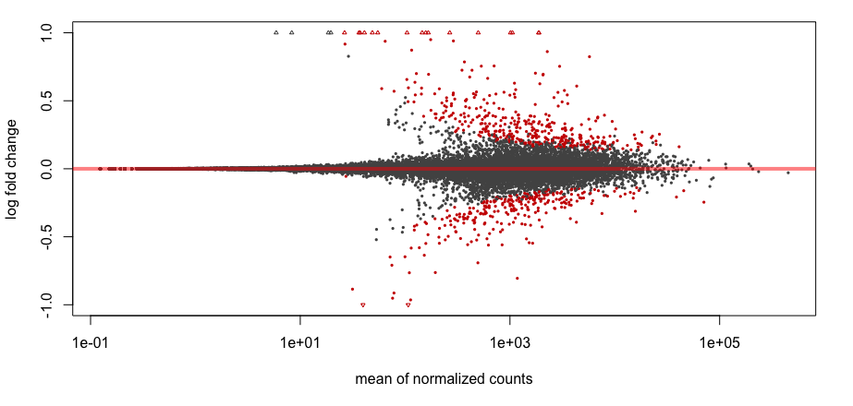
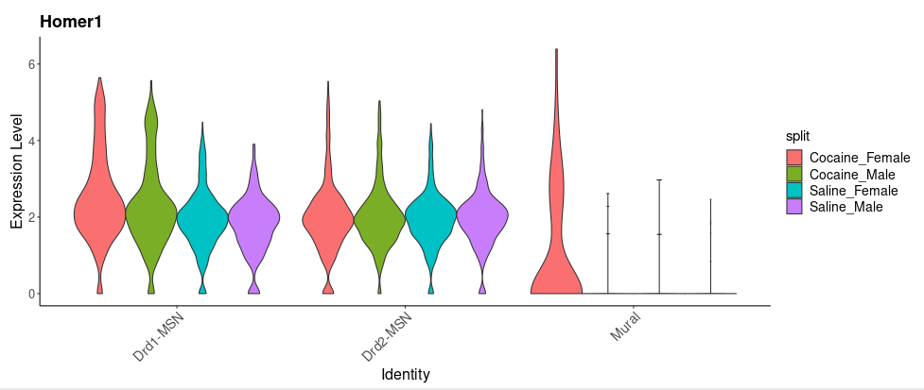
Example of transcriptomics analysis
QC, secondary analysis
Differential expression, visualization, interpretation
Interactive visualization e.g.: https://day-lab.shinyapps.io/ratlas/;
Figures from data published at PMID: 30863790 and PMID: 32637607 (Jeremy Day lab)
Website: https://www.uab.edu/cores/ircp/bds | Twitter: @UAB_BDS

Slide 5
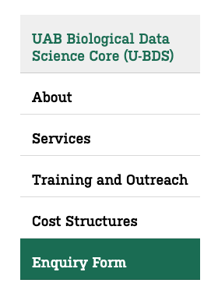
How to get started
Submit Enquiry form
Consultation
U-BDS documents*
Start of project
From U-BDS website
Upon receival of enquiry form, a consultation is scheduled to discuss proposed project or grant application.
To minimize costs associated with the next phase (documentation*), we recommend users to provided detailed project background and goals.
Enquiry linked to a project ready for analysis:
Develop Scope of Work (SOW) document outlining background, methods, milestones, deliverables, estimated timeline and quote.
Enquiry linked to a grant proposal:
Letter of support, grant justification documents, core description for resource page and biosketches for senior personnel if agreed upon.
* Due to demand, all document preparation is charged at $75/hr.
Project is initiated following established core protocols and work detailed under the SOW or grant application.
More information:
FAQs: https://www.uab.edu/cores/ircp/bds-about/frequently-asked-questions
Feel free to contact Dr. Lara Ianov: lianov@uab.edu
Data science office hours (Thursdays 3:30-4:00 pm; & join #datascience Slack channel https://join.slack.com/t/uablabs/signup
Website: https://www.uab.edu/cores/ircp/bds | Twitter: @UAB_BDS

