Slide 1
Laser Microdissection Facility: 6th floor Bevill Biomedical Research Building

Slide 2
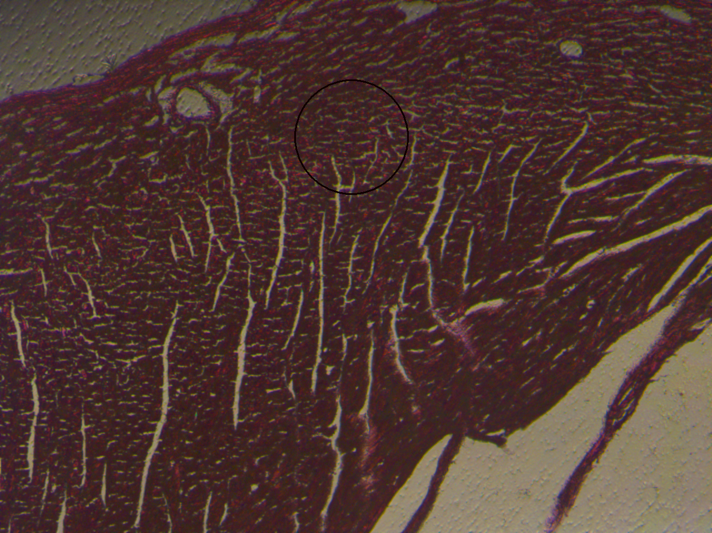
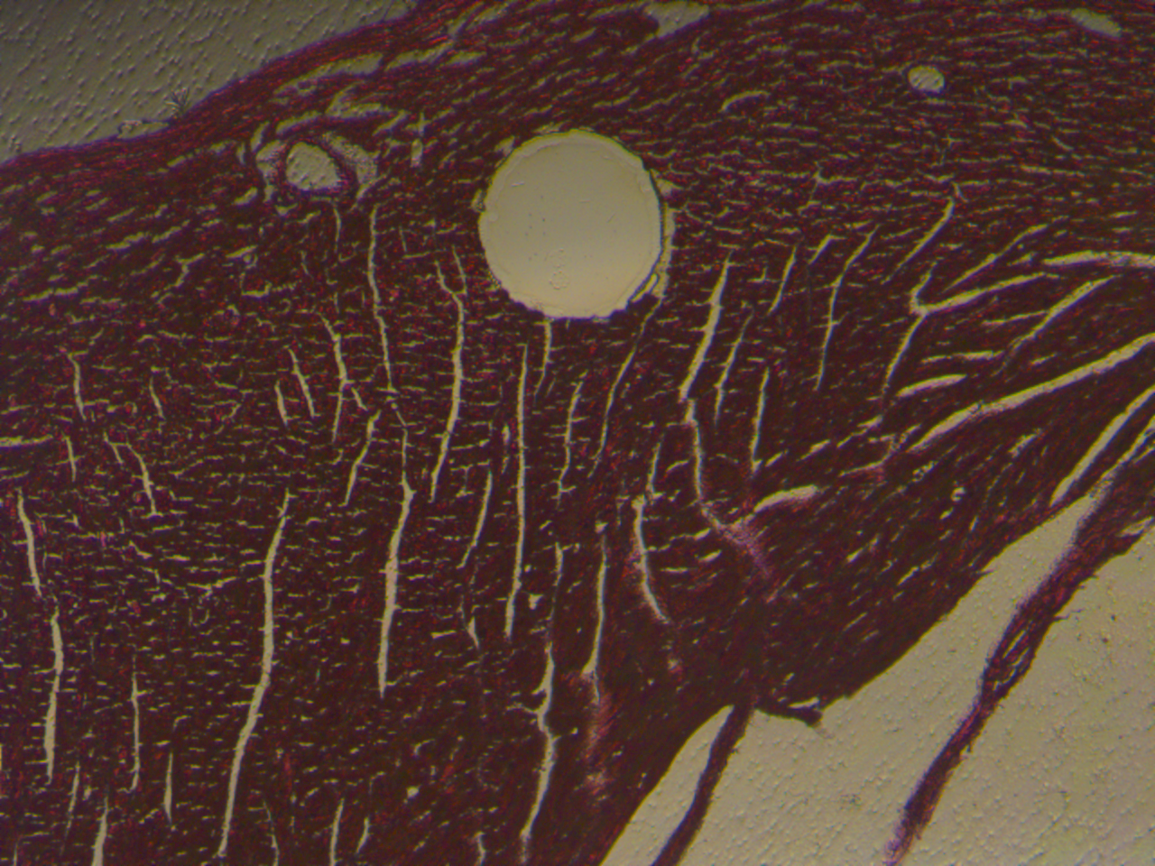
Laser Microdissection
LMD systems allow users to visualize and subsequently isolate regions of interest from entire areas of tissue down to single cells or subcellular structures.
LMD is typically used for the collection of samples in genomics, transcriptomics and proteomics.

Slide 3
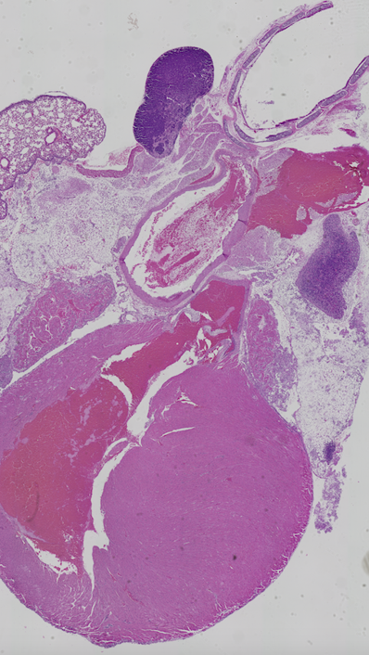
Brightfield capabilities for cutting and imaging
DFC450C - 5 megapixels RGB CCD

Slide 4
Fluorescence capabilities for cutting and imaging DFC3000G 1.3 megapixels monochrome sensor for fluorescence imaging

Slide 5
THANK YOU!
205-934-3879
6th floor Bevill Bldg, 845 19th St S, Birmingham, AL 35205
Core manager: Xiuhong Song
xhsong@uab.edu
https://www.uab.edu/medicine/microbiology/research/resources/laser-microdissection-facility

