Slide 1
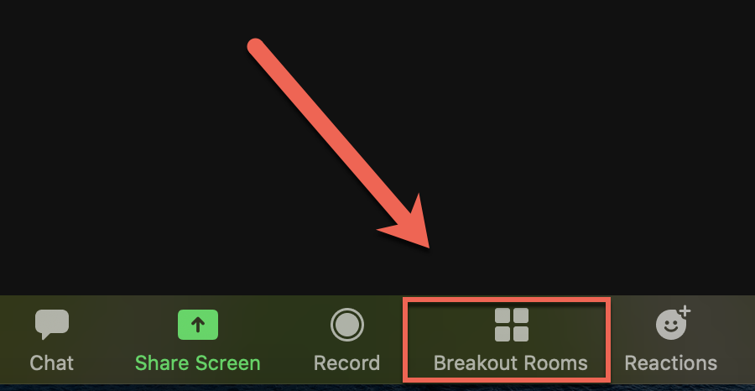
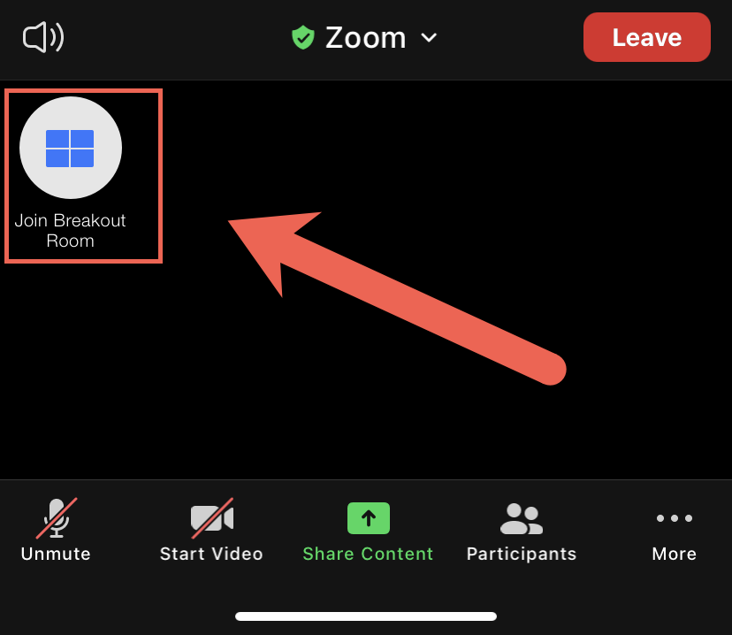
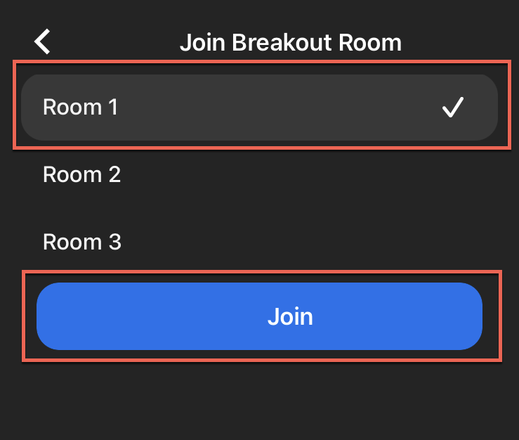
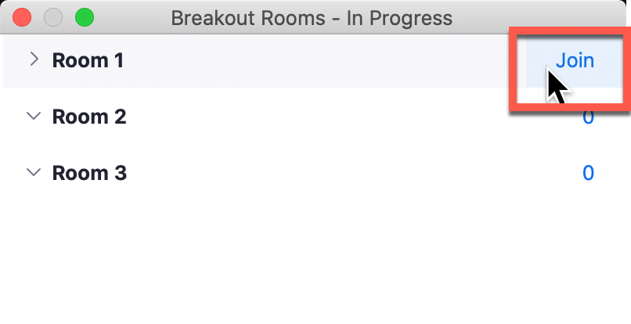
Breakout Room Instructions
Select Breakout Rooms button
Hover over and select to Join the desired/assigned room
Once in room, repeat this process to join other breakout rooms
Desktop
Mobile

Slide 2
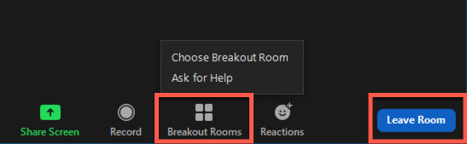
Additional Instructions
Move to another Room
Ask for Help
Return to Main Room
Select the Breakout Rooms
Select Choose Breakout Room and make selection from list
Select the blue Leave Room button
Select Leave Breakout Room
Select the Breakout Rooms
Select Ask for Help and wait for an eLearning representative to arrive

