Slide 1
Office of the Provost, Faculty Affairs
Updated August 7, 2026
Adjunct & Temporary Faculty Hiring Module Intro & Procedures for UAB PeopleAdmin

Slide 2
Message
Hiring Managers,
Please take a few minutes to review the information and resources that are provided in this slide deck. This information is very important to successfully navigate the Adjunct/Temporary Faculty Module and the 04 and 02 faculty hiring process in UAB PeopleAdmin.
This resource also includes the step-by-step process for hiring Credentialed Course Instructors (CCIs).
Thank you.

Slide 3

Adjunct & Temporary Faculty Module in UAB PeopleAdmin
The following hires must be processed in the Adjunct/Temporary module:
  04 Adjunct Faculty (Emeritus, Faculty Retirees)
  04 Credentialed Course Instructors (CCIs)
  02 Full-time Temporary Faculty (Including Visiting Faculty and Instructor Fellows)

Slide 4

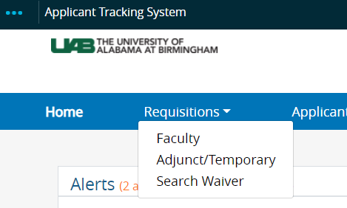
Adjunct/Temporary Module
It takes One Click to Access the Module from your UAB PeopleAdmin dashboard.
The Hiring Proposal, Requisition and Application are the SAME as the Faculty Position Type
The Workflows for review and approval include fewer steps than the Faculty Position Type..

Slide 5
Approval Workflow for 04 Adjunct Faculty and CCIs
1. Hiring Manager Initiates Requisition
2. Department Reviewer Approves Requisition (Chair or Designee)
3. Dean's Office Approves Requisition
4. Faculty Affairs Completes Final Approval
Final Step: APPROVED-INTERNAL, OR NOT APPROVED
Candidates must receive the Quick Link from the requisition to apply for the position.

Slide 6
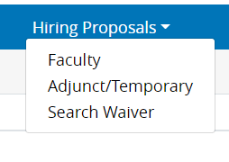
What’s New for the 02 and 04 Hiring Process?
Candidate/new hire applies in UAB PeopleAdmin
You Provide Quick Link to Applicants
Must complete a Hiring Proposal
This process only applies to first-time CCI and adjunct (04) faculty new hires or rehires (those who have terminated from UAB but is now
returning).

Slide 7
The Adjunct/Temporary Faculty Module Allows For:
Onboarding Adjunct Faculty and CCIs (04)
Onboarding Full-time Temporary (02)
Better reporting and tracking at university-level
Background Checks – Automated Process
Pool Postings- Multiple hires from one requisition

Slide 8
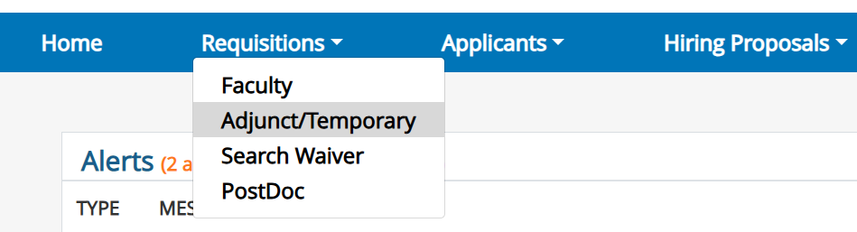
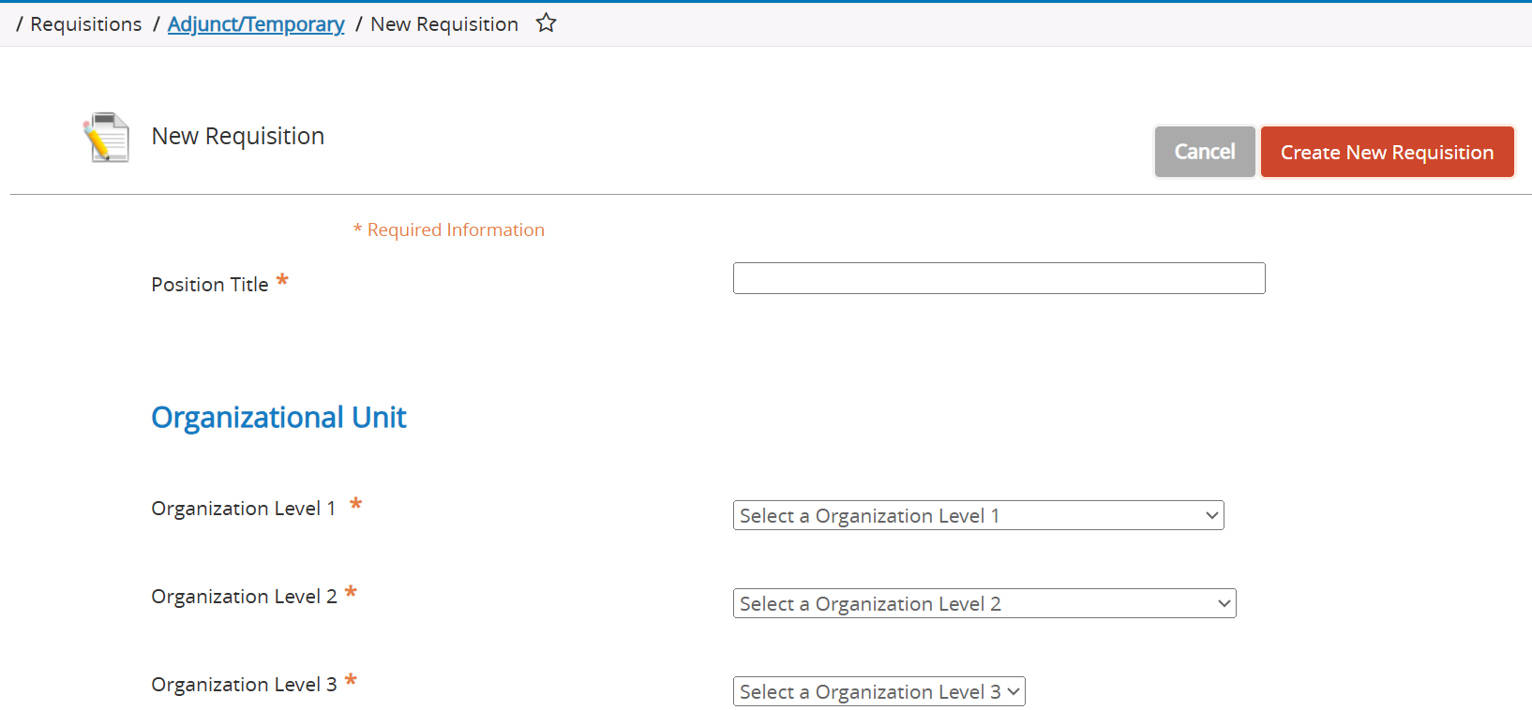
Steps to Create Adjunct/Temporary Faculty Requisition (1/5)
Select Adjunct Temporary Requisition from the Navigation Bar.
2. Click CREATE NEW REQUISITION.

Slide 9
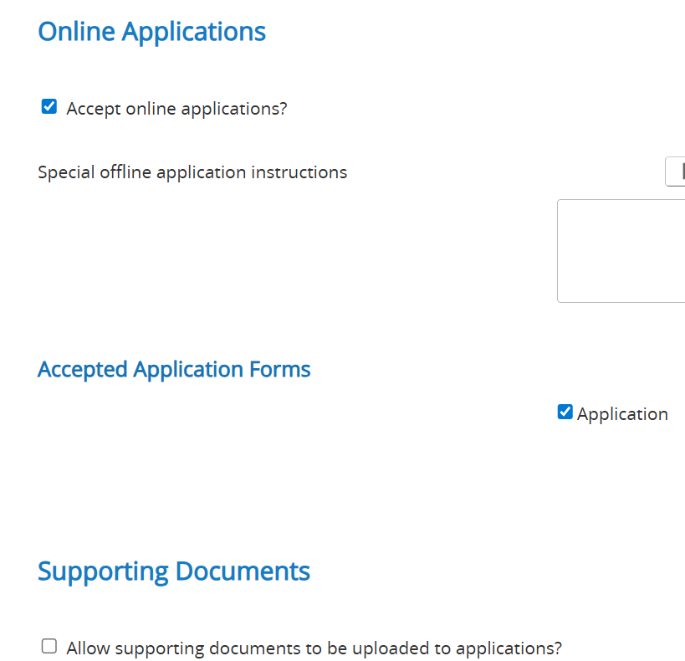
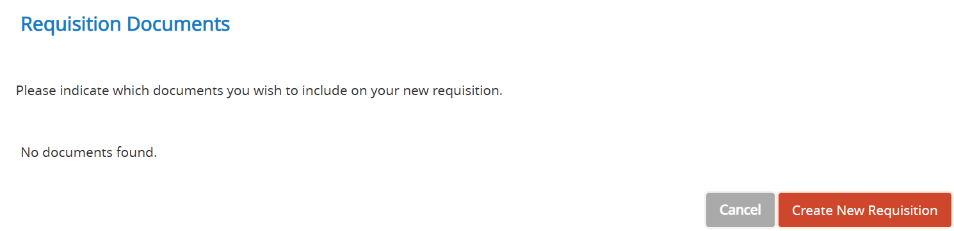
Steps to Create Adjunct/Temporary Faculty Requisition (2/5)
3. If not already selected, check “Accept Online Applications” and “Allow Supporting Documents.”
4. Click Create Requisition.

Slide 10
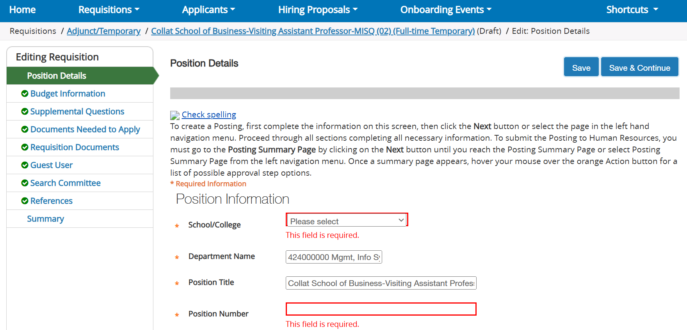
Steps to Create Adjunct/Temporary Faculty Requisition (3/5)
5. Complete all the necessary and required fields in the Requisition. Use the Wizard to guide you through each section of the requisition.

Slide 11
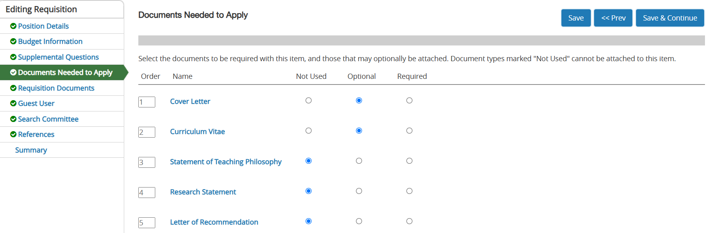
Steps to Create Adjunct/Temporary Faculty Requisition (4/5)
6. Indicate/mark documents needed to apply. If the document is marked as required, the candidate must upload the document to submit their application.
The most common documents required are the CV and Cover Letter.

Slide 12
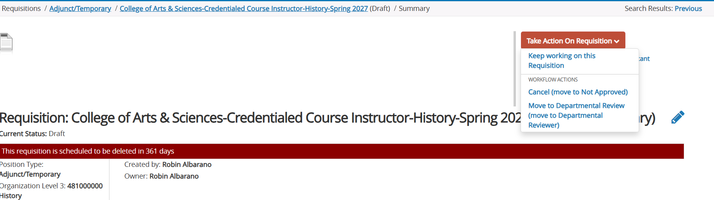
Steps to Create Adjunct/Temporary Faculty Requisition (5/5)
7. The last step is to move the Requisition to the First Approver, the Departmental Reviewer. If you no longer need to submit your requisition, move it to CANCEL.

Slide 13
The 04 and 02 Faculty Hiring Process (New Hires and Rehires Only) (1/2)
CREDENTIALED COURSE INSTRUCTORS are regularly hired and appointed in academic units to primarily teach courses. Some academic units refer to this group as adjunct faculty because of their teaching responsibilities. 04 –Adjunct Faculty are appointed to cover teaching responsibilities, research, mentoring, etc.
The Hiring and Appointment Process is:
Create requisition. DON’T FORGET TO ADD IT TO YOUR WATCH LIST in UAB PeopleAdmin.
Give “Quick Internal Posting Link” to your candidate when requisition has been fully approved (at the Approved-Internal workflow state). Instruct candidate to complete a short application and profile in UAB PeopleAdmin.
Your Candidate/New Hire completes their application/candidate profile.
Move their application to Recommend for Hire.
Complete Hiring Proposal.
Attach the offer letter (signed by Chair and/or Dean) to the Hiring Proposal.

Slide 14
The 04 and 02 faculty hiring process (New Hires and Rehires Only) (2/2)
Submit Hiring Proposal into workflow for approval.
When the Hiring Proposal is approved; the Hiring Manager will receive and email notification from UAB Faculty Jobs.
Department administrator should complete the steps below to complete the hiring process.
    Obtain Original Transcripts
    Complete and submit ACT Document
    Get signed Offer Letter
    Background Check Request
    Electronic I-9 using the I-9 process established by your unit
    Complete FDF for 04 Faculty
10. Onboard your new hire

Slide 15
Frequently Asked Questions (1/2)
1. What if I hired a CCI for the current semester, do I need to submit a new requisition in the Adjunct/Temporary module for the new semester/term?
No.
What if my Credentialed Course Instructor is a current UAB staff employee, do I need to have them apply in UAB PeopleAdmin?
Yes. Only if this is the first time the employee has been a CCI or adjunct (04) faculty member.
3. If I am ONLY giving a CCI a new contract to teach during a new semester; do they need to apply, and I create a Hiring Proposal?
No.
4. If I hire a CCI for future terms, will they need to complete a new application?
No. An application is only required if the CCI is new to UAB or has terminated from UAB assignment terminated in Oracle.

Slide 16
Frequently Asked Questions (2/2)
5. Does an 04 Adjunct Faculty who is an emeritus faculty or retired faculty need to apply in UAB PeopleAdmin?
Yes. But only if they do not have an active appointment or assignment in Oracle.
6. Can I hire more than 1 Credentialed Course Instructor or 04 Adjunct Faculty on one requisition?
Yes. If you are hiring 15 Credentialed Course Instructors, you can hire them all from one requisition. You will give the Quick Link to each of the CCIs so that they can apply.
7. Do I hire 02 Instructor Fellows in the Adjunct/Temporary Module?
Yes. 02 full-time temporary Instructor Fellows must be managed using the Adjunct/Temporary Faculty Module. This group of faculty must also complete an application/profile in the system, and you will complete a Hiring Proposal for them.
8. Do 04 to 02 full-time temporary hires need a new hiring proposal in UAB PeopleAdmin
No. Only if the 04 appointment that they currently hold was processed in UAB PeopleAdmin. This is for Instructor Fellow hires only.

Slide 17
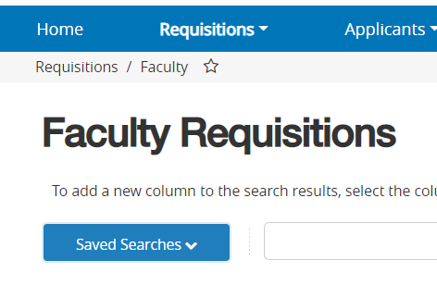
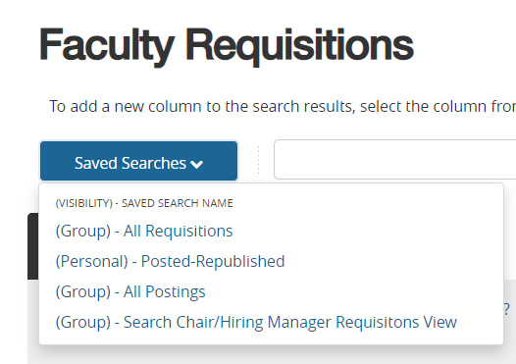
Finding Your Items in UAB PeopleAdmin
Click Saved Searches
You can view all of your active requisitions here; including DRAFTS

Slide 18
Resources
Creating a Requisition: One Page How To Guides for Requisitions
Creating a Hiring Proposal: One Page How To Guide for Hiring Proposals
Credentialed Course Instructor Offer Letter Template: CCI Letter Template Irregular Appointment Assignment Category 04 - All Schools and Colleges
04 Irregular Faculty Offer Letter Template: Contingent Faculty Appointment Offer Letter Template
02 Full-time temporary Faculty Offer Letter Template: Non-Tenure Track Faculty Full-Time Temporary College and Academic Schools
Email facultyaffairs@uab.edu with any questions. We will add these to the FAQs.
THANK YOU

