Slide 1
New Faculty Data Form Info Sessions- How to Guide
Office of the Provost
Updated, November 2020

Slide 2
Introduction to the faculty data form
Dear Faculty Data Form User,
The slides included in this PowerPoint presentation provides you with instructions for completing and submitting a Faculty Data Form (FDF). And, you will find additional information about the purpose of the form, the functions, and how to navigate the new form and dashboard.
Thank you for reviewing this information.
Faculty Affairs
Office of the Provost

Slide 3
Content
UAB Faculty Data Form Overview
Current Faculty Data Form
Transition & Implementation Schedule
New Form Features and Functionality
Creating A Faculty Data Form
Q&A

Slide 4


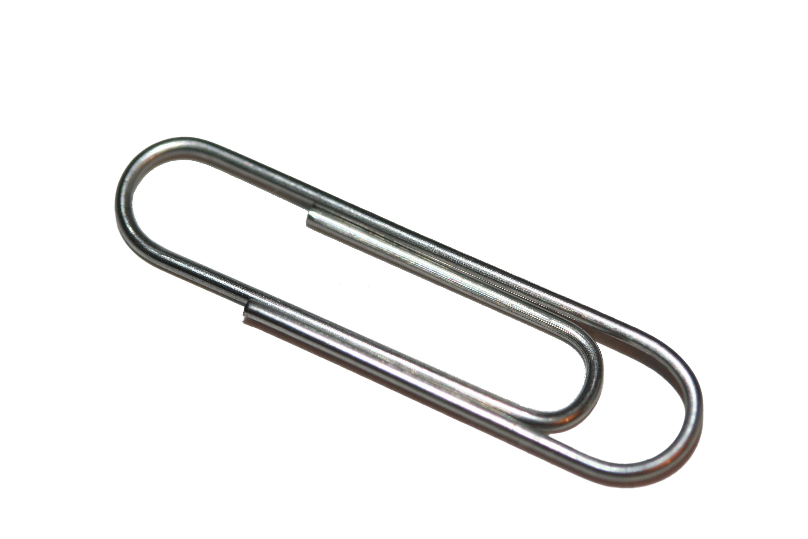
FDF – Primary Functions
Primary Data Entry Form
Primary/Secondary Appointments
Center and Administrative Appointments
Tenure Status
Query View Form
Self-Service View Form
Administrative Views
Additional Features
Attachments
Workflow Approval Routing via WAM
Dynamic Approval Routing

Slide 5
Form Content Overview
Earned Degrees/
Certification
Degree
Discipline
Location
Primary
Appointment
Rank
School or College
Appointment Type
Appointment Length
Secondary Appointment
Appointment Date
School or College
Center Appointment
Position Title
Date Appointed
School or College
Administrative Appointment
Position Title
Date Appointed
School or College
Tenure Status
Initial Appointment Date
Tenure Award Date
Tenure Review Date

Slide 6
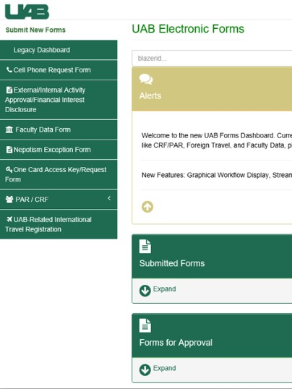
What’s New On the Faculty Data Form?
Look-and-feel
Navigation
Named Title Field
Field Lockdown
Different Functionality
Center and Secondary Appointments Approvals
Graduate School Appointments
Editing capabilities for Central Administration
Help Tools (Hover Overs)
Document Cancel
Graphical Workflow Display

Slide 7
Available Functionalities
Printing/Print View
Uploading Docs/Attachments
Admin Reports
Email Notifications
Dashboard
Form Cancel
Transaction Types Screen
FAQs with Search Filter
Return to Requestor

Slide 8
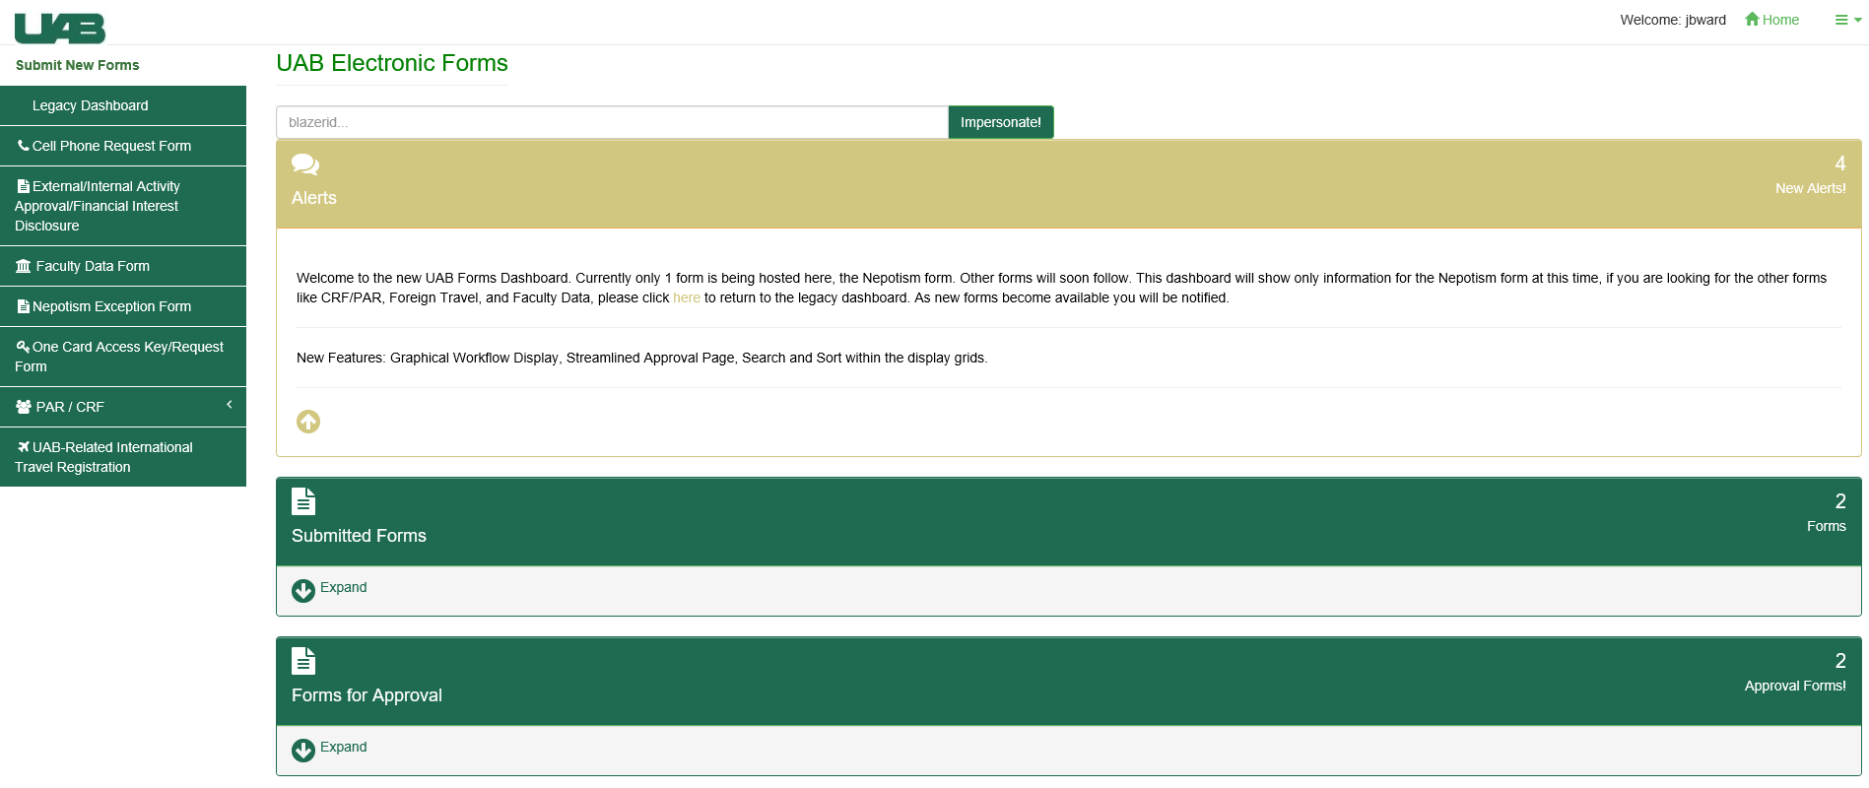
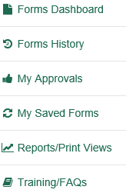
Dashboard & Navigation
Dashboard Menu
Impersonate Feature
Submitted Forms
Forms for Approval

Slide 9
How To Create The FDF?
Choose To Begin New FDF

Slide 10
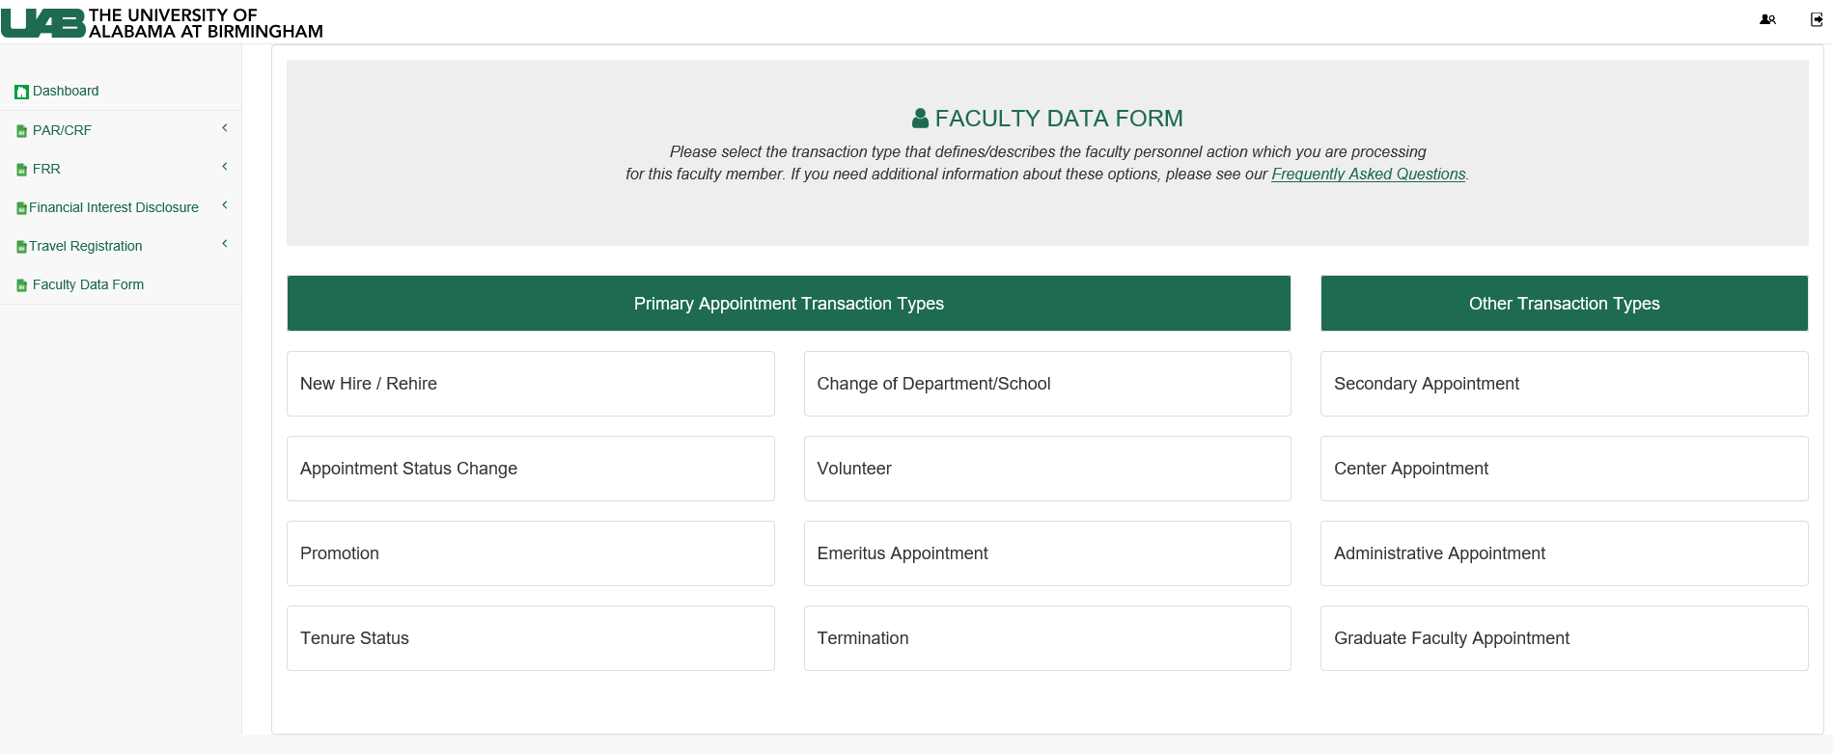
Main FDF Landing Page

Slide 11
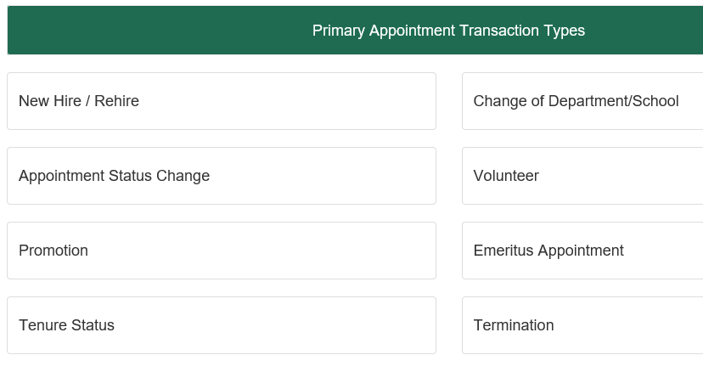
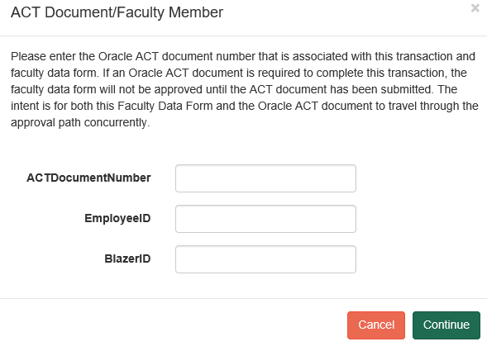
How To Create The FDF?
Enter ACT Document Number
Select Transaction Type

Slide 12
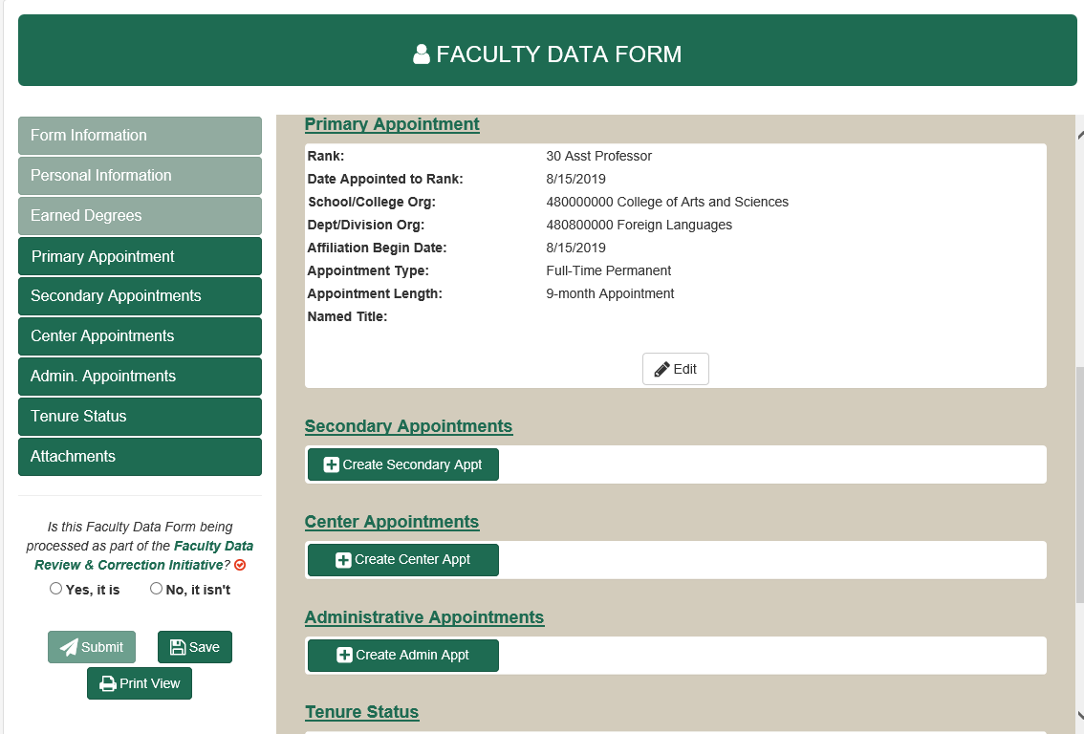
Faculty Data Form Available Fields
Available fields will be related to Transaction Type selected

Slide 13
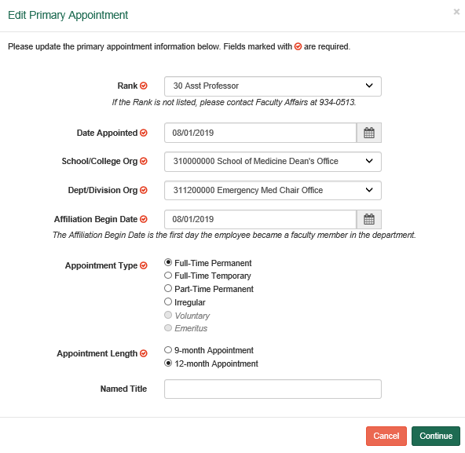
Faculty Data Form Data Entry

Slide 14
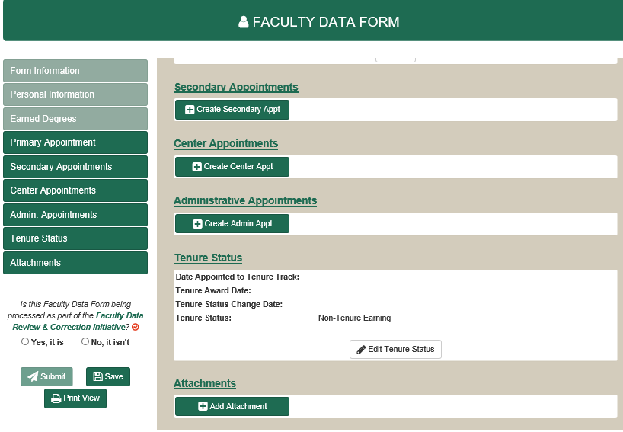
FACULTY DATA FORM DATA ENTRY

Slide 15
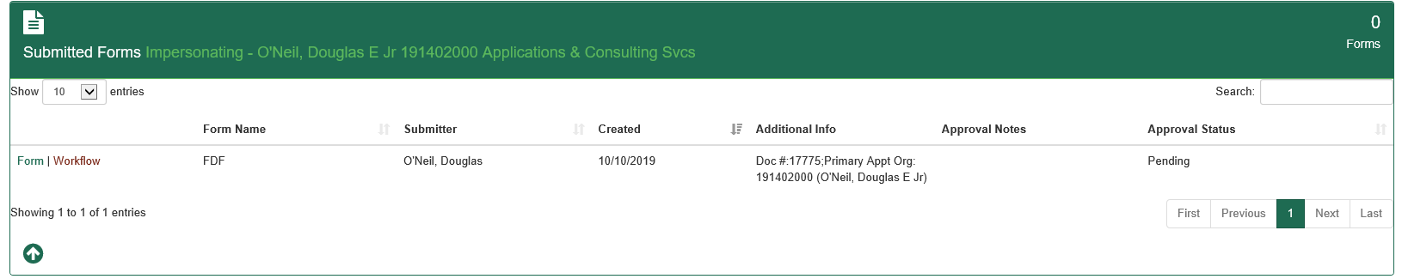
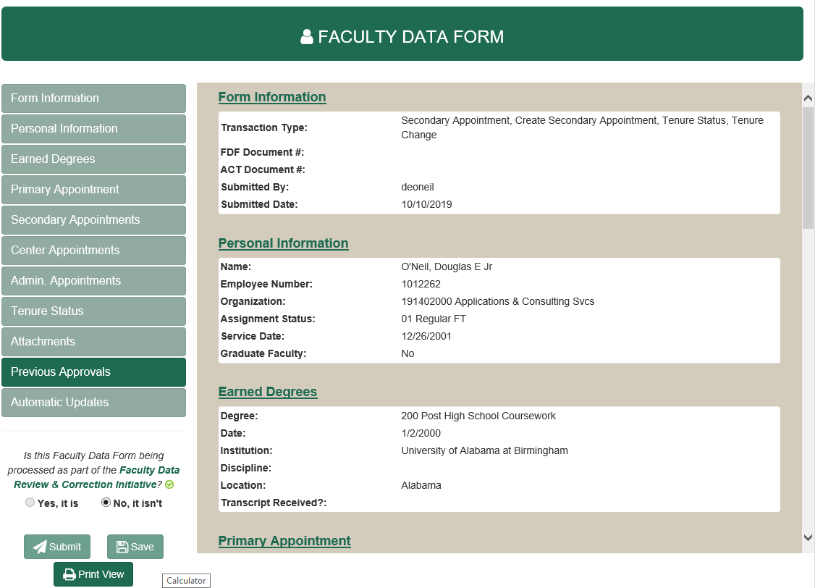
Faculty Data Form – Form View
View Submitted Form

Slide 16
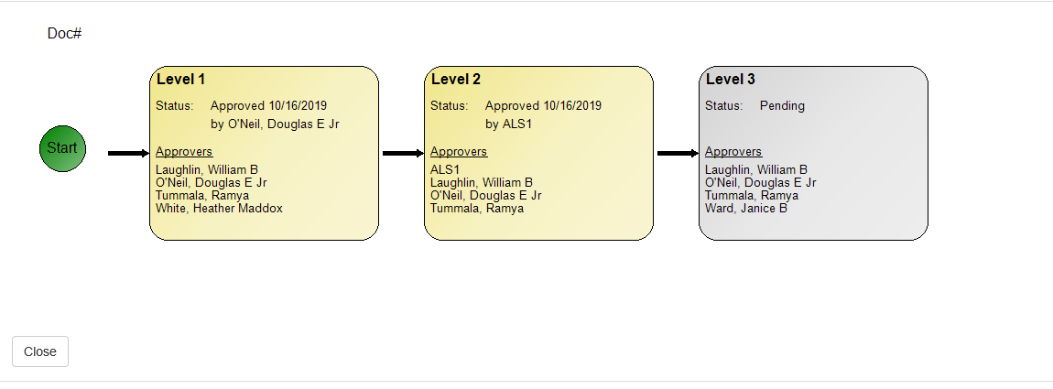
Faculty Data Form – Workflow View
View Form in Workflow

Slide 17
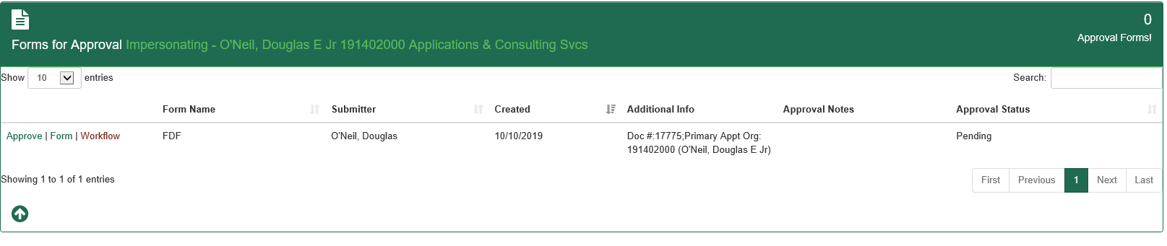
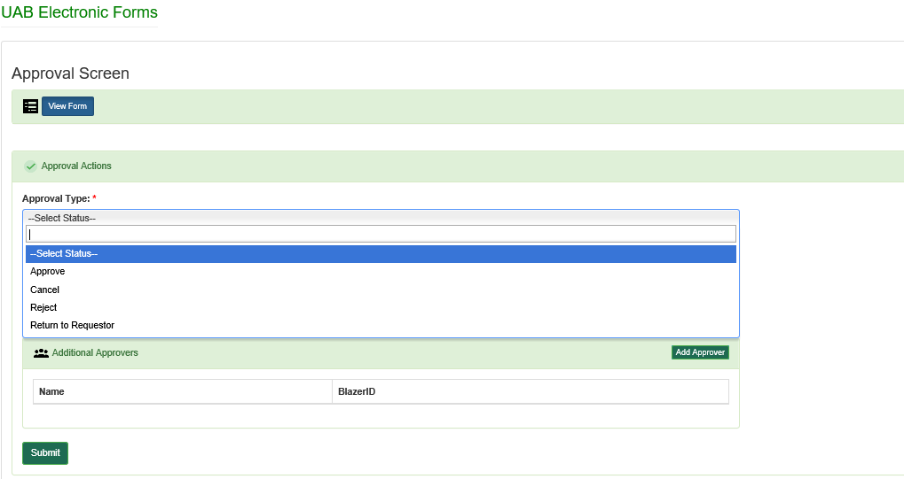
Faculty Data Form – Approve And Submit
To Approve
Select Approval Type
Submit Form (Approved)

Slide 18
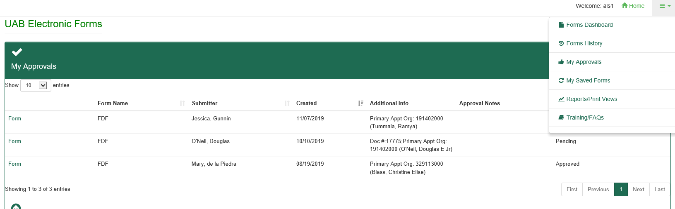
Faculty Data Form – My Approvals
Select To Review Forms You Have Approved
Opens Faculty Data Form
(Read-Only)

Slide 19
FAQs
Will I be able to see old/legacy FDFs that were completed before the new form?
Yes. A Legacy Dashboard will be available on the Forms Dashboard.
What if I have forms in process at the time of the switch over?
Any outstanding or pending FDFs at the time of the switch-over will be approved in the old UAB Forms system. After December 8th, any outstanding FDFs will need to be redone/resubmitted in the new FDF Forms System.
What is the ‘Named Title” field?
This is a new field that corresponds with an Oracle/ACT field by the same name. It allows faculty members to include additional descriptors for their titles (Kirby I. Bland, M.D., Endowed Professorship in Surgery)

Slide 20
FAQs Continued
I have never processed a FDF for Graduate School Appointments. Why did that change?
Allowing each department to add the Graduate School appointment information to the Faculty Data Form streamlines and expedites the process. Before now, this option was not available on the FDF. Additional instructions for this feature will be addressed in training.
How does this impact the Faculty Data Correction Project that is in process?
Any Faculty Data Form that has been submitted prior to implementation of the new form can be approved in the old system through December 8, 2019.

Slide 21
FAQs Continued
What if I have not completed all of the FDFs that I need to do for the Faculty Data Correction Initiative?
Beginning November 25, 2019, if you need to submit FDFs as part of the Faculty Data Clean-Up process, you will submit those FDFs in the new system.
How do I access the new FDF?
From UAB Forms on Admin Systems Page; just like now.
Did the center and secondary appointments process change?
Yes. The new workflow allows secondary and center appointments to bypass approval steps and move to HR. Departments will receive notifications.
Will I have access to report views for FDFs in my unit?
Yes. Links to various report views will reside on your dashboard.

Slide 22
Information from roll out of new form in 2019

Slide 23
Transition Plan & Implementation Schedule
Process FDFs in new system
Last Day to approve old FDFs
Old FDF Closes
11/22
11/25
12/8
12/31
New FDF Available
Old FDF will be retired

Slide 24
What Stays the same?
Same Purpose
Same Process
Same Requirements (see HR Transaction Documents Guide)
Same Attachments
Same Workflows (except center/secondary)

Slide 25
Why Change The Faculty Data Form Now?
Electronic Form implemented in 2012
University moving forms to new platform
Opportunity to enhance form and process
FDF moves faculty appointment data to Oracle and other downstream systems

Slide 26
Information & Resources
Need Assistance?
FAQs
ASK IT (askit@uab.edu or 6-5555)
Faculty Affairs Team at facultyaffairs@uab.edu or 4-0513

Slide 27
Thank You!

