Slide 1
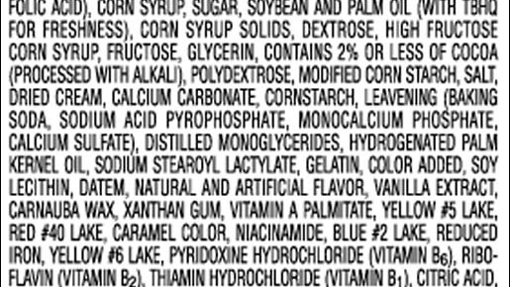
Ingredients Not listed:
An Emerging Drug Contaminant
Brett Cooke, BS; Parth Patel, MD;
Carlos Estrada, MD, Ms; Starr Steinhilber, MD, MPH
Notes:
Thank you everyone for being here. My name is Brett Cooke, and I am an MS4 in the UAB Heersink School of Medicine.
I am presenting a case today that I saw when rotating on the general medicine teaching service as an acting intern

Slide 2
Learning Objectives:
Recognize the clinical presentation of an emerging drug contaminant
Avoid anchoring and reevaluate the diagnosis when the clinical syndrome doesn’t fit
Notes:
The two main learning objectives for today are:
Recognize the clinical presentation of an emerging drug contaminant
AND
2. Recognize the importance of avoiding anchoring and need to reevaluate the diagnosis when a clinical syndrome does not fit

Slide 3
51-year-old man, HFrEF, colon cancer in remission, previous UE line-associated DVT on apixaban, unilateral nephrectomy (donor)
OSH w/ SOB → HFrEF exacerbation (EF of 25%)
CHF improving
New LE skin lesions
Skin lesions worsened: small dark bullae → increase in # → large and confluent
Surgery - graft likely needed
Day 0
Day 2
Day 7
Day 14
Platelet 14K (nadir)
New LLE DVT
HIT Score 4
Heparin d/c → Apixaban
Diuresis
IV Heparin
Worsening thrombocytopenia (110K)
Transferred to UAB
Notes:
- Our patient was a 51yoM w/ ….
- Prior to coming to us, he presented to an OSH with a HFrEF exacerbation and was diuresed – with his history of a prior DVT thought to be related to a line placement from a previous admission, he was placed on heparin for anticoagulation
- Clinical improvement with diuresis, but developed new LE skin lesions – initially small dark bullae over right shin
- He also started developing worsening thrombocytopenia around this time – his admission platelet count was 110K
- Over the next few days the lesions worsened on his leg with increase in number and size until they became confluent
- His platelets also continued to downtrend until day 7 of hospitalization with a nadir of 14,000 – platelets began to uptrend after this
- Also noted to have a new LLE DVT and intermediate risk HIT Score (4) – changed to Eliquis 2/2 concern for HIT
- Continued management at OSH, but gen surg believed he made need grafting so transferred to UAB

Slide 4
Physical Exam
Vitals: HR 110, RR 19, BP 100/74, SpO2 98, Temp 36.3
General: Alert and oriented, no acute distress
HEENT: Normocephalic, clear conjunctiva
CV: Tachycardic, normal peripheral perfusion, no LE edema
Pulm: LCTA bilaterally
Abd: Soft, non-tender, non-distended
Notes:
- Aside from lower extremity lesions, the patient came in with a rather benign physical exam
- He was mildly tachycardiac and had soft pressures throughout the admission, but vitals were largely unimpressive on admission
- Physical exam was also largely normal aside from the skin lesions on his lower extremities
- Large ulceration from his anterior R shin to dorsal right foot with black eschar present as well as a similar, smaller ulcerated plaque on the left leg --- borders were clean, no purulent discharge

Slide 5
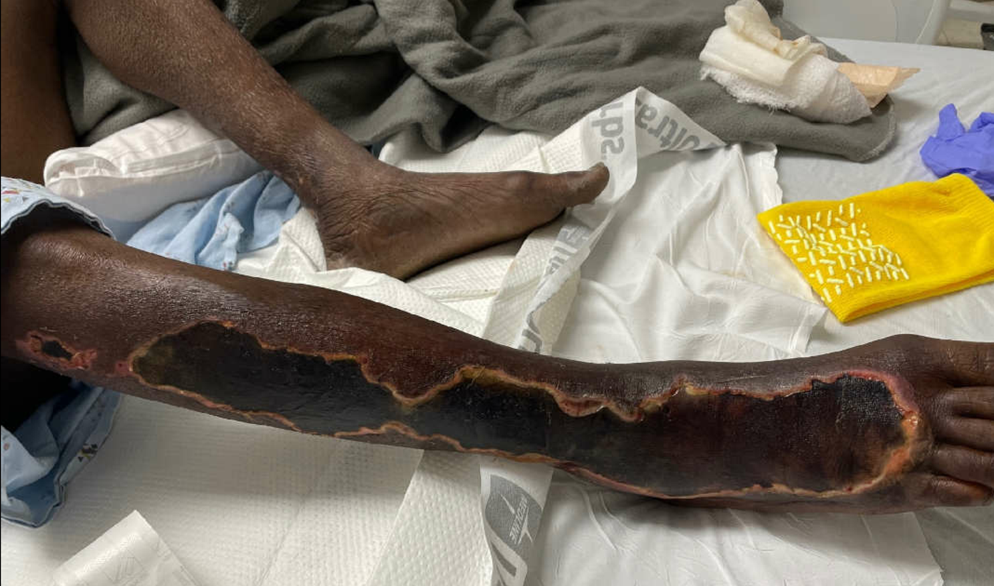
Skin: Ulcerated plaque extending from lateral lower leg to dorsal right foot with eschar, clean borders, no purulent drainage
Notes:
As I mentioned before, the lesion had irregular, but very clean borders and there was no purulent drainage from the wound

Slide 6
Labs
9.7
BNP – 1626
Mg – 1.6
Albumin – 2.1
138
98
21
9.2
272
143
3.7
31
0.9
28
Neutrophils – 68
Abs Neutro. – 6.22
Lymphocytes – 11
Abs Lymph. – 1.1
Monocytes – 14
Alk Phos – 378
ALT – 86
AST – 120
Total Bilirubin – 4.3
DB – 2.6
IB – 1.7
Notes:
- You can see the patient’s labs on admission here
- The majority of these lab abnormalities are thought to be secondary to his severely reduced cardiac function and secondary cardiac cirrhosis and congestive hepatopathy
- No leukocytosis present on admission – did not develop

Slide 7
Differential Diagnosis
Ecthyma Gangrenosum
Pyoderma Gangrenosum
Vasculopathy
  Vasculitis
  Infarction
  Venous Ulceration 2/2 chronic venous insufficiency
HIT Induced Skin Necrosis
Primary Infection
Notes:
We had a broad differential for the etiology of this patient’s leg lesions when he presented to our hospital
As you can see, our differential included more systemic causes and some local processes
Ecthyma gangrenosum – ulcerative lesion that develops in the setting of bacteremia, most commonly with pseudomonas
Pyoderma gangrenosum – can manifest as very painful and rapidly progressive lesions, and can commonly present on the extensor surface of the lower limbs

Slide 8
Teams Involved:
GIM – primary resident team, vasculitis workup
Dermatology – punch biopsies, wound care
Infectious Disease – wound eval, antibiotic management
Burn – wound eval, wound care
Vascular Surgery – vascular workup, no intervention
General Surgery – bedside debridement
Hematology – HIT workup, anticoagulation recs
Notes:
GIM – main teaching service – managed patients care while working with multiple consultants
Derm – evaluated wounds, performed punch biopsies, and helped to decide wound care management
ID – wound eval and antibiotic management
Burn – wound eval and wound care management along with dermatology
Vascular surgery – worked patient up for potential vascular process leading to lesions
General surgery – bedside debridement's
Hematology – HIT workup and gave anticoagulation recs in the setting of questionable HIT

Slide 9
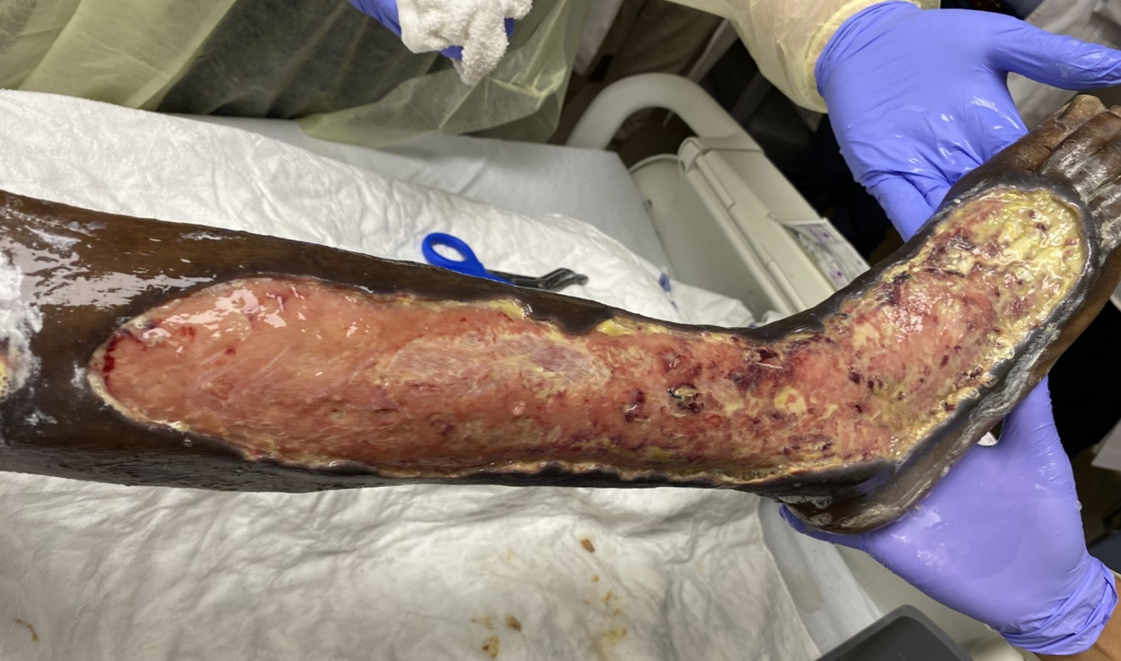
Notes:
Here you can see a picture of the patient’s RLE ulceration s/p bedside debridement with general surgery.
- You can see there are very clean borders, and the yellow tissue seen in the image was granulation tissue, not any sort of purulence
- After the debridement, derm and burn continued to lead on wound care

Slide 10
Results of Workup
Punch biopsies non-specific, no evidence of vasculitis
Vasculitis panel negative
Wound cultures – polymicrobial, put on empiric abx
CTA w/o significant atherosclerosis – no intervention
HIT Score intermediate/high risk, HIT Ab (-), no LE DVT, UE DVT (residual)
Notes:
- You can see the main results of our workup here
- Punch biopsies were nonspecific for any specific pathology, no evidence of vasculitis on biopsy or lab workup
- wound cultures were polymicrobial, but ID did not believe infection was primary source – he did complete an antibiotic course
- Vascular surgery ordered a CTA of the lower extremities that did not show any significant atherosclerosis and had good blood flow distally
- Hematology worked up patient for HIT – presentation at OSH combined with thrombocytosis present at our institution, HIT Ab negative, and only a residual LIJ DVT present (the one thought to be from a previous line) –overall, low concern for HIT – no SRA/PEA

Slide 11
Differential Diagnosis:
Ecthyma Gangrenosum
Pyoderma Gangrenosum
Vasculopathy
  Vasculitis
  Infarction
  Venous Ulceration 2/2 chronic venous insufficiency
HIT Induced Skin Necrosis
Primary Infection
Notes:
Ecthyma gangrenosum - Biopsy of ecthyma gangrenosum lesions typically shows hemorrhagic necrosis, gram-negative bacilli, and damage to the media of arterial blood vessels [19]. Most patients have fever and may be systemically ill
Pyoderma gangrenosum – no associated systemic disorder of note, dermatology did not favor pyoderma
Vasculitis – lab workup negative, no evidence on biopsy
Infarction – CTA LE w/ good flow
Venous Ulceration – acute process
HIT induced skin necrosis – HIT Ab negative, hematology not convinced presentation consistent with HIT, also lesions usually present at injection site
Primary infection – not consistent with clinical picture

Slide 12
New Hypothesis
Workup negative
Consultant discussed potential drug contamination
Additional history – patient used cocaine 2 days prior to presentation to OSH
Further literature review
  Xylazine vs. Levamisole
Notes:
- With our original list of differentials all knocked down in terms of likelihood, we had to reassess our approach
- Consulting services continued to discuss the patient, and one consultant brought up that they remember hearing about an illicit drug contaminant that had grown in prevalence over the last few years could cause similar lesions
- With this information, we went back and talked to the patient about his drug use and found out that he used cocaine 2 days prior to his presentation to the OSH
- Further literature review continued to bolster this hypothesis and led us to add xylazine and levamisole illicit drug contamination to our differential

Slide 13
Xylazine vs. Levamisole
Xylazine
Use: Veterinary Tranquilizer
Levamisole^{3*,4*, 5*}
Use: Veterinary Anti-Parasitic
Drug Mixtures: Fentanyl (mostly) – also detected in cocaine and heroin¹
  Fentanyl adulterated cocaine^{2*}
Drug Mixtures: Cocaine
Lesion Locations: Extremities
Lesion Locations: Nose, ears, cheeks, extremities
Labs: Not characterized
Labs: leukopenia, neutropenia, + ANA, and + ANCA
Biopsy: Not characterized
Biopsy: Variable - ranging from leukocytoclastic vasculitis to occlusive vasculopathy
Notes:
- Workup negative for: leukopenia and neutropenia and w/ (-) ANA, p-ANCA, c-ANCA
- Biopsy negative for vasculitis and occlusive vasculopathy

Slide 14
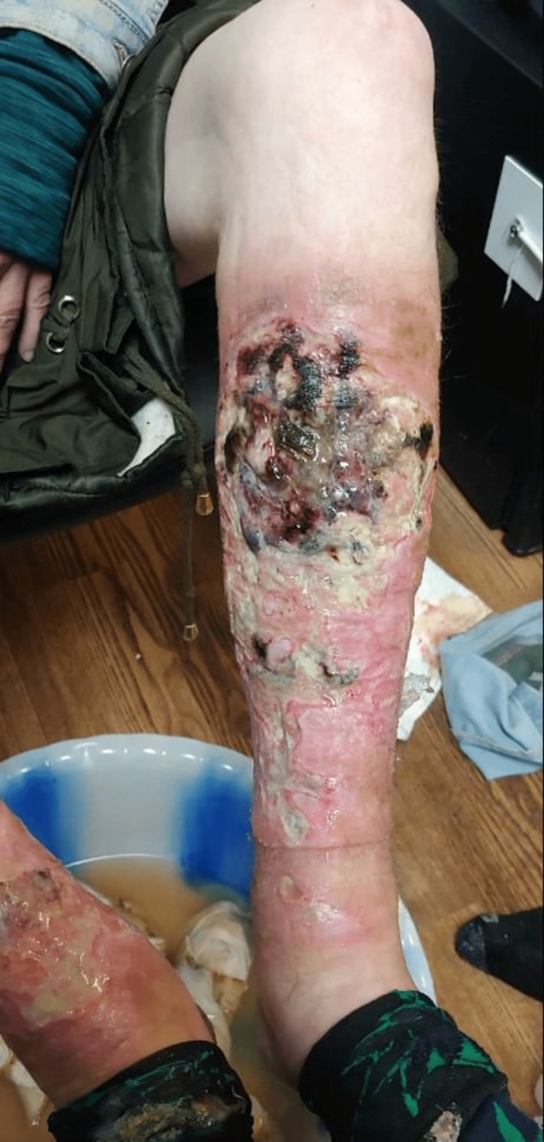
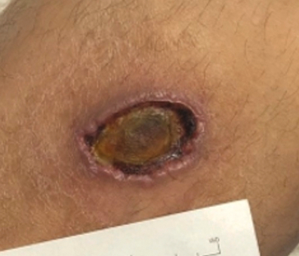
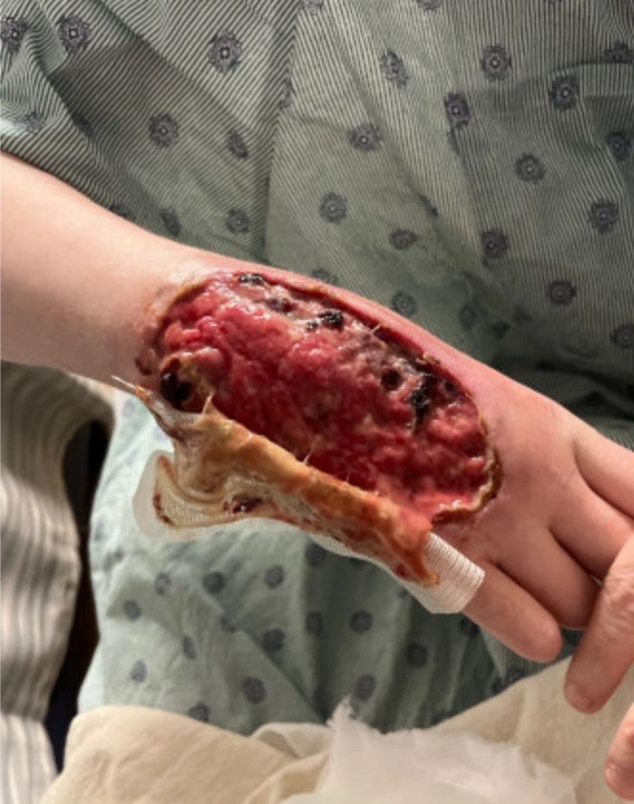
Xylazine-induced acute skin necrosis in two patients who inject fentanyl. JAAD Case Rep. 2023;36:113-115.
Xylazine-Induced Skin Necrosis
Xylazine (“Tranq”): The Potential for Loss of Life and Limb, American Academy of Dermatology. 2022 Dec 7.
Xylazine-Induced Skin Ulcers in a Person Who Injects Drugs in Philadelphia, Cureus. 2022 Aug 19.
Notes:
- You can see some skin lesions that have been documented in the literature thus far
- one the left you can see a larger lesion that was complicated by cellulitis
- In the middle and right of the screen you can see more typical well circumscribed lesions that can cause significant ulceration and tissue necrosis

Slide 15
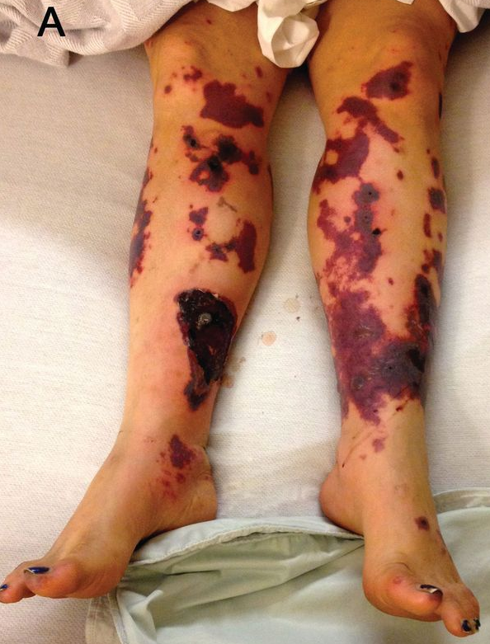
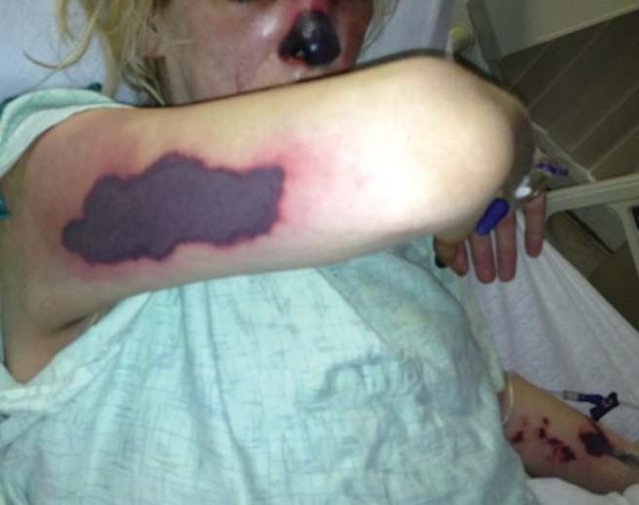
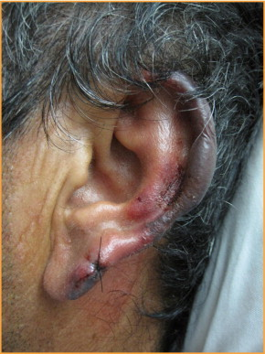
Lawrence LA, Jiron JL, Lin HS, Folbe AJ. Levamisole-adulterated cocaine induced skin necrosis of nose, ears, and extremities: Case report. Allergy Rhinol (Providence). 2014;5(3):132-136. doi:10.2500/ar.2014.5.0101
Ezra Hahn and Isaac I. Bogoch. Levamisole-induced Vasculitis in a Cocaine User. The Journal of Rheumatology. October 2015, 42 (10) 1924-1925; DOI: https://doi.org/10.3899/jrheum.150027
Lee KC, Ladizinski B, Federman DG. Complications associated with use of levamisole-contaminated cocaine: an emerging public health challenge. Mayo Clin Proc. 2012;87(6):581-586. doi:10.1016/j.mayocp.2012.03.010
Levamisole-Induced Skin Necrosis
Notes:
- Tender, purpuric rash in a retiform distribution with erythematous borders and necrotic centers
- large, painful hemorrhagic bullae and/or necrosis

Slide 16
Xylazine
A veterinary tranquilizer, increases drug yield and potency^{1,6}
Growing prevalence of xylazine contamination
  Xylazine-fentanyl combinations in 48 states⁷
  One study found xylazine in 80% of opioid samples tested⁸
Mechanism – α-2 agonist, decreases sympathetic tone⁶
Severe vasoconstriction may cause significant skin necrosis^{6,9,10}
Notes:
- Xylazine – large animal anesthetic – horses and cattle
- Over the last few years, xylazine contamination in the illicit drug supply has become more and more common, with some studies reporting it being found in xylazine-fentanyl combinations in 48 states and in 80% of opioid samples tested in one study done in Maryland
- Xylazine acts as an alpha-2 agonist and decreases sympathetic tone
- There has been a growing amount of literature documenting skin lesions associated with xylazine contamination – while the exact mechanism of these skin lesions isn’t nailed down, it is thought that severe vasoconstriction may contribute to significant skin necrosis

Slide 17
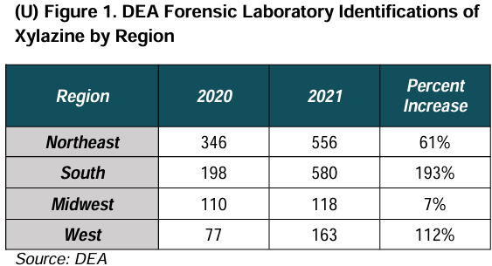
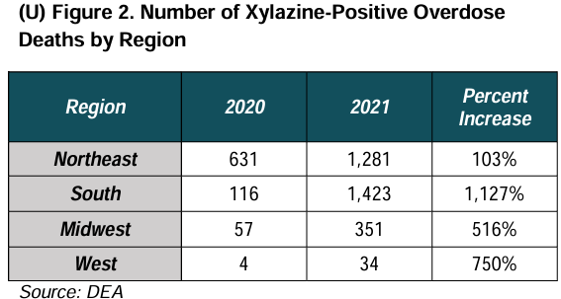
Xylazine
“The Growing Threat of Xylazine and its Mixture with Illicit Drugs” DEA Joint Intelligence Report, October 2022
Notes:
- As I mentioned before, the prevalence of xylazine in the illicit drug supply is growing
- The Northeast, and specifically Philadelphia, were noted to have large amounts of xylazine before the rest of the country – but as you can see, it has been rapidly spreading
- On the left, you can see the number of xylazine identifications made by forensic testing in the south increased by 193% between 2020 and 2021
- On the right, you can see an even more remarkable trend with xylazine-positive overdose deaths increasing by over 1000% in the South
- The south had the highest rate of change of all the regions between 2020 and 2021

Slide 18
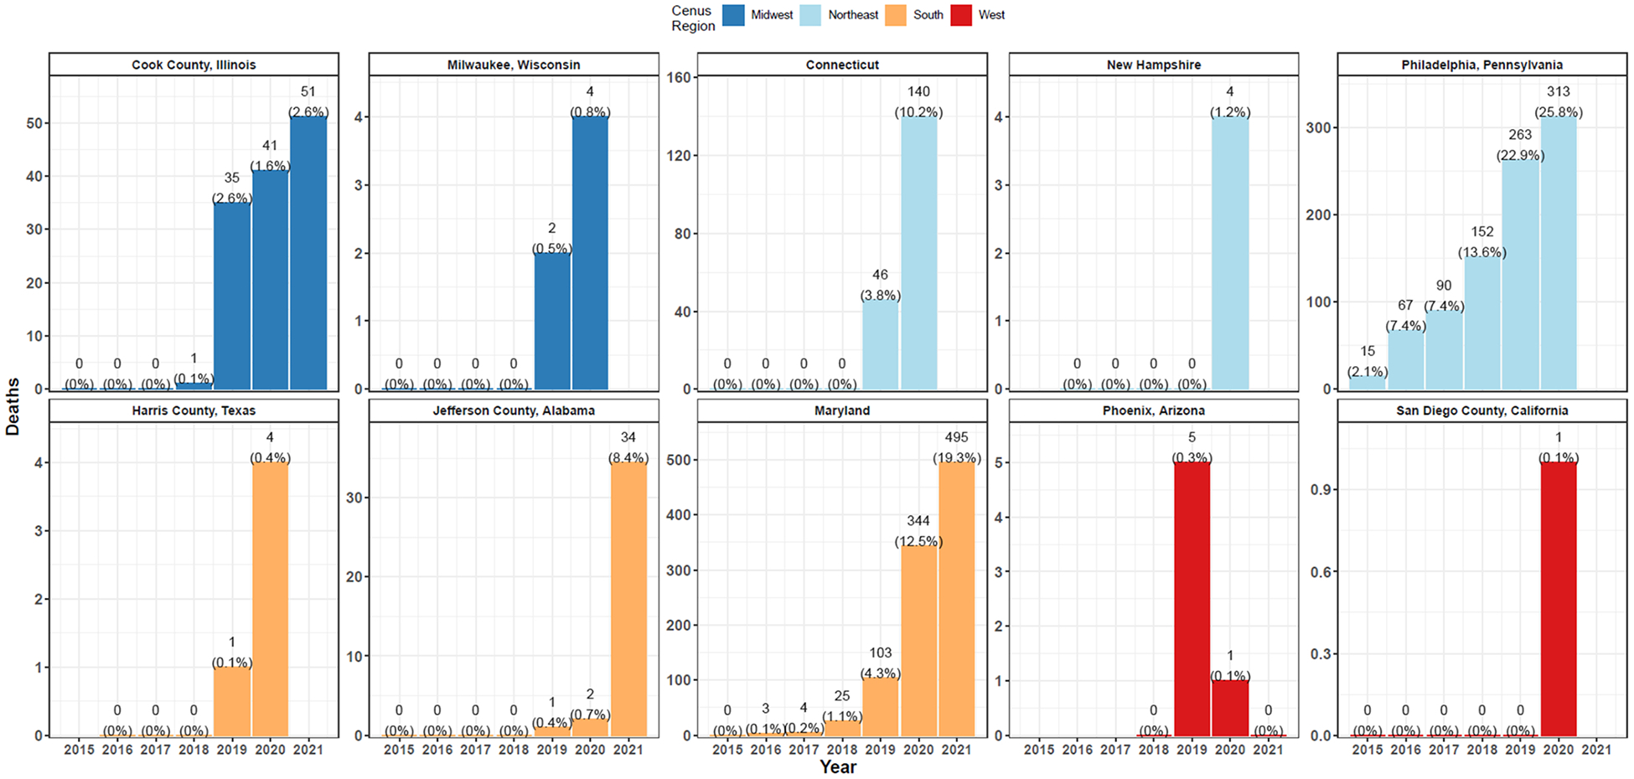
Xylazine-Present Overdose Deaths by Jurisdiction and Year. Xylazine-present deaths are show as counts and as a percent of all overdose deaths in text
Friedman J, Montero F, Bourgois P, et al. Xylazine spreads across the US: A growing component of the increasingly synthetic and polysubstance overdose crisis. Drug Alcohol Depend. 2022;233:109380. doi:10.1016/j.drugalcdep.2022.109380
Notes:
- Similar to the last slide, you can see that the rates of xylazine present overdose deaths has been increasing across the country
- The literature does not have consensus right now on if xylazine is associated with higher overdose risk when combined with other illicit drugs, but this still does serve as a good metric for the increase in prevalence across the country
- Here with the red star, you can actually see Jefferson County, Alabama included in the study, which is the county where UAB is located

Slide 19
Xylazine
Detection
  Not detected on standard urine drug screens
  Test strips being developed, utility still being determined¹³
Management⁶
  Supportive wound care, debridement
  Grafting
  In severe cases, amputation of necrotic limbs
Notes:
- Detection remains limited outside of forensic laboratory settings
- xylazine is not detected on standard urine drug screens, and we did not have access to the patient's drug sample to be able to test it
- Test strips are being developed, but their utility is still being determined with things like false positives and indeterminant results still being present
- Management is largely supportive with wound care, debridement, and grafting if needed
- in severe cases, some patients have been reported to require amputation due to the degree of necrosis of the limb

Slide 20
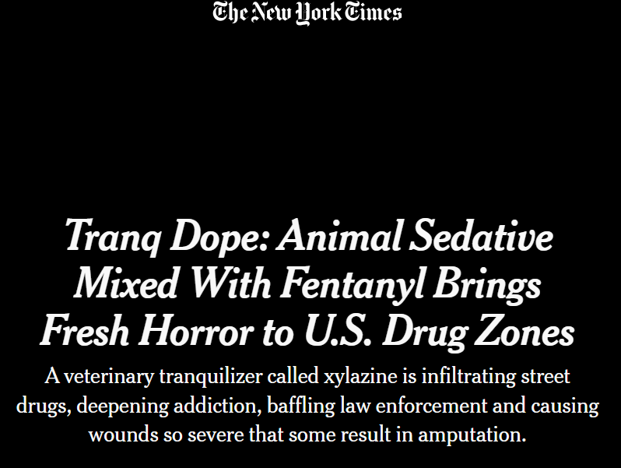
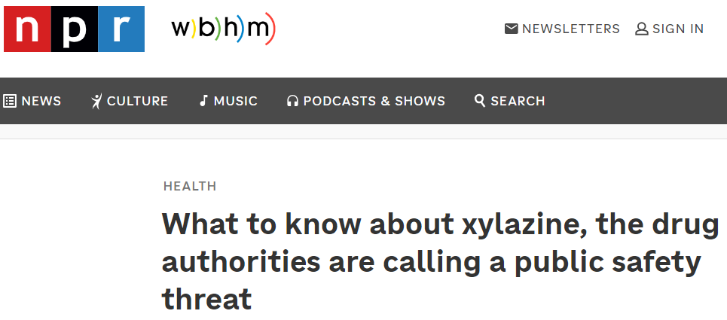
Xylazine
Treisman, Rachel. “What to Know about Xylazine, the Drug Authorities Are Calling a Public Safety Threat.” NPR, NPR, 21 Mar. 2023, www.npr.org
Hoffman, Jan. “Tranq Dope: Animal Sedative Mixed with Fentanyl Brings Fresh Horror to U.S. Drug Zones.” The New York Times, The New York Times, 7 Jan. 2023, www.nytimes.com/2023/01/07/health/fentanyl-xylazine-drug.html.
Notes:
- This is a growing problem, and it has started to gain national attention
- In 2023, both the New York Times and NPR published stories on the significant public health issue of xylazine contamination in the illicit drug supply
- Government officials are trying to crack down on the xylazine distribution and have stricter barriers and monitoring, but we likely still have a while to go

Slide 21
Case Resolution
Patient underwent bedside debridement
Addiction medicine, social work involvement
Discharged with wound care instructions
Followed up with burn team and cardiology outpatient
Skin grafting pending improvement of cardiac status
Notes:
- Back to the case, our patient underwent two bedside debridements – couldn’t sedate in the OR w/ cardiac status
- Had other services like social work and addiction medicine see him to help set up resources and we also discussed his cocaine use and its implications both for these skin lesions and for his heart health
- discharged with wound care instructions to him and his family
- followed up outpatient, awaiting grafting

Slide 22
Take Home Points
Clinicians should be aware of this emerging drug included in the illegal drug supply in the US and the symptoms/physical exam findings it causes
A thorough history and multi-disciplinary team approach led to the suspicion of this complication
Going to conferences like this is helpful!
Notes:
- A few main take home points we have
Clinicians should be aware of this emerging drug included in the illegal drug supply and its presentation
A thorough history and multi-disciplinary care are very beneficial when dealing with an unclear diagnosis
Going to conferences like this is helpful – the consultant who brought up xylazine had actually heard a talk about it a few months prior at a conference

Slide 23
References
“The Growing Threat of Xylazine and its Mixture with Illicit Drugs” DEA Joint Intelligence Report, October 2022
“Deadly Contaminated Cocaine Widespread in Florida (2018).” DEA, www.dea.gov/documents/2018/2018-02/2018-02-01/deadly-contaminated-cocaine-widespread-florida-2018. Accessed 16 Feb. 2024.
Lee KC, Ladizinski B, Federman DG. Complications associated with use of levamisole-contaminated cocaine: an emerging public health challenge. Mayo Clin Proc. 2012;87(6):581-586. doi:10.1016/j.mayocp.2012.03.010
Lawrence LA, Jiron JL, Lin HS, Folbe AJ. Levamisole-adulterated cocaine induced skin necrosis of nose, ears, and extremities: Case report. Allergy Rhinol (Providence). 2014;5(3):132-136. doi:10.2500/ar.2014.5.0101
Ezra Hahn and Isaac I. Bogoch. Levamisole-induced Vasculitis in a Cocaine User. The Journal of Rheumatology. October 2015, 42 (10) 1924-1925; DOI: https://doi.org/10.3899/jrheum.150027
D'Orazio J, Nelson L, Perrone J, Wightman R, Haroz R. Xylazine Adulteration of the Heroin-Fentanyl Drug Supply : A Narrative Review. Ann Intern Med. 2023;176(10):1370-1376. doi:10.7326/M23-2001
“DEA Reports Widespread Threat of Fentanyl Mixed with Xylazine.” DEA Reports Widespread Threat of Fentanyl Mixed with Xylazine | DEA.Gov, www.dea.gov/alert/dea-reports-widespread-threat-fentanyl-mixed-xylazine. Accessed 29 Jan. 2024.
Russell E, Sisco E, Thomson A, et al. Rapid Analysis of Drugs: A Pilot Surveillance System To Detect Changes in the Illicit Drug Supply To Guide Timely Harm Reduction Responses — Eight Syringe Services Programs, Maryland, November 2021–August 2022. MMWR Morb Mortal Wkly Rep 2023;72:458–462. DOI: http://dx.doi.org/10.15585/mmwr.mm7217a2
Heymann, MD, FAAD, Warren R. “XYLAZINE (‘TRANQ’): THE POTENTIAL FOR LOSS OF LIFE AND LIMB.” Xylazine (“Tranq”): The Potential for Loss of Life and Limb, American Academy of Dermatology, 7 Dec. 2022
Malayala SV, Papudesi BN, Bobb R, Wimbush A. Xylazine-Induced Skin Ulcers in a Person Who Injects Drugs in Philadelphia, Pennsylvania, USA. Cureus. Published 2022 Aug 19.
Rose L, Kirven R, Tyler K, Chung C, Korman AM. Xylazine-induced acute skin necrosis in two patients who inject fentanyl. JAAD Case Rep. 2023;36:113-115. Published 2023 Apr 26. doi:10.1016/j.jdcr.2023.04.010
Friedman J, Montero F, Bourgois P, et al. Xylazine spreads across the US: A growing component of the increasingly synthetic and polysubstance overdose crisis. Drug Alcohol Depend. 2022;233:109380. doi:10.1016/j.drugalcdep.2022.109380
Shuda SA, Lam HY. Characterization of Xylazine Test Strips for Use in Drug Checking. The Center for Forensic Science Research & Education; October 2022. Accessed at www.cfsre.org/images/ content/reports/drug_checking/ CFSRE_Xylazine_Report-Rev-1-18-23. pdfon29June2023.
Hoffman, Jan. “Tranq Dope: Animal Sedative Mixed with Fentanyl Brings Fresh Horror to U.S. Drug Zones.” The New York Times, The New York Times, 7 Jan. 2023, www.nytimes.com/2023/01/07/health/fentanyl-xylazine-drug.html.
Treisman, Rachel. “What to Know about Xylazine, the Drug Authorities Are Calling a Public Safety Threat.” NPR, NPR, 21 Mar. 2023, www.npr.org

Slide 24

Brett Cooke
Thank You!
If you have any questions, please feel free to reach out using the link below
UAB Heersink School of Medicine, MS4
bjc0056@uab.edu

Slide 25
Supplemental Information

Slide 26
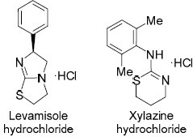
Derivatives of cyclic isothioureas
Cyclic Isothiourea in Drug Design. Chem Heterocycl Comp 57, 889–899 (2021). https://doi.org/10.1007/s10593-021-02996-2
Notes:
Clinically used derivatives of cyclic isothioureas
Nurieva, E.V., Alexeev, A.A. & Zefirova, O.N. Cyclic Isothiourea in Drug Design. Chem Heterocycl Comp 57, 889–899 (2021). https://doi.org/10.1007/s10593-021-02996-2

Slide 27
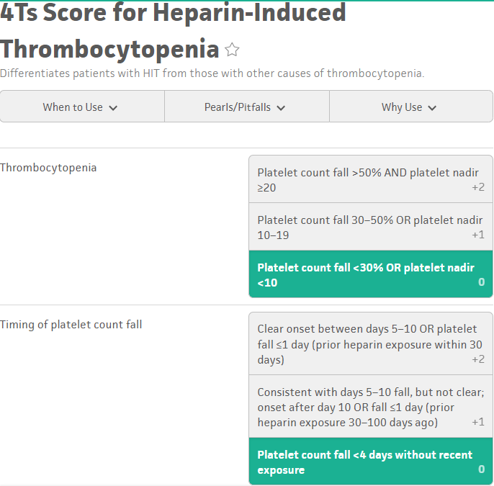
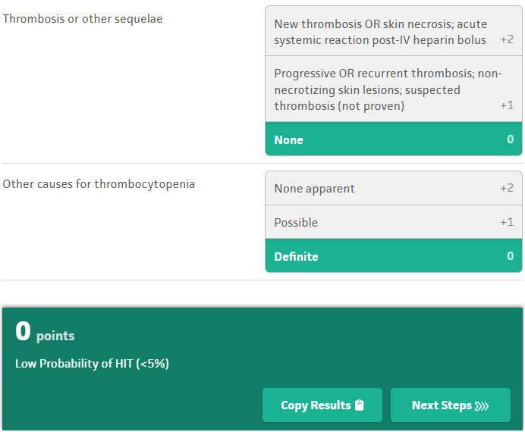

Slide 28
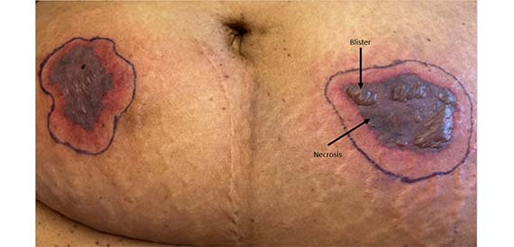
HIT-Induced Skin Necrosis
Notes:
- Tender, purpuric rash in a retiform distribution with erythematous borders and necrotic centers
- large, painful hemorrhagic bullae and/or necrosis

