Slide 1
Mastering Your EQ – Emotional Intelligence – The Differentiator for Life Success
Dr. Jean Ann Larson, FACHE, LFHIMSS, FIISE, DSHS
Leadership Development Officer
July 19, 2017

Slide 2
Agenda
Why EQ?
What is Emotional Intelligence?
How does EQ work?
What are the 5 parts of EQ?
Applications in your professional and personal life - Application practice
Debriefing the Report
Creating a personalized action plan to improve your EQ

Slide 3
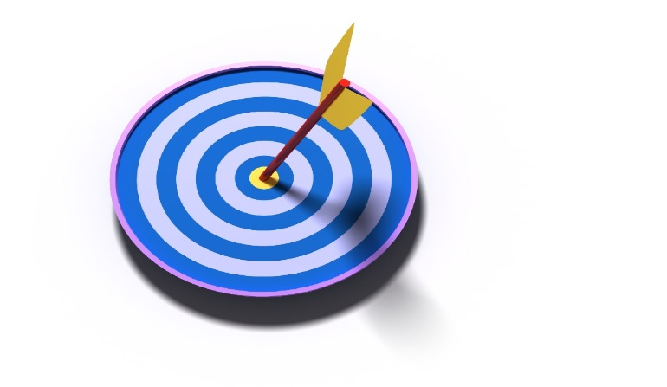
Objectives
Participants will gain an understanding of:
The Fundamentals of EQ
The Application of EQ in Your Personal and Professional Life
Practical Tools and Approaches to Improving EQ

Slide 4

Why EQ?
What if you had a tool or method to help you:
navigate interpersonal differences
manage change effectively, and
build strong relationships?
Notes:
Per Daniel Goleman, 90% of the difference between star performance and average performers in high levels of leadership can be explained by EQ (Goleman, 1995). Understanding the multifaceted aspects of EQ and learning how to develop our own EQ will help us develop wisdom in order to lead better personal and professional lives.

Slide 5
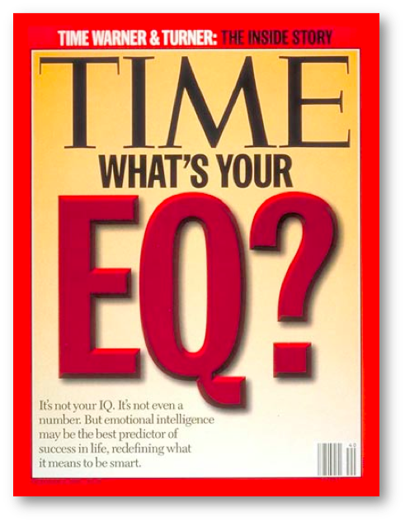

Slide 6
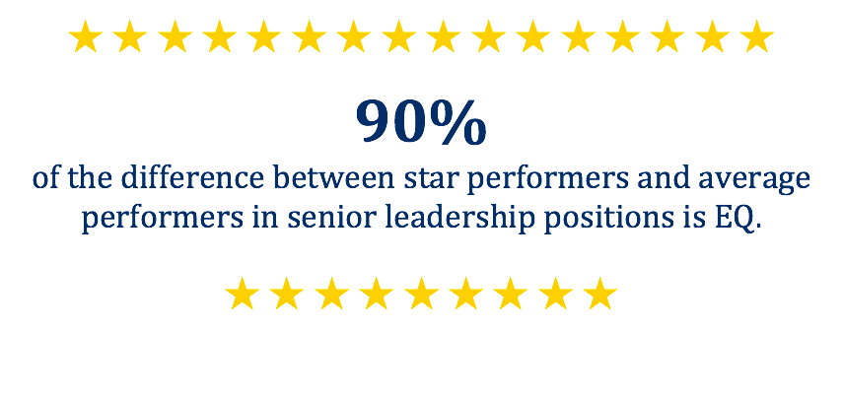
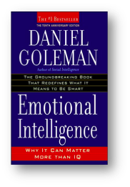
EQ Stats & Facts

Slide 7
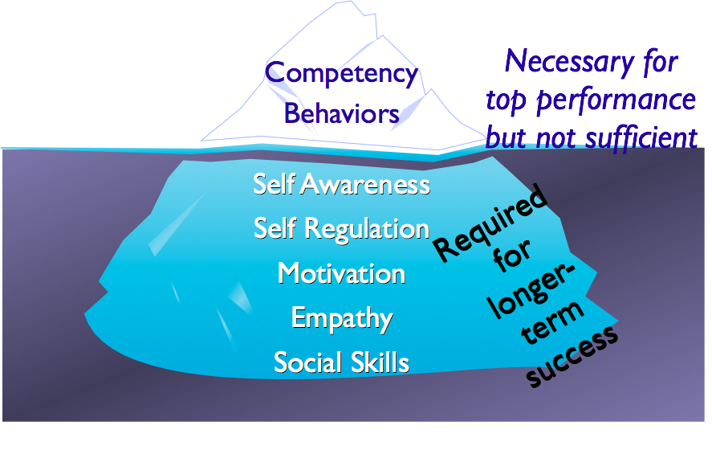
Traditional Focus

Slide 8
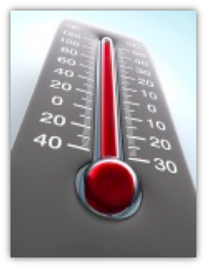
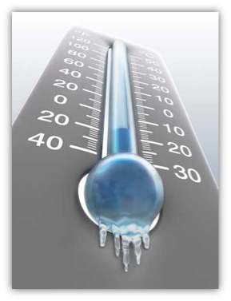
Take YOUR Emotional Temperature
Take your emotional temperature as you view the images.
Please number a piece of paper 1-13

Slide 9

1
Copyright © 2013. Target Training International, Ltd. under Licensing Agreement with Dr. Izzy Justice

Slide 10
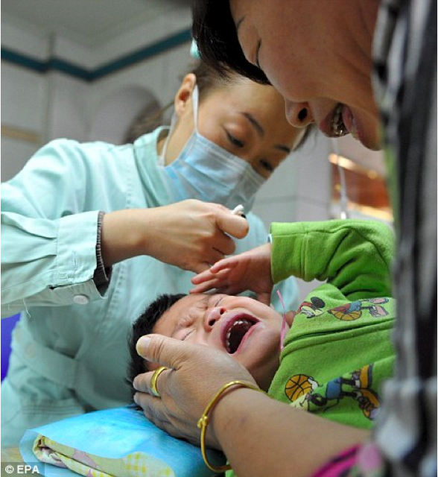
2
Copyright © 2013. Target Training International, Ltd. under Licensing Agreement with Dr. Izzy Justice

Slide 11
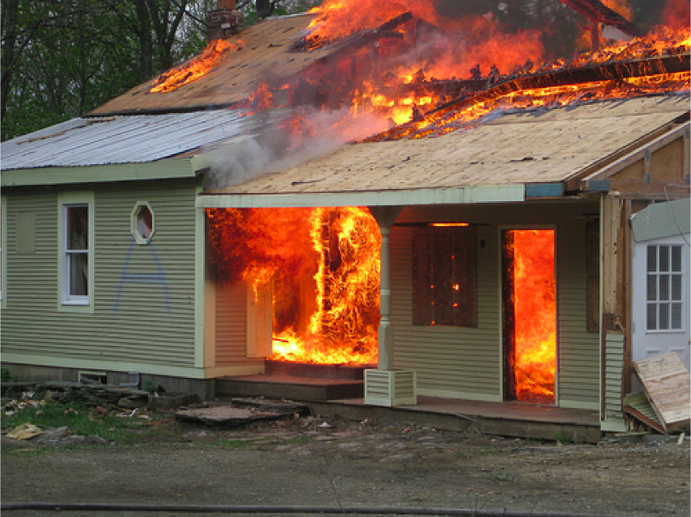
3
Copyright © 2013. Target Training International, Ltd. under Licensing Agreement with Dr. Izzy Justice

Slide 12
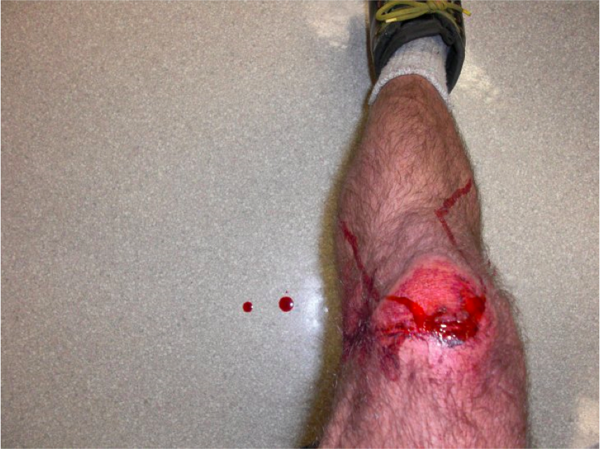
4
Copyright © 2013. Target Training International, Ltd. under Licensing Agreement with Dr. Izzy Justice

Slide 13
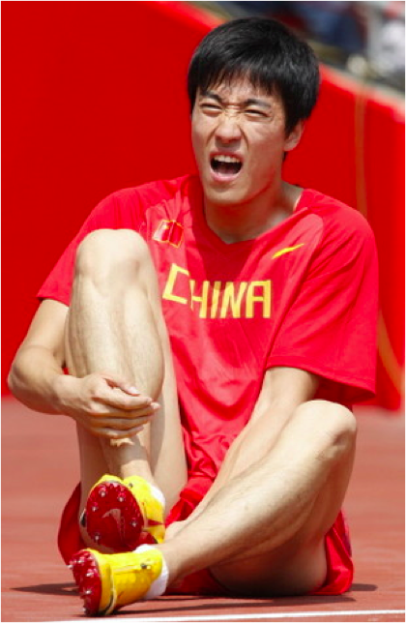
5
Copyright © 2013. Target Training International, Ltd. under Licensing Agreement with Dr. Izzy Justice

Slide 14

6
Copyright © 2013. Target Training International, Ltd. under Licensing Agreement with Dr. Izzy Justice

Slide 15

7
Copyright © 2013. Target Training International, Ltd. under Licensing Agreement with Dr. Izzy Justice

Slide 16
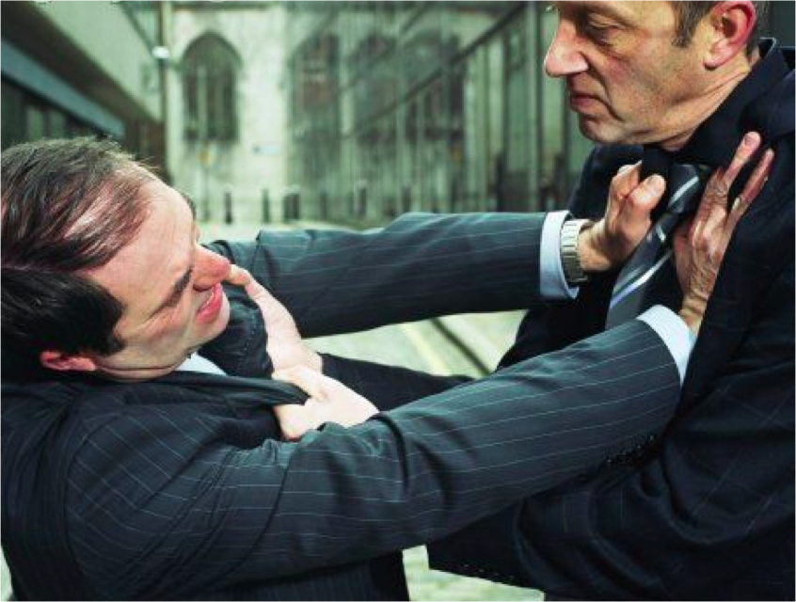
8
Copyright © 2013. Target Training International, Ltd. under Licensing Agreement with Dr. Izzy Justice

Slide 17

9
Copyright © 2013. Target Training International, Ltd. under Licensing Agreement with Dr. Izzy Justice

Slide 18
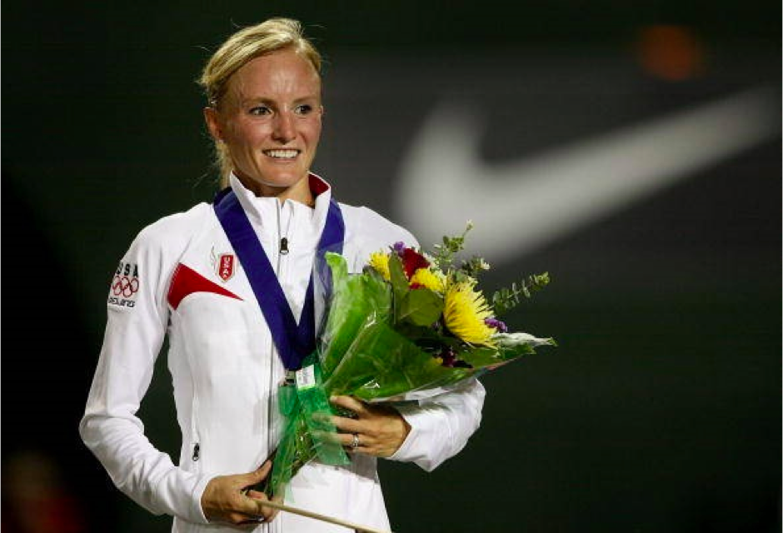
10
Copyright © 2013. Target Training International, Ltd. under Licensing Agreement with Dr. Izzy Justice

Slide 19
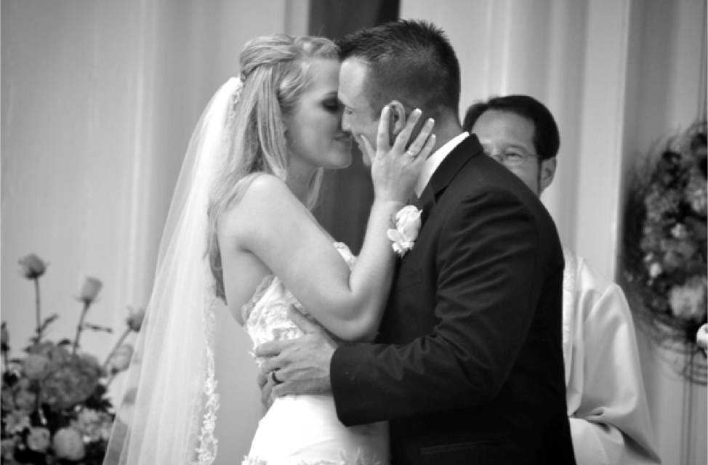
11
Copyright © 2013. Target Training International, Ltd. under Licensing Agreement with Dr. Izzy Justice

Slide 20
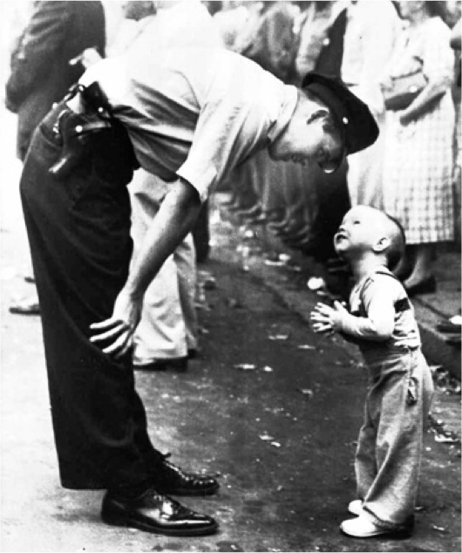
12
Copyright © 2013. Target Training International, Ltd. under Licensing Agreement with Dr. Izzy Justice

Slide 21

13
Copyright © 2013. Target Training International, Ltd. under Licensing Agreement with Dr. Izzy Justice

Slide 22

Reviewing the photos…
How do our responses compare?

Slide 23
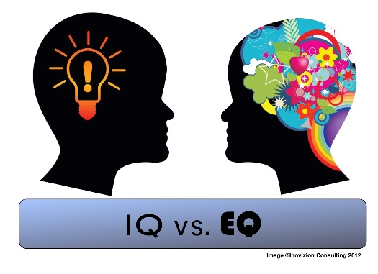
What is EQ?
“The ability to perceive and express emotion, assimilate emotion in thought, understand and reason with emotion, and regulate emotion in self and others.”
Mayer, J.D., Salovey, P., Caruso, D. R. (2000). Models of emotional intelligence as a standard intelligence. In R.J. Sternberg (Ed.), Handbook of intelligence (2nd ed., pp396-420). New York: Cambridge University Press.

Slide 24
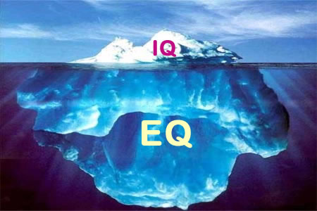
IQ v. EQ
Notes:
Some say that the key leadership competencies that allow you to tap your skills, competencies and talents are: self awareness (part of EQ) and personal accountability

Slide 25

Why is EQ Important?
EQ affects your:
Performance at work
Physical health
Mental health
Relationships
Ability to manage stress
Ability to process change

Slide 26

Change, Transition and EQ
Change is the stuff that happens to us (external).
Transition is how we respond to change.
Higher EQ helps us through transition more positively and productively.

Slide 27
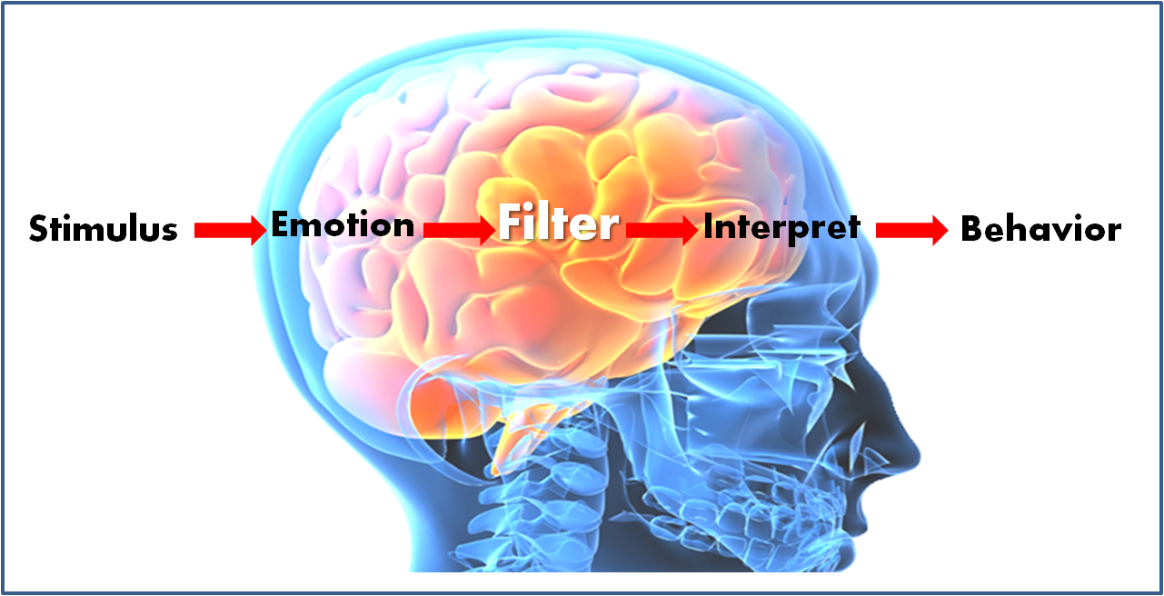
So how does EQ work?

Slide 28

How does EQ work?

Slide 29
What Does Change Represent to People?
Competence
Confidence
Status Quo = Expectations Met
Comfort
Change = Disruptions in
Expectations
Control
Notes:
JAL

Slide 30
EQ
Change
Stress
You

Slide 31
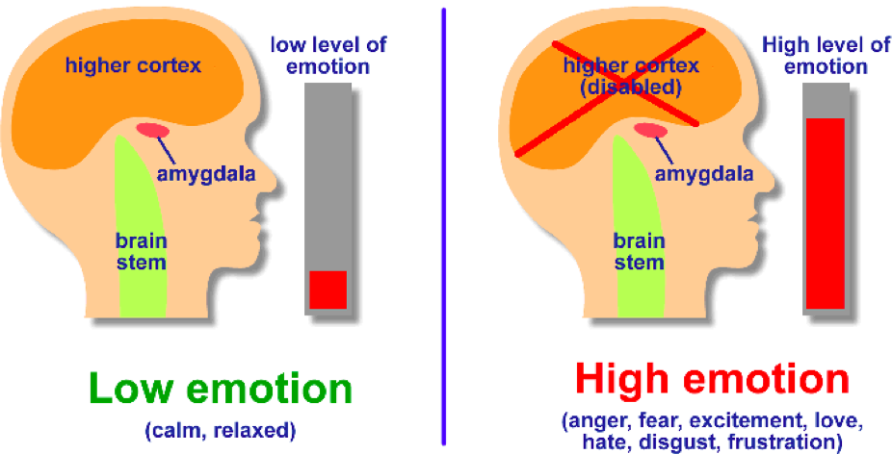
Your Brain Under Stress
Copyright © 2013. Target Training International, Ltd. under Licensing Agreement with Dr. Izzy Justice

Slide 32

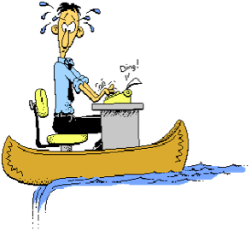
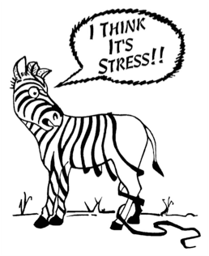

How Does Stress Affect You?

Slide 33
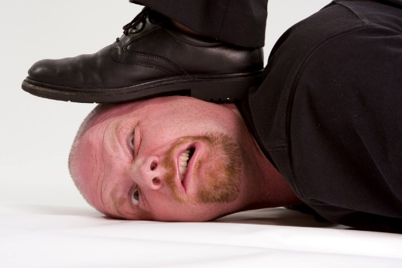
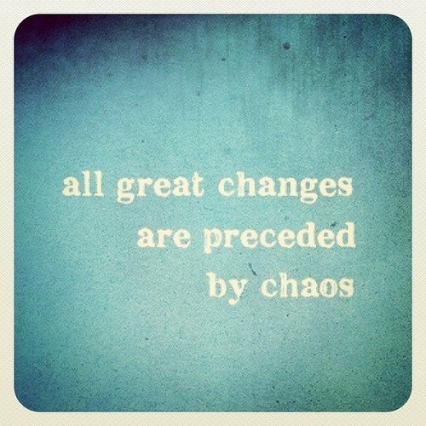
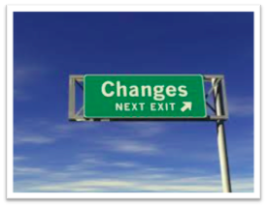
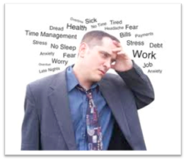



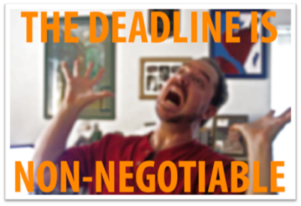
The Effects of Stress on Everyday Life

Slide 34
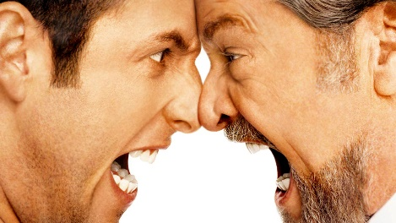
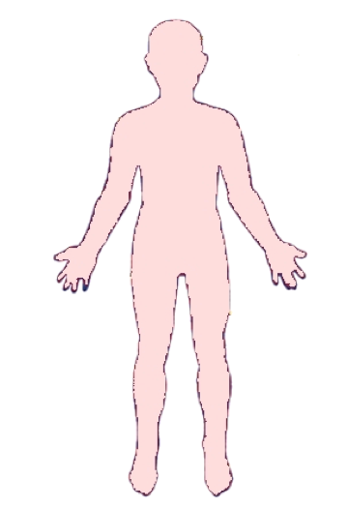
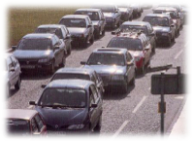
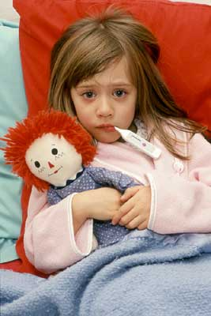





Negative Events and Interactions
Copyright © 2013. Target Training International, Ltd. under Licensing Agreement with Dr. Izzy Justice

Slide 35
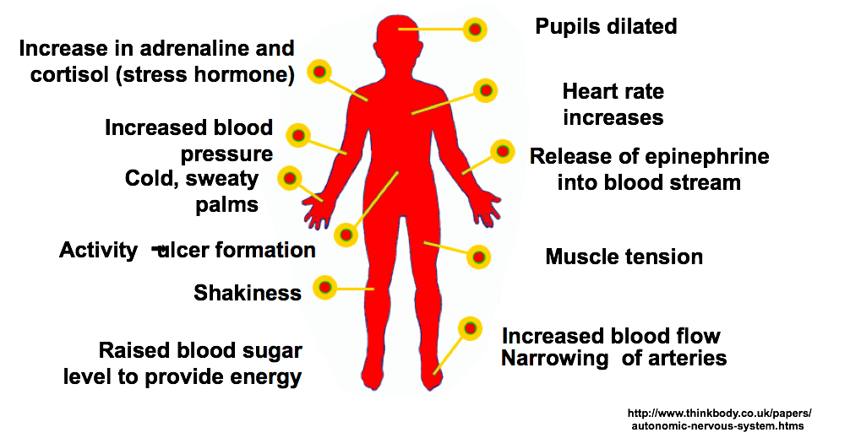
Stress Response
Copyright © 2013. Target Training International, Ltd. under Licensing Agreement with Dr. Izzy Justice

Slide 36
Stressed State
Have decreased cognitive performance
Have less oxygen available for critical brain functions
Tend to over generalize
Respond with defensive action
Perceive small stressors as worse than they actually are
Are easily aggravated
Will struggle to get along with other co-workers
Cannot perform at your best

Slide 37
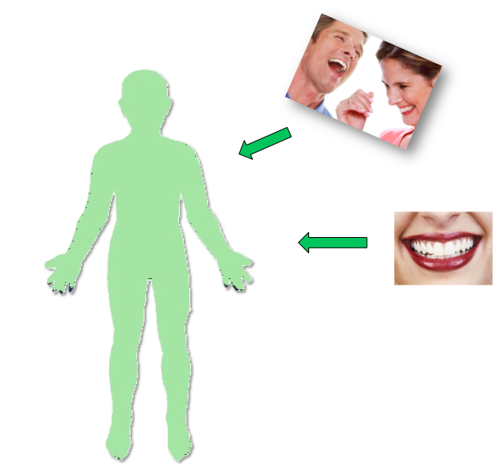




Positive Events and Interactions
Copyright © 2013. Target Training International, Ltd. under Licensing Agreement with Dr. Izzy Justice

Slide 38
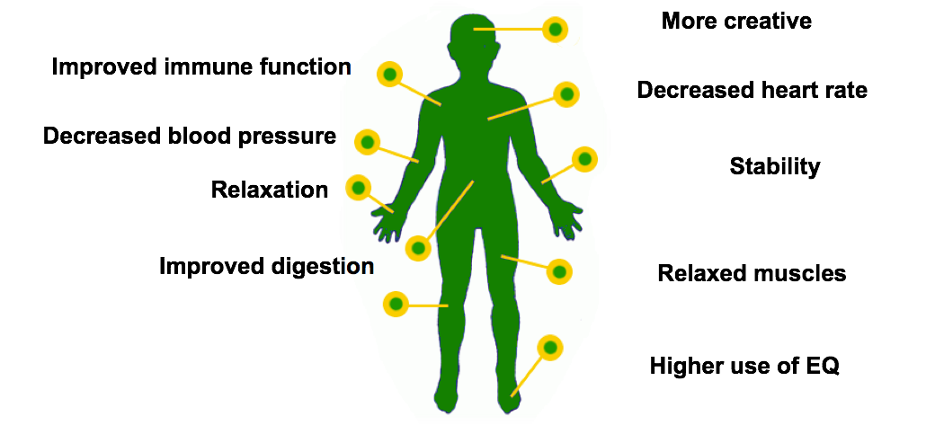
Relaxation Response
Copyright © 2013. Target Training International, Ltd. under Licensing Agreement with Dr. Izzy Justice

Slide 39

Non-stressed/Relaxation State
Are intrinsically motivated
Have improved cognitive functioning (i.e. rational, creative thought)
Are willing to do difficult things
Are willing to take risks
Think deeply about issues developing creative solutions
Collaborate productively
Are engaged
Perform at higher levels

Slide 40
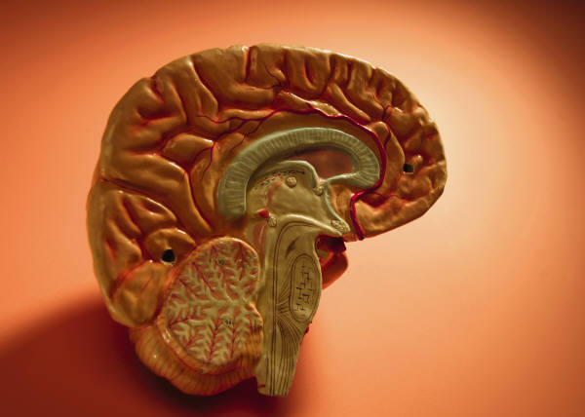
Dimensions of EQ
Self-Awareness
Self-Regulation
Motivation
Empathy
Social Skills

Slide 41
Self-Awareness
The ability to recognize and understand your moods, emotions and drives, as well as their effect on others.
Knowing how you’re feeling and why
Knowing your personal strengths and limits
Having a sense of your self-worth and capabilities

Slide 42
Self-Regulation
Self-Regulation is the ability to control or redirect disruptive impulses and moods and the propensity to suspend judgment and think before acting.
Keeping disruptive emotions and impulses in check.
Maintaining standards of honesty and integrity.
Taking responsibility for personal performance.
Flexibility and handling change.
Being comfortable with novel ideas, approaches and new information.

Slide 43
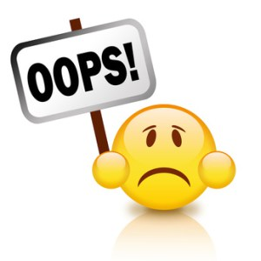
Self-Regulation Exercise
Think of a time when you practiced self-regulation
Now think of a time when you didn’t practice self-regulation
Any regrets?

Slide 44
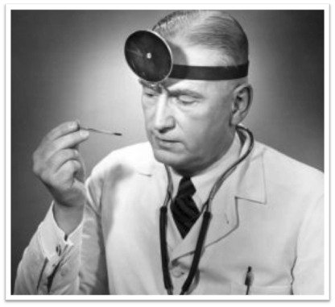
YOUR Emotional Temperature
Take your emotional temperature throughout the day.

Slide 45
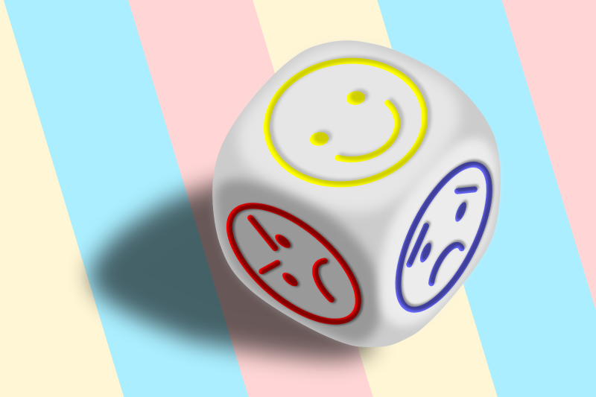
What’s My Mood?
Moods affect:
Team performance
Individual performance
Why?
They’re contagious
They affect how people interact
They affect decision-making
The affect energy levels

Slide 46

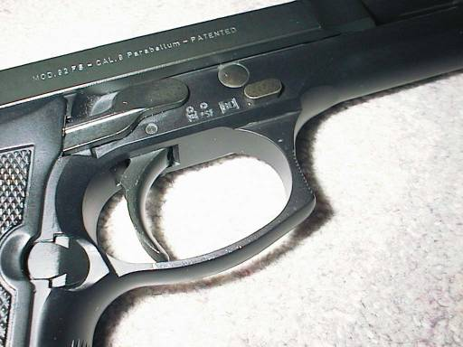
Hair triggers and hot buttons– What are yours?
Notes:
Page 43

Slide 47
Identifying Triggers and Hot Buttons
It makes me angry when…
I don’t like it when…
I feel offended when…
I think it’s rude to shout…
At work, I wish people would…
It makes me crazy when…
If only people would…
It makes me angry when people say…
I get irritated when I come to work and…
Notes:
Brainstorm your triggers and hot buttons. Some may be answers to these questions. Others may be your pet peeves. Think about the people who press your buttons…what buttons do they push?

Slide 48
Motivation
A passion to work for reasons that go beyond money or status, and a propensity to pursue goals with energy and persistence.
Striving to improve or meet a standard of excellence.
Aligning with the goals of group or organization.
Readiness to act on opportunities.
Persistence in pursuing goals despite obstacles and setbacks.

Slide 49
Motivation Exercise
Think about someone you’ve observed who seems to really love their job:
How can you tell someone is passionate about their job?
What are the characteristics you observe?
Now, think about your feelings about your own job.
How do the two compare?

Slide 50
Empathy
The ability to understand the emotional makeup of other people.
Sensing others’ feelings and perspectives and taking an active interest in their concerns.
Sensing others’ development needs and bolstering their abilities.
Anticipation, recognizing and meeting the needs of others.
Cultivating opportunities through different kinds of people.
Reading a group’s emotional currents and power relationships.

Slide 51
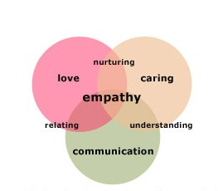
Empathy
http://youtu.be/cDDWvj_q-o8
Notes:
Journal the emotions you see and feel during this brief video

Slide 52
Social Skills
A proficiency in managing relationships and building networks.
Wielding effective tactics for persuasion.
Listening openly and sending convincing messages.
Negotiating and dissolving disagreements.
Inspiring and guiding individuals and groups.
Initiating or managing change.
Nurturing instrumental relationships for building bonds.
Working with others toward shared goals.
Creating group synergy in pursuing collective goals.

Slide 53
EQ Models
Action
How did I react?
What did I see?
What could be driving them ?
Me
Others
How was I feeling?
How did they feel?
Awareness

Slide 54
EQ Models
Action
Self-Regulation
(Self Management)
What can I do about it?
How can I control it?
Social Skills
(Social Management)
What can we do about it?
What am I experiencing from them?
Motivation
Why would I do it?
Why would they do it?
ME
Others
Empathy
(Social Awareness)
How is everyone else feeling?
How is it impacting them?
Self-Awareness
How am I feeling?
How is it impacting me?
Awareness

Slide 55

Let’s review your Reports

Slide 56
Applications in our Professional and Personal Life
Better Decision-Making and Life Choices
Role
Skills, knowledge, abilities
Actions
Emotional Intelligence

Slide 57
How Emotional Intelligence Enhances Productivity
Low
Clerks, machine operators, etc.
High EQ = 3X more productive
Medium
Sales clerks, mechanics, etc.
High EQ = 12X more productive
High
Doctors, consultants, industrial engineers
High EQ = 127X more productive

Slide 58
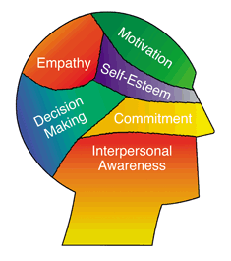
In Short, EQ Helps you…
Lead change more effectively
Engage your team around shared goals and objectives
Manage stress
Make better decisions
Create and maintain collaborative teams
Notes:
JAL

Slide 59
General Ideas for improving EQ
Improve your non-verbal communication
Focus on the other person
Make eye contact
Pay attention to non-verbal cues
Smile
Use humor and play to deal with challenges
Take hardships in stride
Smooth over differences
Simultaneously relax and energize yourself
Be creative
Resolve conflict positively and in a trust building way
Stay focused in the present
Choose your arguments
Forgive
End conflicts that cannot be resolved

Slide 60

Ideas for Improving in Each of the Areas
Self Awareness
Self Regulation
Motivation
Empathy
Social Skills

Slide 61
Improving Self-Awareness
Practice self-reflection by recognizing your current emotional state
Once you identify the emotion, describe it aloud or write it down on paper
To improve your ability to self-assess, ask a family member or trusted advisor to describe your strengths and weaknesses
Compare with your own self-assessment
Pay attention to your behaviors and see if you recognize patterns throughout the day
Reflect on the connection between your emotions and your behavior
Write in a journal about your emotional responses to situations that were significant

Slide 62
Improving Self-Regulation
Practice self-restraint by listening first, pausing and then responding
When becoming frustrated, identify what brought on that emotion
Create effective responses to stressful situations by finding strategies for altering a negative mood
Discuss ways of dealing with change and stress with family members, friends or a trusted advisor
Focus on events that provide a sense of calm or positive emotions
Ask yourself, "What is the worst thing that can happen?" in order to consider the reality of the situation
Journal occurrences during which you were able to regulate your responses or emotions
Begin regular exercise, yoga or meditation to increase your ability to manage your emotions and relax both body and mind. Exercise regulates your emotions by releasing endorphins, adrenaline, serotonin and dopamine

Slide 63

Improving Your Motivation
Set specific goals with dates for achievement
Clarify why these goals are important to you. Ask yourself not only, "What are my goals?" but also, "Why are they my goals?"
Work with a peer or trusted advisor to create detailed action items to work toward your overall goals
Set aside time to work on your goals each day, even if it is just five minutes at a time
List your goals and post them where you can see them every day
Spend time visualizing the achievement of your goals
Ask a close friend to help hold you accountable for reaching your goals
Celebrate accomplishments, both big and small
Learn from your mistakes; keep track of the lessons learned in a journal
Find inspiration from others who use internal motivation to overcome obstacles to reach their dreams

Slide 64

Improving Your Empathy
Attempt to understand others before communicating your point of view
Observe nonverbal behavior to evaluate the negative or positive emotions of others
Go people watching or see emotions in movie characters
Practice empathetic communication in response to your family members and coworkers
Watch interactions of other people that you determine to be empathetic. What can you do to model that behavior?
Break bad interpersonal habits such as interrupting others
Seek clarification from others when attempting to read emotional responses
Be nonjudgmental in your interactions with others
Offer assistance to your friends, family and even strangers

Slide 65

Improving Your Social Skills
Be aware of the message your body language is communicating
Ask those you admire to describe their experience when socializing with you
Remember people's names. Everyone has a hard time with it
Use memory techniques and be known as the one that remembers!
After making a mistake, take accountability quickly and find ways to make amends
Describe scenarios to a trusted advisor in order to gain experiential knowledge on how to increase your level of social skills (i.e. discuss the details of a social function and what makes you uneasy)
Take notice when emotions are taking over an interaction and then find ways to remove yourself from the situation
Be open and curious - Show a genuine curiosity for others' well-being
Explain your decisions, don’t just make them

Slide 66
EQ Improvement Plan - SAMPLE
New Behavior | What part of EQ | Why do I want to employ this new behavior | Strategies | By when?
EX: Listen without interrupting | Self-management | To be more respectful and to learn more | Allow a pause before speaking; take notes while listening; focus on the other person; get an accountability partner | Practice 3 weeks and reassess

Slide 67

Q&A, Evaluations and Next Steps
What are you taking forward from the session?
What new insights have you gained?
What new behaviors will you try?

Slide 68

Ahhhhhh…

Slide 69
Bibliography
Emotional Intelligence: Why It Can Matter More than IQ, Daniel Goleman, 1995.
Emotional Intelligence 2.0, Jean Greaves, Travis Bradbury, 2009
The Emotional Life of Your Brain, Richard Davidson and Sharon Begley, 2012
How to Improve Your Emotional Intelligence at Work and in Relationships, Shawn Kent Hayashi, 2016
The Leadership Code: 5 Rules to Lead By, Dave Ulrich, Norm Smallwood, Kate Sweetman, 2008
Leadership Vertigo: Why Even the Best Leaders Go Off Course and How They Can Get Back On Track, S. Max Brown, Tanveer Naseer, 2014
Mindset: The New Psychology of Success, Carol Dweck, 2006
Bridging the Soft Skills Gap, Bruce Tulgan, 2015

