Slide 1








Created by Geeta Chhabra
A
S
T
S
I
S
Application Submission System & Interface for Submission Tracking

Slide 2

Why a New System?

Slide 3

Unfortunately..
The Structure of NIH’s multi-project applications cannot be accommodated by Grants.gov’s downloadable forms

Slide 4

NIH partnered with Grant.gov team to develop ASSIST, a web-based submission system to accept multi-project applications that
works in conjunction with Grants.gov.

Slide 5
Electronic Submission of Multi-Project Applications Using ASSIST

Slide 6
Registration- Preparing Application
All ASSIST users must have eRA Commons credentials
ASSIST recognizes accounts with any role
Principal Investigator (PI)
Assistant (ASST)
Account Administrator (AA)
Work with the OSP office to register with eRA Commons

Slide 7








Overview of Process
Find
Opportunity
Enter application data
for all components
Initiate application and
create the application shell
Submit your application
through Grants.gov to NIH
Find
Plan
Initiate
Build Team
Enter Data
Finalize
Submit
Track
Get Familiar
with the process
and create an
application plan
Finalize components
and prepare your application for submission
Track status and view final
application
image
Define your team and
provide application
access

Slide 8

Find Opportunity
Find
Plan
Initiate
Build Team
Enter Data
Finalize
Submit
Track

Slide 9

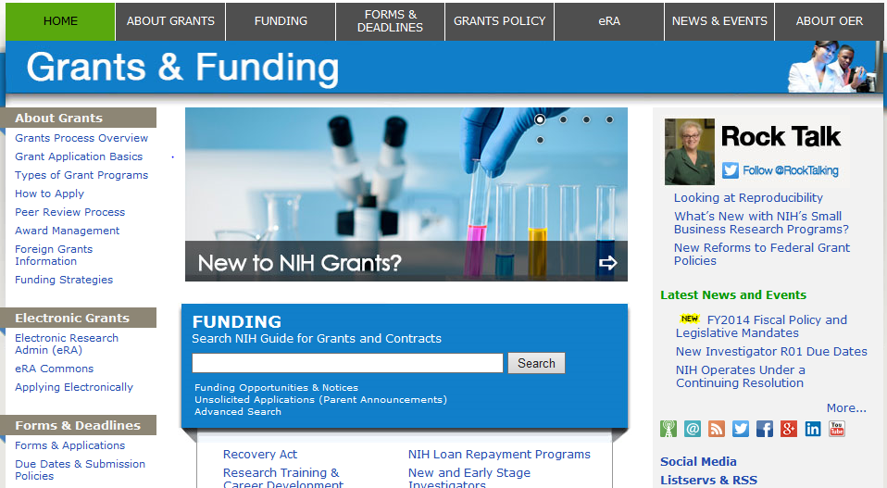
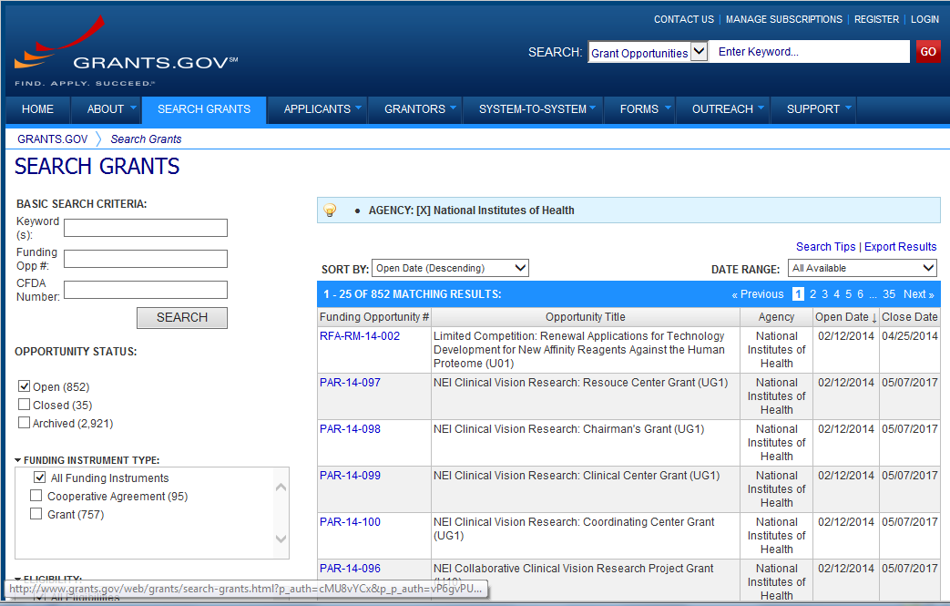
Find Multi-project FOA in….
NIH Guide for Grants & Contracts
Grants.gov Search Grants

Slide 10
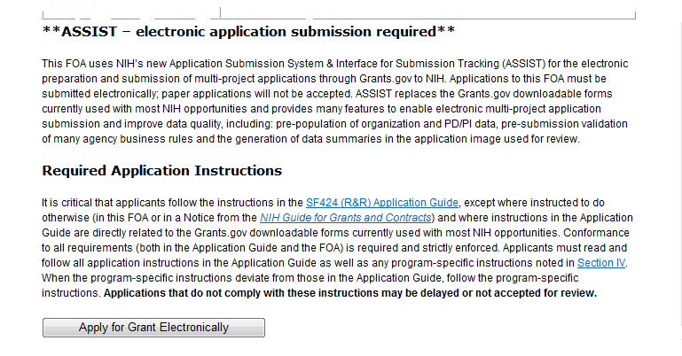
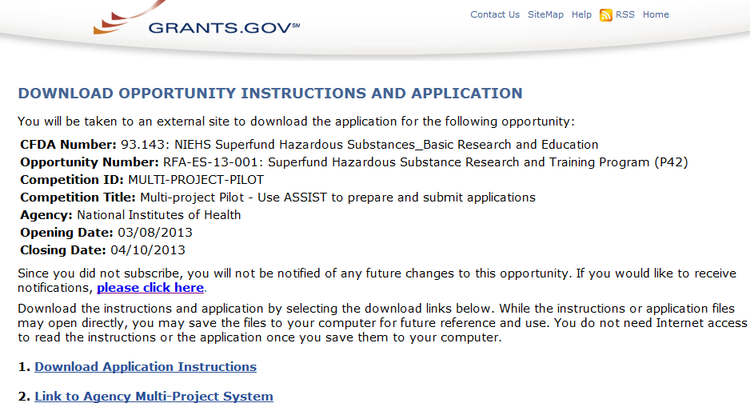
FOAs Link You to ASSIST
NIH Guide for Grants & Contracts
Grants.gov ‘Apply’

Slide 11

Before Jumping into ASSIST, take some time to learn about the new process

Slide 12
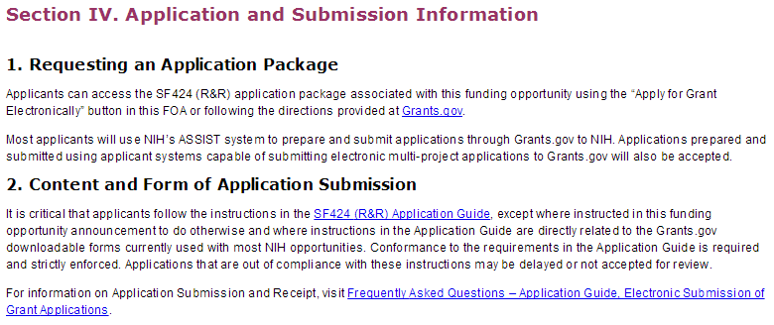
Multi-project FOAs
Section IV. Application and Submission information
of NIH FOAs including important guidance for
preparing your application in ASSIST
The SF424 (R&R) Application Guide
provides general instructions for completing
application forms

Slide 13
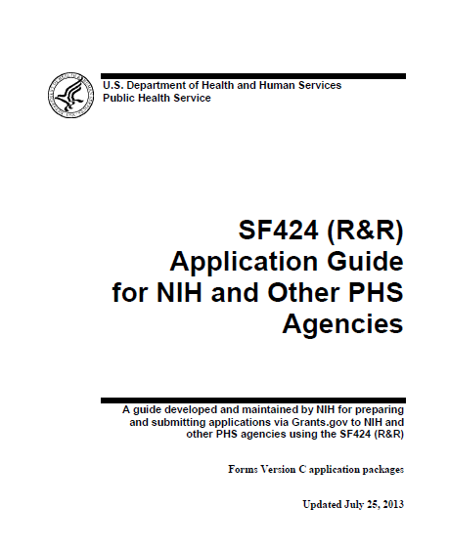

Application Guide
Agency-specific instructions
are marked with the
HHS logo
Pay special attentions to
Section 9-Instructions for
Preparing a Multi-Project Application
Refer to Supplemental Grant Instructions as needed (human subjects, policies, assurances, definitions and more)

Slide 14
New Application Format
All electronic multi-project applications will include:
A single Overall component
Provides overview of entire application
Some number of additional components
Component types allowed will vary by opportunity
Announcements will clearly indicate the types of components expected in a responsive application
Automatically prepared data summaries
Compiled from information included in components
Helps reviewers and staff work with the applications

Slide 15

Multi-project Application Assembly
Understand how your application image will be
assembled by NIH
The Overall component is presented first
Including system-generated data summaries
Additional component types are presented in alphabetical order (e.g., Cores before Projects)
Components of the same type are grouped together
Components are identified by type and sequential number
(e.g., Core-001, Core-002)
Check out this resource:
http://grants.nih.gov/grants/ElectronicReceipt/files/Electronic_Multi-project_Application_Image_Assembly.pdf

Slide 16

Create an
Application Plan
Find
Plan
Initiate
Build Team
Enter Data
Finalize
Submit
Track

Slide 17
Create an Application Plan
Carefully read the FOA and note the allowable types of required/optional components and any special instructions
Decide how to distribute the work
Ensure all eRA Commons and Grants.gov registrations are in place
Gather the Commons IDs for everyone who will be working on your application in ASSIST

Slide 18
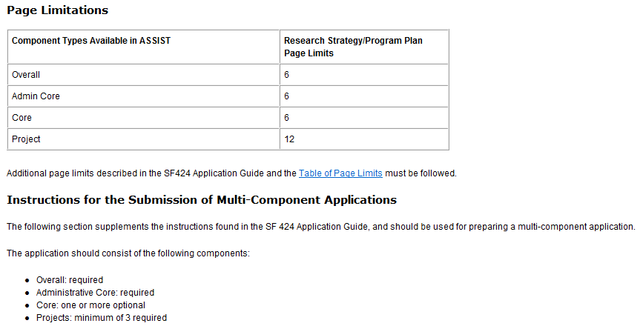
FOA Text Instructions
Sample excerpt from FOA (section IV)

Slide 19
Define the Layout of Your Application
Think about the components you plan to include
PD/PI(s) for entire application
Organization lead for each component
Project lead for each component
Project Title for application/components
Start/End dates for application/components

Slide 20
Create an Application Shell
Create an application shell by initiating the application and adding the components in the order you would like them to appear
Applicants can rearrange components of the same type (e.g., have the third project entered in ASSIST appear first in the assembled application image)
Components can be added or abandoned at any time

Slide 21







Sample Application Layout
Overall Component
PD/PIs: Cher Lee, Ben A Round
Organization: A
Project Title: Research Center to Cure the Diseases of the World
Component Type: Admin Core
Component Type: Core
Component Type: Project
Admin Core-001
Core-001
Project-001
Project Title:
Administrative Core
Project Lead:
Jed I. Knight
Organization: A
Project Title: Research Core
Project Lead: Ben A. Round
Organization: A
Project Title: Fabulous
Research Focus 1
Project Lead: Cher Lee
Organization: A
Subaward Budget
Project-002
Organization: D
Project Title: Fabulous
Research Focus 2
Project Lead: John Doe
Organization: B
Core-002
Project Title:
Communication Core
Project Lead: Tim Brown
Organization: B
Project-003
Project Title: Fabulous
Research Focus 3
Project Lead: John Doe
Organization: C

Slide 22

Initiate your
Application and Create an Application Shell
Find
Plan
Initiate
Build Team
Enter Data
Finalize
Submit
Track

Slide 23
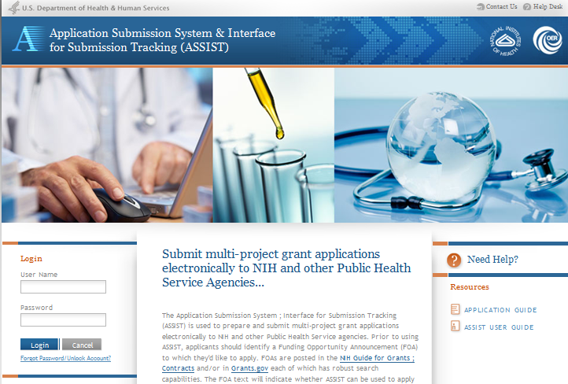
Log In to ASSIST
http://public.era.nih.gov/assist
Use your eRA Commons credentials to access ASSIST

Slide 24
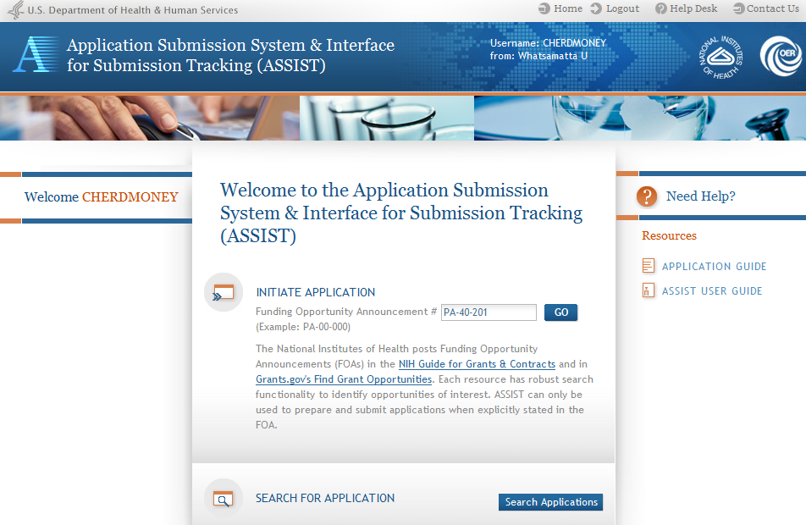
Initiate Application

Slide 25
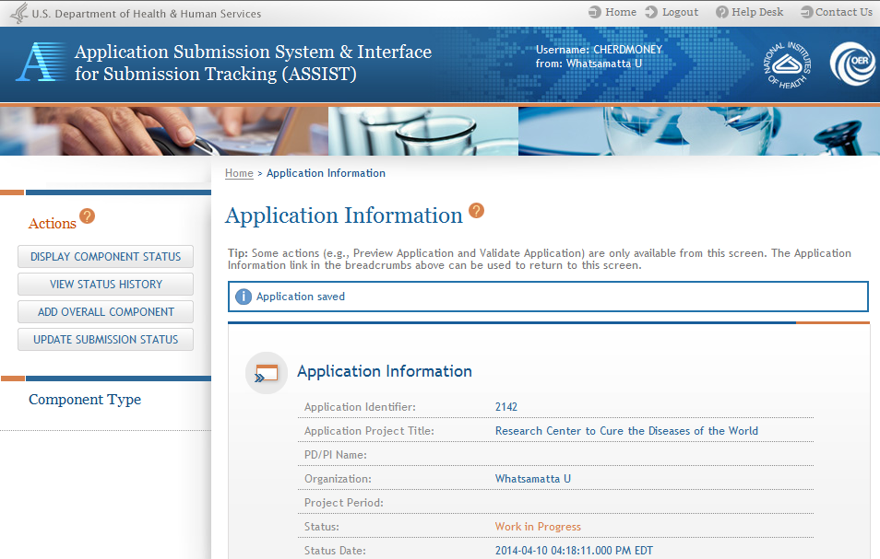
Using ASSIST
Click on question mark icon to access ASSIST help
ASSIST messages appear at top of screen
Available actions vary based on application context and access

Slide 26
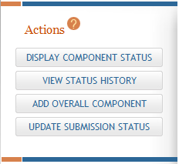
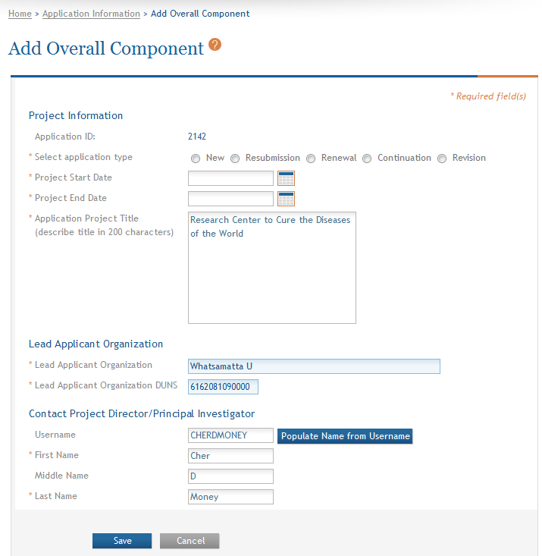
Add Overall Component
Click Add Overall Component to
start building your application
Enter the Commons Username for the contact PD/PI and use the Populate Name from Username button or type PD/PI name

Slide 27
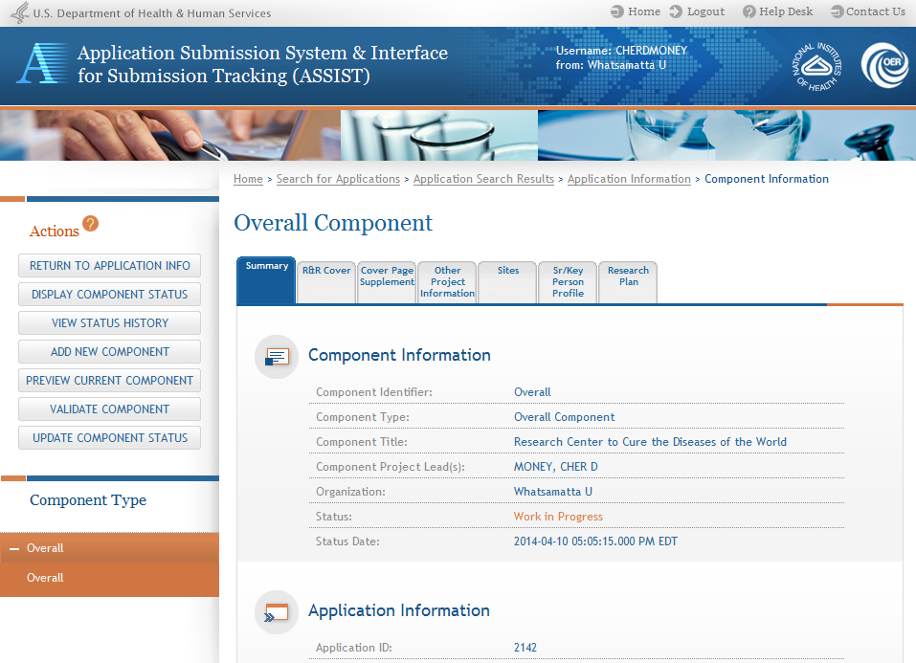
Overall Component
Required forms are presented for the component
The Overall Component is added to the component navigation

Slide 28
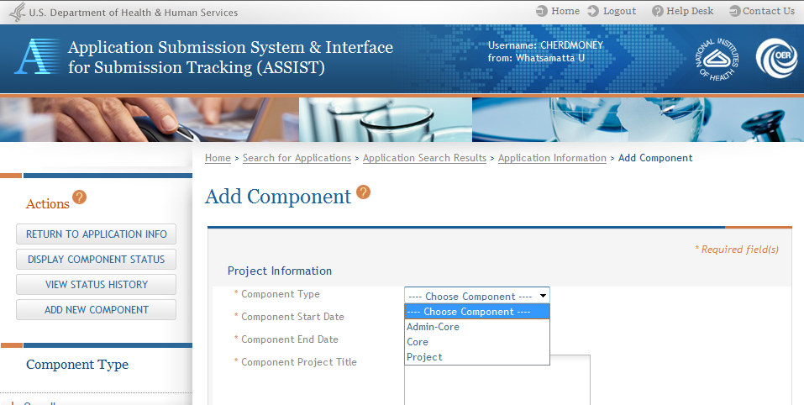
Adding Additional Components
Add Additional components
Applicants are presented with allowable component type as
defined in the FOA

Slide 29
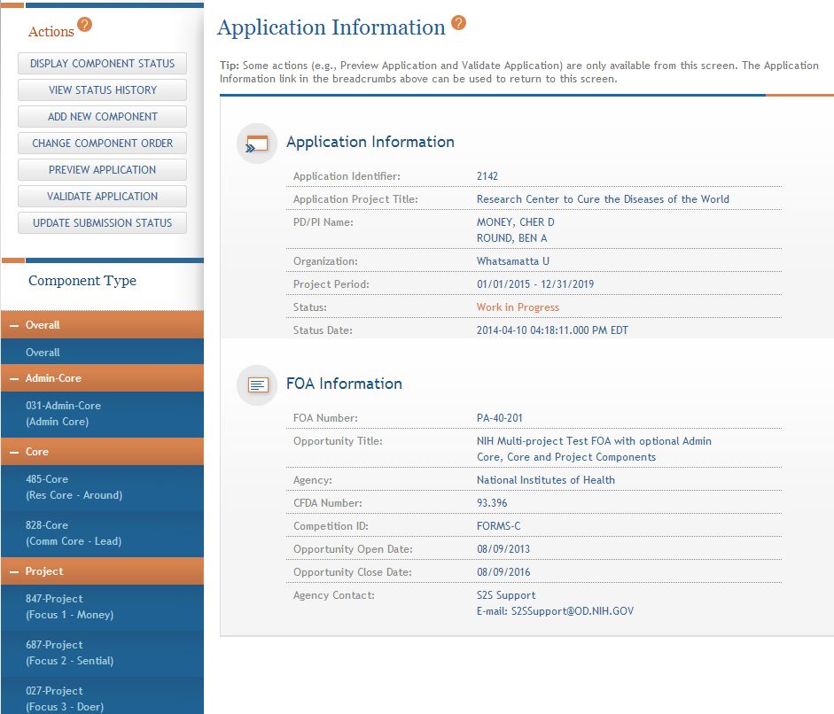
Adding Components
Continue adding components to build out the application shell

Slide 30
Define your Team and Provide
Application Access
Find
Plan
Initiate
Build Team
Enter Data
Finalize
Submit
Track

Slide 31
Automatic Application Access
ASSIST automatically provides application access to some individuals based on their Commons roles or role on the application
The person that initiates the application has edit access for the entire application
All SOs and AOs at the applicant institution have irrevocable edit access for the entire application
All PD/PIs listed on the Overall application have edit access for the entire application
All SOs and AOs at an organization leading a component have irrevocable edit access for their component
The component Project Leads have edit access for their components

Slide 32

Managing Access
Application access can be given to additional users with Commons IDs
Within or outside applicant organization
Application access can be controlled across these variables:
Entire application vs. specific components
Read vs. Edit
Budget vs. Non-budget data

Slide 33

Signing Officials (SOs)
SOs at the applicant institution can
Manage application access for other users
Manage application status all the way to Ready for Submission status
Delegate Access Maintainer and Status Maintainer authority to other users within their institution
Access the Submit action

Slide 34
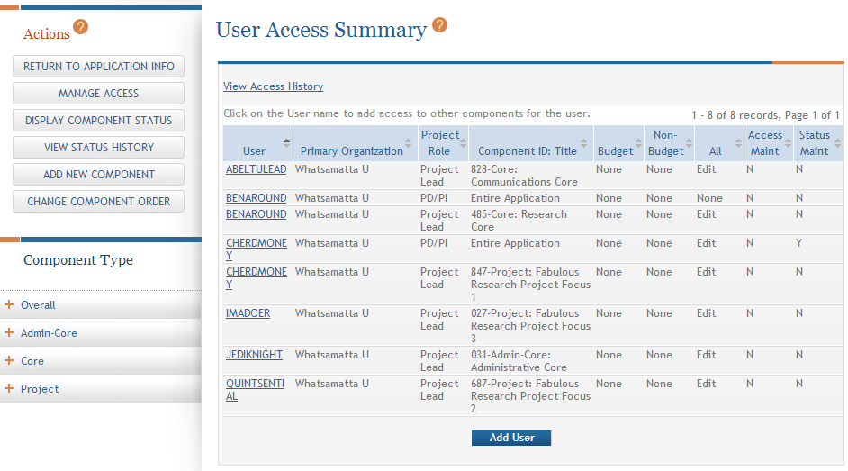
Managing Access
The Manage Access action can be used to provide access to additional
users or modify access for existing users

Slide 35
Enter Application Data
Find
Plan
Initiate
Build Team
Enter Data
Finalize
Submit
Track

Slide 36
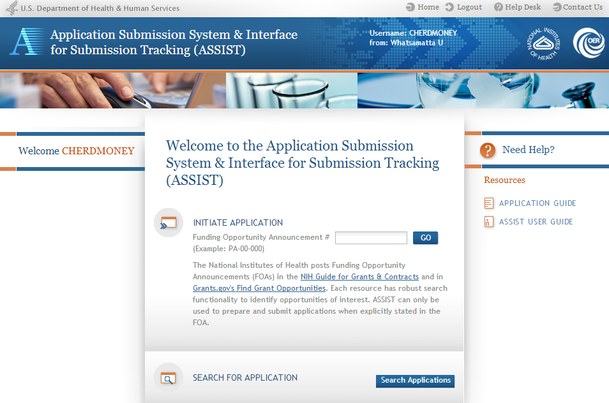
Searching for In-progress Applications
Use Search Applications to access your in progress application

Slide 37
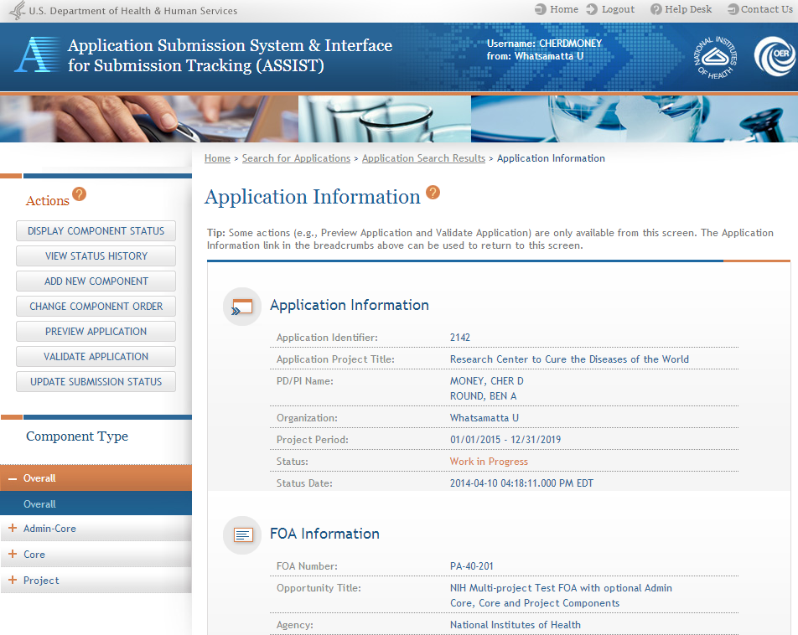
Navigating to a Specific Component
Use the component navigation to identify the component you want to work on

Slide 38
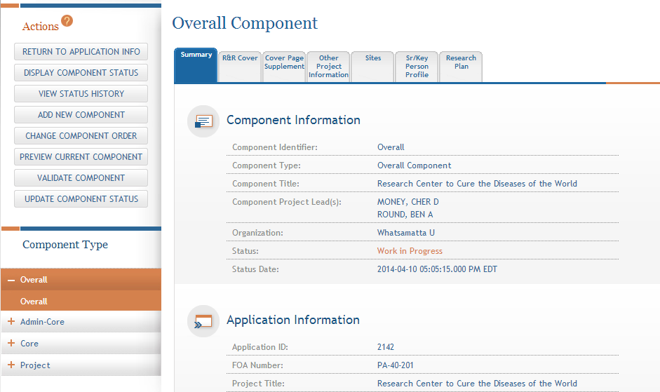
Summary Page
Every component has a Summary Page
Some actions
are only available from the
Summary Page

Slide 39
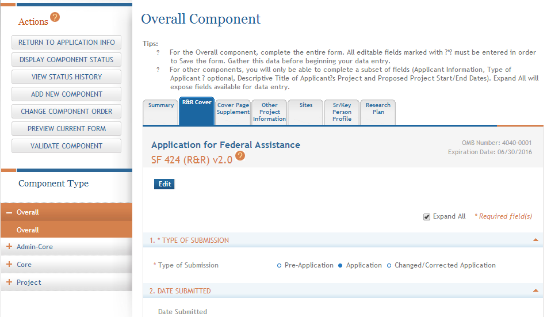
Entering Application Data
Click each tab to access form data entry screens
Clicking Edit blocks other users from editing form

Slide 40
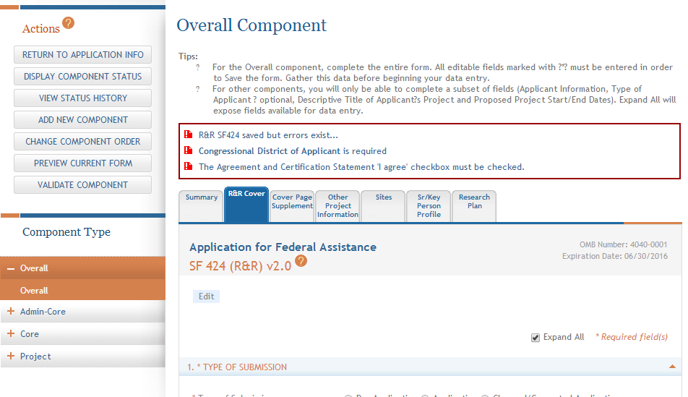
Data Entry Validation
ASSIST will validate entered data and provide errors at the top of the screen when you Save

Slide 41
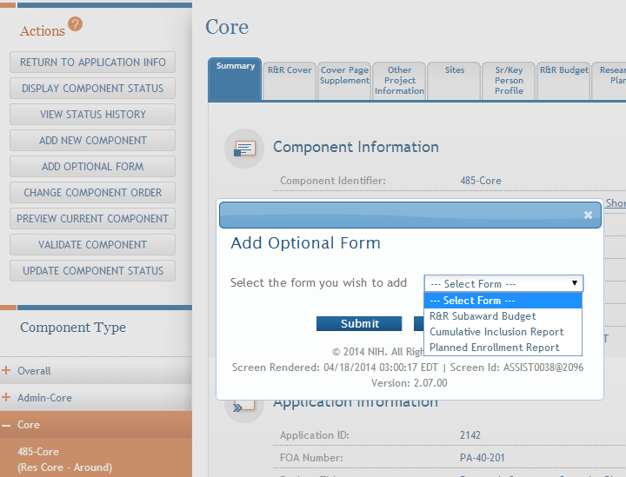
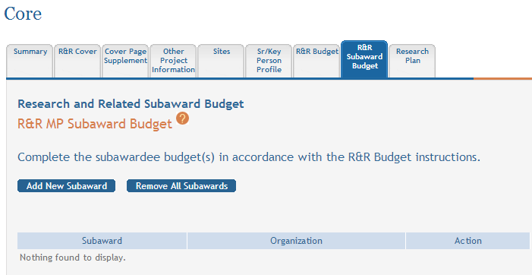
Adding Optional Forms
Select form and click Submit
The form tab is added to navigation

Slide 42
Data Entry: R & R Cover
Overall | All other components
All form fields used | Subset of fields used: Field 5: Organization Information Field 7 (Optional): Type of Applicant Field 11: Descriptive Title of Applicant’s Project Field 12: Proposed Project Start/End Dates

Slide 43
Data Entry: Other Project Information
Overall Component | All other components
Human Subjects: Standard Application Guide instructions apply | Human Subjects: Answer only the ‘Are Human Subjects Involved?’ and Is the Project Exempt from Federal regulations?’ questions.
Vertebrate Animals: Standard Application Guide instructions apply | Vertebrate Animals: Answer only the ‘Are Vertebrate Animals Used?’ question.
Project Narrative: Used by NIH for statement of public health relevance; required | Project Narrative: FOA may specify attachment is optional.

Slide 44
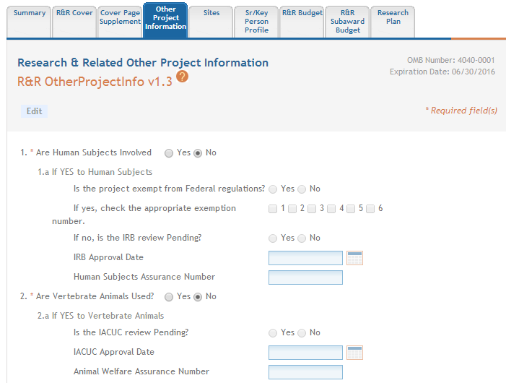
Data Entry: Other Project Information
ASSIST prevents data entry of additional Human Subject and Vertebrate Animal info on components other than Overall

Slide 45
Data Entry: Research Plan
Overall Component | All other components
Attachments: Describe the entire application. | Attachments: Reflect the activity in the specific component.
Introduction: Required for Resubmission/ Revision applications | Introduction: See FOA instructions.
Specific Aims: Required | Specific Aims: Required
Research Strategy: See FOA instructions for page limit. | Research Strategy: See FOA instructions for page limit.

Slide 46
Data Entry: Senior/Key Person Profile
Overall Component | All other components
Use the Project Director/Principal Investigator section to designate the Contact PD/PI Include any Multi-PD/PIs Project Role of PD/PI | Use the Project Director/Principal Investigator section to designate the Project Lead Must not use PD/PI role ASSIST defaults role to Other, Project Lead Follow FOA instructions
Applications must include a single biosketch for each Senior/Key person regardless of the number of components they are listed on. Biosketch
can be included with any entry – just pick one

Slide 47
Component Actions
As component data is entered several actions are available:
Change Component Order
Validate Component
Preview Current Component
Update Component Status
Work In Progress – only status that allows editing
Complete – component data entry is complete
Final – component has been reviewed by applicant organization and incorporated into the application

Slide 48
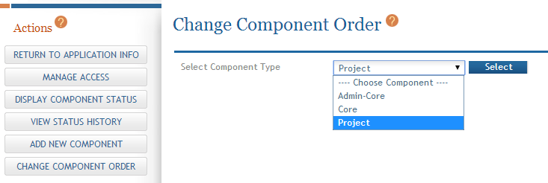
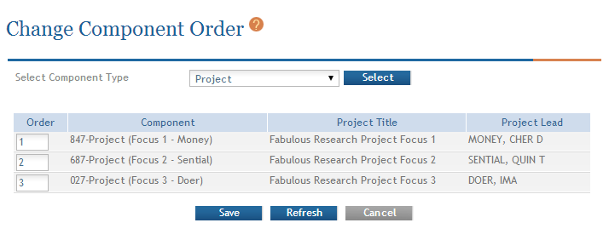
Change Component Order
Select Component Type to reorder
Provide desired sequence

Slide 49
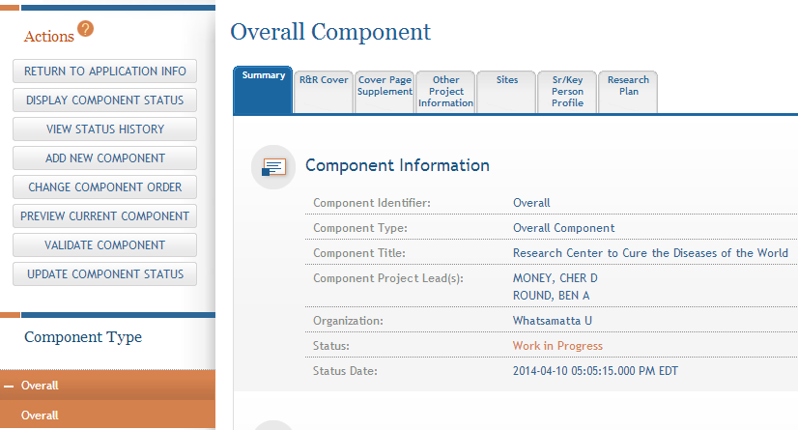
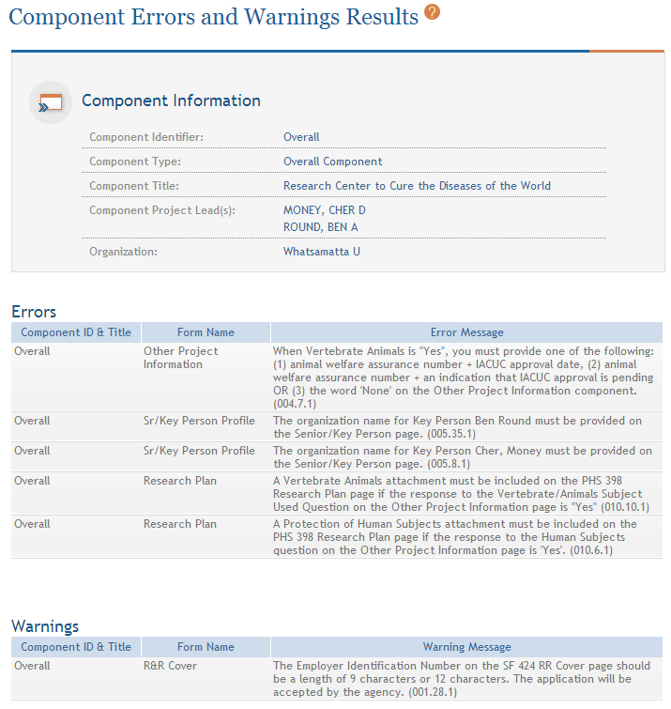
Validating a Component
Errors and Warnings are displayed

Slide 50


Errors and Warnings
Errors stop application submission and processing and must be corrected before the deadline
Warnings do not stop application submission or processing and are corrected at the discretion of the applicant before the deadline

Slide 51
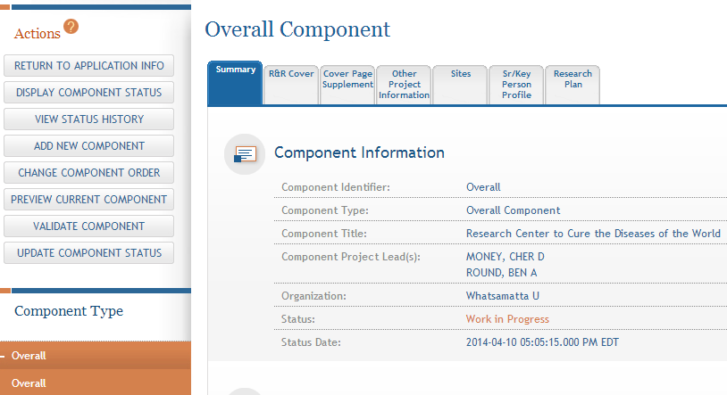
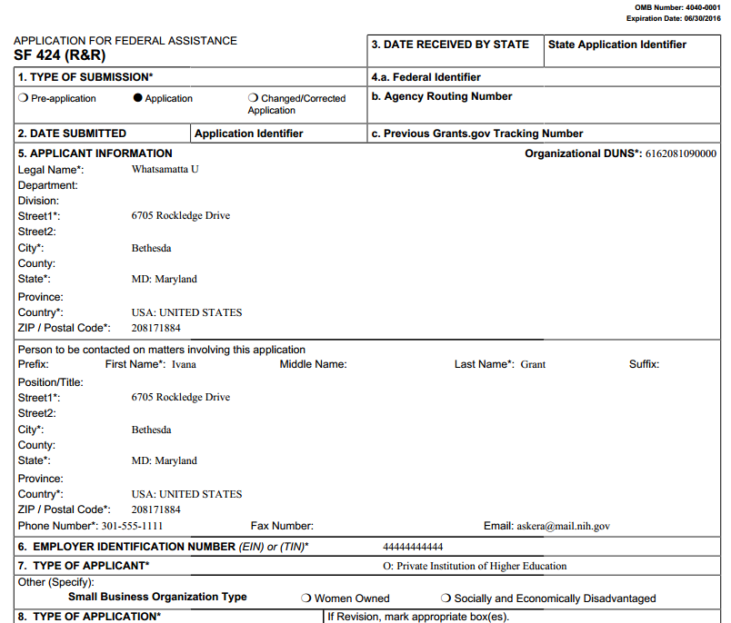
Previewing a Component
Component preview does not include bookmarks, Table of Contents, data summaries or biosketches

Slide 52
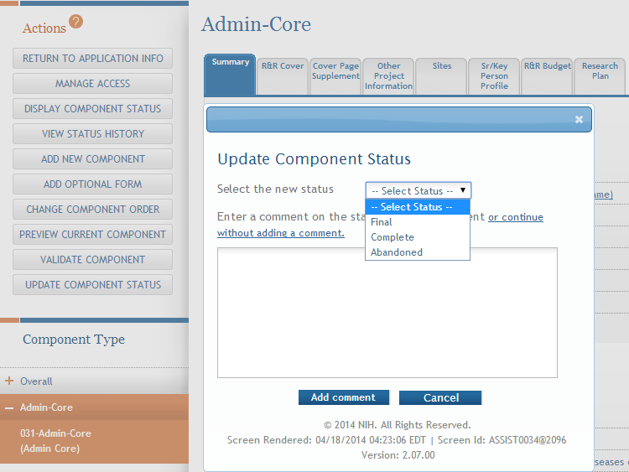
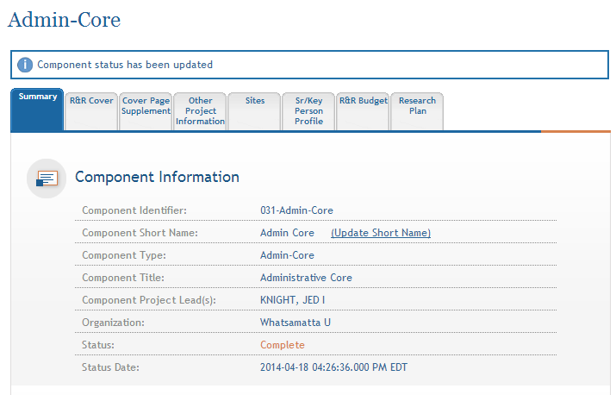
Updating Component Status to Complete
Select status and enter comment for Status History
Once a component is marked “Complete” no additional edits can be made unless someone with entire application edit authority returns the status to “Work in Progress”

Slide 53

Finalize Content & Prepare Your
Application for Submission
Find
Plan
Initiate
Build Team
Enter Data
Finalize
Submit
Track

Slide 54
Finalizing Components
As components are marked ‘Complete’, the applicant organization can preview them and incorporate those that are ready into the final application by updating the component status to ‘Final’.
All components must be marked ‘Final’ before an application can be prepared for submission.

Slide 55
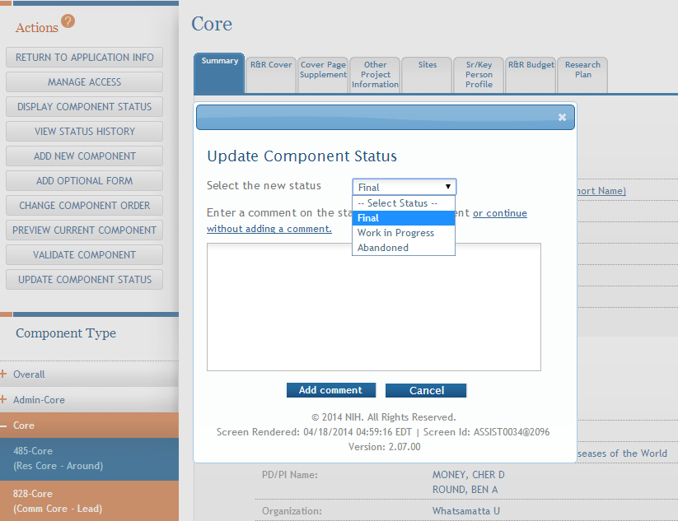
Finalizing Components
Update the component status to Final once you are satisfied that the component is ready to be included in the final application

Slide 56
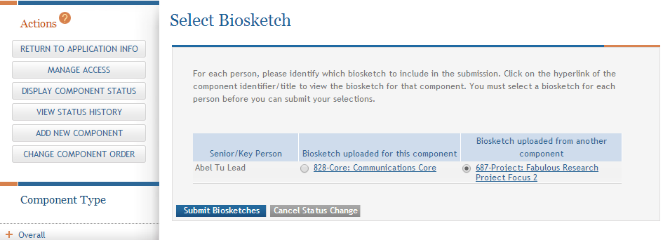
Finalizing Components
ASSIST will check to ensure that only one biosketch is included for every Senior Key person in the application
If a biosketch is already included for the Senior Key, you will have the option to view each biosketch and select the one you wish to keep

Slide 57
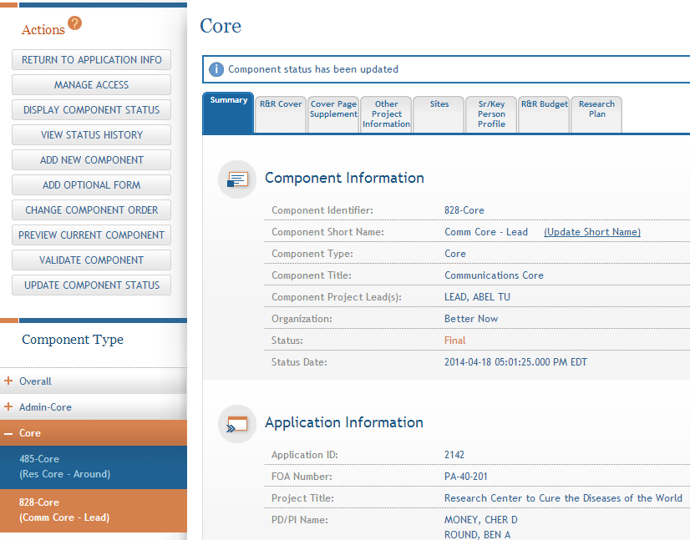
Finalizing Components
After all biosketch issues are reconciled, the component status is set to Final

Slide 58
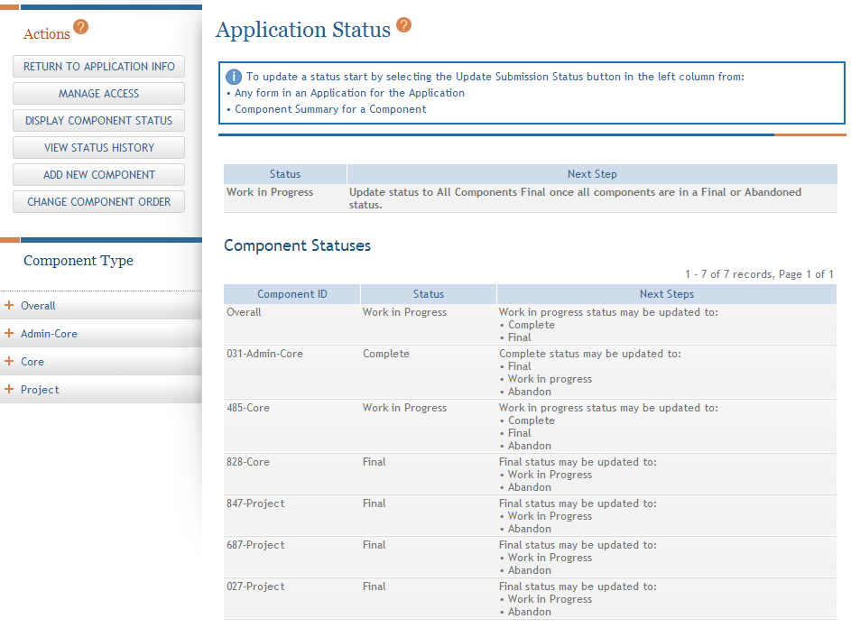
Display Component Status
Provides all application and component status on a single screen

Slide 59
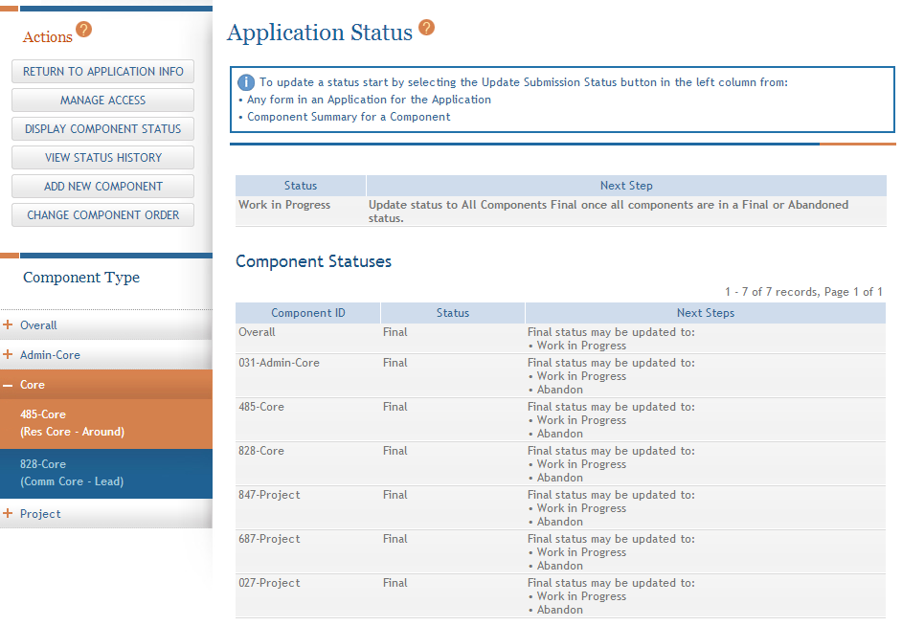
Updating Application Status
Although the Status is set to Final for each component, the Application Information still shows a Status of Work in Progress

Slide 60
Application Status Flow
Work In Progress – Allows editing
All Components Final – Can only be updated once each component status is Final; must Validate Application to move to next status
All Components Validated – Automatically set once Application Validation is error-free
Ready for Submission – Should be set after all internal reviews have taken place
Submitted – Automatically set after submitting to Grants.gov

Slide 61
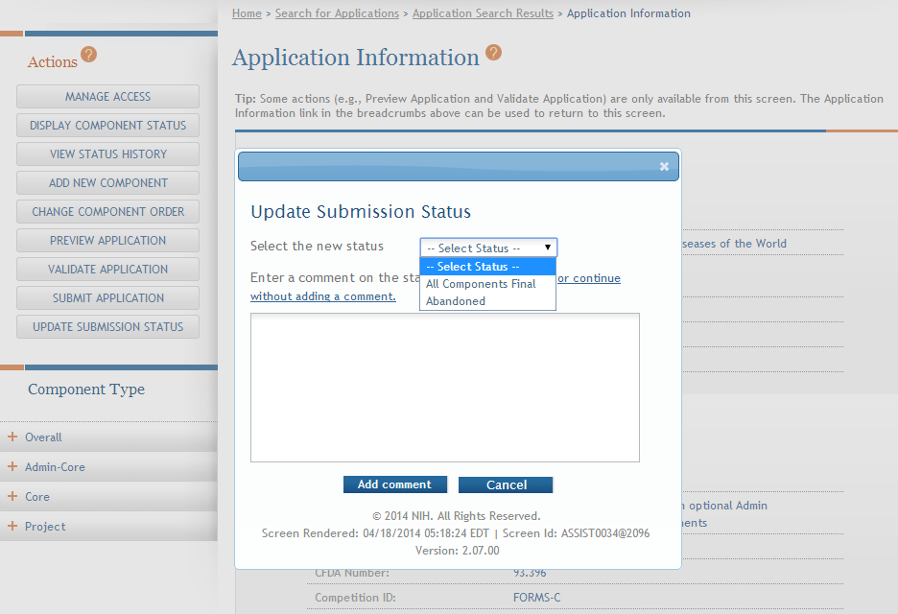
All Components Final
You can prepare your application for submission once the status for all individual components has been set to Final
Set the application status to All Components Final

Slide 62
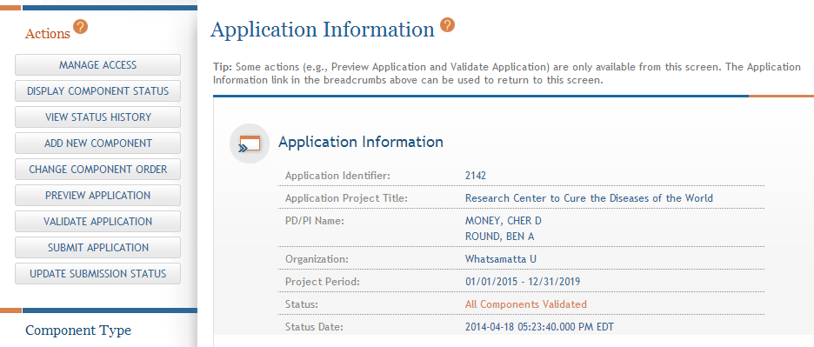
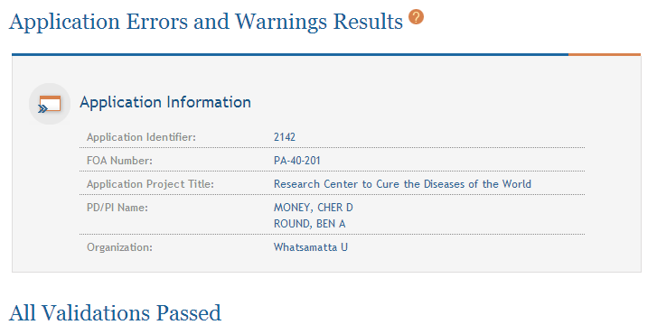
Final Validation Check
Before an application can be submitted, it must pass validations (Warnings are OK)

Slide 63
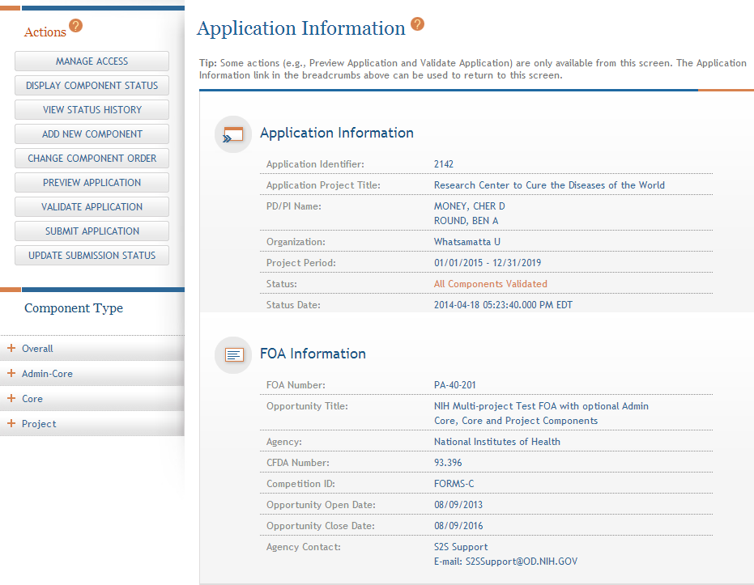
All Components Validated
When the application passes validations, the application status is automatically updated to All Components Validated

Slide 64
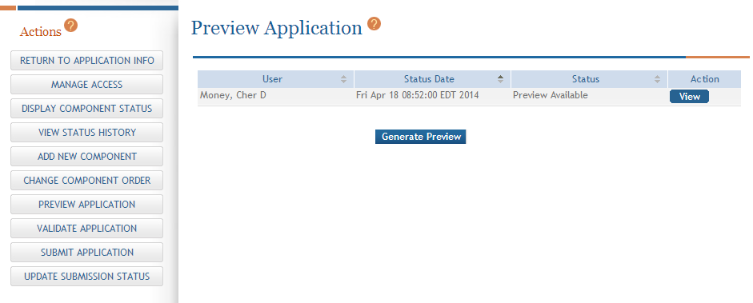
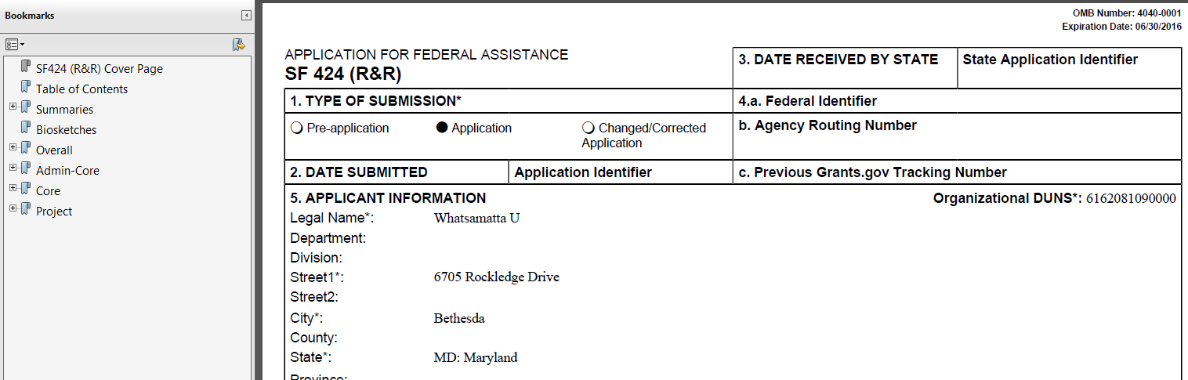
Preview Application
Before you submit you can Preview the Application and verify that everything is just the way you want it to go to review

Slide 65
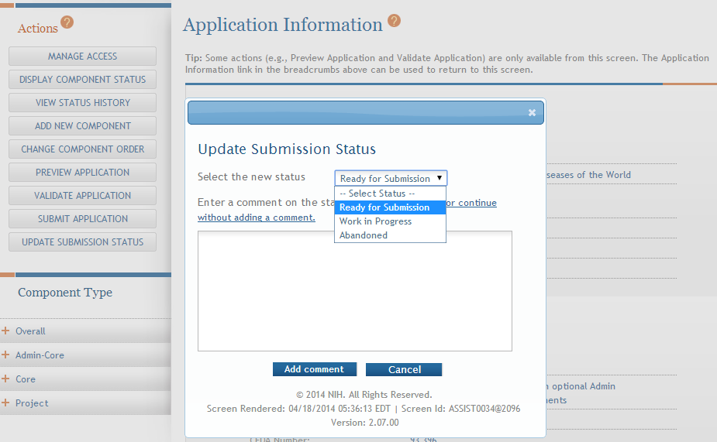
Ready for Submission
Once all internal reviews are complete, update the application status to Ready for Submission

Slide 66
Submit Your
Application
Find
Plan
Initiate
Build Team
Enter Data
Finalize
Submit
Track

Slide 67

On-time Submission
Error-free submission must be made by 5:00 p.m. local time (of submitting organization) on due date
It takes time to prepare your application for submission
Submit early (days, not minutes) to have time to address any unforeseen issues and to view your assembled application

Slide 68
Track Your
Application
Find
Plan
Initiate
Build Team
Enter Data
Finalize
Submit
Track

Slide 69

Notifications
ASSIST sends out quite a few email notifications throughout the preparation and submission process to help you track your application
Application access changes, component/application updates, component/application status changes, submission status updates and more
Check out this resources:
http://grants.nih.gov/grants/electronicreceipt/files/ASSIST_eNotifications.pdf

Slide 70

Tracking Submission Status- ASSIST
ASSIST provides the ability to track both Grants.gov and NIH status
ASSIST provides a link to the Commons Detailed Status Information to view your assembled application

Slide 71

Application Viewing Window
Applicants have two (2) business days to view the assembled application image in Commons before it automatically moves forward to NIH staff for further processing
If you can’t VIEW it, we can’t REVIEW it!

Slide 72
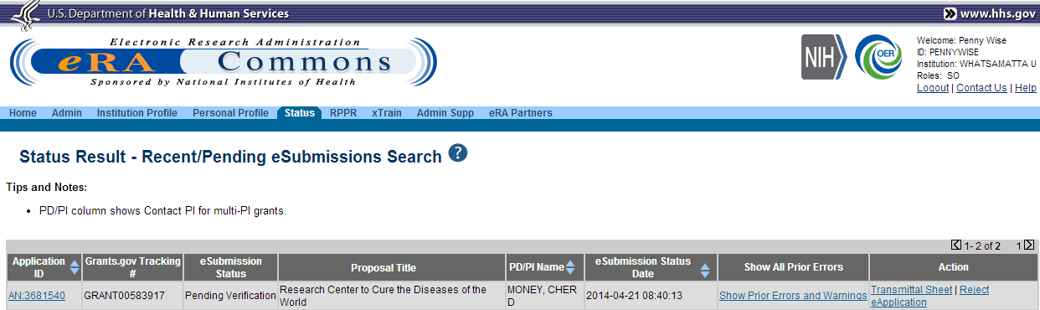
Rejecting the Application
SO (Signing Official) can Reject application in Commons within viewing window and submit a Changed/Corrected application prior to the due date

Slide 73

Submission Complete
If no action is taken to reject the application during the two business day viewing window, the application automatically moves forward to NIH for further processing.

Slide 74

Links and Resources
ASSIST:public.era.nih.gov/assist
Online help: era.nih.gov/erahelp/ASSIST/
Applying Electronically Website for Multi-project Applications: grants.nih.gov/grants/ElectronicReceipt/com_index.htm
Webinar for Applicants:
http://grants.nih.gov/grants/webinar_docs/webinar_20130813.htm
Annotated form set: grants.nih.gov/grants/ElectronicReceipt/files/annotated_multi-project.pdf

Slide 75

Help Desk
eRA Commons Help Desk
Web: http://era.nih.gov/help/
Toll-free: 1-866-504-9552
Phone: 301-402-7469
Hours: Mon-Fri, 7a.m. to 8 p.m. Eastern Time (Except for Federal holidays)
Although NIH has worked closely with Grants.gov, ASSIST is a system developed and managed by NIH
The eRA Commons Help Desk should be the applicant’s first stop for Support

