Slide 1
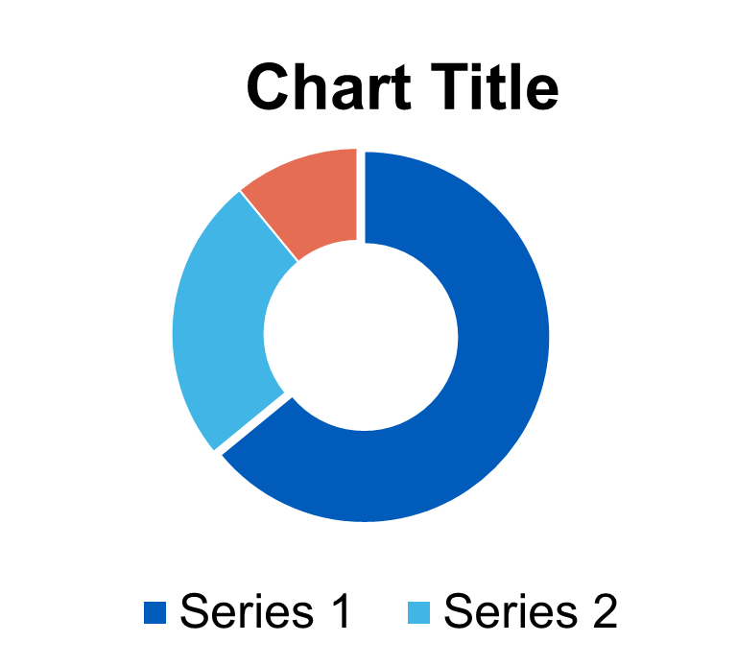
Title Of Project
Author 1, Degree; Author 2, Degree; Author 3, Degree
Medical Scientist Training Program, List Your Department; Department B; Department C
Physician Scientist Development Office, University of Alabama at Birmingham
Introduction
Data Analysis
Mauris orci mi, varius id diam id, egestas auctor enim. Praesent ut massa nibh.
Mauris orci mi, [See Figure A].
Conclusion
Mauris orci mi,
Sed Risus Nibh: CiIn nisl quam, aliquet sed nibh sitamet, faucibus placerat dui augue scelerisque.
Methods
Mauris orci mi,
MAURIS ORCI VARIUS ID DIAM
Sed in
EUISMOD JUSTO VITAE PURUS
Proin s
Results
Mauris orci mi,
Graphic Elements
References
MAURIS ORCI MI VARIUS ID DIAM Egestas auctor enim.
Phasellus nec lectus bibendum, posuere nibh id, lacinia magna
Mauris orci mi, varius id diam id, egestas auctor enim
Mauris orci mi, varius id diam id, egestas auctor enim.
*Unamcorper efficitur sed in nulla.
Research for this project was supported by

