Slide 1
2018 Revised Common Rule
Expedited Status Update
January 14, 2019

Slide 2
NOTE & DISCLAIMER
January 21, 2019 is both the effective date and the compliance date for the Revised Common Rule.
This means that applications currently submitted and awaiting review may require revision based on the revised common rule requirements. Please be patient...

Slide 3
TOPICS
Introduction and Background
Major Changes
  Continuing Review
  New & Revised Exemption Categories

Slide 4
INTORDUCTION AND BACKGROUND
Common Rule – Federal regulations governing human subjects research
Current regulations published in 1991
19 agencies follow the current regulations

Slide 5
THE NEW REGULATIONS
The Revised Common Rule (2018 Common Rule) – Published on January 19, 2017
Effective date – January 21, 2019
Some agencies have NOT signed on
  DOJ expected to become a signatory
  FDA has not yet harmonized their regulations

Slide 6
MAJOR CHANGES
Continuing Review
New & Revised Exempt Review Categories

Slide 7
EXISTING EXPEDITED STUDIES
Studies approved before January 21, 2019 will continue to submit continuing review submissions.
*Unless you received a letter from the IRB telling you that your study was transitioned.
Can I transition my old study to the revised regulations?
Notes:
No. We will address a transition plan after the revised regulations have been implemented.

Slide 8
CONTINUING REVIEW REGULATION
§ ll.109(f)(1) Unless an IRB determines otherwise, continuing review of research is not required in the following circumstances:
(i) Research eligible for expedited review in accordance with §ll.110;
(ii) Research reviewed by the IRB in accordance with the limited IRB review described in § ll.104(d)(2)(iii), (d)(3)(i)(C), or (d)(7) or (8);
(iii) Research that has progressed to the point that it involves only one or both of the following, which are part of the IRB-approved study:
(A) Data analysis, including analysis of identifiable private information or identifiable biospecimens, or
  (B) Accessing follow-up clinical data from procedures that subjects would undergo as part of clinical care.
Notes:
Full text.

Slide 9
CONTINUING REVIEW REGULATION TRANSLATION
§ ll.109(f)(1) Unless an IRB determines otherwise, continuing review of research is not required in the following circumstances:
(i) Research eligible for expedited review in accordance with §ll.110;
Continuing review will no longer be required for research that qualifies for expedited review.​
Notes:
Studies approved via expedited procedure AFTER January 21, 2019 will no longer submit continuing review (unless you hear from IRB saying your study has been transitioned to the Revised Rule)

Slide 10
CONTINUING REVIEW REGULATION TRANSLATION
§ ll.109(f)(1) Unless an IRB determines otherwise, continuing review of research is not required in the following circumstances:
(i) Research eligible for expedited review in accordance with §ll.110;
The IRB can require ongoing continuing review with a documented justification.
FDA-regulated projects (& a few others) will require continuing review.
Notes:
Unless an IRB determines otherwise – studies the IRB feels need more frequent observation and studies regulated by agencies that have not signed on to the Revised Common Rule.

Slide 11
CONTINUING REVIEW REGULATION TRANSLATION
§ ll.109(f)(1)(iii) Research that has progressed to the point that it involves only one or both of the following, which are part of the IRB-approved study:
(A) Data analysis, including analysis of identifiable private information or identifiable biospecimens, or
  (B) Accessing follow-up clinical data from procedures that subjects would undergo as part of clinical care.
Continuing review will no longer be required for studies that initially required full board review once the research interventions/interactions with participants have been completed.​
*The IRB will continue to indicate when a study is eligible for this transition.
Notes:
Studies approved under convened review are sometimes told they qualify for Expedited Category 8. This will still occur, the IRB will indicate when your study is eligible for transition.

Slide 12
EXPEDITED STATUS UPDATE (ESU)
Still required to submit amendments and problem reports to the IRB, as necessary
  IRB will send you email reminders annually
  Must check in at least every 3 years
  The check in (amendment or problem report) will be considered an Expedited Status Update (ESU)
    Each time an ESU is submitted, the 3 year date will reset
Notes:
No more continuing review, but you must still submit a PRAF for any changes to the study.

Slide 13
ESU NOTICES
An email will be sent to the PI (and delegates) at one and two years after the last qualifying submission.
The email will contain the currently-known protocol status and approved enrollment number.
The email will include a reminder about responsibilities for keeping the IRB abreast of any changes.

Slide 14
ESU – THREE YEAR REQUIREMENT
An email will be sent to the PI and delegate one month before the three-year anniversary of the initial approval or the last qualifying submission.
A reminder will be sent at 14 days prior to the anniversary.
An ESU must be completed at this time even if there are no other protocol changes.

Slide 15
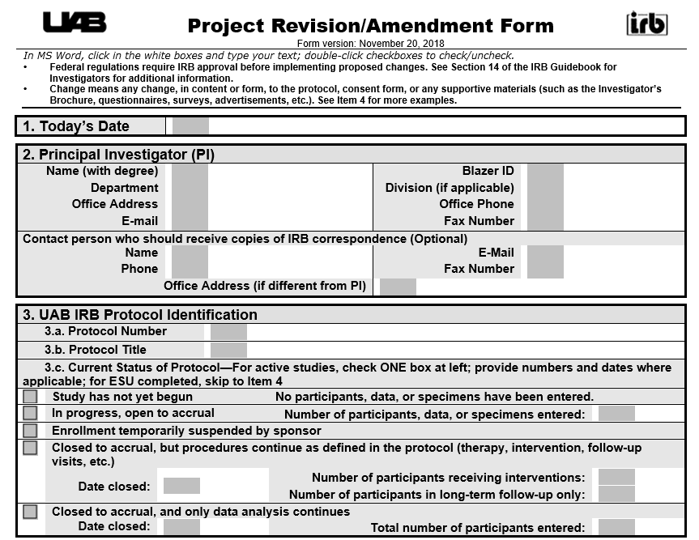
ESU QUALIFYING SUBMISSION
Each amendment or problem report submission will reset the three-year clock when the OIRB issues approval/determination

Slide 16
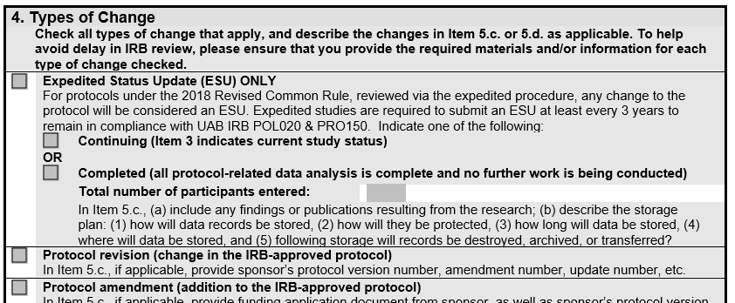
ESU ONLY SUBMISSION
If you are not making changes, but
    You would like to update your study’s enrollment status
    It has been 3 years since the last approval
    You would like to close an expedited study

Slide 17
ESU EXAMPLE
Expedited protocol approved on January 22, 2019 (ESU required before January 22, 2022)
Amendment approved June 17, 2020 (ESU required before June 17, 2023)
Protocol completed – Submit ESU Only prior to June 17, 2023

Slide 18
ESU EXAMPLE
Expedited protocol approved on January 22, 2019 (ESU required before January 22, 2022)
Protocol completed – Submit ESU Only prior to January 22, 2022
No protocol changes

Slide 19
NEW & REVISED EXEMPT REVIEW CATEGORIES
Due to changes in Exemption Criteria and Categories, the following may now be reviewable under Exemption Review:
Medical Record Reviews involving identifiers (previously Expedited Category 5/now Exempt Category 4)
Surveys/Interviews involving sensitive and identifiable content (previously Expedited Category 7/now Exempt Category 2)
Benign Behavioral Interventions (previously Expedited Category 3/now Exempt Category 3)

Slide 20
SUMMARY
  Continuing reviews are no longer required for (most) expedited studies approved after January 21, 2019
  Some studies have already been transitioned
    (~900 Expedited studies without consent forms in data analysis)
  Email notifications to PI and Delegates
    (if/when we haven’t heard from you in 1 year, 2 years, or 3 years)
  If your study was approved prior to January 21, 2019 & you have not received an email from the IRB…
      Keep sending in your Continuing Review submissions!
      We will let you know when to stop!

Slide 21
STAY TUNED
As we move forward, business decisions will continue to be made.
Guidance documents from OHRP may prompt revisions to our implementation strategy.
Be mindful of ongoing communications
  IRB website
  IRB Listserv
  Training sessions

