Slide 1
2018 Revised Common Rule
An Introduction to Regulatory Changes to Human Subjects Research

Slide 2
TOPICS
Introduction and Background
Definitions
Expedited Status Updates
Informed Consent
Exempt Categories

Slide 3
INTRODUCTION AND BACKGROUND

Slide 4
ABOUT THE REGULATIONS
Common Rule – Federal regulations governing human subjects research
Current regulations published in 1991
19 agencies follow the current regulations

Slide 5
THE NEW REGULATIONS
The Revised Common Rule (2018 Common Rule) – Published on January 19, 2017
Effective date – January 21, 2019
Most agencies will follow revised regs
DOJ expected to become a signatory
FDA has not yet harmonized their regulations
Be mindful of ongoing communications
IRB website
IRB Listserv
Training sessions

Slide 6
STAY TUNED
As we move forward, business decisions will continue to be made.
Guidance documents from OHRP may prompt revisions to our implementation strategy.
Be mindful of ongoing communications
IRB website
IRB Listserv
Training sessions

Slide 7
DEFINITIONS

Slide 8
DEFINITIONS
MAJOR CHANGES
Research
Human Subject
Clinical Trial
Identifiable Private Information
Identifiable Biospecimen

Slide 9
Research
Research means a systematic investigation, including research development, testing, and evaluation, designed to develop or contribute to generalizable knowledge.
Activities that meet this definition constitute research for purposes of this policy, whether or not they are conducted or supported under a program that is considered research for other purposes. For example, some demonstration and programs may include research activities

Slide 10
Scholarly and Journalistic Activities – NOT RESEARCH
Scholarly and journalistic activities (e.g., oral history, journalism, biography, literary criticism, legal research, and historical scholarship), including the collection and use of information, that focus directly on the specific individuals about whom the information is collected.

Slide 11
Public Health Surveillance – NOT RESEARCH
Public health surveillance activities, including the collection and testing of information or biospecimens, conducted, supported, requested, ordered, required, or authorized by a public health authority.

Slide 12
Human Subject
Human subject means a living individual about whom an investigator (whether professional or student) conducting research:
(i) Obtains information or biospecimens through intervention or interaction with the individual, and uses, studies, or analyzes the information or biospecimens; or
(ii) Obtains, uses, studies, analyzes, or generates identifiable private information or identifiable biospecimens.

Slide 13
Clinical Trial
Clinical trial means a research study in which one or more human subjects are prospectively assigned to one or more interventions (which may include placebo or other control) to evaluate the effects of the interventions on biomedical or behavioral health-related outcomes.
*Nearly identical to the NIH definition of a clinical trial

Slide 14
Identifiable Private Information
Identifiable private information is private information for which the identity of the subject is or may readily be ascertained by the investigator or associated with the information.

Slide 15
Identifiable Biospecimen
An identifiable biospecimen is a biospecimen for which the identity of the subject is or may readily be ascertained by the investigator or associated with the biospecimen.

Slide 16
Reassessment of Identifiability
Within one year of implementation and then at least every four years after that there will be:
An assessment of the meaning of identifiable private information and biospecimen
An assessment of current technology and techniques that may generate identifiable private information or biospecimens

Slide 17
EXPEDITED REVIEW

Slide 18
EXPEDITED REVIEW
MAJOR CHANGES
Requirement for Continuing Review going away in most cases
Some research will now qualify for Exempt Review

Slide 19
CONTINUING REVIEW
Continuing review will no longer be required for research that qualifies for expedited review or for studies that initially required full board review once the research interventions/interactions with participants have been completed.​
The IRB can require ongoing continuing review with a documented justification.
FDA-regulated projects will require continuing review (unless the FDA revises their regulations).

Slide 20
EXPEDITED STATUS UPDATE (ESU)
Expedited studies that do not require continuing review will have a check-in process.
An Expedited Status Update (ESU) is required at least every three years.
Any changes to the research must continue to be submitted as an amendment.

Slide 21
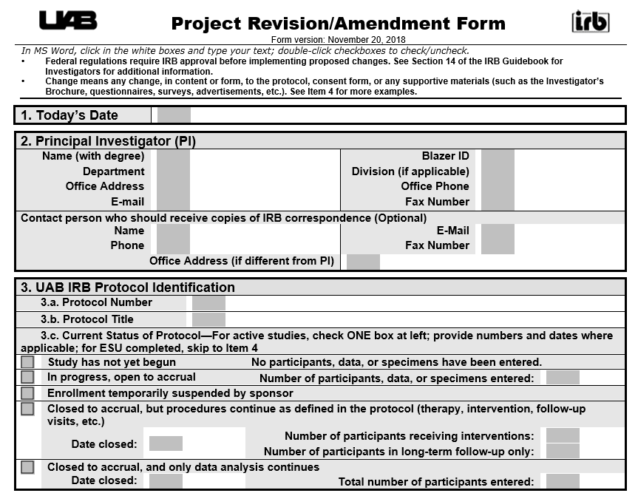
ESU QUALIFYING SUBMISSIONS
Qualifying submissions (i.e. amendment, problem report) count as an ESU and will reset the three-year clock when the OIRB issues approval/determination

Slide 22
ESU NOTICES
An email will be sent to the PI (and delegates) at one and two years after the last qualifying submission.
The email will contain the currently-known protocol status and approved enrollment number.
The email will include a reminder about responsibilities for keeping the IRB abreast of any changes.

Slide 23
ESU – THREE YEAR REQUIREMENT
An email will be sent to the PI and delegate one month before the three-year anniversary of the initial approval or the last qualifying submission.
A reminder will be sent at 14 days prior to the anniversary.
An ESU must be completed at this time even if there are no other protocol changes.

Slide 24
ESU ONLY SUBMISSION
If there are no changes within the three year period, the amendment form now includes an option for an ESU Only submission.
This will also be the mechanism for closing a protocol that does not require continuing review.

Slide 25
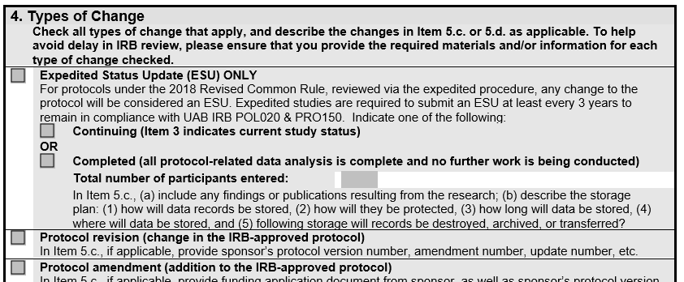
ESU ONLY SUBMISSION

Slide 26
ESU EXAMPLE
Expedited protocol approved on January 1, 2019 (ESU required before January 1, 2022)
Amendment approved June 1, 2020 (ESU required before June 1, 2023)
Protocol completed – Submit ESU Only prior to June 1, 2023

Slide 27
ESU EXAMPLE
Expedited protocol approved on January 1, 2019 (ESU required before January 1, 2022)
Protocol completed – Submit ESU Only prior to January 1, 2022
No protocol changes

Slide 28
RE-CATEGORIZATION OF SOME REVIEW
Due to changes in Exemption Criteria and Categories, the following may now be reviewable under Exemption Review:
Medical Record Reviews involving identifiers (previously Expedited Category 5/now Exempt Category 4)
Surveys/Interviews involving sensitive and identifiable content (previously Expedited Category 7/now Exempt Category 2)
Benign Behavioral Interventions (previously Expedited Category 3/now Exempt Category 3)

Slide 29
INFORMED CONSENT

Slide 30
INFORMED CONSENT
MAJOR CHANGES
“Key information” at beginning of consent document
New required elements of consent
Changes to waiver criteria and documentation
“Broad consent” option

Slide 31
INFORMED CONSENT – KEY INFORMATION
The consent form must begin with a “concise and focused presentation of the key information” that will assist subjects in deciding why they might or might not want to participate in the research.
Key information must be organized and presented in a way that facilitates comprehension.
Key information appears at the beginning of the consent form and is presented first in the consent discussion.

Slide 32
INFORMED CONSENT – KEY INFORMATION
Elements likely to promote understanding of study and whether to participate
A statement that project is research and participation is voluntary
A summary of research, including
Purpose
Duration
Procedures
Reasonable, foreseeable risks or discomforts
Reasonable, expected benefits
Alternative procedures or course of treatment, if any

Slide 33
INFORMED CONSENT – KEY INFORMATION “CONCISE SUMMARY TABLE”
[Insert applicable Concise Summary Table – see samples in separate document]
General Information | You are being asked to take part in a research study. This research study is voluntary, meaning you do not have to take part in it. The procedures, risks, and benefits are fully described further in the consent form.
Purpose | The purpose of the study is…
Duration & Visits | You will be in this study for…
Overview of Procedures | This study will include…
Risks | The most likely risks are…
Benefits | The benefits are…
Alternatives | If you do not want to take part in the study…

Slide 34
INFORMED CONSENT – FOUR NEW ELEMENTS
For research that involves collection of identifiable private information or identifiable biospecimens, include a statement indicating whether:
identifiers may be removed, and
de-identified information or biospecimens may or may not be used or shared for future research

Slide 35
INFORMED CONSENT – FOUR NEW ELEMENTS
For research involving use of biospecimens, include a statement indicating whether:
biospecimens may be used for commercial profit, and
the subject will share in that profit

Slide 36
INFORMED CONSENT – FOUR NEW ELEMENTS
For research expected to generate clinically relevant results, include a statement indicating whether
the clinical results (including individual research results) will be returned to the subject, and
if so, under what conditions

Slide 37
INFORMED CONSENT – FOUR NEW ELEMENTS
For research involving whole genome sequencing, include a statement that the research will or might include whole genome sequencing

Slide 38
INFORMED CONSENT – OTHER CHANGES
for a waiver of consent for secondary use of identifiable private data/biospecimens now must justify why the use of identifiers is necessary to carry out the research
if the research could be done using non-identifiable information, then that is what should be done

Slide 39
INFORMED CONSENT – OTHER CHANGES
use of identifiable information or biospecimens to screen, recruit, or determine eligibility of prospective subjects is allowed without informed consent under certain circumstances:
the information is obtained through oral or written communication with the subject or the subject’s legally authorized representative, or
identifiable private information or identifiable biospecimens are obtained by accessing records or stored identifiable biospecimens

Slide 40
INFORMED CONSENT – OTHER CHANGES
for federally-sponsored clinical trials, a copy of the consent form must be posted to a “publicly available, federal website”
post-recruitment
no later than 60 days after the last study visit by any subject

Slide 41
INFORMED CONSENT – BROAD CONSENT
Broad consent is an optional, alternative consent process for use only for the storage, maintenance, and secondary use of identifiable private information or identifiable biospecimens for unspecified future research
Requires recording and tracking who has agreed to or refused consent
Requires you apply that agreement/refusal of consent to all secondary use research – waivers would no longer be allowed
UAB not adopting broad consent at this time.

Slide 42
EXEMPTION REVIEW

Slide 43
EXEMPTION REVIEW
MAJOR CHANGES
New Categories
Categories going away
Expanded/Revised Categories
“Limited Review”

Slide 44
CURRENT CATEGORIES
Category 1 – Educational Research
Category 2 – Surveys/Interviews/Educational Tests
Category 3 – Surveys/Interviews with Public Officials
Category 4 – Research on Pre-existing Data
Category 5 – Research and Demonstrations Projects
Category 6 – Taste and Food Quality

Slide 45
2018 REVISED COMMON RULE CATEGORIES
Category 1 – Educational Research
Category 2 – Surveys/Interviews/Educational Tests
Category 3 – Benign Behavioral Interventions
Category 4 – Secondary Research
Category 5 – Research and Demonstrations Projects
Category 6 – Taste and Food Quality
Category 7 – Storage/Maintenance for Secondary Research (Broad Consent)
Category 8 – Secondary Research (Broad Consent)

Slide 46
EXEMPTION REVIEW: New Categories
Category 3 – Benign Behavioral Interventions
“Research involving benign behavioral interventions in conjunction with the collection of information from an adult subject through verbal or written responses (including data entry) or audiovisual recording if the subject prospectively agrees to the intervention”
[§ 46.104(d)(3)(i)]

Slide 47
Research is brief in duration - should be a maximum of a few hours on a single day
Participation is harmless and painless
The intervention does not introduce risks of harm, physical or emotional discomfort, offense, or embarrassment

Slide 48
EXEMPTION REVIEW: New Categories
Category 7 – Storage/Maintenance of data/specimens for secondary research for which broad consent is required
[§ 46.104(d)(7)]

Slide 49
EXEMPTION REVIEW: New Categories
Category 8 – Secondary Research for which broad consent is required
[§ 46.104(d)(8)]

Slide 50
Broad Consent – an (optional) alternative consent process for use only for the storage, maintenance, and secondary use of identifiable private information or identifiable biospecimens for future, yet-to-be-specified research.
If a participant declines, the IRB may not waive consent for that participant on other projects; therefore, this requires the PI to record and track who has agreed to or refused consent in a manner that other investigators and the IRB can access.

Slide 51
The UAB IRB has determined that as currently interpreted, Broad Consent is not feasible at UAB and these 2 categories will NOT BE IMPLEMENTED at this time.
We will be watching the discourse on this concept as the new regulations roll out.

Slide 52
EXEMPTION REVIEW: Categories Going Away
Category 3 – Surveys/Interviews with Public Officials
Replaced with Benign Behavioral Interventions
Research previously reviewed under old Category 3 will generally fit into Category 2

Slide 53
EXEMPTION REVIEW: Expanded/Revised Categories
Category 1 – Educational Research
NEW: Research that involves potential negative effects on student learning or the assessment of the educators will not qualify

Slide 54
EXEMPTION REVIEW: Expanded/Revised Categories
Category 2 – Surveys/Interviews/Educational Tests
NEW: Inclusion of sensitive and identifiable data. However, the following is not allowed:
Interventions
The collection of biospecimens
Linking to additional identifiable data
Limited Review Required

Slide 55
EXEMPTION REVIEW: Expanded/Revised Categories
Category 4 – Secondary Research
NEW: Prospective data review
NEW: Collection of identifiers if all study data is protected health information
Limited Review Required
NEW: Research that is conducted by, or on behalf of, a Federal department/agency or using government-generated or –collected information obtained for non-research activities

Slide 56
EXEMPTION REVIEW: Expanded/Revised Categories
Category 5 – Research and Demonstration Projects
NEW: To qualify, the project must be published on a federal website

Slide 57
EXEMPTION REVIEW: Expanded/Revised Categories
Category 5 – Taste/Food Quality
Unchanged

Slide 58
EXEMPTION REVIEW: Limited Review
Limited Review - Its purpose is to ensure privacy/confidentiality protections are in place

Slide 59
KEEP WATCHING…
Due to the extensive nature of the Exemption changes, the UAB OIRB plans to conduct a separate, more in-depth session on Exempt Research in the near future.

